Slide 1
Teamwork Training in GIFT: Updates on Measurement and Audio Analysis
29 May 2020
Robert McCormack¹, Alexander Case¹, Daniel Howard¹, Jianna Logue¹, Kristy Kay¹, Anne M.Sinatra²
Aptima, Inc.¹
U.S. Army Combat Capabilities Development Command (CCDC) - Solider Center - Simulation & Training Technology Center (STTC)²

Slide 2
Introduction
Objective: Develop a scalable system capable of training teamwork skills for teams and teams-of-teams.
Why train teamwork?
  Teamwork skills Performance outcomes.
  Training typically focuses on task-related skills, and treats teamwork skills as a by-product.
  Teams change over time. Need to proactively train rather than rely on pre-existing relationships.
  Army has specifically recognized the importance of teamwork. From ADRP 6-0, training should:
    “Build cohesive teams through mutual trust,”
    “Create shared understanding.”
Focus on two teamwork skills
  Coordination
  Cohesion
This presentation:
  Reviews previous work to date
  Provides updates on measurement
  Speech-to-Text capability
+

Slide 3
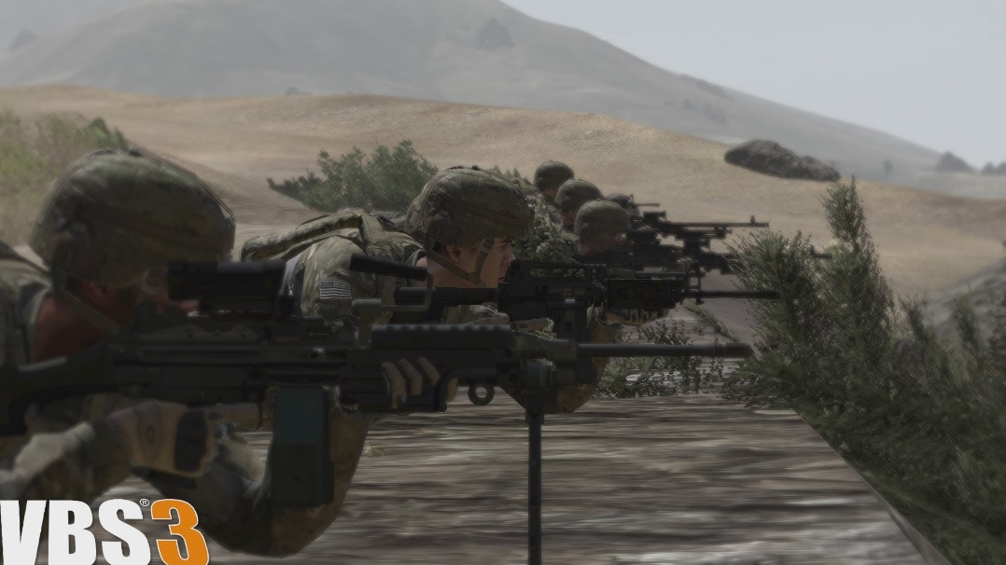
Virtual Environment for Training
Virtual Battlespace 3 (VBS3)
Used for tactical training and mission rehearsal.
Widely used throughout the Army, and readily available at many facilities.
Several previous efforts have
already integrated GIFT and
VBS3 (and previous versions).
Capable of supporting rich
and complex scenarios.
Cooperative tasks and
communication tools ideal
for teamwork training.

Slide 4
Teamwork Training Scenario
The scenario is adapted from an Army Basic Leader Course (BLC) Combat Search and Rescue (CSAR) training module.
The team consists of 9 individuals: 1 squad leader and 2 four-person fire teams.
The narrative of the scenario involves search and rescue of an F-16 pilot who has ejected and landed in hostile territory.
Primary Objective: Locate and extract the pilot
Secondary Objective: Reach the nearby village
The scenario is broken into 5 (somewhat) independent vignettes
  Encountering an IED
  Finding and Rescuing the Pilot
  Reacting to Harassing Fire from Hostile Militia
  Encountering an IED
  Reacting to an Unknown Individual

Slide 5
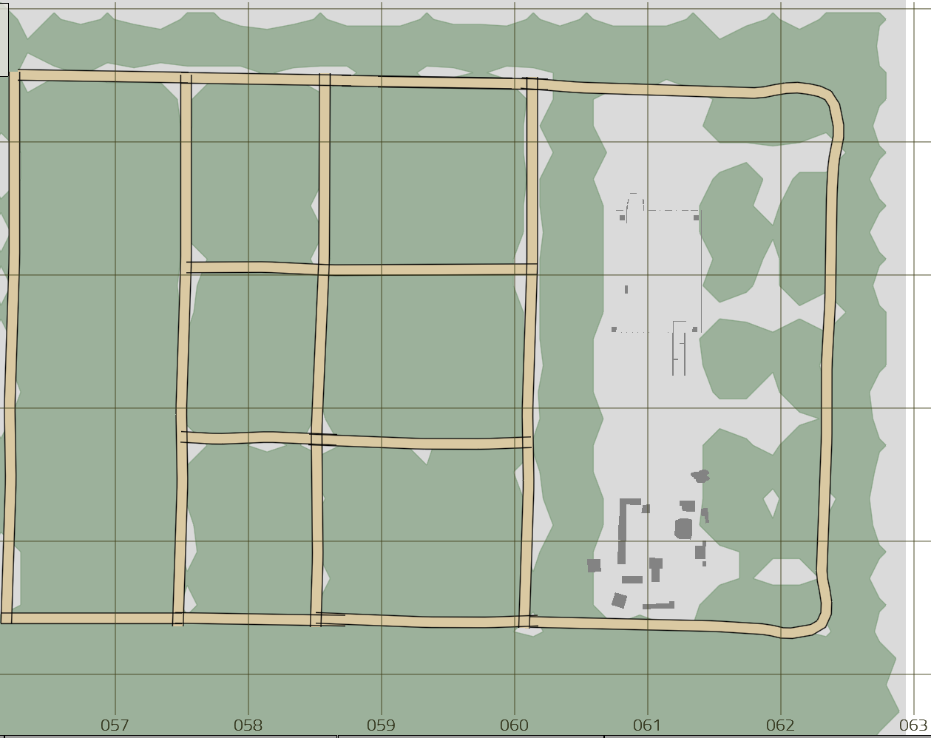
Scenario Map
Hoax IED
Start
Downed Pilot
Harassing Fire
Village/End
Civilian Cart
Real IED

Slide 6
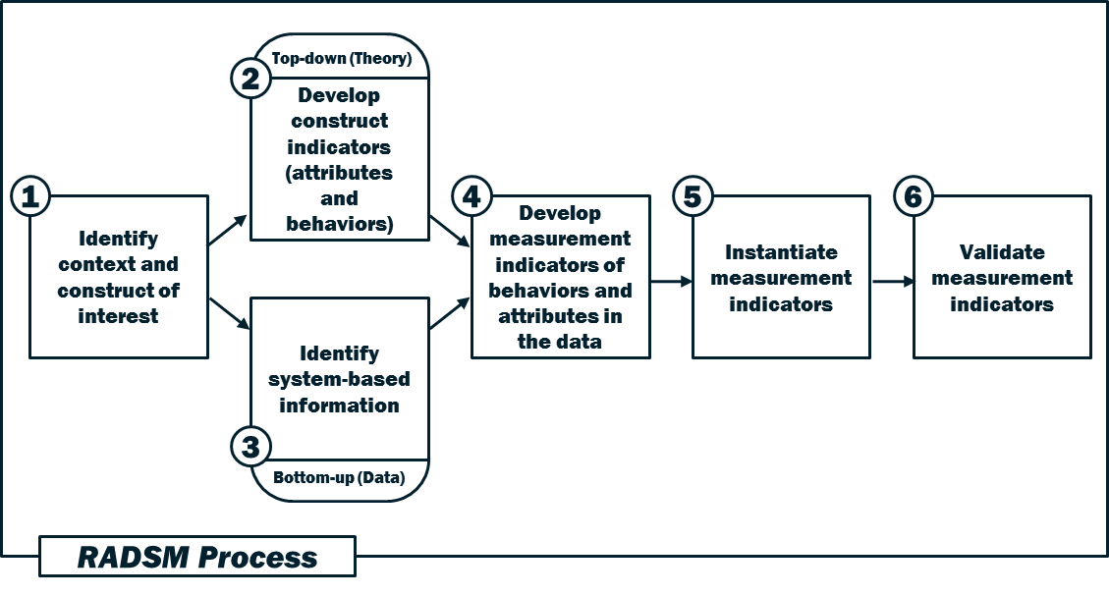
Measurement Process

Slide 7
Measuring Cohesion
Cohesion is typically decomposed into two categories: task cohesion and social cohesion.
Task cohesion
  The ability of team members to work together to achieve a common goal.
Social cohesion
  How well the members of a team like each other and interact (often in the absence of a goal-oriented environment).

Slide 8
Example Behaviors and Attributes Related to Cohesion
Facet of Cohesion | Task / Social | Description | Source
Bonding | Social | Team enjoys time spent together outside of work hours | Carless & de Paola, 2000
Proportion of communication | Task | All team members contribute somewhat evenly to communications | Horn, Rench, Orvis & Sullivan, 2014
Certainty | Task | Communications that indicate certainty | Horn, Rench, Orvis & Sullivan, 2014
Acknowledgement | Task | Communications with acknowledgement | Horn, Rench, Orvis & Sullivan, 2014
Positive reply | Task | Communications with positive replies | Horn, Rench, Orvis & Sullivan, 2014
Certainty followed by acknowledgement | Task | Communications with certainty followed by communications with acknowledgement | Horn, Rench, Orvis & Sullivan, 2014
Certainty followed by positive reply | Task | Communications with certainty followed by communications with positive reply | Horn, Rench, Orvis & Sullivan, 2014
Conflict resolution | Social | Amount of communications indicating conflict (frustration, criticism, negative replies) declines over time | Horn, Rench, Orvis & Sullivan, 2014
Team-focused language | Social | Communications with more team-focused (we, us, our) than individual-focused (I, me, my) language | Horn, Rench, Orvis & Sullivan, 2014
Positive reply | Social | Communications with positive replies | Horn, Rench, Orvis & Sullivan, 2014
Politeness | Social | Communications with politeness aspects | Horn, Rench, Orvis & Sullivan, 2014
Praise | Social | Communications representing praise | Horn, Rench, Orvis & Sullivan, 2014

Slide 9
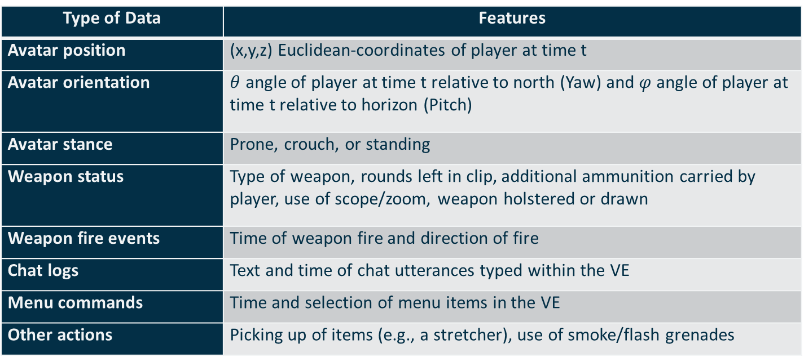
Example Data Types
Type of Data | Features
Avatar position | (x,y,z) Euclidean-coordinates of player at time t
Avatar orientation | $θ$ angle of player at time t relative to north (Yaw) and $φ$angle of player at time t relative to horizon (Pitch)
Avatar stance | Prone, crouch, or standing
Weapon status | Type of weapon, rounds left in clip, additional ammunition carried by player, use of scope/zoom, weapon holstered or drawn
Weapon fire events | Time of weapon fire and direction of fire
Chat logs | Text and time of chat utterances typed within the VE
Menu commands | Time and selection of menu items in the VE
Other actions | Picking up of items (e.g., a stretcher), use of smoke/flash grenades

Slide 10
Previously Developed Coordination Measures
Vignette: Hoax IED
  The team identifies the potential threat, communicates with each other, and comes to a halt.
  The team maintains a close formation during movement.
  The team maintains visual control over their environment.
  The team coordinates selection of the 5 “C”s after the IED threat is identified
Vignette: Pilot MEDEVAC
  The team quickly locates, applies first aid, and evacuates the pilot
  The team coordinates selection of the first aid procedure
  The team maintains visual control over the environment
Vignette: Harassing Fire
  The team maintains a close formation during movement
  The team quickly takes cover when harassing fire starts
  The team quickly identifies the location of the militants
  The team eliminates the hostile threat (militants killed or fled), but does not pursue
Vignette: Real IED
  The team identifies the potential threat, communicates with each other, and comes to a halt.
  The team maintains a close formation during movement.
  The team maintains visual control over their environment.
  The team coordinates selection of the 5 “C”s after the IED threat is identified
Vignette: Person with Cart
  The team quickly identifies the person as a potential threat and halts movement
  The team coordinates selection of “Show, Shout, Shoot” from the menu

Slide 11
Cohesion Measure #1
No Person Left Behind
  Construct: Cohesion
  Applicable Vignettes: Hoax/Real IEDs, Individual with Cart
  Description: The team members should be maintaining awareness of each other to ensure that no person is falling behind. We measure this by determining, for each person, how long it has been since they have entered any other team member’s field of view (FOV). This measure starts when the team starts moving down the road in formation and stops when the halt is called. For each person, we measure the amount of time that has elapsed since they have entered any other person’s field of view.
  Measurement Elements:
    ID of each team member
    Position of each team member
    Field of view of each team member
  Assessment Criteria:
    Above Expectation: Less than 15 seconds has elapsed since any team member has not entered another’s field of view.
    At Expectation: Between 15 and 30 seconds have elapsed since at least one team member has entered another’s field of view.
    Below Expectation: More than 30 seconds has elapsed since at least one team member has entered another’s field of view.
  Measurement Feedback:
    Team assessment (Above/At/Below Expectation)
    Time elapsed since a team member has last been seen.
    ID/Name of person who has been out of anyone’s FOV for more than 30 seconds
    Number of people that have been out of FOV for more than 15 seconds.

Slide 12
Cohesion Measure #2
Mirroring of Stance/Movement
  Applicable Vignettes: All
  Description: Team members should have the same stance (standing/kneeling/prone) or movement (walking/running) as each other. Measuring the amount of time that more than one individual is out of sync with the rest of the team (e.g., two people are running while the rest of the team is walking). This measure starts when the team starts moving down the road in formation and stops when they need to perform an activity.
  Measurement Elements:
    ID of each team member
    Stance/movement status of each team member
  Assessment Criteria:
    Above Expectation: Less than 15 seconds has elapsed since any team member has not been in the same stance/movement status as another team member.
    At Expectation: Between 15 and 30 seconds have elapsed since at least one team member has not been in the same stance/movement status as another team member.
    Below Expectation: More than 30 seconds has elapsed since at least one team member has not been in the same stance/movement status as another team member.
  Measurement Feedback:
    Team assessment (Above/At/Below Expectation)
    Time elapsed since a team member has not been in the same stance/movement status as another team member.
    ID/Name of person who has been out of stance/movement status for more than 30 seconds.
    Number of people that have been out of stance/movement status for more than 15 seconds.

Slide 13
Cohesion Measure #3
Use of Inclusive Language
  Applicable Vignettes: All
  Description: Team members should use more inclusive (we/us/our) language than exclusive (I/me/mine/my) language. Measuring the ratio of the use of inclusive (We/us/our) to exclusive (I/me/mine) language. This measure can run throughout the scenario.
  Measurement Elements:
    Count of first-person singular (exclusive) messages.
    Count of first-person plural (inclusive) messages.
  Assessment Criteria:
    Above Expectation: Ratio of inclusive : exclusive messages is greater than 3:1 (3).
    At Expectation: Ratio of inclusive : exclusive messages is between 2:1 (2) and 1:1 (1).
    Below Expectation: Ratio of inclusive : exclusive messages is less than 1:1 (e.g., .9).
  Measurement Feedback:
    Team assessment (Above/At/Below Expectation)
    Inclusiveness ratio (e.g., “Your inclusiveness ratio is 0.5,” i.e., for every inclusive message, there are two exclusive messages). The team is below expectations.

Slide 14
Cohesion Measure #4
Use of Inclusive Language
  Applicable Vignettes: All
  Description: Team members should use more acknowledgement (roger, copy, okay, got it) messages than negative/uncertain (unable, unknown, don’t know, believe, seems, probably, assuming) messages. We measure the ratio of the use of acknowledgement (roger, copy, okay, got it) to negative/uncertain (unable, unknown, don’t know, believe, seems, probably, assuming) language.
  Measurement Elements:
    Count of first-person singular (exclusive) messages.
    Count of first-person plural (inclusive) messages.
  Assessment Criteria:
    Above Expectation: Ratio of inclusive : exclusive messages is greater than 3:1 (3).
    At Expectation: Ratio of inclusive : exclusive messages is between 2:1 (2) and 1:1 (1).
    Below Expectation: Ratio of inclusive : exclusive messages is less than 1:1 (e.g., .9).
  Measurement Feedback:
    Team assessment (Above/At/Below Expectation)
    Inclusiveness ratio (e.g., “Your inclusiveness ratio is 0.5,” i.e., for every inclusive message, there are two exclusive messages). The team is below expectations.

Slide 15
Speech Analysis
Communication is an essential aspect of teamwork
  Information sharing
  Coordination
  Developing emergent states (e.g., cohesion, trust)
VBS3 has text chat features, but it is difficult to naturally communicate through text while engaging in mission activities (e.g., moving the avatar, interacting with objects)
There are currently no capabilities to capture audio, extract text, and analyze it in GIFT

Slide 16
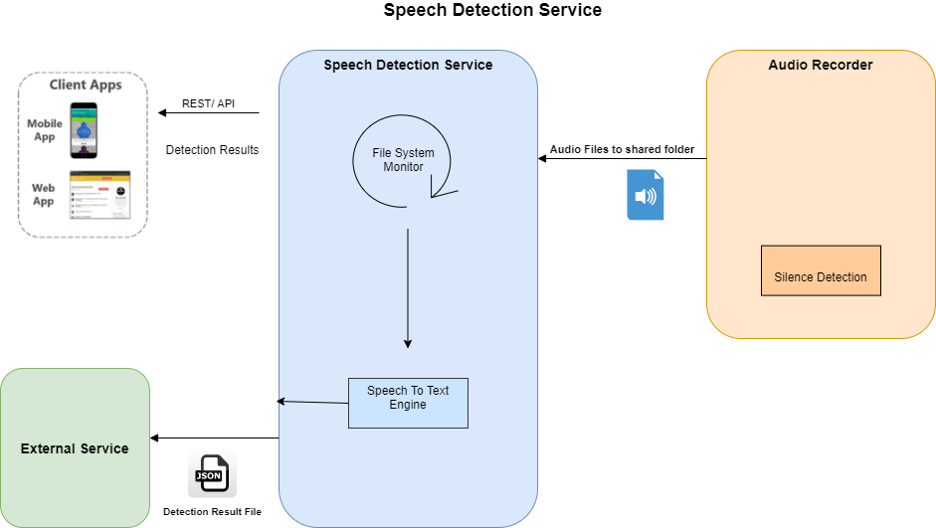
Speech-to-Text Microservice

Slide 17
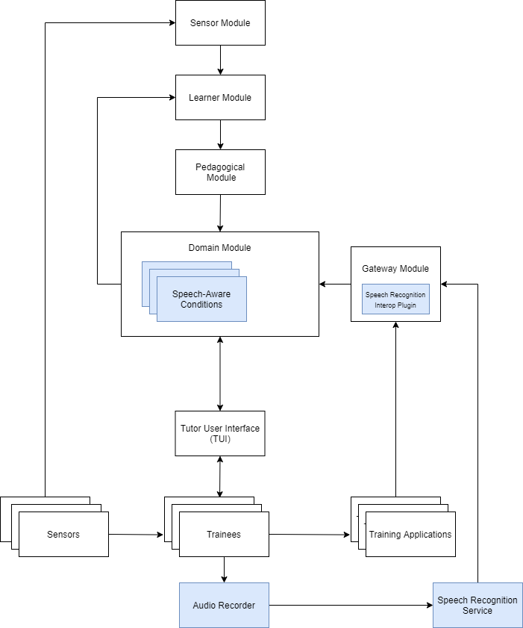
Utilizing Speech-to-Text in GIFT
Speech Recognition Interop Plugin monitors a specified directory for new json files from the speech recognition service
Decodes and dispatches Speech messages through GIFTs internal message bus.
Speech-Aware conditions can then utilize the data
  Trainee ID
  Time spoken
  Text content

Slide 18
Updating Previous Measures
Several previous measures utilized non-speech approaches and can now be updated
Team Sequence Condition
  Goal: Trainees should coordinate a sequence of activities to be performed by different team members. For example, the “5 C’s” of an IED encounter.
  Previous approach:
    VBS3 menus are used to select various “C” options. Options must be selected in the right order by different individuals.
  New approach:
    Speech capability looks for mentions of the “Cs” in trainee speech. Words must be spoken in the right order by different trainees.

Slide 19
Future Work
Finalize Teamwork Tutor System
  Implement/test measures
  Implement/test real-time feedback functionality
  Finalize speech services
Experiment
  Experimentally validate the effectiveness of the teamwork tutor system. Identify performance enhancement effects utilizing real-time feedback vs. post-vignette feedback.
  Feedback Hypothesis
    H1. The functional performance difference score (i.e., performance enhancement) will be greater for teams that receive real-time feedback throughout the vignettes compared to post-vignette feedback
  Measure Validation Hypotheses - Cohesion
    H2a. GIFT measures of cohesion will demonstrate moderate to strong positive correlations with other self-report and/or observer measures of cohesion and other conceptually similar constructs (convergent validity).
  Measure Validation Hypotheses - Coordination
    H3a. GIFT measures of coordination will demonstrate moderate to strong positive correlations with other self-report and/or observer measures of coordination and other conceptually similar constructs (convergent validity).

Slide 20
Acknowledgement
The research reported in this document/presentation was performed in connection with contract number W911NF-17-C-0061 with the U.S. Army Contracting Command - Aberdeen Proving Ground (ACC-APG). The views and conclusions contained in this document/presentation are those of the authors and should not be interpreted as presenting the official policies or position, either expressed or implied, of ACC-APG, U.S. Army Research Laboratory or the U.S. Government unless so designated by other authorized documents. Citation of manufacturer's or trade names does not constitute an official endorsement or approval of the use thereof. The U.S. Government is authorized to reproduce and distribute reprints for Government purposes notwithstanding any copyright notation hereon.

