Slide 1
Toward Data-Driven Models of Team Feedback in Synthetic Training Environments with GIFT
Jonathan Rowe¹ | Randall Spain¹ | Benjamin Goldberg³
Bob Pokorny² | Bradford Mott¹ | James Lester¹
¹North Carolina State University
²Intelligent Automation, Inc.
³US Army CDCC Soldier Center STTC

Slide 2
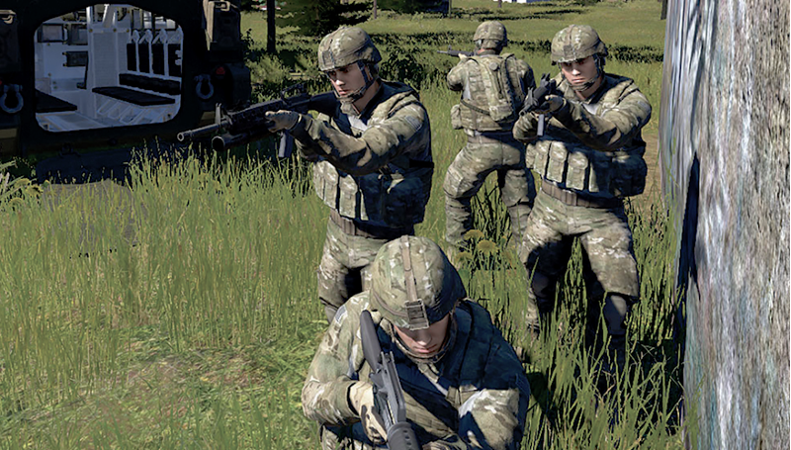
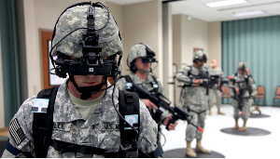
Feedback in Simulation-Based Training
Image source: nationaldefensemagazine.org

Slide 3
Feedback and Learning
“…Feedback is critical for learning. It helps learners evaluate their own progress and performance, identify knowledge gaps, and repair faulty knowledge which can help them develop a deeper understanding of the subject matter…”

Slide 4
Feedback for Multiple Learners
The presence of multiple learners in collective training missions presents new opportunities for delivering feedback in simulation-based training environments.
Team Feedback Timing
Team Feedback Direct Targets
Team Feedback Observers
Team Feedback Modality
Immediate
Individual team member
Individual team member
Spoken Feedback
Intermediate
Partial team
Partial team
Delayed
Text-Based Feedback
Full team
Full team
After-action
Speech + Text Combination
Modified from Goldberg, Nye, Lane, & Guadagnoli (2018)

Slide 5
Project Overview
The research program’s objective is to devise and empirically investigate a generalized data-driven pedagogical planning framework to automatically deliver run-time feedback during team training tasks in simulated environments.

Slide 6
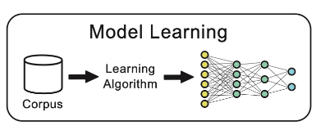
TEAMCOACH: Conceptual Framework

Slide 7
Outline
Feedback and Coaching in Simulation-Based Training
Data-Driven Pedagogical Planning
Human-In-The-Loop Adaptive Instruction with GIFT
Integrating Data-Driven Models of Team Coaching with GIFT
Conclusion and Future Work

Slide 8
Outline
Feedback and Coaching in Simulation-Based Training
Data-Driven Pedagogical Planning
Human-In-The-Loop Adaptive Instruction with GIFT
Integrating Data-Driven Models of Team Coaching with GIFT
Conclusion and Future Work

Slide 9
Feedback in Simulation-based Training
Feedback content
Detailed process feedback leads to better performance than general feedback (Serge, Priest, Durlach, & Johnson, 2013)
Feedback timing
Immediate feedback is beneficial when learning procedural tasks (Johnson, Priest, Glerum, & Serge, 2013; Van Buskirk, 2011)
Delayed feedback leads to faster and more timely decisions (Landsberg, Bailey, Van Buskirk, Gonzalez-Holland, & Johnson, 2016)
Feedback modality
Important to consider the processing demands of the feedback message and task when determining modality (Van Buskirk, 2011)
Adapting feedback
Adapting from specific to general feedback leads to better transfer (Billings, 2012)
Notes:
In one-on-one contexts a number of studies have investigate how feedback should be presented to learning to improve learning

Slide 10
Model of Teamwork Behaviors
VERBAL
Information Exchange
(WHAT IS SAID)
Communication Delivery
(HOW IT’S SAID)
Knowing and using available information sources
Passing information before being asked
Providing situation updates within the Squad and to the Platoon
Using correct terms when describing an event
Providing complete reports
Being brief and summarizing information
Providing clear description
Supporting Behavior
(ASSISTING)
Leadership / Initiative
(COACHING)
Recognizing and correcting others’ errors
Providing back-up when others are struggling
Requesting back-up when you are struggling
Providing guidance as the situation changes
Stating priorities as the situation changes
Adapting to new requirements and guidance
BEHAVIORAL
(Johnston, 2019)
Notes:
These are skills that you’re trying to promote.
Prescriptive guidance on how to provide feedback is lacking.

Slide 11
Considerations for Team Feedback
Model of effective teamwork behaviors
Model of team development
Feedback in simulation-based training
Team interaction feedback taxonomy
Task dynamics
Targeted outcomes
Training phases
Notes:
Effective teamwork behaviors
Team development Phases
Team development KSAs
Feedback for team training
Task dynamics
Targeted outcomes
Training phase

Slide 12
Outline
Feedback and Coaching in Simulation-Based Training
Data-Driven Pedagogical Planning
Human-In-The-Loop Adaptive Instruction with GIFT
Integrating Data-Driven Models of Team Coaching with GIFT
Conclusion and Future Work

Slide 13
Data-Driven Pedagogical Planning
Hints
Feedback
Scenario adaptations
Embedded assessments
Remedial instruction
Notes:
Tutorial planning is a critical feature of ITS and AIS – controlling how scaffolding is structured and delivered to learners
In the classical ITS architecture a tutorial planner is a component of the pedagogical module.
Formalization of pedagogical rules that an AISs can use to support learning
A significant challenge that authors face when designing AISs is determining when to scaffold learners, what type of scaffolding to deliver, and how scaffolding should be realized
Another challenge facing adaptive course designers is that rules that drive adaptive pedagogical decisions often must be manually engineered, which can significant- ly increase the time required to author adaptive instructional materials (Aleven, McLaren, Sewall, & Koedinger, 2009; Sottilare, 2015).
Pedagogical strategies and tactics / rules are based on learning theories. – guidance provided by these theories may be too general. (Top-down planning approach)
Decisions are represented as a set of production rules that are encoded manually
Remained fixed unless they’re manually updated

Slide 14
Research Context: RL-Based Pedagogical Planning
Induce teaching policies using reinforcement learning (Beck, Woolf, & Beal, 2000; Doroudi, Aleven, & Brunskill, 2019)
Induce tutorial planning policies in narrative-centered learning environments (Rowe, Mott, & Lester, 2014; Rowe & Lester, 2015; Sawyer, Rowe, & Lester, 2017; Wang et al., 2017a; 2017b; 2018)
Aptitude-treatment interaction with RL-based pedagogical policies (Shen et al., 2018a; 2018b; Ausin et al., 2019)
Hierarchical RL for inducing pedagogical policies in ITSs (Zhou et al., 2019)
Credit assignment in RL-based pedagogical planning (Azizsoltani et al., 2019)

Slide 15
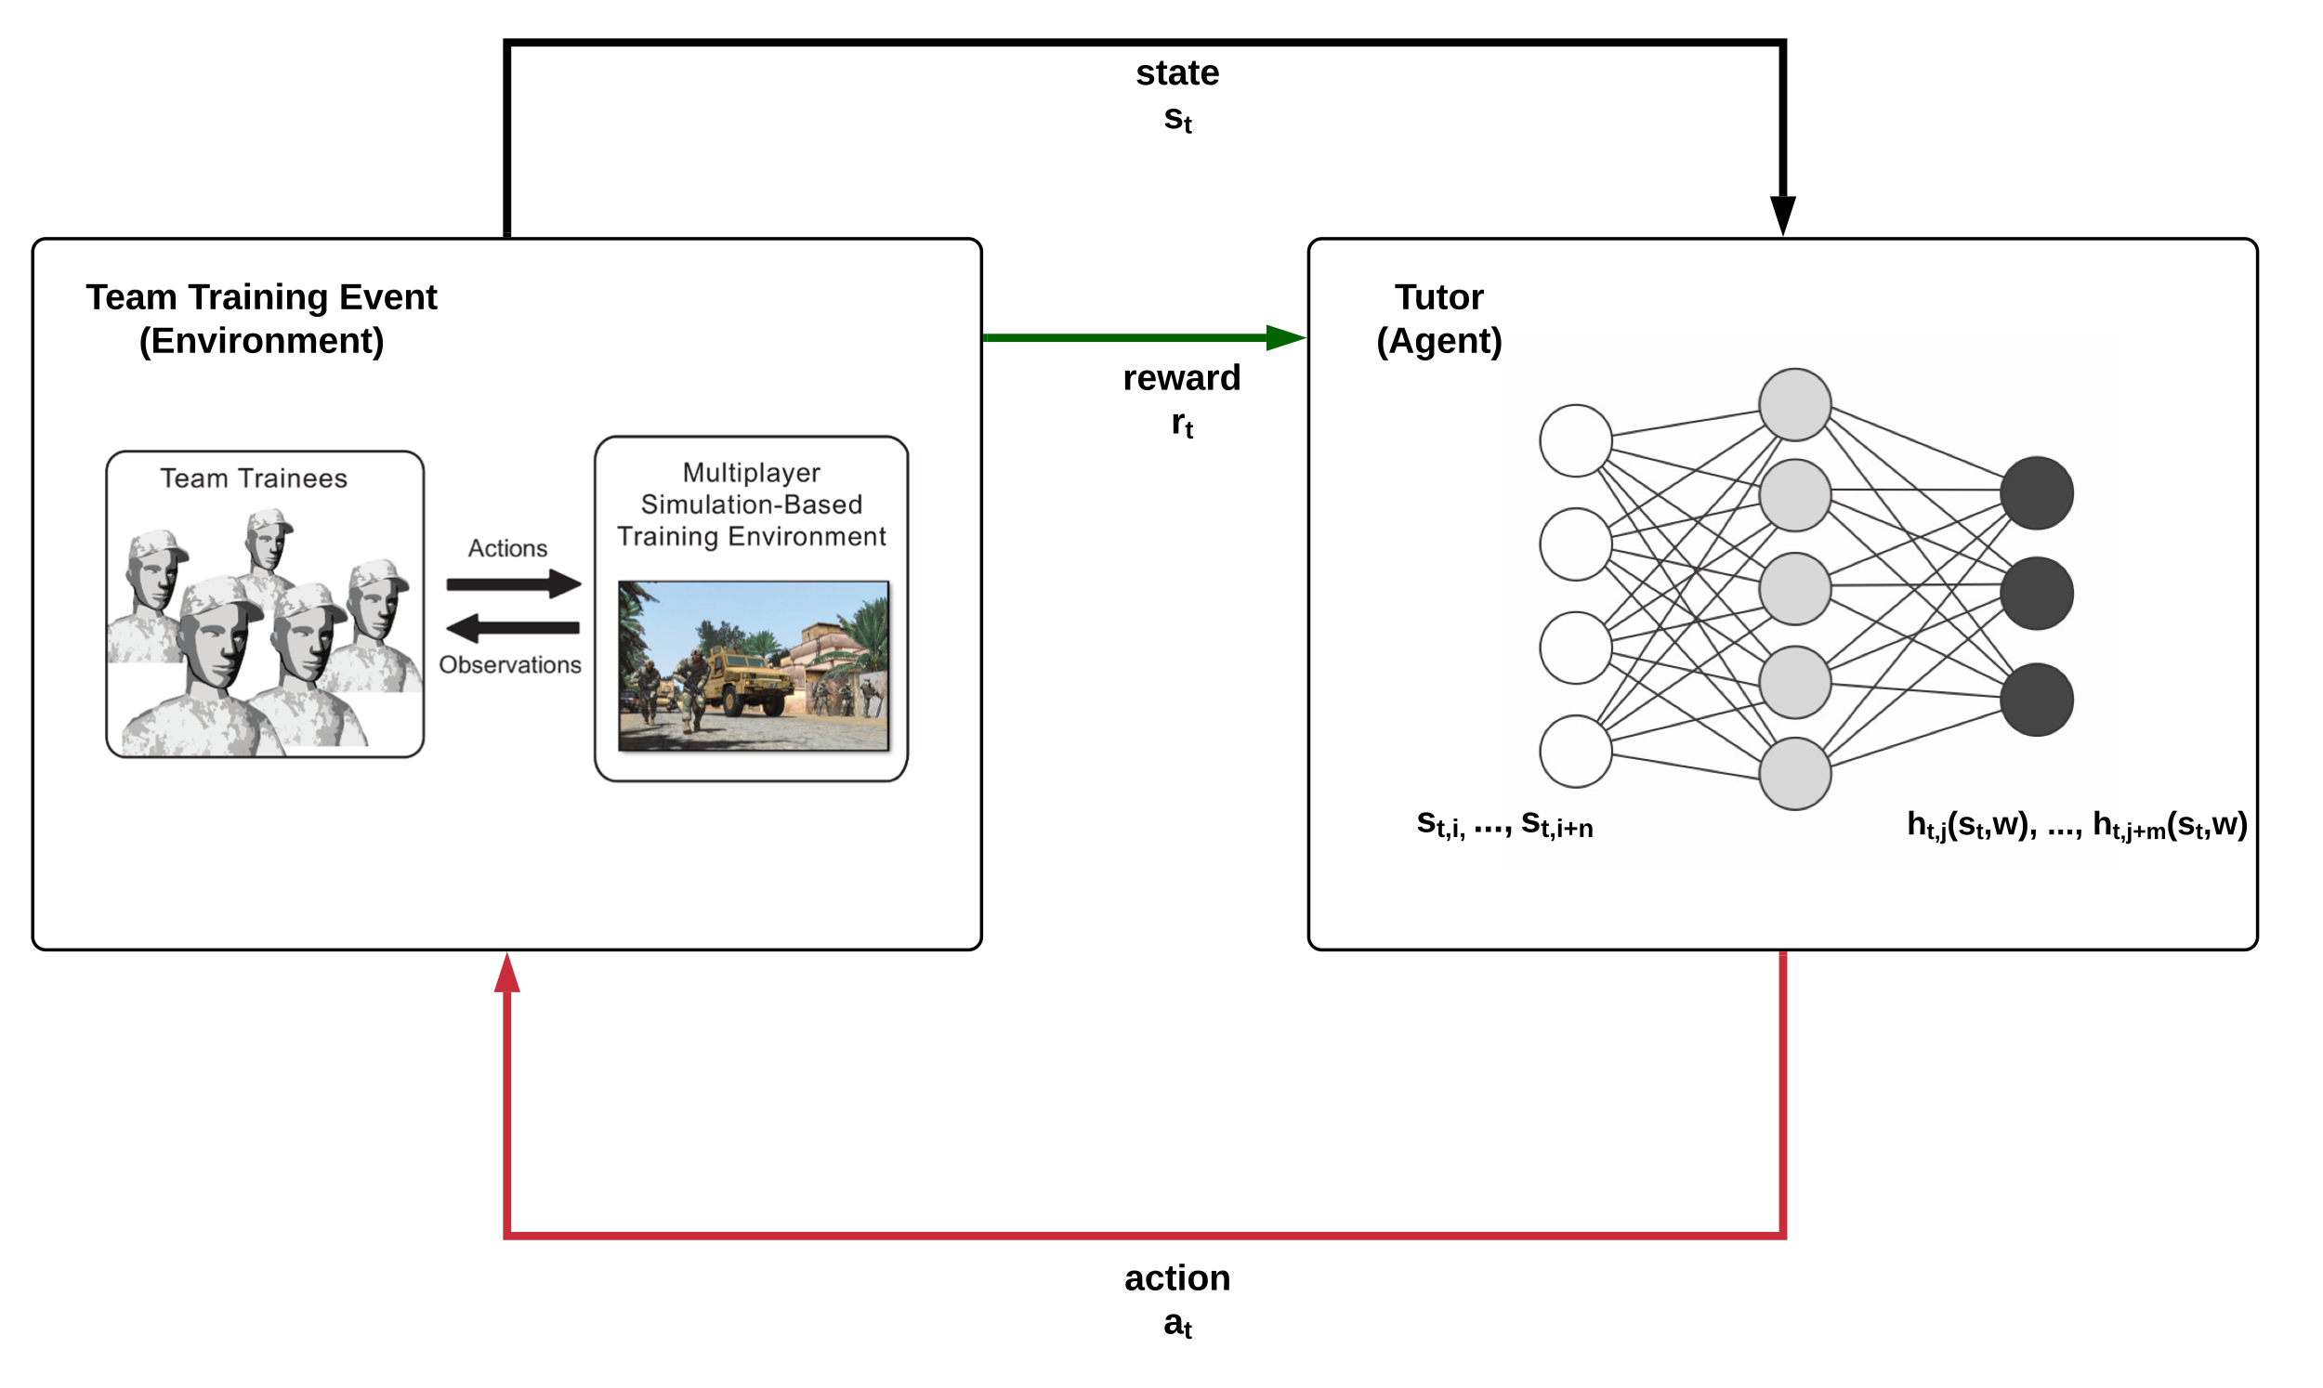
RL-Based Pedagogical Planning for Team Feedback

Slide 16
RL-Based Pedagogical Planning for Team Feedback
Select state representation

Slide 17
RL-Based Pedagogical Planning for Team Feedback
Select state representation
Select actions

Slide 18
RL-Based Pedagogical Planning for Team Feedback
Select state representation
Define reward
Select actions

Slide 19
Outline
Feedback and Coaching in Simulation-Based Training
Data-Driven Pedagogical Planning
Human-In-The-Loop Adaptive Instruction with GIFT
Integrating Data-Driven Models of Team Coaching with GIFT
Conclusion and Future Work

Slide 20
GIFT Game Master
Notes:
Interface for observer controller trainer (OC-T).
Perform manual and automated assessment
Provide prompting and feedback in real-time
Inject scenario adaptations to drive events in training scenario

Slide 21
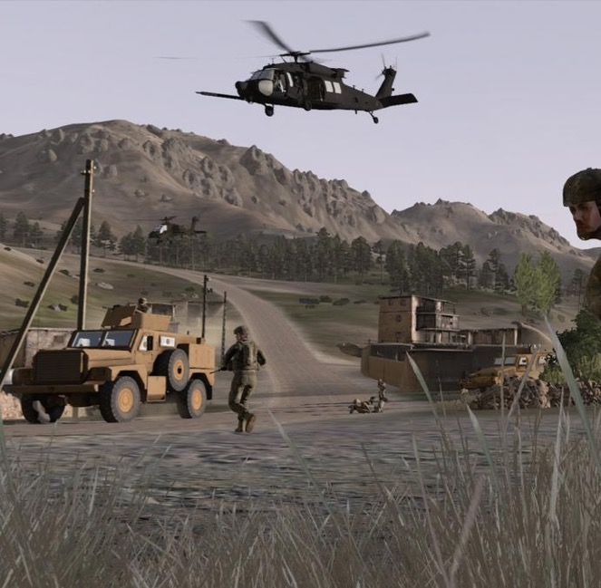
Virtual Battlespace 3
Popular simulation platform for small-unit training
Developed by Bohemia Interactive Simulations
Integrated with GIFT
Scenarios support collective training
Initial Task Domain: Crew Gunnery
Image source: bizjournals.com
Notes:
Closed source
Integration with GIFT ensures that we can spend maximum time on advancing scenario generation rather than creating software infrastructure
IED Identification:
Visually identify and properly react to possible improvised explosive devices while maintaining relative safety and minimizing risk
Call for Fire:
Infantry soldier requests indirect fire from supporting artillery (e.g., unmanned aircraft) on an identified target
Steps: Identify the target, wait for artillery to move into position, call for artillery fire using comm protocol, adjust fire, provide damage assessment
IAI has prior experience in assessment for IED Identification task in VBS

Slide 22
Crew Gunnery Training
Partnership with Warrior Skills Training Center in Fort Hood, TX
Vehicle crews with 2-4 Soldiers
Stryker
Humvee
MRAP
Extensive library of VBS3 missions and add-ons for crew gunnery training
Develop gunnery assessments in GIFT using DKF editor
Image source: Warrior Skills Training Center
Notes:
MRAP = Mine Resistant Ambush Protected

Slide 23
Outline
Feedback and Coaching in Simulation-Based Training
Data-Driven Pedagogical Planning
Human-In-The-Loop Adaptive Instruction with GIFT
Integrating Data-Driven Models of Team Coaching with GIFT
Conclusion and Future Work

Slide 24
Integrating Data-Driven Models of Team Coaching with GIFT
Align methodology for data-driven pedagogical planning with the Learning Effect Model for Teams
Embrace the exploration-exploitation tradeoff in data-driven models of team feedback
Enhance tools and workflows for data-driven team feedback in GIFT

Slide 25
Learning Effect Model for Teams
Image source: (Sottilare et al., 2017)

Slide 26
Data-Driven Team Feedback with the Learning Effect Model
 | Data-Driven Pedagogical Planning | Learning Effect Model for Teams
State Representation | Draw upon broad range of information sources (Ausin et al., 2019; Wang et al., 2018) Automated feature selection (Mitchell, Boyer, & Lester, 2013; Shen & Chi, 2016) | Distinguish between domain-independent and domain-specific features Emphasize generalizability
Actions | Instructional micro-tactics (Ausin et al., 2019; Chi et al., 2011) Concept sequencing (Mandel et al., 2014) ICAP-based remediation (Spain et al., 2019) | Distinguish between instructional strategies and instructional tactics Deliver feedback to individual, subset of team, or whole team
Reward | Learning outcomes (Wang et al., 2018) Task efficiency (Ausin et al., 2019) Engagement (Sawyer, Rowe, & Lester, 2017) | Pedagogical policies guided by subject-matter expertise Informed by theory and/or real-world experience

Slide 27
Data-Driven Team Feedback with the Learning Effect Model
 | Data-Driven Pedagogical Planning | Learning Effect Model for Teams
State Representation | Draw upon broad range of information sources (Ausin et al., 2019; Wang et al., 2018) Automated feature selection (Mitchell, Boyer, & Lester, 2013; Shen & Chi, 2016) | Distinguish between domain-independent and domain-specific features Emphasize generalizability
Actions | Instructional micro-tactics (Ausin et al., 2019; Chi et al., 2011) Concept sequencing (Mandel et al., 2014) ICAP-based remediation (Spain et al., 2019) | Distinguish between instructional strategies and instructional tactics Deliver feedback to individual, subset of team, or whole team
Reward | Learning outcomes (Wang et al., 2018) Task efficiency (Ausin et al., 2019) Engagement (Sawyer, Rowe, & Lester, 2017) | Pedagogical policies guided by subject-matter expertise Informed by theory and/or real-world experience

Slide 28
Data-Driven Team Feedback with the Learning Effect Model
 | Data-Driven Pedagogical Planning | Learning Effect Model for Teams
State Representation | Draw upon broad range of information sources (Ausin et al., 2019; Wang et al., 2018) Automated feature selection (Mitchell, Boyer, & Lester, 2013; Shen & Chi, 2016) | Distinguish between domain-independent and domain-specific features Emphasize generalizability
Actions | Instructional micro-tactics (Ausin et al., 2019; Chi et al., 2011) Concept sequencing (Mandel et al., 2014) ICAP-based remediation (Spain et al., 2019) | Distinguish between instructional strategies and instructional tactics Deliver feedback to individual, subset of team, or whole team
Reward | Learning outcomes (Wang et al., 2018) Task efficiency (Ausin et al., 2019) Engagement (Sawyer, Rowe, & Lester, 2017) | Pedagogical policies guided by subject-matter expertise Informed by theory and/or real-world experience

Slide 29
Data-Driven Team Feedback with the Learning Effect Model
 | Data-Driven Pedagogical Planning | Learning Effect Model for Teams
State Representation | Draw upon broad range of information sources (Ausin et al., 2019; Wang et al., 2018) Automated feature selection (Mitchell, Boyer, & Lester, 2013; Shen & Chi, 2016) | Distinguish between domain-independent and domain-specific features Emphasize generalizability
Actions | Instructional micro-tactics (Ausin et al., 2019; Chi et al., 2011) Concept sequencing (Mandel et al., 2014) ICAP-based remediation (Spain et al., 2019) | Distinguish between instructional strategies and instructional tactics Deliver feedback to individual, subset of team, or whole team
Reward | Learning outcomes (Wang et al., 2018) Task efficiency (Ausin et al., 2019) Engagement (Sawyer, Rowe, & Lester, 2017) | Pedagogical policies guided by subject-matter expertise Informed by theory and/or real-world experience

Slide 30
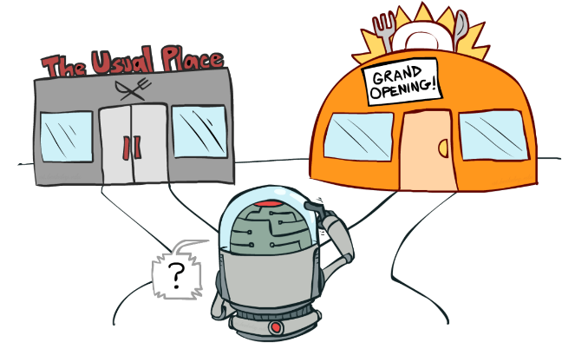
Exploration-Exploitation Tradeoff in Data-Driven Models of Team Feedback
Select actions that have worked well so far vs. new actions that could yield greater rewards
Random yet reasonable pedagogical policies
Delivering team feedback in practice:
Automated feedback provided directly to Soldiers
Feedback suggestions provided to human instructors
Image source: UC Berkeley AI Course, Lecture 11

Slide 31
Enhancing GIFT Tools for Data-Driven Team Feedback Workflows
Streamline workflows for data-driven pedagogical planning
Filter relevant event types for pedagogical planning use cases
Extract common domain-independent features from log data
Generate reports formatted for external ML tools
Integrate machine learning tools with GIFT to enable self-improving systems
Configurable data pipeline that processes run-time data to drive models of team feedback
Notes:
Automatically filter relevant data
Learner survey responses, tutor replies, practice outcomes are relevant
Logs of internal messages between GIFT modules are not
Automatically extract common domain-independent features from log data

Slide 32
Outline
Feedback and Coaching in Simulation-Based Training
Data-Driven Pedagogical Planning
Human-In-The-Loop Adaptive Instruction with GIFT
Integrating Data-Driven Models of Team Coaching with GIFT
Conclusion and Future Work

Slide 33
Conclusion
Providing effective coaching and feedback to teams is a key challenge in adaptive instructional systems
We are investigating the design, development, and evaluation of data-driven models of team feedback in simulation-based training environments with GIFT
Data-driven models of team feedback highlight the importance the Learning Effect Model, the exploration-exploitation tradeoff, and enhancements to pedagogical planning workflows

Slide 34
Future Directions
Devise an empirical account of how OC-Ts provide coaching and feedback to teams during collective training exercises in VBS3
Investigate recent advances in reinforcement learning to induce data-driven models of team feedback in simulation-based training environments
Integrate data-driven models of team feedback with GIFT Game Master to support training management tool priorities for the Synthetic Training Environment

Slide 35
Acknowledgments
Keith Brawner (CCDC SC)
Eugene Brewer (WSTC)
Elyse Burmester (CCDC SC)
Mike Hoffman (Dignitas)
Joan Johnston (CCDC SC)
Jay Ritz (WSTC)
Support provided by the U.S. Army Research Laboratory under cooperative agreement W912CG-19-2-0001.

