Slide 1
Automating Assessment and Feedback for Teamwork to Operationalize Team Functional Resilience
J.T. Folsom-Kovarik, Ph.D. Soar Technology, Inc.
Anne M. Sinatra, Ph.D. U.S. Army Combat Capabilities Development Command (CCDC) – Soldier Center – Simulation and Training Technology Center (STTC)
8th GIFT Symposium, 29 May 2020

Slide 2
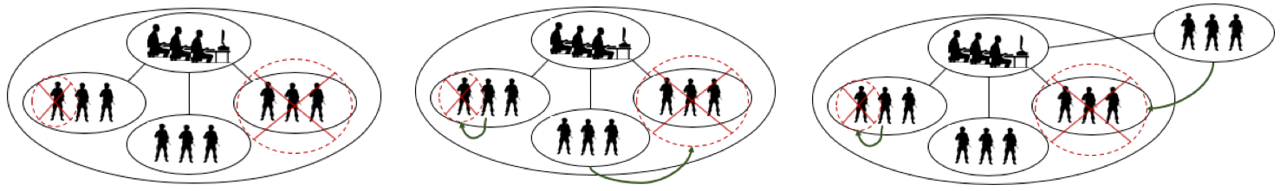
Summary
The Need
  Automate further team assessment
  Link individual contributions to overall team performance
  Assess team functional resilience
  Adaptively support team AAR
Challenges
  Identifying observable behaviors as indicators of team cognitive skill
  Assessing one team skill with several interacting conditions
  Scalability of expressing all possible team members and interactions
Approach
  Enhance GIFT conditions to:
  Express roles and responsibilities
  Share memory of events across time to identify corrective actions/actors
  Design for reuse in varying contexts
Individual / team
performance compromised
Detect corrective action / resilient performance
Keep training on track for efficiency and effectiveness
Identify individual contributions to overall team performance
Record, link, and prioritize examples to output adaptive AAR support
Tailor training events,
Instructor interventions

Slide 3
Team Functional Resilience (TFR)
Team members provide the team with heterogenous functional roles based on:
  Job title, job tasks, equipment
  Individual states (knowledge, skills) and traits (demographics, OCEAN)
  Assignments from instructor or team leader
  Based on changing situation (event awareness, formation, proximity)
Roles have responsibilities. Responsibilities can be met or failed due to:
  Casualty or understrength
  Momentary or ongoing poor performance
  Triggered failure for the purpose of testing teamwork
Functional loss or failure can be repaired
  Corrective action = Within the team. After the fact. During the scenario
  In future work, additional sources of repair like prevention or mitigation

Slide 4
Candidate Team Competencies to Understand TFR
Project Focus: Team Dimensional Training (TDT)
  Smith-Jentsch, K.A., Zeisig, R.L., Acton, B., & McPherson, J.A. (1998). Team dimensional training: a strategy for guided team self-correction.
  Smith-Jentsch, K.A., Cannon-Bowers, J.A., Tannenbaum, S.I., & Salas, E. (2008). Guided team self-correction: Impacts on team mental models, processes, and effectiveness.
  Johnston, J.H., Phillips, H.L., Milham, L.M., Riddle, D.L., Townsend, L.N., et al. (2019). A Team Training Field Research Study: Extending a Theory of Team Development.
Prince & Salas (1989) | Helmreich & Foushee (1993) | Cannon-Bowers & Salas (1997) | Smith-Jentsch et al. (1998)
Communication Leadership Decision making Adaptability Assertiveness Situation awareness Mission Analysis/Planning | Communication and Decision Behavior Team Building Workload Management Situation Awareness Operational Integrity | Shared Task Models Cue/Strategy Associations Task Organization Compensatory Behavior Collective Efficacy Dynamic Reallocation of Function Task Interaction | Information exchange Communication Supporting behavior Initiative/Leadership

Slide 5
Linking Individual Contributions to Team Performance
Team Competency
Information Exchange
Initiative / Leadership
Domain-general Measure
Time from role failure to role replacement
“Is expressed by”
Individual Contribution
Team member in compromised role
Replacing team member
Domain-specific Observation
Actions indicating compromise
Actions indicating role replacement

Slide 6
Linking Individual Contributions to Team Performance
Team Competency
Information Exchange
Initiative / Leadership
Domain-general Measure
Time from role failure to role replacement
Diagnose
Individual Contribution
Team member in compromised role
Replacing team member
Assess
Domain-specific Observation
Actions indicating compromise
Actions indicating role replacement
Monitor

Slide 7
Linking Individual Contributions to Team Performance
Team Competency
Information Exchange
Initiative / Leadership
Domain-general Measure
Time from role failure to role replacement
Relations: Crossing
event boundaries
Individual Contribution
Team member in compromised role
Replacing team member
Context: Who else was available,
Who “should” have replaced,
Who directed the replacement
Domain-specific Observation
Actions indicating compromise
Actions indicating role replacement
Memory: Who originally held the role

Slide 8
Team Dimensional Training Benefits
Training delivery recommendations
  How to ensure training content and initial brief focus on teams and roles
(Human-readable) measures
  New contributions needed: implement with GIFT conditions and assessments
Focus on competencies for teamwork and taskwork
  Multiple domain-specific examples per reusable dimension
  Reason to sustain / improve actions even if no negative outcome
Instructional recommendations
  How to prioritize events for review in AAR
  How to focus on process rather than outcomes
  How to distribute feedback among team members
  How to elicit discussion and buy-in
Team Training Dimensions:
Information exchange Communication Supporting behavior Initiative/Leadership

Slide 9
Example Team Training Scenario
Team is a squad of Soldiers who have mostly deployed together
  Goal of training is to integrate new members and introduce them to certain collective tasks
  A squad on patrol learns that a high-value target (HVT) may be present in a nearby building
  Environment is cordoned off by a company of US Infantry
Movement to contact when approaching HVT building
  Demonstrates coordinated action
    Bounding overwatch
    Divide and clear several windows
  Differs from existing movement conditions: maintain separation, cover your quadrant
    Existing conditions only flag the team as a whole, not individual differences in performance
    Existing conditions only find errors, do not pair the errors with corrective action
Enter a building to capture the HVT
  Differs from existing room clearing
    Multiple variants on what is inside the building: +/- hostiles, +/- HVT, more possible: IED, TC3, …
    Automate and interpret measures from Vanderbilt study
    Tractably and reusably define correct behavior in each combination of variants

Slide 10
GIFT Enhancements Under Development
Express individual contributions (expected, actual) with team roles
Reuse conditions under varied world states
Coordinate conditions with shared information in a world state model
Link conditions across history to infer a team assessment
Provide adaptive support for AAR
GIFT Abstract Condition
Enhanced Condition Class
1
Role Manager
Expert Model / Responsibilities
2
State Manager
Domain-specific Queries
Shared World State Model
Query Manager
3
Instructor AAR Support Script
Historical Context

Slide 11
1: Express Individual Contributions with Team Roles
Roles are key to tractability, via many-to-many links with team actions
  Backward compatible: a role is a property of a team or teamMember
    Soldier. Multiple learners use one set of rules
    First in the door, second in the door… One learner uses multiple roles
    Roles can differentiate a vehicle driver, entry team vs security team, etc.
  Conditions can accept roles and resolve to individuals
Roles have responsibilities based on the current setting
  Overlays enable checking only relevant Conditions
  In year 1, multiple overlays take effect in sequence based on priority overrides
    Hostile enemies present
    High value target present
    Medical attention needed
  Overlays now being developed in the expert model (next slide)

Slide 12
Responsibilities and Corrective Actions
Some corrective actions are better than others. Track scalar scores or categories?
  Recommend limited number of categories: Optimal, Acceptable, Unacceptable
  Motivation: aligned with assessments rather than scores, goal to prioritize AAR feedback
Corrective action differences should be able to express
  Observable action
  Who takes the corrective action
  When
    Relative delay
    Corrective action before a failure may be correct or incorrect in context
Example: Individual contributions to team outcomes
  New addition to the team is going into the room third (because third is less dangerous)
  The second Soldier is a casualty immediately on entering (can be a learner or a SAF)
  Optimal: The third Soldier adjusts the direction he enters, covers the sector of the second Soldier
  Suboptimal: The third Soldier keeps going the direction he planned.
  The fourth Soldier covers the empty sector.

Slide 13
2: Coordinate Conditions via a World State Model
Conditions can now communicate with each other
  Shared knowledge of the world state, or whiteboard
  Memory structure is a key-value map
  Remember semantic labels (in range) to interpret world facts (20 ft away)
  Implemented EnterRoomDirectionCondition which uses working memory to express:
  Each Soldier should enter the room in the direction
  opposite the direction taken by the previous Soldier
Conditions can now remember past world states
  Semantics agreed by the accessing conditions
  Implemented MedicalAssistanceCondition
  which checks medical actions in a sequence:
  Actions must be done before the injured person health status changes.
    VBS messages will update the NPC health degrading over time
    Condition needs to remember the last status message received

Slide 14
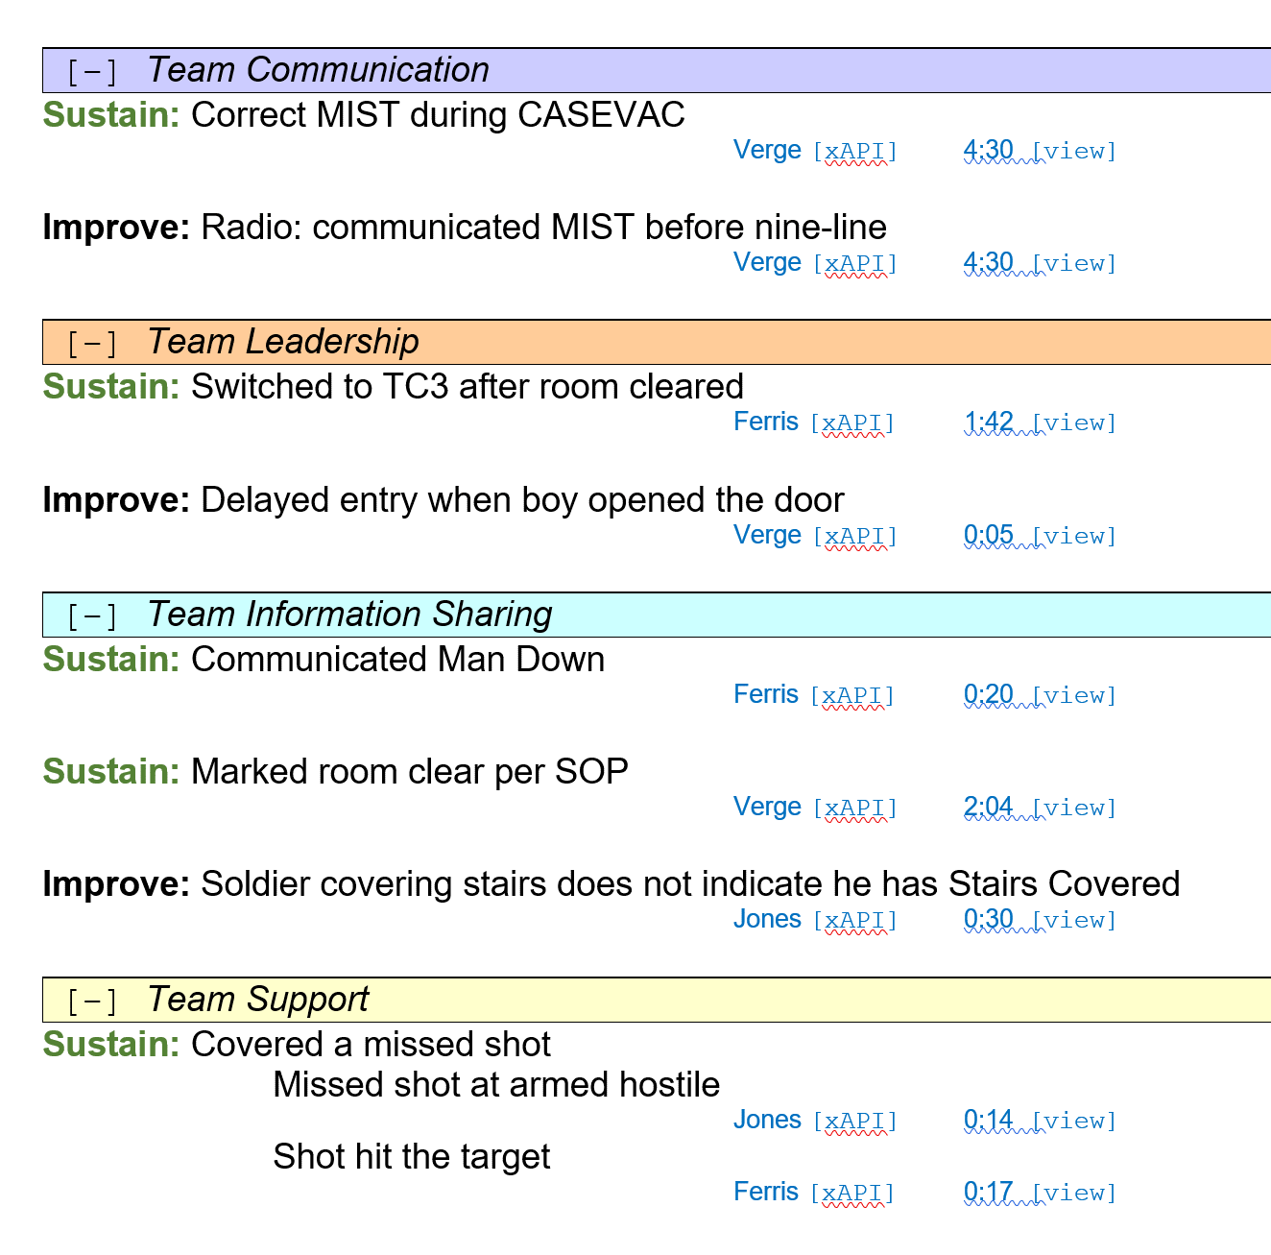
3: Design for Adaptive AAR Support
Proposed GIFT enhancements can log world state changes, actions, and inferences
  Difference from observer/controller timeline: info is for internal processing
  Currently captures
    Roles
    Outputs from the two new Conditions
  Can query
    List of all events
    List of corrective actions
    List of events with a filter
AAR support
  Prioritizes gaps and corrective actions to discuss
  Goal to suggest examples for each of the four team dimensions
  Goal to suggest topics for each team member
AAR Support – Design Candidate

Slide 15
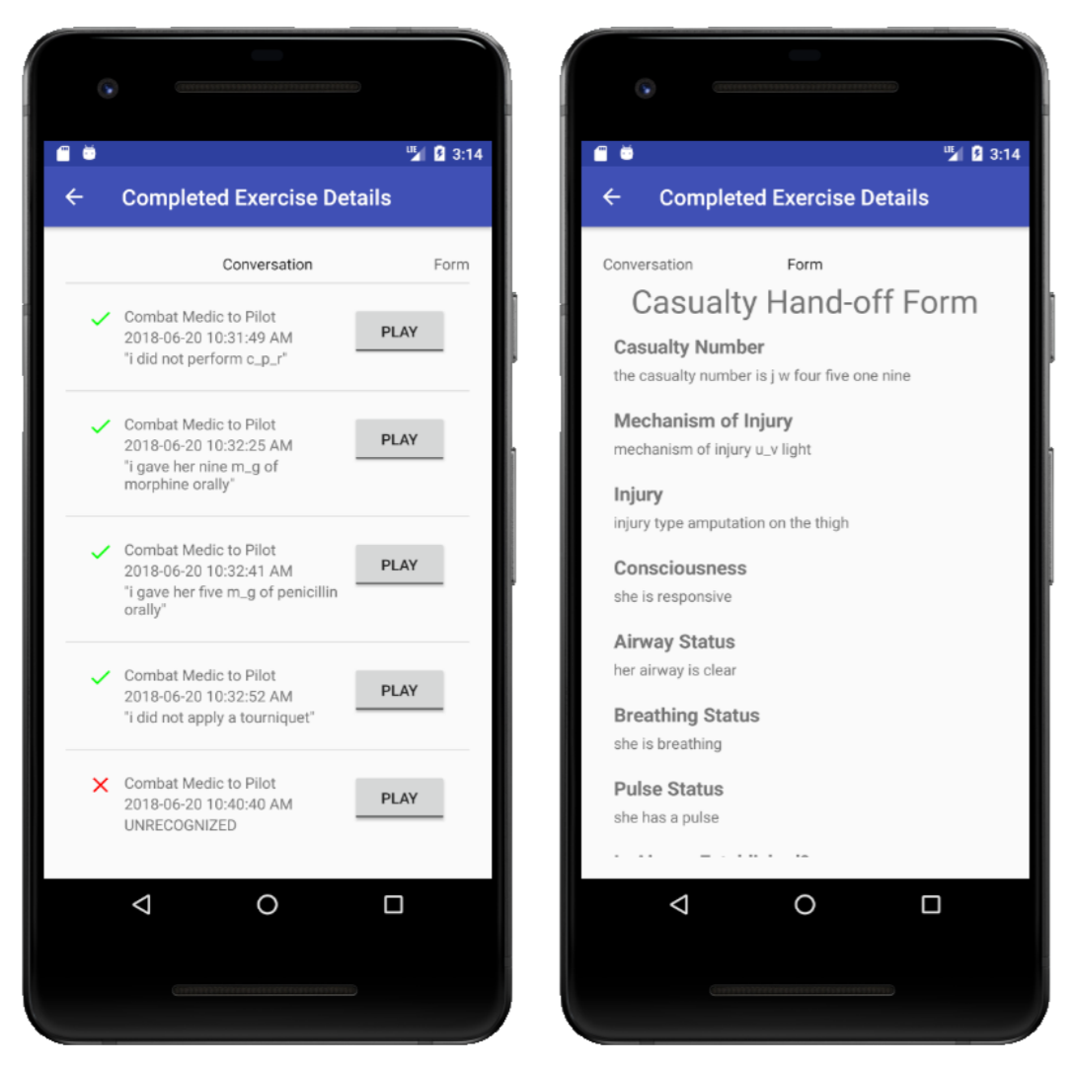
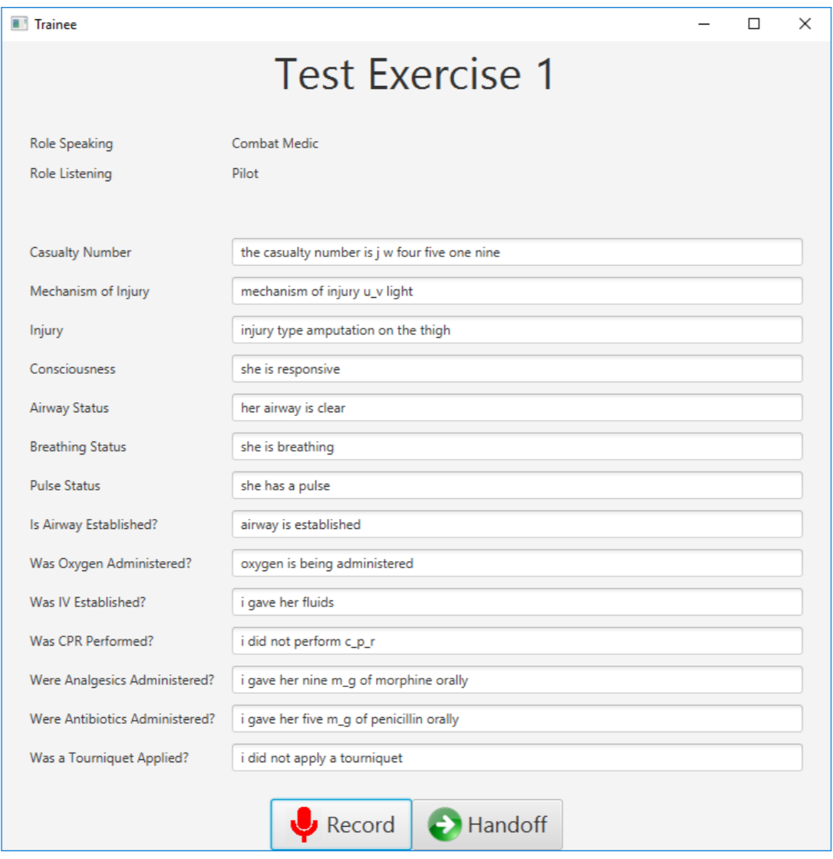
Next Steps: Directly Observe Team Process
DHA research in assessing team speech content
  Audio capture, replay, and transcription into complete protocol forms
  Stand-alone speech stack does not send audio to third parties
Assesses patient handoff
  Onto CASEVAC
  Into field hospital
Domain-specific protocols, terminology, and intents
Domain-general errors in information shared and clear communication
Flexibly recognize, parse Team Speech
Match domain protocols and populate forms
Assess clarity, timing, completeness in an instructor dashboard, history, and replays
“Patient blood pressure 120 over 75 and 52 pulse but currently unresponsive.”
Tanaka, Alyssa, Brian Stensrud, Greg Welch, Fransisco Guido-Sanz, Frank Guido, LCDR Lee Sciarini, and CDR Henry Phillips. "The Development and Implementation of Speech Understanding for Medical Handoff Training.“ IITSEC 2019

Slide 16
Next Steps: Dynamic Role Binding
Existing Static Role Definitions in DKF
(Simplified)
Dynamic Binding Variables in DKF:
Conditions update roles in world state
<condition>
If vehicle 1 breaks speed limit
Display message to learner 1
</condition>
<condition>
If vehicle 2 breaks speed limit
Display message to learner 5
</condition>
<condition>
If vehicle 3 breaks speed limit …
<condition>
At training start, or in-world
Bind vehicle→driver in world state
</condition>
<condition>
If {vehicle} breaks speed limit
Send message to {driver}
</condition>
Also expresses:
Order of units entering a building
Person closest to a wounded Soldier
Who is watching the intersection
… And so on

Slide 17
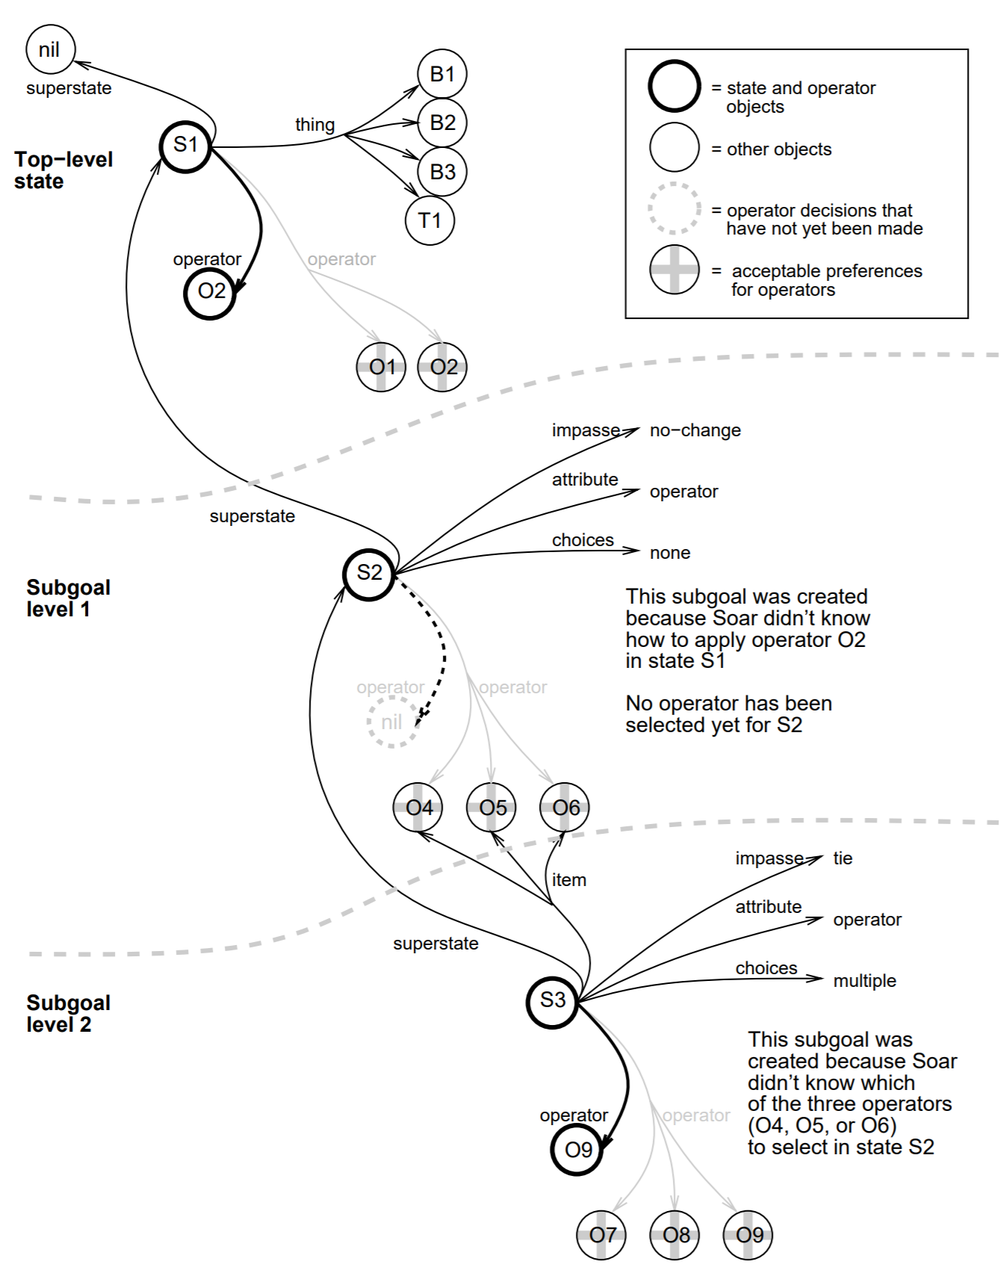
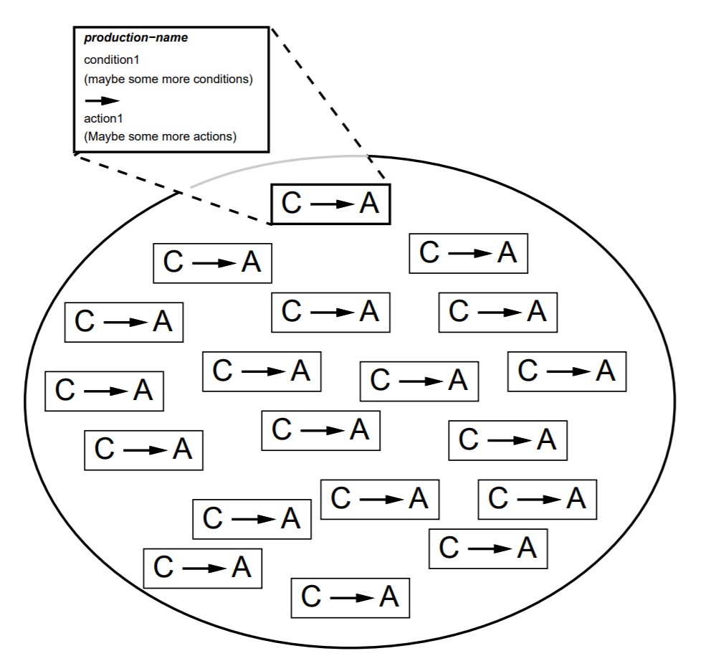
Next Steps: Realtime Feedback at Scale
Variable matching and binding can lead to many candidate instantiations
Larger teams (up to Battalion size) are desired for training
Efficiently representing and searching the conditions and world state can
enable real-time tailoring, transparently replacing stacks of if-then statements
Condition → Assessment
When
The world state is large.
A small part of it changes
at any given time.
When
There are many possible assignments for a role. Conditions might match many.
Use
Efficient Rete Match Algorithm
John E. Laird, Clare Bates Congdon, Mazin Assanie, Nate Derbinsky and Joseph Xu. 2017. “The Soar User’s Manual: Version 9.6.0.” https://soar.eecs.umich.edu/downloads/Documentation/SoarManual.pdf

Slide 18
Conclusions
Assess team functional resilience and provide principled, adaptive AAR support
Link individual contributions to team performance, across GIFT conditions
Automate team assessment for some technically challenging domain expressions
Proposed enhancements aim to make DKF authoring more scalable and reusable
Invite discussion as the proof of concept is implemented and demonstrated
Questions?
J.T. Folsom-Kovarik
Senior Scientist
Soar Technology, Inc.
Jeremiah@soartech.com
The research reported in this document/presentation was performed in connection with contract number W912CG-19-C-0009 with the U.S. Army Contracting Command - Aberdeen Proving Ground (ACC-APG). The views and conclusions contained in this document/presentation are those of the authors and should not be interpreted as presenting the official policies or position, either expressed or implied, of ACC-APG, CCDC-SC STTC or the U.S. Government unless so designated by other authorized documents. Citation of manufacturer's or trade names does not constitute an official endorsement or approval of the use thereof. The U.S. Government is authorized to reproduce and distribute reprints for Government purposes notwithstanding any copyright notation hereon.

