Slide 1
Authoring Collective Training Demonstrations in GIFT
Elyse Burmester
Research Assistant
GIFTSym8 – May 2020

Slide 2
Agenda
Authoring Tool Timeline
Components of the DKF
Recommendations
DKF Authoring Demonstration

Slide 3
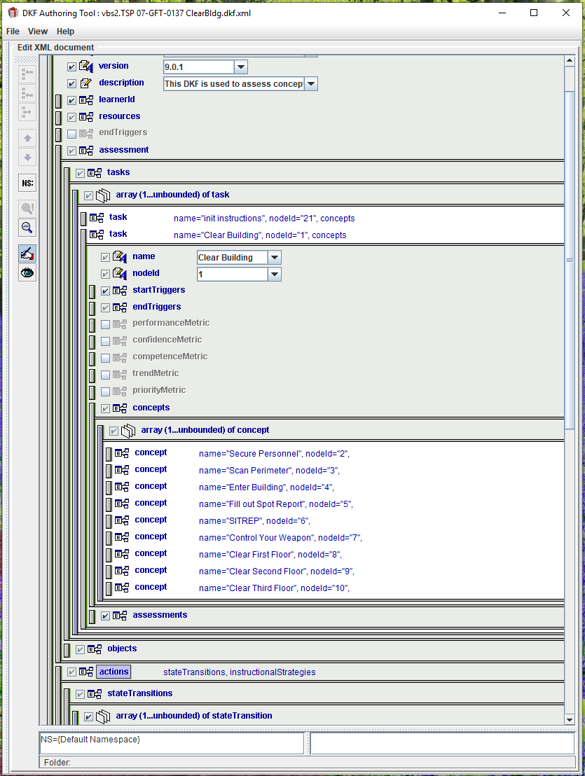
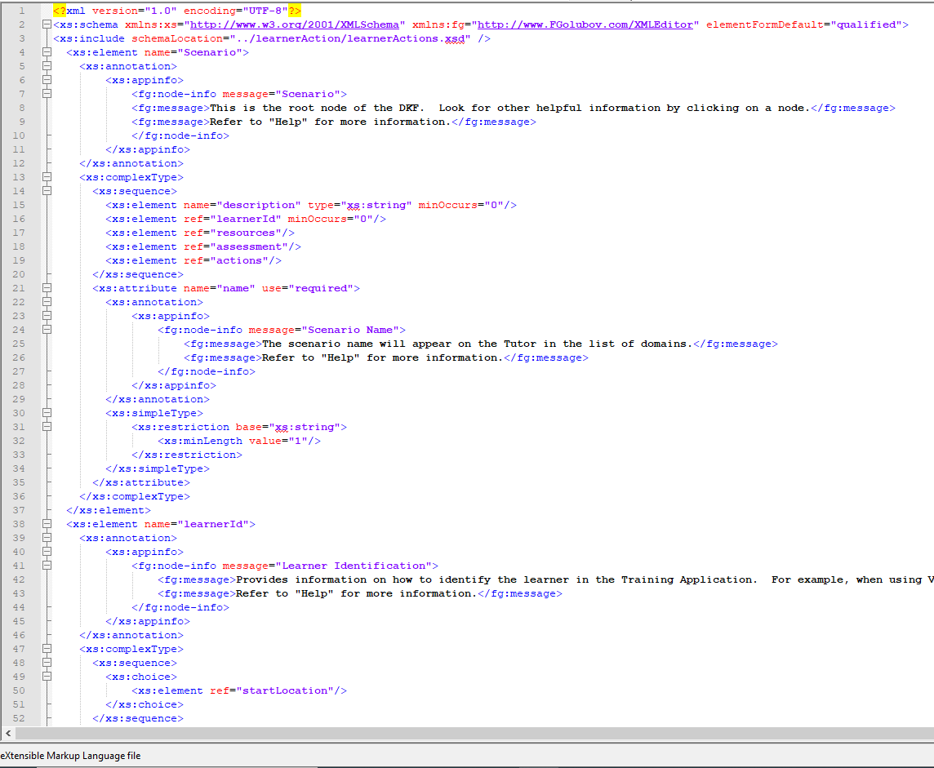
DKF Authoring Tool History
2012 – GIFT 2.0
2011 – Prototype

Slide 4
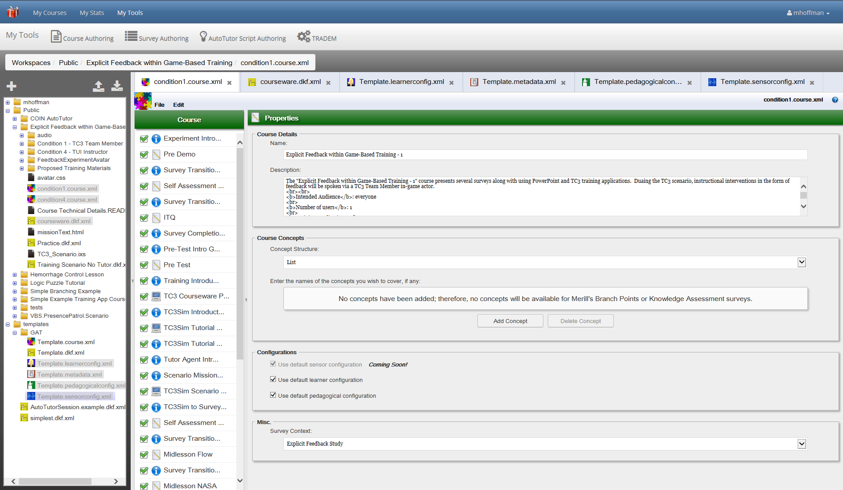
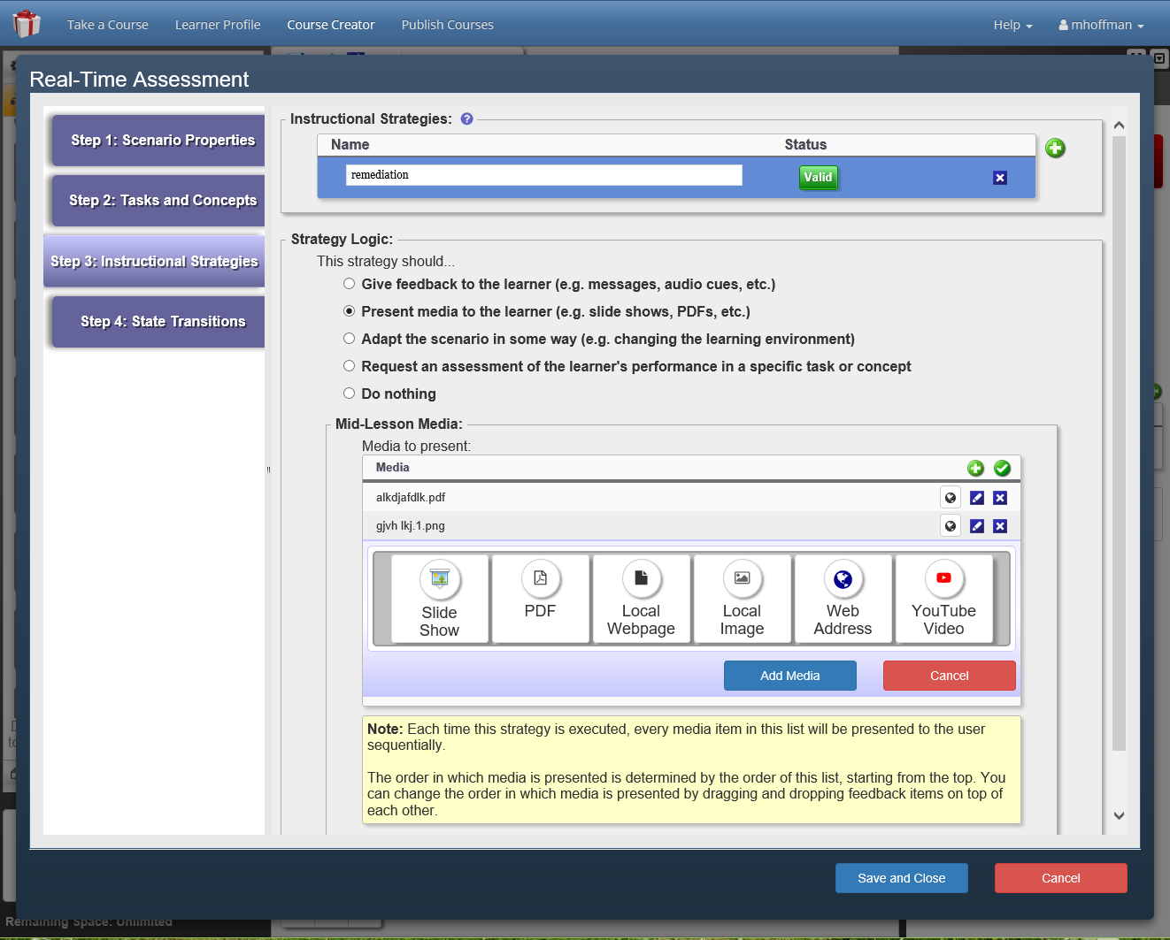
DKF Authoring Tool History
2015 – DKF Authoring Tool (DAT)
2017 – DKF Editor in GAT

Slide 5
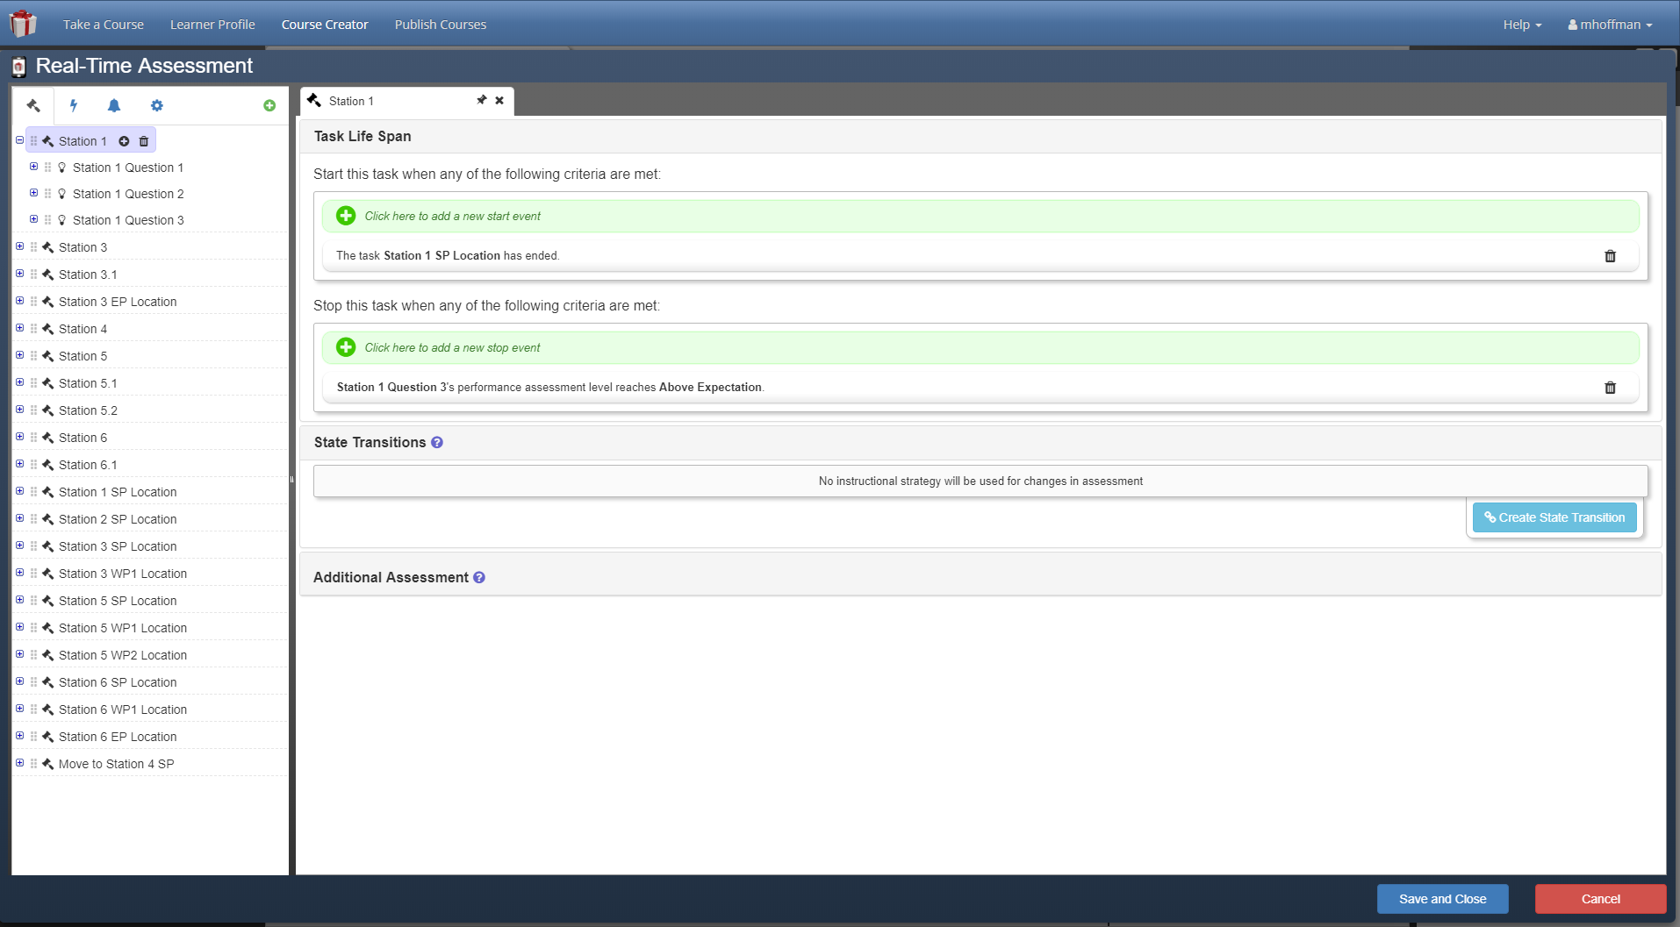
DKF Authoring Tool History
2019 – DKF Editor Revamped

Slide 6
Overview
Domain Knowledge File (DKF)
XML file which contains the information needed to execute on a single lesson
Configures the assessment logic for a domain
Authored using the DKF Authoring Tool (DAT)
Training Applications
Unity
VR Forces
Mobile Application
Virtual Battlespace (VBS)
Documentation provided at https://gifttutoring.org

Slide 7
Authoring Tool Components
Tasks
Strategies
State Transitions
Assessment Properties

Slide 8
Tasks
Task
Performance Nodes associated with assessing this domain
Task Life Span
Start and End Triggers
Concept
Lowest level performance node
Assessed via conditions
Condition
contains logic to assess the learner’s actions in the domain

Slide 9
Strategies
Adaptive Instructional Strategies
implemented based on changes in learner state
Strategy Choices
Instructional Interventions
Feedback
Present Media
Modify Scenario
Teleport Learner, Add/Remove Actors, Fog, Time of Day, etc.
Present a Survey
Start a Conversation

Slide 10
State Transitions
Logical Expression
A change in learner state from the current value to the next value
causes instructional strategies to be given to the learner
Criteria
Performance Node State
Learner State

Slide 11
Assessment Properties
End Triggers
Learner Actions
Places of Interest*
Team Organization*
Miscellaneous

Slide 12
Before you begin…
Task/Concept Outline
What tasks will the learner(s) be responsible for completing during the training exercise?
What concept is being assessed within each task?
What is the intended learning outcome/goal for each task?
What are the thresholds for measuring a learners’ performance for each task?
Strategy Handling Considerations
What actions taken by the learner would be considered good performance for each task?
What actions taken by the learner would be considered bad performance for each task?
What instructional intervention would best correct each poor performance?
What reinforcements, if any, should be applied when good performance occurs?

Slide 13
Demonstration of DKF Authoring in GIFT

Slide 14
Questions?

