Slide 1
Intelligent, Adaptive Training in The Synthetic Training Environment: 2020 Update
Gregory A. Goodwin Michael Hoffman
Approved for Public Release: Distribution Unlimited
Senior Research Scientist Senior Software Engineer
CCDC-SC-STTC Dignitas Technologies
29 MAY 2020

Slide 2
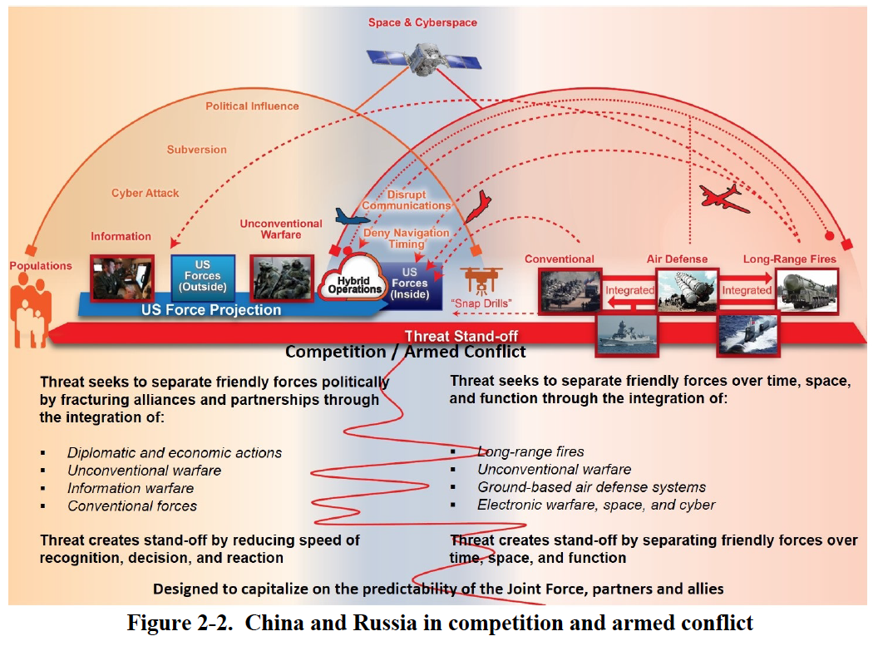
Multi domain operations
SOURCE: TRADOC Pamphlet 525-3-1.

Slide 3
MDO and cft’s
SOURCE: 2019 Army Modernization Strategy.

Slide 4
STE VISION
“As Is”
1980s technology – limits ability to train Combined Arms operations
57 terrain formats
Concurrency challenges and not designed to meet compliancy directives
Facilities-based TADSS
High overhead and long exercise lead times
Stove pipe systems
Requires increased resources
for TADSS
Cannot replicate the Operational Environment
No Joint/UA integration
“To Be”
Common Synthetic Environment that fully enables Combined Arms maneuver in a multi-domain environment
Dynamic one-world terrain Software-enabled updates
Less fixed infrastructure reliance –
point of need delivery
Fewer contractors, less hardware, &
faster exercise design
Reconfigurable trainers
Uses ongoing commercial innovation
for updates
Full replication of the Operational Environment
Joint and Unified Action (UA) integration
7
7

Slide 5
STE Operational view

Slide 6
STE Framework c. 2019
SOLDIERS AND LEADERS - OUR ASYMMETRIC ADVANTAGE
Mission Command Information Systems (MCIS)
Temporary Interface to
Legacy Systems
(LVC-IA)
Synthetic Training Environment (STE)
Common Synthetic Environment (CSE)
Training Management Tool (TMT)
Big Data, Intelligent Tutors, Training Effectiveness, Human Dimension
Global Terrain
Standard, Shareable Geospatial Foundation
Training Simulation Software (TSS)
“the engine”
Scale & Entity Count Open Software PoN / Network Virtual Humans / AI
Plan Prepare* Execute Assess
*Includes OE/Red Force
Virtual Semi- Immersive
User Interface and Hardware
Virtual Immersive User Interface and Hardware Mixed Reality Haptics Physiological Affects Simulator Sickness Reconfigurable Transportable
S/SVT | Reconfigurable Virtual Collective Trainers
Staff Training User Interface and Hardware
Live TADSS
For example, HITS, MILES
Authoritative Data Sources
For example, JLCCTC
For example, VBS3
For example, Army Training Information System (ATIS)

Slide 7
STE Framework 2020
SOLDIERS AND LEADERS - OUR ASYMMETRIC ADVANTAGE
Synthetic Training Environment
STE Information System (STE-IS)
STE Next Generation Constructive (NGC)
Training Management Tool (TMT)
Big Data, Intelligent Tutors, Training Effectiveness PLAN PREPARE EXECUTE ASSESS
STE Future Live Training Environment (LTE)
Training Simulation Software (TSS)
“the engine”
Scale & Entity Count, Open Software, PoN / Network, Virtual Humans, AI
Reconfigurable Virtual Collective Trainer (RVCT)
Air and Ground Tactical Trainers
One World Terrain (OWT)
Standard, Shareable,
Soldier/Squad Virtual Trainer (S/SVT)
Incorporating Squad Immersive Virtual Trainer (SIVT), Weapon Skills Development (WSD), Joint Fires Trainer (JFT), Use of Force Trainer (UoF)
Enabling Systems
Authoritative Data Sources
For example, Army Training Information System (ATIS)
Army Network
Mission Command Systems
Legacy Systems
Live Ranges

Slide 8
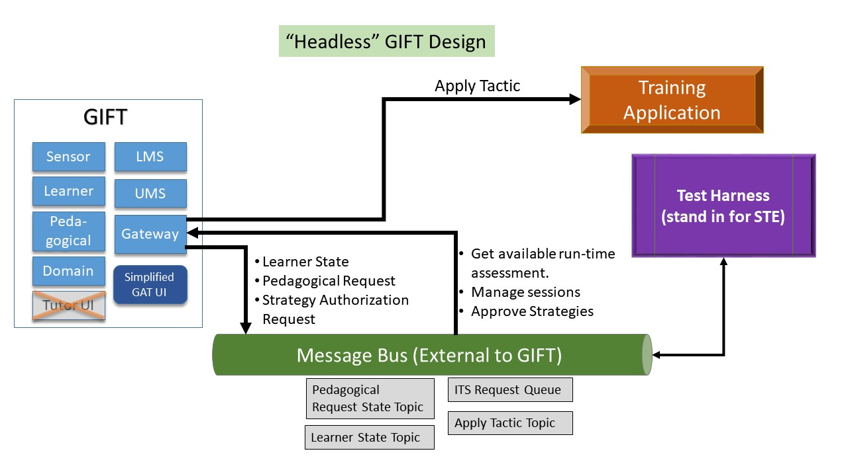
STE-GIFT integration

Slide 9
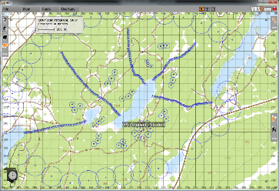
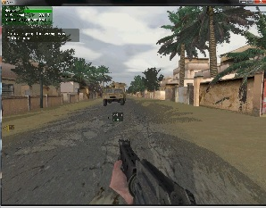
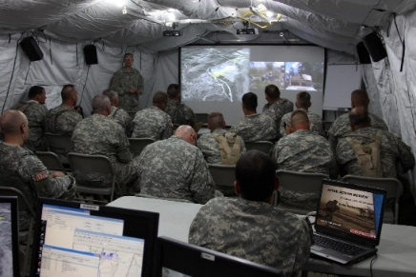
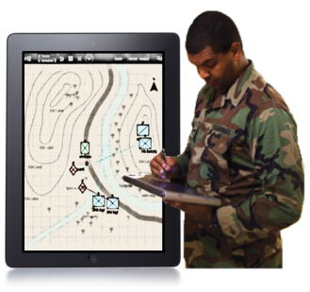
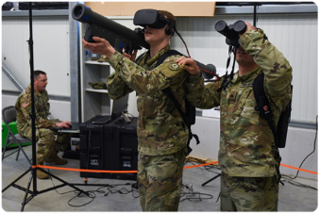
TMT Core Capabilities and S&T Drivers
PLAN
PREPARE
TRAINING EXECUTION
ASSESS
Tailored Scenario Generation
Real-time Feedback and Adaptation
Rapid Assessment and AAR
S&T DRIVERS
Automated Performance Assessment for Individual and Teams
Automated Feedback and Data Visualization for Individuals and Teams
Intelligent, Adaptive Training for Individuals and Teams
Competency Tracking for Individuals and Teams

Slide 10
TMT S&T Technology Roadmap
Human
Expert Dependent
AI Delivered
 | Near (FY20-22) | Mid (FY23-25) | Far (FY26-28)
Unit + Scenario | Small Team, Procedural Task | Company, Simple Mission | Joint/Combined Arms, Complex Mission
Automated Assessment | Pre-authored, scenario specific team metrics | Reusable team metrics | Machine generated team metrics for complex missions
Adapt + Exercise Control | Pre-authored, rule-based feedback/adaptation, OC Dependent | System supported recommendations | Learning AI that provides feedback/ adaptation and exercise control.
Data Visualization + Feedback | Event-based Storyboard, OC Dependent | Customized for mission and unit, Leader dependent | AI Agent delivered, adaptive and customized for any audience (e.g., trainers, leaders, trainees)
Competency Tracking | Persistent Performance Tracking for small units | Human generated competency profiles for individuals and teams | AI generated & validated competencies for individuals and teams.
Notes:
In the

Slide 11
Research Goals
Visualization of real-time team performance for exercise control
Visualization of projected training outcomes.
Visualization of battlefield effects (e.g., cyber, kinetic, non-kinetic) on physical, social, cultural, etc. elements of OWT.
Tools for rapid creation of AAR
Management of information complexity during execution
Exercise control tools/interfaces for training managers
Visualization of projected impact of scenario adaptation on training outcomes.
TMT TESTBED
Data requirements for TSS to support TMT analysis, visualization, feedback and scenario adaptation
MR Visualization
xAPI formats for reporting Team performance
Adaptive Training
Policies for automating real-time scenario adaptation/injects
Techniques for automating assessments for Armored PLTs
Techniques for automating assessments for BN-BDE CP teams
Persistent competency frameworks for military teams
Techniques for automating assessments for dismounted squads
NLP for team verbal comms
Policies for automated feedback to individuals vs teams
Automated AAR for diverse teams/missions

Slide 12
Questions?

Slide 13
Backup slides

Slide 14
Automated Performance Assessment for Teams
What is it & why does it matter?
STE’s team performance assessments need to be GENERALIZABLE.
Teamwork assessments need to be automatically collected during scenario execution and diagnosed in real time.
Event-based automated teamwork assessments increase quantity, quality and type of feedback, AAR, and training adaptation possible.
What is available from govt/industry/academia?
Current collective training assessments for simulations are SUBJECTIVE, GO/NO-GO hand-held checklists.
These limit the training effectiveness of AARs that can improve team performance, and tracking/documenting training effectiveness of simulations over time.
Drives up the cost of labor for Observer/Controllers to run the assessments.
What are the S&T challenges?
Natural Language Processing for Team Assessments.
Methods for developing valid generalizable assessments in complex scenarios developed with SME input.
Rapidly contextualizing interaction and communication data within a set of scenario tasks/conditions/standards.
Tracking teams across scenarios and domain spaces through persistent modeling techniques.
Deriving data sources that inform team communication protocols void of natural language (gestures and signaling).

Slide 15
Automated Feedback and AAR for Teams
What is it & why does it matter?
Providing data that is too raw or granular does not support learning. Assessment entails interpreting data to learners/trainees so that they understand their mistakes through effective AARs.
Automated real-time feedback for teams with little or no experience and objective, validated performance assessment to enable rapid AAR at any point of need.
Enables rapid identification of key scenario events relevant to conduct the AAR.
What is available from govt/industry/academia?
Current AAR systems can automatically generate Powerpoint charts and provide recordings (with playback/pause) that can be bookmarked by SME’s.
Data/Metrics require significant work to analyze and summarize.
Systems lack an automated objective team assessment capability.
What are the S&T challenges?
Data Visualization for Team Performance
Personalizing feedback across the roles and tasks performed within a team structure
Tailoring feedback based on team skill acquisition over time.
Establishing a pedagogical strategy for managing real-time instructional support versus AAR and post-exercise remediation.

Slide 16
Intelligent Adaptive Training for Teams
What is it & why does it matter?
The ability to automatically adapt training difficulty, provide prompts, recommend remedial training to enable teams to achieve training goals effectively and efficiently.
Current approaches to adapting collective training events require a great deal of preparation and control by human trainers. This level of support is available at large simulation training centers. AI based adaptive training will enable STE to have this capability at any point of need.
What is available from govt/industry/academia?
Individual tutoring systems for specific to domains/skills. These are very expensive to build.
Few team tutors exist (e.g., collaborative problem solving).
Only rudimentary tutoring systems exist for military teams.
What are the S&T challenges?
Creation of domain independent tutoring systems that are flexible enough to work across team types, sizes, and missions.
Pedagogical models that can determine optimal feedback and interventions at both individual and team levels to produce effective training.
Selecting an optimal training strategy and scenario based on team needs (varying based on echelon structure).

Slide 17
Competency tracking for individuals and Teams
What is it & why does it matter?
A competency is a complex domain of skill and/or knowledge that has value within the context of a job, career, or organization. To develop competencies, it is necessary understand and have a representation of the component skills/knowledge and their interrelationships (i.e., a framework).
Individuals and teams develop and lose competencies over time. By tracking competencies over time, it will be possible to automatically adapt training to any individual or team at any time.
What is available from govt/industry/academia?
Competency frameworks (e.g., CASS) are emerging but authoritative representations of competencies are still not widely available.
Data pipelines and databases for automatically updating competency measures are not widely available.
What are the S&T challenges?
Research on methods for automatically creating and validating competency frameworks for individuals and teams.
Research on the use of competencies to adapt training at the individual or team level.
Research on models of competency development and atrophy over time.

