Slide 1
Matching Content to Competencies w/Machine-Learning A Service-Oriented Content Alignment Tool for Authoring in GIFT and Beyond
Benjamin Bell, Ph.D.¹, Keith Brawner, Ph.D.², Debbie Brown¹, Elaine Kelsey¹
¹ Eduworks Corporation, Corvallis, OR
² CCDC STTC, Orlando, FL
GIFTSym 8 May 28-29, 2020

Slide 2
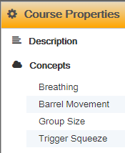
Vision: Automate Content Alignment & Tagging
Need training mgmt tools to:
Find, organize & curate resources aligned with desired competencies
Distinguish content aligned with taskwork v. teamwork

Slide 3
Machine-Assisted Generation of Instructional Content (MAGIC)
OBJECTIVES
Enhance team training development w/content discovery & auto-tagging
Find, organize & tag resources aligned w/desired competencies
Identify taskwork/teamwork content
Extend reach of team tutoring to diverse competencies & content
Enhance team training outcomes across spectrum of Army needs
Enable workflows that propel reuse and repurposing
Help advance STE TMT, GIFT

Slide 4
Top-level Workflow
Domain Training (Performed Once)
Authoring Support (on-demand, multiple x)
Competencies, METLs, TSPs
Competencies, METLs, TSPs
Human Rating Data
Training content aligned with competencies
Can be different corpora
Corpus
Corpus

Slide 5
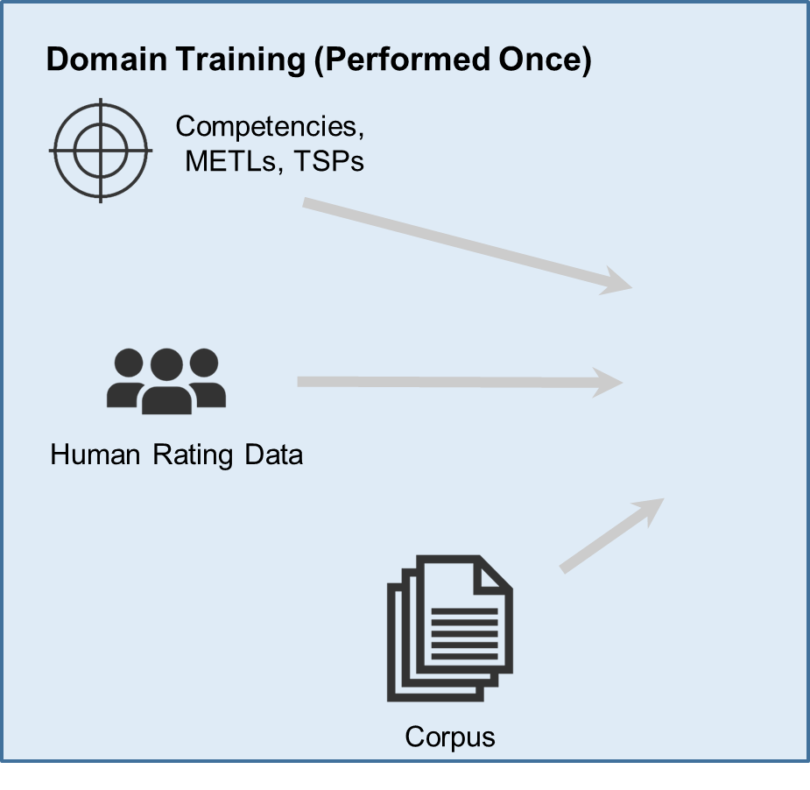
Domain Model Training
Create training corpus
Employ ML to create concept maps
Tested on three ML methods
Unsupervised learning, generic corpus
Unsupervised learning, domain corpus
Supervised learning, domain corpus

Slide 6
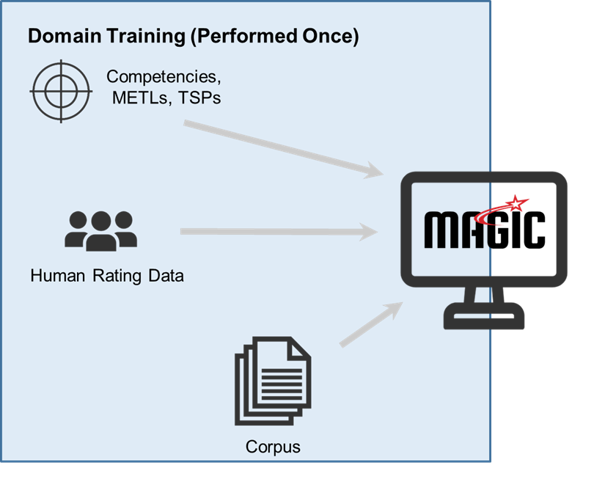
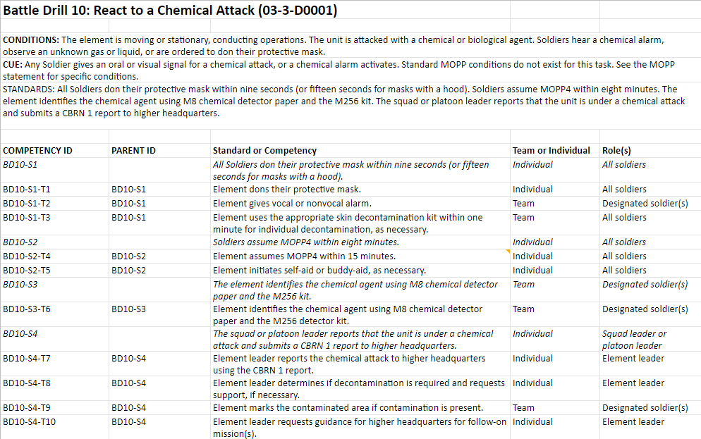
Limitations of Topic Mapping
Goal: Extract content excerpts aligned to a competency in a Competency Framework
Process: Match short text string (competency) & limited context (other competencies or text in same Competency Framework)
Short text sample makes this much more challenging than topic detection in large documents
Notes:
TRADEM used LDA-based topic detection algorithms to detect ‘natural’ topics in a corpus of documents; each topic is modeled as a multinomial distribution of words; rich topic models are available for matching topics to content excerpts
Extracting content excerpts aligned to competencies in a competency framework is much harder - we only have a short text string (an competency) and limited context (any other competencies or text in the competency framework)
First challenge:
current short text string analysis techniques in the literature are mostly limited to keyword extraction, or named-entity extraction (using an ontology),
but there is no guarantee that those exact keywords or entities appear in the target corpus documents, or that if they do appear, they are being used in a way similar to the meaning encoded in the competency.
Humans can detect ‘concept equivalency’ between text strings that use different words or terms to describe the same underlying concepts or ideas; likewise, humans perform contextual word sense disambiguation to detect when similar words are used to describe different concepts in different contexts
A second challenge: Topics are usually modeled in purely semantic terms, but competencies (usually) consist of multiple ‘concepts’ whose relationships are defined through syntactic structure - the relationships between the concepts is important in correctly detecting the the overall ‘meaning’ of the competency

Slide 7
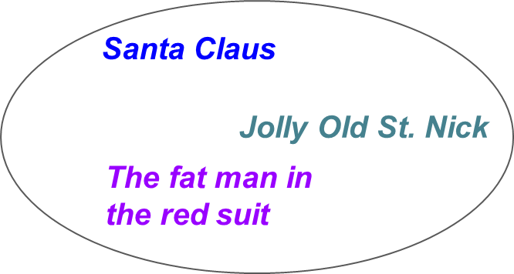
Novel Solution: Concept Embedding
Build concept map’ aided by word embedding neural network approaches (Word2Vec, GLoVe)
Parse input corpus
Build corpus models
Define Concepts
Detect entities and relations as short text strings (rather than as individual words)
using TensorFlow / SyntaxNet - style dependency parsing, and traditional ontological approaches (e.g. Wikipedia for general knowledge ontology)
Build an entity embedding model, a relation embedding model, and a combined model (modified W2V-SG) with words replaced by the short text strings from Step 1.
Instantiate ‘concepts’ as tight clusters of phrases in the resulting entity and relation vector spaces
Notes:
Define ‘topics’ as distinct clusters in the combined vector space
Result: produces a result similar to traditional topic detection, but not limited to individual words
Possible experimental upgrade: iterative hardening of concept boundaries

Slide 8
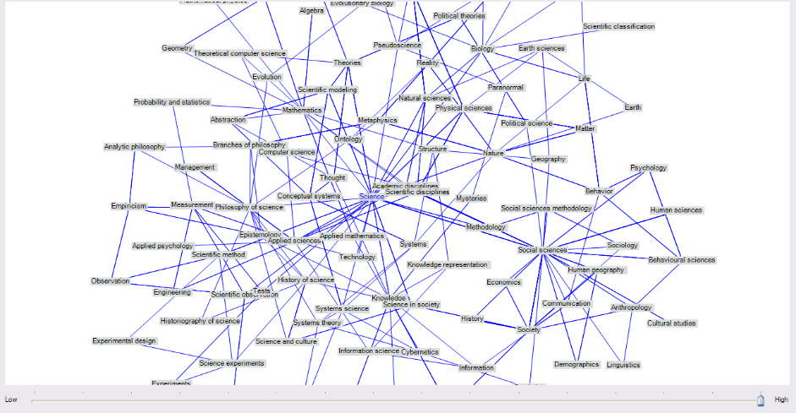
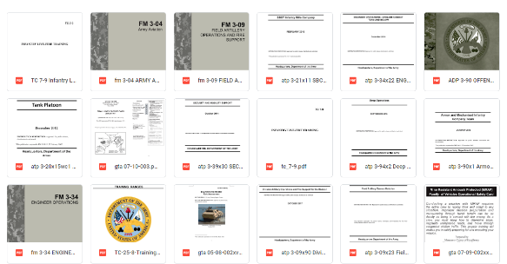
Two Unsupervised ML Models
1. Unsupervised General model: Trained using Wikipedia & NYTimes Corpus to map concepts
2. Unsupervised Domain-specific model: Trained using corpus of military-related documents to define domain-specific concepts

Slide 9
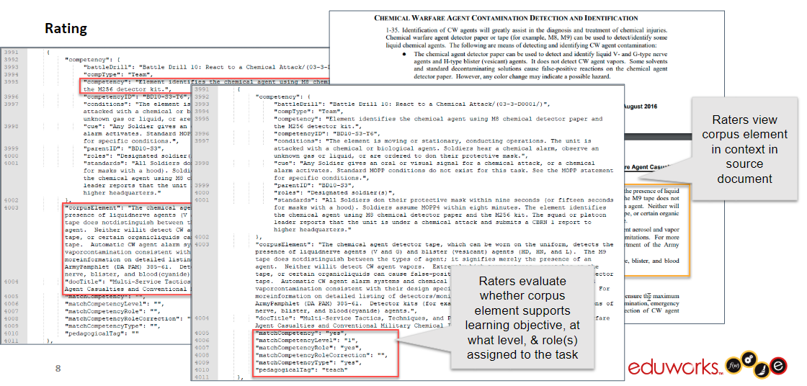
Supervised ML Model
Domain-specific Supervised Training Layer (using human-labeled data)
Each labeling and evaluation task completed by 3 human evaluators simulating the role of an instructional designer
Average Interrater Reliability: Text Selection and Extraction: 81.6%
Distinguish Team and Individual Content: 87.8%

Slide 10
Excerpt Extraction Preliminary Results
 | Unsupervised Domain-General Model | Unsupervised Domain-General Model + Unsupervised Domain-Specific Model | Unsupervised Domain-General Model + Unsupervised Domain-Specific Model + Supervised Domain-Specific Model
Match 1: Machine agrees with raters when all humans agree | 0.827 | 0.923 | 0.986
Match 2: Machine agrees with the majority when humans disagree | 0.514 | 0.723 | 0.769
Match Total | 0.762 | 0.871 | 0.948
Slightly Below Mean Human Performance
Slightly Above Mean Human Performance
Interrater Reliability: 81.6%
Listed values are Fleiss’ kappa
Approaches Mean Human Performance
Exceeds Mean Human Performance

Slide 11
Excerpt Extraction Preliminary Results
 | Unsupervised Domain-General Model | Unsupervised Domain-General Model + Unsupervised Domain-Specific Model | Unsupervised Domain-General Model + Unsupervised Domain-Specific Model + Supervised Domain-Specific Model
Match 1: Machine agrees with raters when all humans agree | 0.827 | 0.923 | 0.986
Match 2: Machine agrees with the majority when humans disagree | 0.514 | 0.723 | 0.769
Match Total | 0.762 | 0.871 | 0.948
Slightly Below Mean Human Performance
Slightly Above Mean Human Performance
Interrater Reliability: 81.6%
Approaches Mean Human Performance
Exceeds Mean Human Performance
Notes:
Match 2: Above human performance when more often in the majority than any individual rater
Match total is % of time in full agreement + majority; human performance is mean across all raters

Slide 12
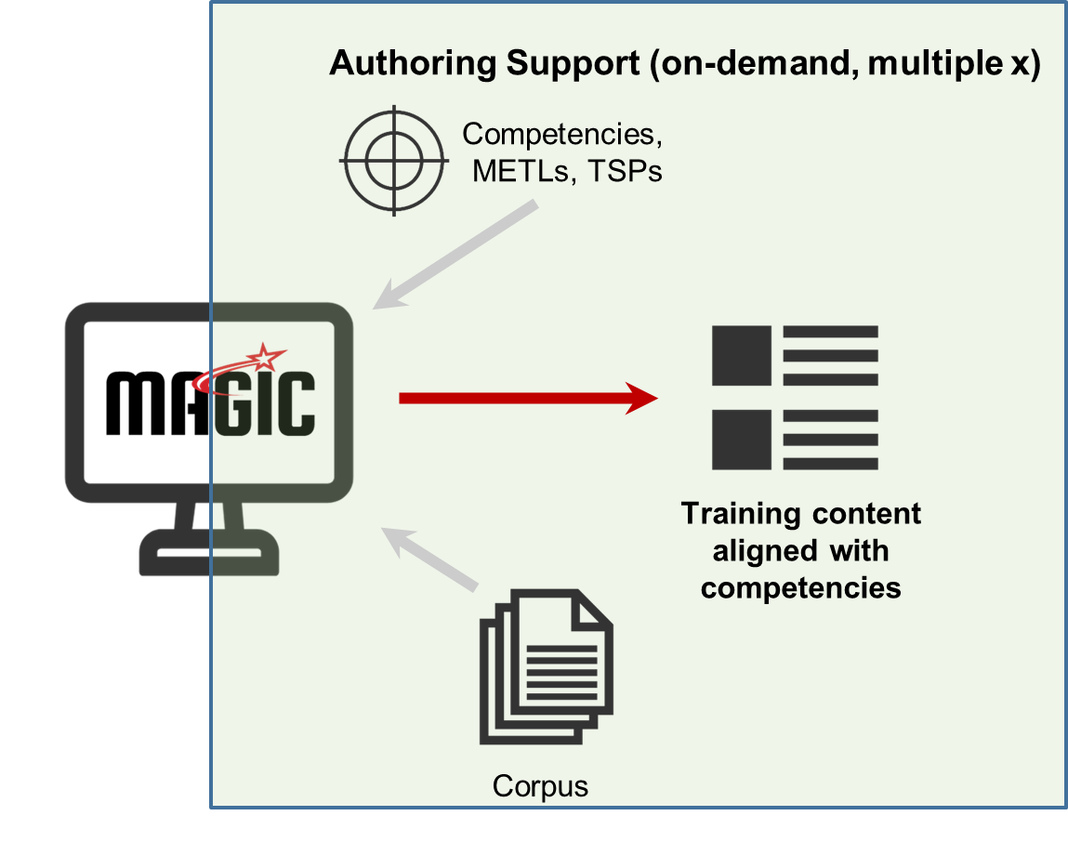
Authoring Workflow (or “we built the model. Now what?”)
Create/modify corpus
Import/select competency frameworks
Review/filter/export aligned content

Slide 13
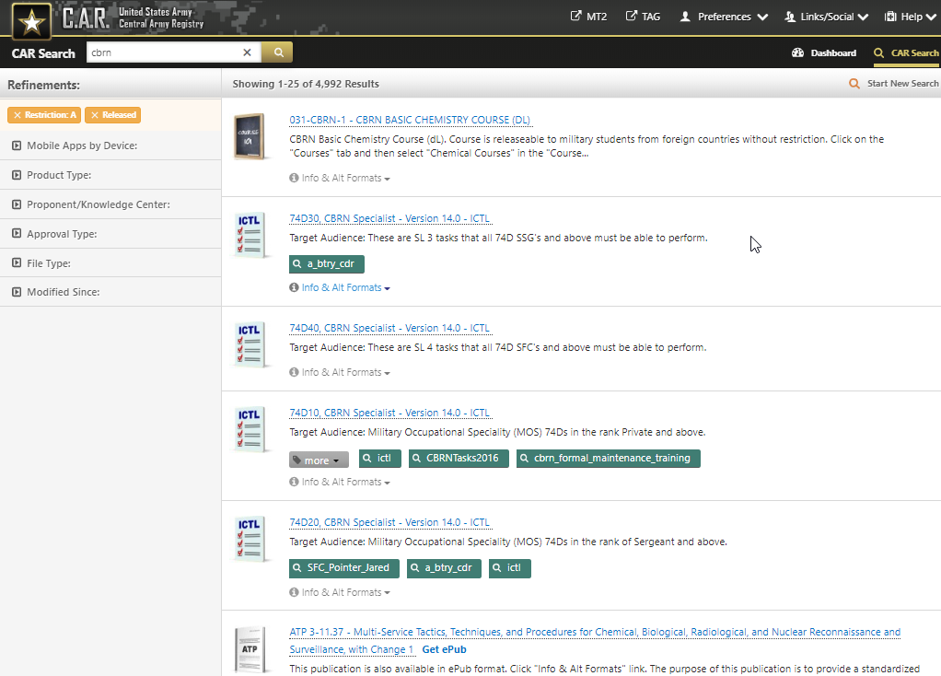
Example Source Documents

Slide 14
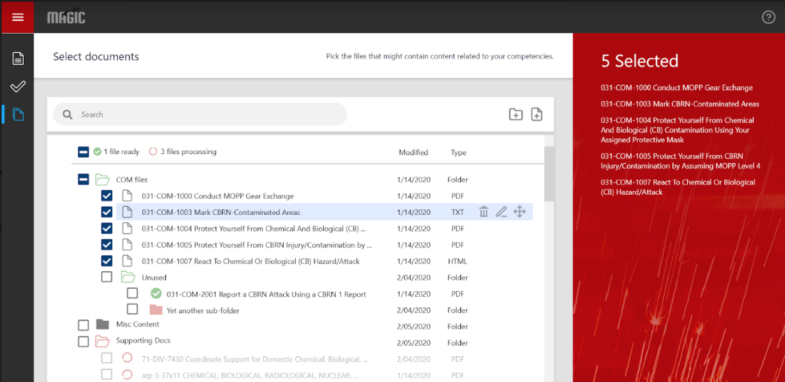
1. Create/modify corpus

Slide 15
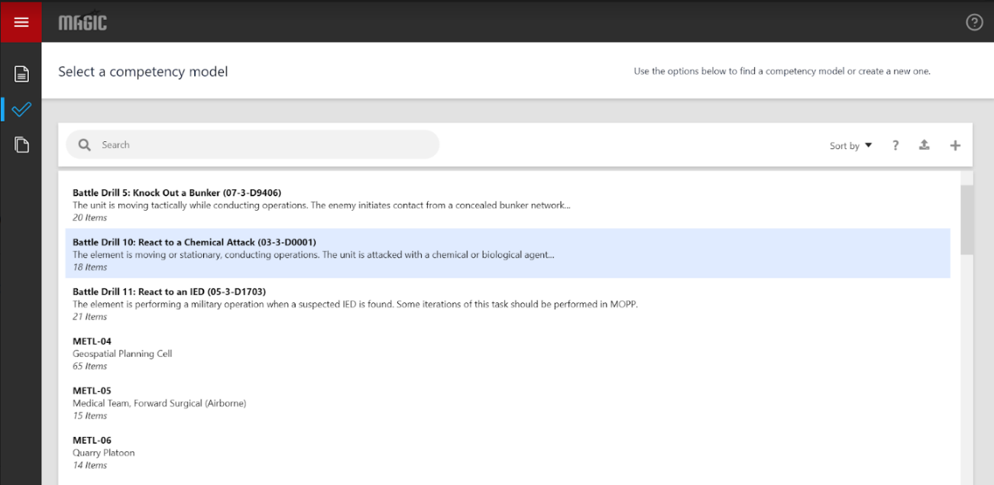
2. Import/select competency frameworks (Competency Frameworks captured in CaSS*)
* Competency and Skills System, an open-source competency framework tool www.cassproject.org

Slide 16
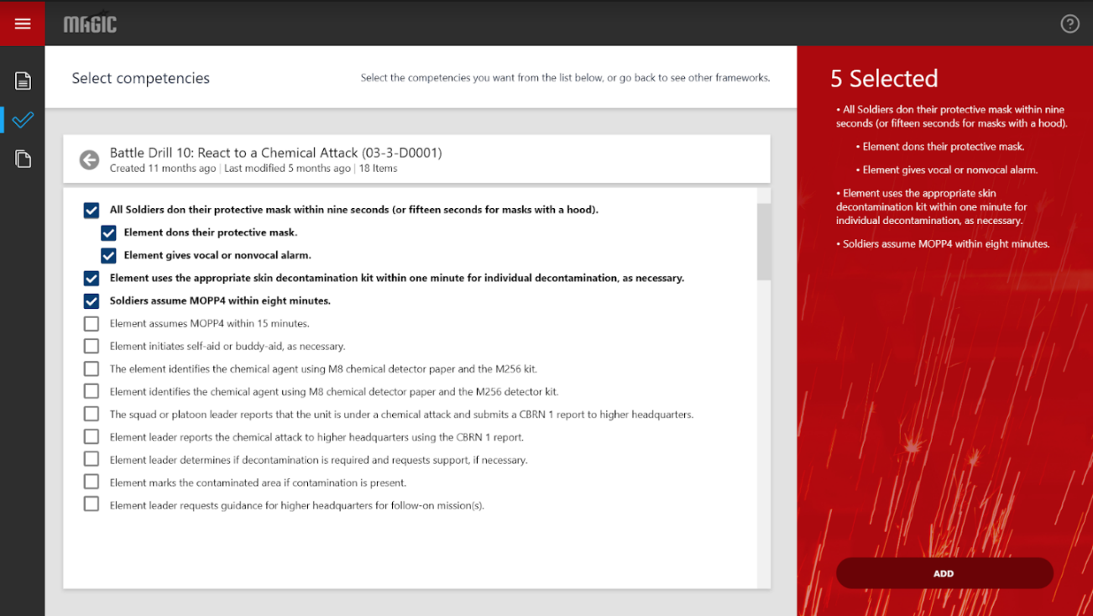
2. Import/select competency frameworks (Competency Frameworks captured in CaSS*)
* Competency and Skills System, an open-source competency framework tool www.cassproject.org

Slide 17
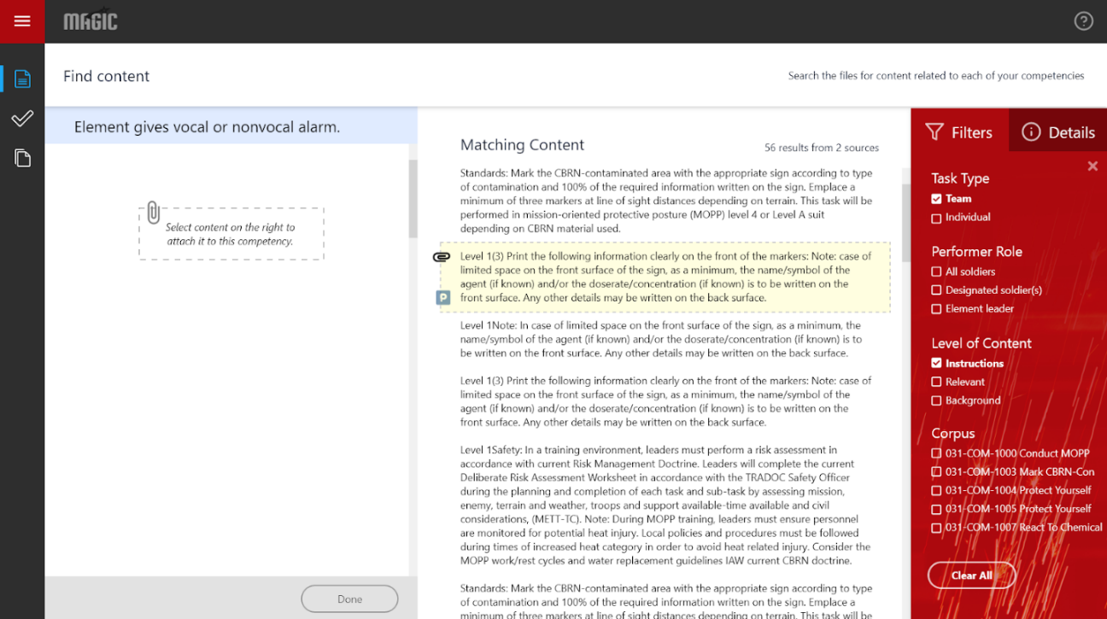
3. Review/filter/export aligned content

Slide 18
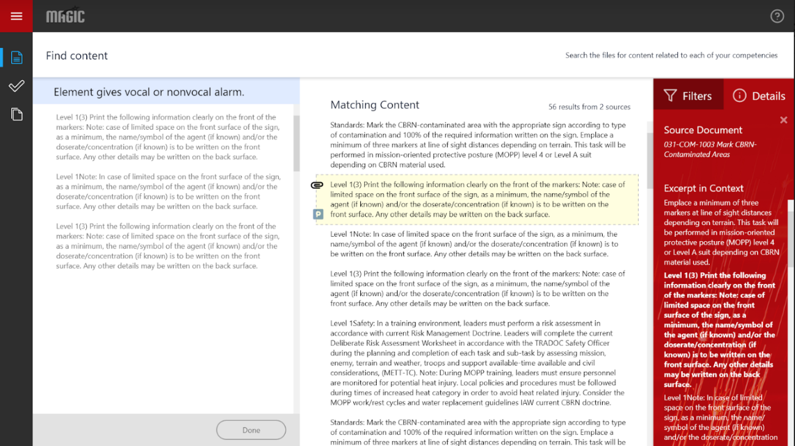

Slide 19
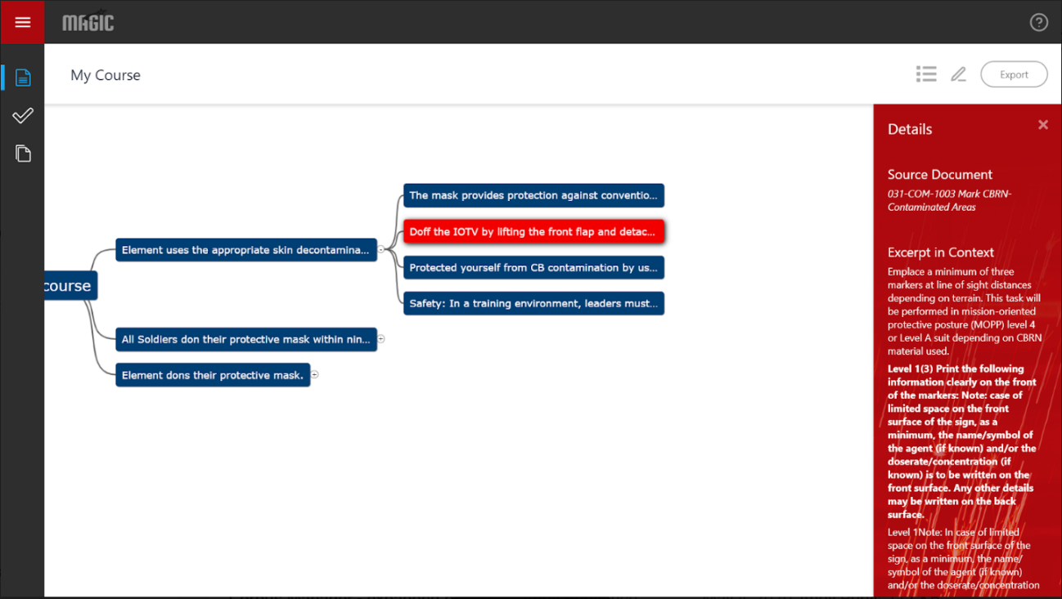

Slide 20
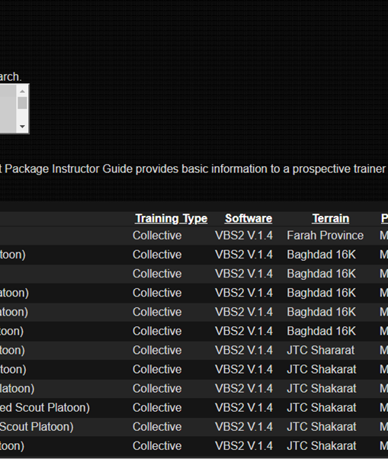
Adjacent Use Case Example: Aligning Training Support Packages & competencies

Slide 21
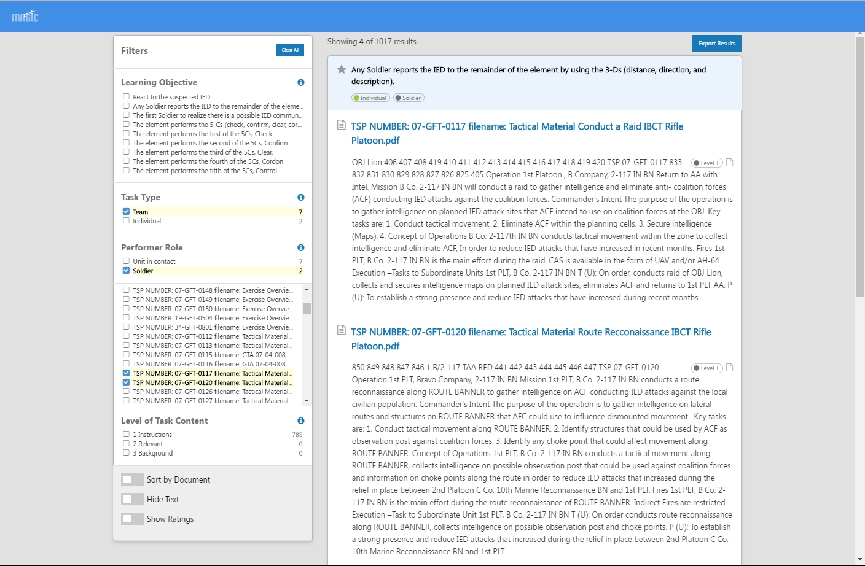
Example: Aligned Results

Slide 22
GIFT Integration
Expanding MAGIC RESTful APIs to support integration requirements, including CaSS
Designed UI modifications to incorporate new MAGIC-supported workflows
CaSS Competency Framework Management
Uses CaSS API for competency management, alignment to resources
MAGIC Services
Uses MAGIC API for resource curation, ML & NLP processing pipeline, queries, performance analytics, and packaging
GIFT Cloud
21

Slide 23
Potential GIFT Integration Points
GOAL: Incorporate MAGICal powers into GIFT authoring
MAGICal curation
Importing competencies into centrally managed, reusable frameworks
Importing new content into the MAGIC pipeline
Review and validation of MAGIC outputs
MAGICal searching
Finding content in context for a set of competencies
Finding content in context for a competency and course object
MAGICal packaging
Integrating selected items into originating GIFT component format
Notes:
1) Viewing the search results; (2) Selecting those to be saved or collected into a folder; (3) Exporting those saved items into a data store or competency framework indexed by LO; (4) Incorporating those into the training app using GIFT as the example authoring tool.

Slide 24
Conclusion & Next steps
Results
MAGIC algorithmic results approach human performance
Incorporating supervised models can exceed human performance
Testing with other inputs (TSPs, FRAGOs) shows broader potential value
Benefits
Helps team tutors extend reach, span diverse competencies & content
Finds, organizes & tags resources aligned with desired competencies
Enables workflows that propel reuse and repurposing
Helps advance STE TMT, GIFT
Future Work
Aligning content with specific team roles
Incorporate non-text content using metadata; automated transcription
Integrate w/Army-selected authoring/CMS/LMS tools
Test/evaluate MAGIC prototype w/authors of team training simulations

