Slide 1
Generalized Intelligent Framework for Tutoring (GIFT) – GIFTSym8
Synaptic Sparks, Inc. May 28, 2020
Notes:
Hello everyone, happy to be here at GIFTSym8 virtually.
- Presenting for Synaptic Sparks here on May 28

Slide 2
Using GIFT, Competencies, and virtual reality training to provide effectiveness improvements for nuclear technicians
Demonstration category
Notes:
---------------------------------Good luck reading the title!
This paper is in the Demonstration category and obviously that has changed a bit due to the circumstances. So, we’ll move forward to the Outline and explain a bit further…

Slide 3
Outline
Introductions
Background – What This Demonstration Will Be Someday
GIFT: The AIS and ITS of the Project
Competency Frameworks Utilizing CaSS
Nuclear Reactor Training Challenges and Modernization
Integrating GIFT and CaSS: Competency Frameworks as Course Concepts
Current Desktop/Virtual Reality Nuclear Reactor Software Training
Bringing It All Together
Future Experiments
Discussion
Notes:
First off, you’re Lucy Woodman and you’ve been with the company a couple of years.
Coauthors include Mike Kalaf and Chris Meyer, also with the company since it began. Our paper will be made available as part of these proceedings with more detail than we can cover here, and feel free to reach out to GIFT organizers and any of us with questions we cant get to during this event.
You’re probably reading what’s on our agenda which was originally intended to be far more interactive being a demonstration.
So, instead we’re going to do our best to explain the project of bringing Competency-Based training paradigms into GIFT as part of our project.
We’ll go through and show some pictures, movies of the live system, and hopefully be able to co-locate in a physical office sometime and offer demonstrations to anyone in Orlando at a later date.
We’ll be talking to you about one of our interesting training project involving nuclear reactor training, how we built a competency framework around it, and finally how interesting it was to be able to modernize-the-modernized training further by allowing GIFT to do one of the things it does best –
Provide adaptive instruction and tutoring.

Slide 4
BACKGROUND
Demonstration Usually Consists of:
One (1) GIFT Local Server
One (1) Virtual Reality-Capable Nuclear Reactor Training Supercomputer
One (1) Instructor Operator Station
Two (2) Virtual Machines Running CaSS / Middleware
A Professional GIFT-Operating Human
A Nuclear Reactor Operation Trainee
Notes:
So, first a little explanation on why we aren’t mailing everyone HTC vive pros, super computers, or having the entire system online. COST PROHIBITIVE, duh ;).
The full system is actually fairly complex!
The whole goal is to bring in competencies into GIFT’s ability to use as Course Concepts – if you aren’t familiar with those terms don’t worry, they’ll be explained in detail later.
These competencies need a focus though – not merely being test data. Having real data really helps us as codevelopers to understand that we’re not only engineering software correctly, but we’re engineering it WISELY and on target with GIFT community needs.
Another nonprofit project that we contributed to was to modernize training in the nuclear reactor sector. Now – this next part is NOT our opinion – we’ve simply been told that the nuclear reactor training programs have been in need of modernization for a couple of years.
Through joint, multi-company efforts the nuclear reactor training system was created, basically to create a virtual (but also desktop-compatible) program to let technicians train on topics they might not otherwise have access to.
and since we had license to demonstrate it (but not OWN it), it was a perfect fit to use for domain knowledge when trying to come up with competency frameworks to build in CaSS and integrate into GIFT adaptive tutoring methodologies.

Slide 5
Background (GIFT)
This project’s focus points (www.gifttutoring.org)
GIFT offers numerous course objects, styles of adaptive tutoring, and content – what to add? (See #3)
Through adding a formal model for competency-based training, GIFT is enabled to:
Allow GIFT authors to select Course Concepts from an existing competency framework
Allow Subject Matter Experts (SMEs) to use a web portal to create, delete, and maintain said-frameworks
Gauge learner performance in real-time against a competency framework in a GIFT course
GIFT (In a Nutshell) [1]
[1] Sottilare, Robert & Brawner, Keith & Goldberg, Benjamin & Holden, Heather. (2012). The Generalized Intelligent Framework for Tutoring (GIFT). 10.13140/2.1.1629.6003.
Notes:
So, this slide is a bit of an eye chart but it basically explains what GIFT is doing in the context of this project
GIFT brings everything that it normally does to the table, as always and as many other presentations today and tomorrow will explain.
In the context of competency frameworks that are becoming more accessible via GIFT every day – it is a new capability added to GIFT through piggy backing off of Course Concepts.
For those that aren’t familiar, Course Concepts are properties in GIFT that are used to tag not only courses overall but concepts INSIDE of the courses, and once an author tags a Course Object in a GIFT course or tags Course Content as covering a Course Concept, the whole Automagic of GIFT tutoring can start taking place within a course.
Competencies let GIFT have yet another avenue by which to tag these courses, content, and enable adaptive tutoring.
And, looking above to the chart, we start to see the different parts of GIFT that this undertaking influenced.
Sensors through some of the specialized nuclear reactor training hardware that could then be pinged for status using GIFT’s preexisting sensor integrations (for instance the heart rate monitor we presented last year for GIFTSym7)
External applications through serious games (specifically the Unity Game engine this time around)
Now creating an entire competency framework from the ground up is a major undertaking, and that’s why the GIFT team studied existing and available technologies, and we’ll get to that in just a moment…

Slide 6
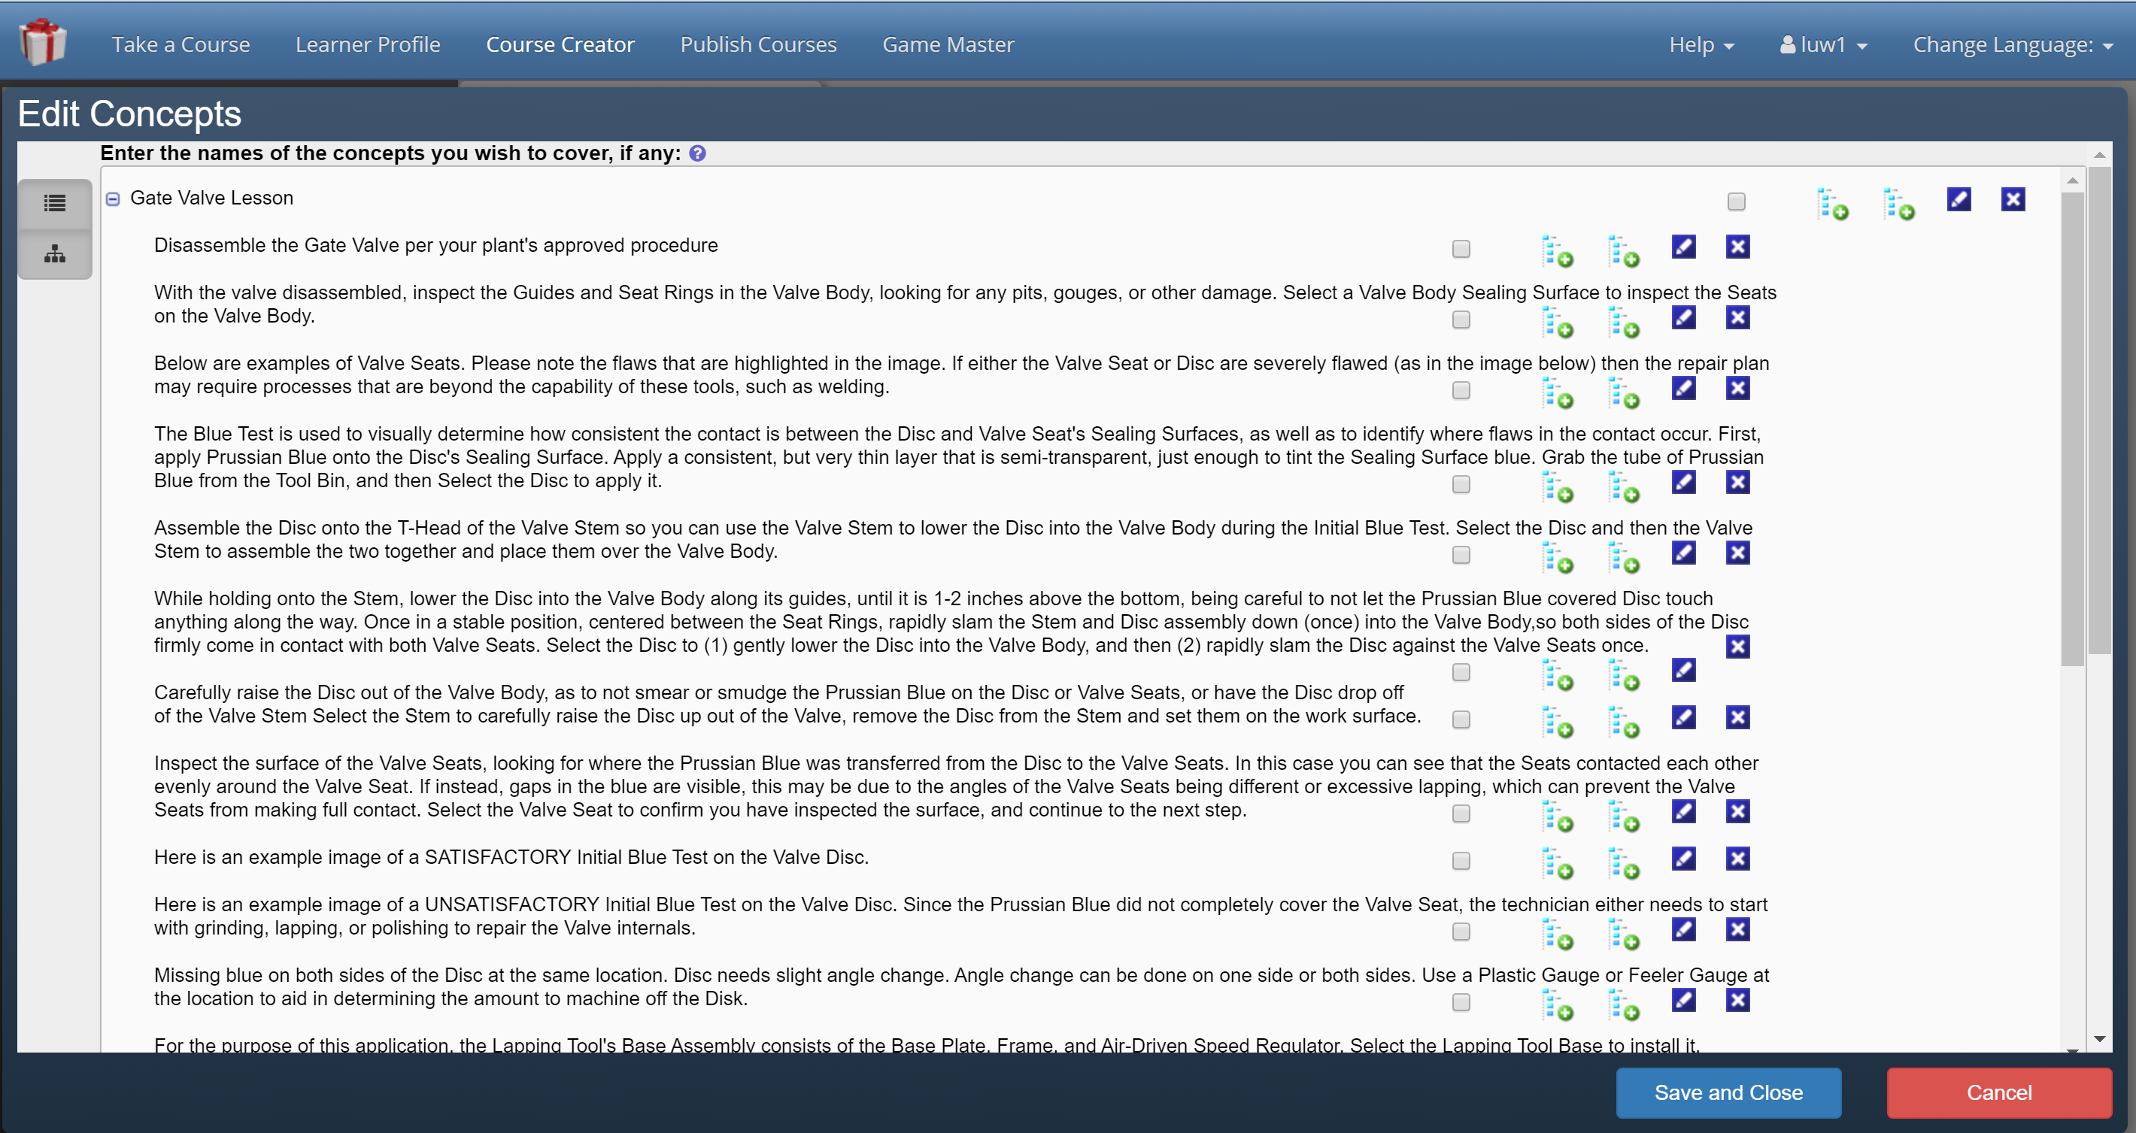
Video slide – GIFT: The AIS and its of the project
Screenshot of GIFT ‘Edit Concepts’ User Interface Window Importing CaSS Competencies
Notes:
BUT FIRST a real quick video on selecting, editing, and cancelling Course Concepts accessed in CaSS.
So, I’ll just hit play while I talk a little bit about what’s going on…
Just like standard course concepts, a competency entered through the CaSS tool will become accessible in a GIFT course.
Now, which competency framework is provided to authors, how it’s selected, whether or not users will be able to point to their own CaSS servers and competency framework – those are the items currently in development.
But, what we have now is an available, online, editable competency framework that a development version of GIFT can access through REST calls.
REST, in this context which I’m sure we could all use more of otherwise, is just a standard protocol that GIFT, CaSS, Unity, and therefore the nuclear reactor training software that we happen to be using for a test bed can all use to communicate together.
And, at this point I hope the video worked, but if not we’ll have all the videos referenced in this presentation linked to at the end, in an unlisted YouTube channel so with the direct link you should be able to watch them later too if you’d like.
So, now let’s take a look at where these competencies came from -

Slide 7
Competency Frameworks Utilizing CaSS
CaSS: The Competency and Skills System
An Advanced Distributed Learning Initiative https://adlnet.gov/projects/cass/
Provides a Multitude of Tools for Creating and Maintaining Competency Frameworks
Open Source, Extensible, and Perfect for GIFT Integration Efforts
http://cassdev.gifttutoringclouddev.org (Public DEVELOPMENT server used with GIFT. Populate at your own risk, but freely)
Notes:
So, CaSS stands for the Competency and Skills System and is an ADL initiative, is open source, and ended up being perfect for integration with GIFT due to all these compatibilities – not only on the software level but logistically as well.
A link is provided here is anyone would like to check it out,
And through using the access to the open source tools we were able not only to create a Framework for our own use on the CaSS public server, but also create one of our own for exclusive use with GIFT
There are some special configurations and work that needed to happen in order to stand up this specific server, so again after things get back to normal all these artifacts will be provided to the community as part of this bundle.

Slide 8
Competency Frameworks Using CaSS
CaSS Landing Page
Sample Project Competencies
Competencies and Relationships
Where it all starts
Straight from Nuclear Technician SMEs
Everything is related to everyone…
The CaSS web portal offers capabilities for GIFT or Content SMEs to create profiles, frameworks, edit competencies, or share work. Try it out for yourself!
These 100+ competencies were provided to the GIFT team as part of the nuclear reactor training software development effort for use in formal test cases.
All competencies can have optional relationships to other competencies in the same or different frameworks. This allows for tiers of skills, team analysis, dependencies, and great potential for adaptive tutoring and content recommendation in GIFT.
Notes:
So a little more on CaSS and how it integrates with GIFT, then we’ll bring in the nuclear trainer software to the picture
When you either access ADLs or our CaSS server and make a free account, you’ll immediately hit the landing page that will allow you to do way more with frameworks than we have time to discuss in this presentation.
For the GIFT integration, we mainly focused on creating a framework that directly ported the competencies and lesson steps that were provided to us from the nuclear reactor training efforts.
We also have some Squad Overmatch styled framework data provided by the CaSS team, and it also sounds like there may be some great medical framework data on the way. All these different styles of competency data really help us design the capabilities in GIFT correctly so we can meet the community’s needs.
You can also see here some of the steps that we ported over from Nuclear Reactor competencies, and of special final note about CaSS for this GIFT project is the concept of competency relationships to each other.
Having stand alone competencies in a good technical solution would be one thing, but being able to utilize all the other capabilities alongside GIFT really opens the door for adaptive tutoring and content recommendation to name just a couple of things.
Through being able to tag a course and course content, and then being able to gauge learner profiles and their progress through different competency trees is really where this project showed us the potential of what was going on here. Then, a step further later in the year or maybe even next, being able to combine those profiles and aggregate them up to team and squad levels of mission readiness assessment is of great importance to a lot of GIFT stakeholders.

Slide 9
Training Content modernization 20-20 Hindsight roadmap for some nuclear reactor stations
STAGE 01
Gaps in knowledge and training were identified across many similar domains in the Department of Energy
Current state of training content was assessed and found to be lacking in areas that could not be replaced with slides or new personnel
STAGE 03
A massive data gathering effort was undertaken to capture at-risk knowledge due to the "brain drain" of the workforce vacating positions
STAGE 02
STAGE 04
STAGE 05
Results of the Data Gathering crusade were cataloged but gathered dust. Training needs skyrocketed (specifically in North America for nuclear technicians)
Technology companies willing to take risks developing new methodologies of training were welcomed
Notes:
So, throughout our nonprofit and community service efforts we come across a lot of areas where we can be of assistance. Turns out that the Dept of Energy was one such area, and it was due to the state of training being in dire need of modernization that we got involved with this project.
We got to be part of a multi-company effort (cant talk about which ones though) to enhance training across in-need sectors
This effort opportunity coincided with GIFT’s need for formal competencies to test use cases against
Led us to basically combine the GIFT integration efforts to include a competency framework, and some of the most modern training available on a Desktop PC
100+ steps of nuclear technician training complete with Desktop and Virtual Reality versions
Was a multi-month effort and the training tool is now actually deployed in the field, which gives us a real opportunity to be included in on those baseline results to test this project’s adaptive training improvements against later in the year
We’ll show some pictures here now then videos later…

Slide 10
Samples from Nuclear Reactor Trainer – STEPS Became Competencies
Notes:
So here are just a couple of screenshots from the nuclear reactor trainer system – each part modeled down to the millimeter level of accuracy
Wish we could have shown you this system in both desktop and VR modes but again later, may be an option for visitors to Orlando
You can see here some of the examples of instructional popup “wristband guides” on the VR controllers, and now that we’ve talked about GIFT using Course Concepts and Competencies in adaptive training, you may be able to start drawing lines between how some lesson steps become competencies become concepts .
For instance, hypothetically the line items 5 through 8 above could be about proper valve disc maintenance as a sample higher level competency, but have a relationship to finer grained competencies that are the individual steps.
We kept this project simple and just gauged people on correctness and time spent on each step, but with more guidance and work GIFT can use this information to adapt all levels of content to all levels of performance and adapt training to each individual learners needs in the most optimum way.

Slide 11
Video slide – Integrating GIFT and CASS: Competencies as course concepts
Notes:
This will be a video slide –
NARRATION WILL BE KEY, PAUSE VIDEO AS NECESSARY
So now that we’ve chatted just a little about what CaSS is and why competencies let us help gauge learner capabilities, guide course content and tag courses with various concepts, we’ll have a quick video on how it works in our project and how we hope to deliver it to the community later.
First, setting up a CaSS Server or using the ADL CaSS teams server is necessary. Again, ours is located at cassdev.gifttutoringclouddev.org and is written down in the slides and paper for reference.
You’ll also need a GIFT server which already has AWS images available for, and instructions online at gifttutoring.org. You can also ask any of our team for access to the shared AMIs you can use to set up your server, or eventually it will make it to GIFT cloud as part of a formal deployment.
Once both servers are setup and operational, we created a CaSS framework directly mirroring what competencies a certain field of study has.
We have the 68 Whiskey competency list provided by the CaSS team, I believe medical competencies are incoming, and of course we created the nuclear reactor training competencies as you see in the video.
The really important parts that you’ll need to enter into your CaSS framework are the competencies and their relationships to each other. Remember – CaSS is a framework but it’s the subject matter experts that determine what competencies are necessary as requirements to others, which are related to each other, and how all items in a certain framework relate to each other to support being included as all part of that top-level parent.
This will allow anyone to create learner profiles based off of valid competency frameworks, and as GIFT has ways to access user accounts and learner record stores, that path we’d like to be part of our future roadmap as well.
And, to conclude, once your framework is in CaSS, we have a prototype GIFT server setup to reference the nuclear framework specifically that allows GIFT to tag nuclear reactor trainer competencies just like an internal Course Concept (with all the benefits of course concepts brought along with it).
Again, that allows GIFT to use the Competencies as Course Concepts, which there’s a nice HowTo video on the gifttutoring.org YouTube channel about if you’d like to know more about everything that enables in the system.

Slide 12
Current Desktop/Virtual Reality Nuclear Reactor Software Training
Original Nuclear Reactor Software Training Module:
Linear, step-wise training
No repeating content within the same session
No skipping content, period
No feedback on performance unless in ”Test” mode
New Training Paths After Project
GIFT-Identified Situation | Lesson Milestone #1 | Lesson Milestone #2 | Lesson Milestone #3
Below Expectation | No Correction (Future Work: Return to Start) | Return to Milestone #1 | Return to Milestone #2
At Expectation | Positive Reinforcement | Positive Reinforcement | Positive Reinforcement
Above Expectation | Skip to Milestone #2 | Skip to Milestone #3 | Suggest “Test” Mode
Notes:
So, we’re about to show you the virtual reality nuclear trainer with GIFT adaptive instruction based on competencies, but to give you some context on what you’re about to see…
The original nuclear reactor trainer software was very linear, and really meant to serve as refresher training for nuclear technicians. In other words, their goals centered more around experts needing refresher training on their already expert-knowledge. A great, great goal that we just wanted to help take to the next step because we know GIFT’s adaptive tutoring capability can really help out in those cases.
So, once GIFT and CaSS we linked for this project and we had some SME knowledge to use as a Course Concept, we hooked up milestones in the virtual world course itself and the middleware messages to let the systems talk to each other. More details are in our paper if you’d like to read some more of the technical details, or check out GIFT developer documentation on integrating with Simple External Applications and Sensors.
This project is still in the prototype phase, but we’d like to take these results in future efforts and make say, formal GIFT Course Objects or extra properties to be integrated into GIFT Cloud releases that added a lot of the same capabilities that are starting to be there with CaSS, Competency, Learner Profiles, and the Unity Game Engine for projects like this.
Ok, so now that you know the learning paths we had GIFT add in to the nuclear reactor training software, let’s take a look at a quick video, again we look forward to eventually having people be able to play around in VR themselves, but at least the video will show you how the GIFT course corrections happen.

Slide 13
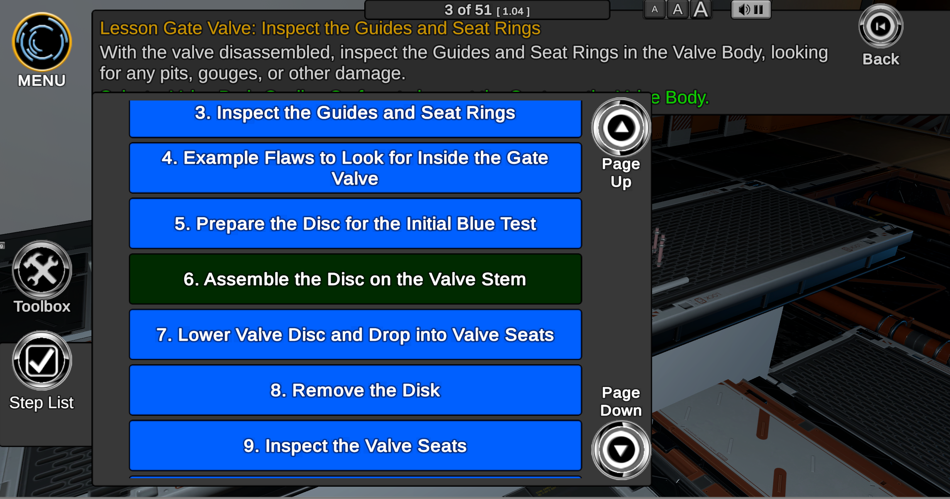
Video slide – Bringing it All Together
Notes:
This will be a video slide –
NARRATION WILL BE KEY, PAUSE VIDEO AS NECESSARY
So what we’re going to see here is primarily the virtual reality screen capture, and since we didn’t have our normal studios available it’s in…well Chris’s living room. Please pardon the informal nature of the video.
This is the modified version – remember originally the training is just one big, static, linear scenario without feedback or reinforcement of any kind
The lesson starts, the correct competencies have been entered in as Concepts, and the learner is going to demonstrate how to do things “Below Expectations,” either by clicking on all the wrong things or taking way too long to complete steps.
The learner reaches Milestone #1, then #2, and is sent back to the first milestone to repeat the content by GIFT and the middleware messages. This can happen anytime a GIFT course is programmed to identify incorrect behavior, and as the system matures say like a lot of VBS plug ins are, the feedback and learner correction and/or content recommendations for competency acquisition can get as fine-grained as a SME would determine is valuable.
Now we’re going to try the lesson again, except acing every step.
The learner goes through, acts, hypothetically, like they know everything and aren’t even needing to read instructions, and therefore gets to warp ahead to the milestones we identified that basically skip chapters of content.
So I know that was a really quick look at how the whole system works together, but now we’ll move on to conclude the presentation and get to questions soon.

Slide 14
Future Experiments
Please forgive the lack of data and wait for updates to a real graph…
But the chart on the left is what trends reveal at least in terms of initial measures from subjective engineering and learner surveys
Data collection is still being performed on the Modernized version of the nuclear reactor training software upgrades
Deploying the virtual reality sets is the #1 logistical challenge and main restriction on availability measures
Having a GIFT system deployed online that links to now-preexisting competencies, when this integration is mature, could add as little as the cost of an AWS image deployment effort to the system
Notes:
Ok, so now is where we have to admit that we are still gathering a looooot of data about the project performance as a whole.
The modernized training content is still being deployed and tested across nuclear reactor stations. Getting virtual reality kits physically has actually been the number one challenge over the past months.
But, since the reactor training content SMEs are not intelligent tutoring experts, adding an adaptive instructional system like GIFT on top of this learning methodology has already given us undeniable improvements to the system as a whole even looking at something as simple as the time necessary to go through refresher training.
The measures in these charts should be taken with a grain of salt and as ratios of scores compared across categories, at the moment because we’re still gathering data, but taking surveys from our pool of trainees and then trying to find new people to use the systems for unbiased testing is what we’re currently looking for to verify the improvements that GIFT with competency frameworks added in adds the improvements that we believe are occurring.

Slide 15
Final Comparisons
Modernized Training
…with GIFT
…was a wonderful step forward in training capability for this particular nuclear reactor station, and every station that the equipment modeled applied to. Technological restrictions and the current national health situation have been the number one restrictions by far, by the project was technologically successful and well received by learners.
…this modernized training system can take the next leap forward, especially as SMEs use available tools such as CaSS to create frameworks for integration with GIFT. The inclusion of these systems together has allowed intelligent tutoring to lower future labor costs, retain knowledge that might otherwise have been lost, and reinforce that knowledge across learners more efficiently.
Notes:
So, to conclude, that has been our project in GIFT that we have enjoyed presenting to you here at GIFTSym8. We believe that we were able to create an intelligent, adaptive tutoring system with GIFT and competency frameworks, and blended them together in a use case that just happened to be a great testbed for some of the GIFT work going on.
Thank you very much for your time, and…

Slide 16
Discussion
Questions
Comments
Concerns
(Please note we may not be at liberty to answer all questions outside of the GIFT work and competency framework integration virtually across an open network)

Slide 17
Contact us
Email lucy@synapticsparks.org
mike@synapticsparks.org
chris@synapticsparks.org
Phone 1(205) SSI-TECH 1(205) 774-8324

