Slide 1
Towards a GIFT Enabled 3A Learning Environment
Faruk Ahmed¹, Keith Shubek¹, and Xiangen Hu^{1,2}
The University of Memphis¹ Central China Normal University²
GIFT Symposium 8
May 28, 2020
Notes:
Welcome to the presentation of “Towards a GIFT enabled 3A learning environment”
My name is Faruk Ahmed, co-authors are Keith Shubek and Prof. Xiangen Hu

Slide 2
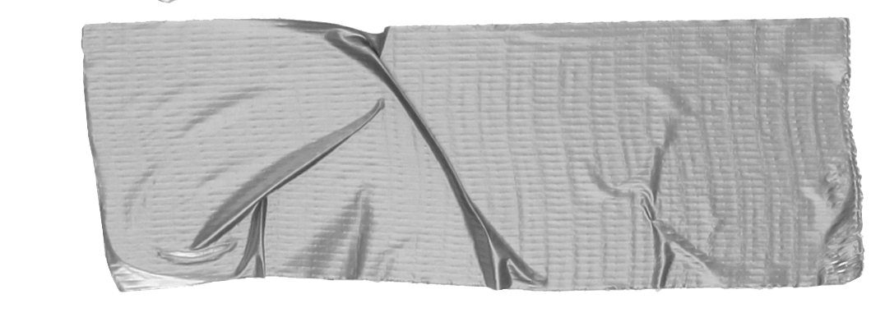
Intro
Three Awareness (3A) is
Content Aware Knowing what content is being delivered.
Context Aware Surrounding (learning environment) of the learner.
User Aware Emotions of the learner (Individualized learner)
Notes:
The 3A means in this case
Content aware: what content learner is interested about
Context aware: surrounding of the learner, learning environment
User aware: emotional learning state of the user or exceptionality of the learner (Note: learner is individual and learning should be individualized)
GIFT modular easy to make new module and plug in

Slide 3
We focused on User Awareness
Existing technologies
Make it work with ITSs.
(we used AWS Rekognition API to detect emotion from an image)
Notes:
We are focusing more on user awareness in this work, we are using existing technologies
Emotion recognition from face image. We are not inventing new technology
But we are using this technology to make learning systems aware of the user
Tutoring system or interaction with tutoring system is individualized
Therefore we need to individualize the emotion detection
So there are two things
Monitoring the individual emotions
Putting into the intelligent tutoring system
Easier to integrate, works with ITS
Cost effective (cheap)
How to do that (next slide)?

Slide 4
How?
Use GIFT monitor module
Centralized Everything is in one place.
GIFT reachable Webcam The learner's machine should have Yawcam to stream video and GIFT should be able to reach the IP address (and port 8081 of course)
Few steps of configuration IP address in cameras.txt and port forwarding in router.
GIFT
Monitor
Learner
Webcam
Notes:
Existing Gift uses Yawcam
It works very well
But configuring is little hard for some users we found
Can monitor learners and store the meta-data
We want to make the emotion detection technology very easy to use, plugable
If we have centralized location/mechanism to capture the emotion that would be great
Here is what we have, we just tried them out (next slide)

Slide 5
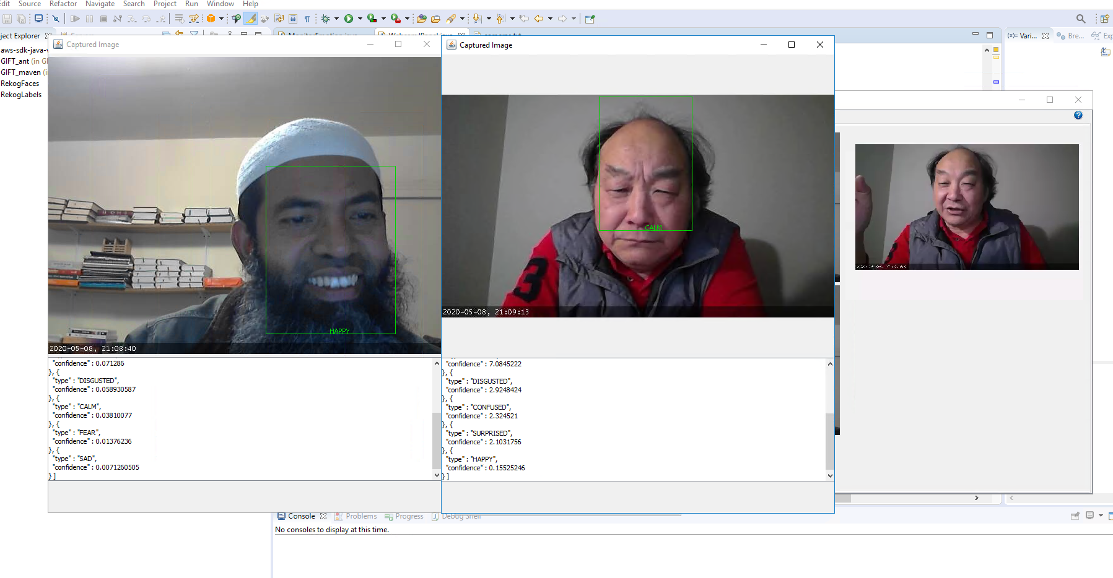
Multiple cameras
(b) Multiple faces in one camera
Notes:
We built a class emotion detection in the monitor module, recompile and put the required jar files
Ask people to configure the yawcam. And captured these.
Left hand side multi camera, multi user. Right hand side single camera multiple faces.
We also tried another distributed method...

Slide 6
How?cont.
HTML5 media of browsers
GIFT
Distributed Computation is distributed in learners’ machines.
GIFT does not need to reach Webcam The computed emotion data will be pushed towards GIFT
No extra configuration There is no configuration necessary.
LRS
Filter
Learner
Webcam
Notes:
We tried with the html5 media capability of the browser through javascript
It captures emotion data (emotion type and confidence) at an interval 3 sec for now
Calculates the moving average and moving standard deviation
Stores into Learning Record Store
This happens for each individual users and
Very fast feedback to the learning system
Features
This is distributed
No configuration needed
If there is webcam present in the learner’s computer, it automatically finds that.

Slide 7
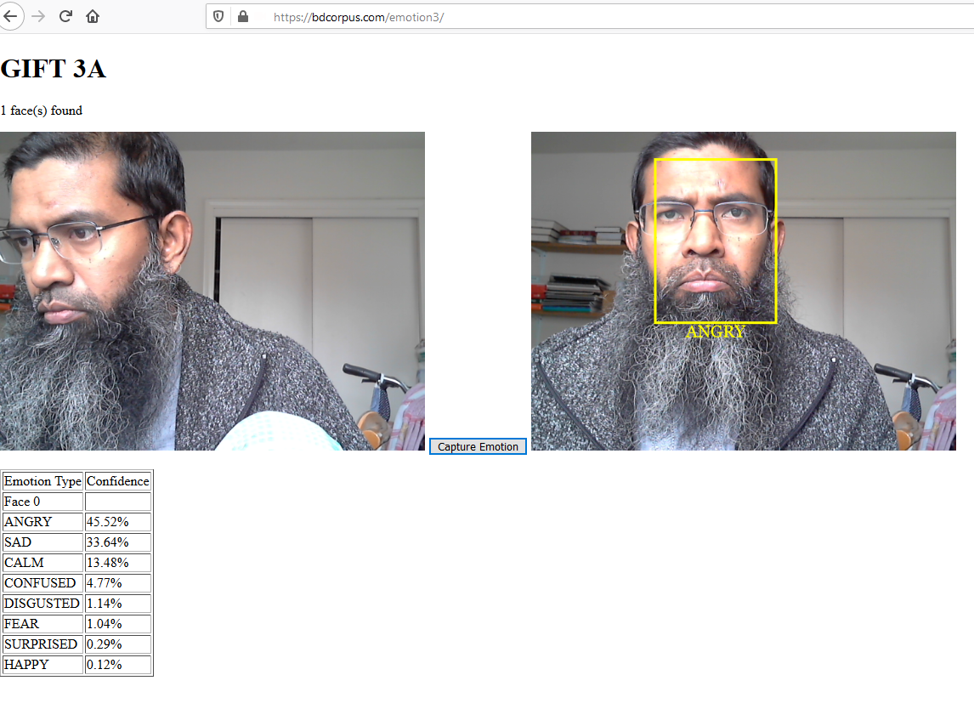
Computation is happening in the browser and records are pushed into LRS
Notes:
This is a screenshot of the js version of the emotion detection
We are producing an engineering solution which is very cheap
Using existing technologies, using cloud
As far as we know, that have not been done before
We are using the Intelligent Tutoring system,
Therefore the data is individualized, if I login it is looking at my emotion.
Every 3 seconds, serving as a baseline in 8 dimension (some emotions may look irrelevant)

Slide 8
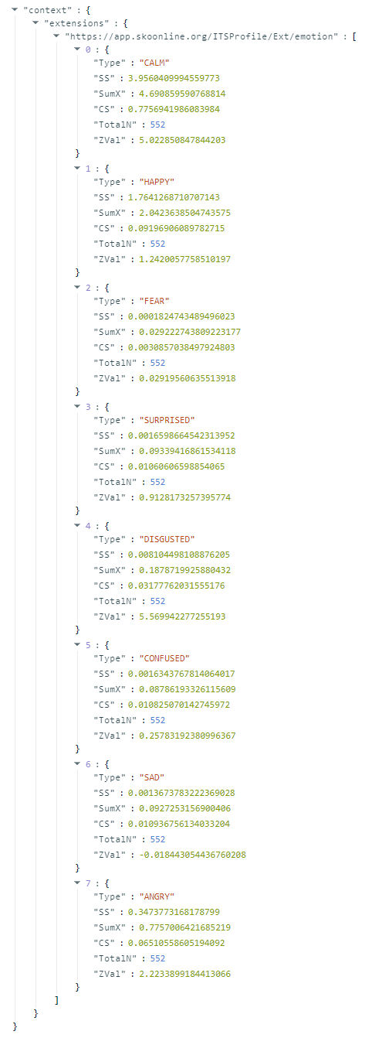
Notes:
In a generic emotion detection system the emotions may not need to individualize
But for learning, for learning, the emotion has to be individualized
A person’s face may be always smiling
Another may be always sad
Micro expressions are very very sensitive
When we talk about 3As those are individualized A (individualized awareness): how can we achieve individualized Awareness
We already mentioned before, Every 3 seconds 40 numbers + 8 type (8 times 6) captures all the history of learning emotion. (underlying assumption is the emotions are normally distributed)
When a user logs in, we retrieve the last record and that gives everything in distribution based the past, then we build on top of it
Ss - sum of square
Sum of x
Cumulative square
Counter
Zval - zval score
95% threshold
Over time the distribution becomes close to exact and significant change in zvalue indicates significance of that specific emotion.
These are generic emotions, some are not relevant to learning (fear, angry etc.)

Slide 9
Notes:
This is the screenshot of integrated ITS (intelligent tutoring system)
Issue, privacy (the emotion is private), we do not want to be in the danger zone of violating privacy
That’s why faces are not shown
The emotion belongs to me.
These information is for me to keep, not public
What we can:
We may implement a special version of this as a survey tool
This may help improving Adaptive Instructional System
We may capture categorical emotions for example while answer questions
Locate geo-localizations
Use responsive design for mobile phone because there are billions of cell phone users
What we want:
We want to answer research question (from 3A data)
What we need:
Economical and ethic enabled application which works. A System which work sufficiently to grab metadata of user. This is one of those.

Slide 10
Limitations
The emotions are generic, may not relevant to learning
Notes:
This is based on generic kind of emotions. Angry, Fear may not related to learning. We are interested to learning relevant emotion classification.

Slide 11
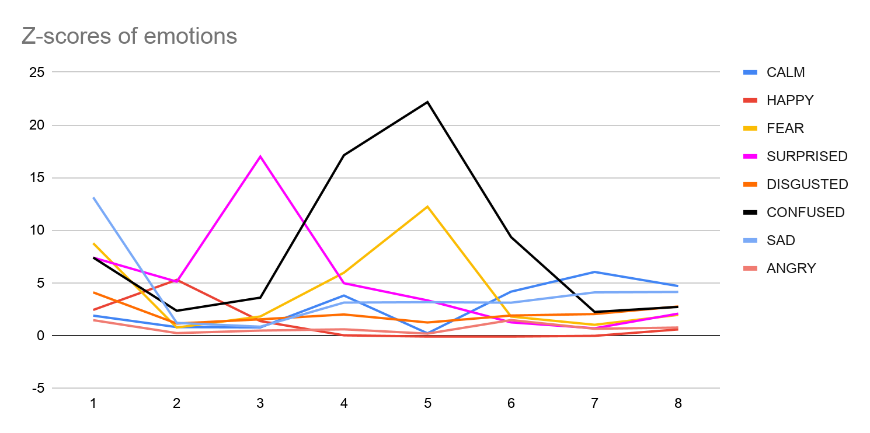
Example analysis.
Notes:
This is based on generic kind of emotions. Angry, Fear may not related to learning. We are interested to learning relevant emotion classification.
Which can give a huge amount of data to learn about learning behavior of individuals from different socio-economic group.

Slide 12
Demo
GIFT monitor
HTML5 version

Slide 13
Thank you
Discussion
Q/A

