Slide 1
Trainers and Fighter Pilots Using GIFT with an OODA Loop framework
May 2020

Slide 2
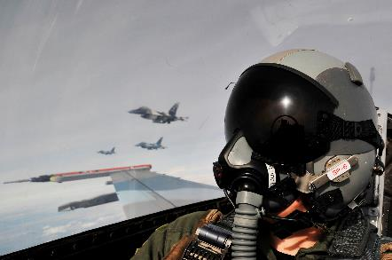
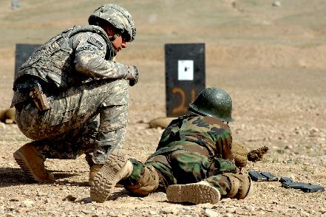
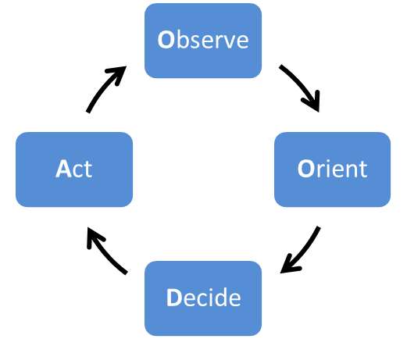
Fighter Pilots and Trainers
Context Sensitive
Must react to changes in the uncertain environment
Fighter Pilots and Trainers
Very different specialties, but both must make context sensitive quick decisions
Time Sensitive
Quick reactions can mean the difference between success and failure
Complex Decision Space
Many options to choose from or create, some better than others
Decision Making Process Needed
The process must help with timely, effective decisions in uncertain environments

Slide 3
OODA Loop
Proven paradigm for emulating thought processes
Most appropriate for complex, rapidly changing environments
Originally used in air to air combat, now applied to other situations
Observe
Orient
Decide
Act
A soldier sees a market empty at midday.
Knowing that the market is usually busy, he
realizes that an attack may be imminent.
He decides to inform his Commander.
He makes the radio call.

Slide 4
Velox Toolkit OODA Loop
b
b
p
g
g
b
p
p
p
b
b
g
g
b
b
p
p
Observe Orient Graph
Decide Act Graph

Slide 5
Simulation Monitoring And Reporting Tool
FO SMART provides easily accessible individual performance assessment for Forward Observers conducting adjust fire missions, increasing repetitions and enabling students and trainers to better utilize high fidelity training environments
Squad SMART provides collective training for Infantry Squad Leaders requesting indirect fire support. It contains all FO SMART functionality plus tasks focused on the interaction between the Infantry Squad and Forward Observer

Slide 6
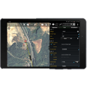
Initial SQD SMART Scenario
An Infantry Squad experiences small arms fire, reports in ATAK
The Squad Leader or Platoon Leader call for fire using built in ATAK functionality
The Forward Observer (FO) receives the call for fire through ATAK
He uses a radio to coordinate with the Fire Direction Center
A simulated Fire Direction Center (FDC) responds verbally to the FO
FO
SL
PL

Slide 7
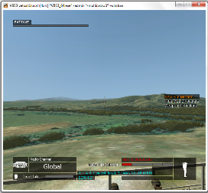
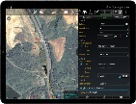
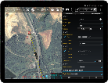
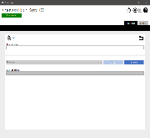
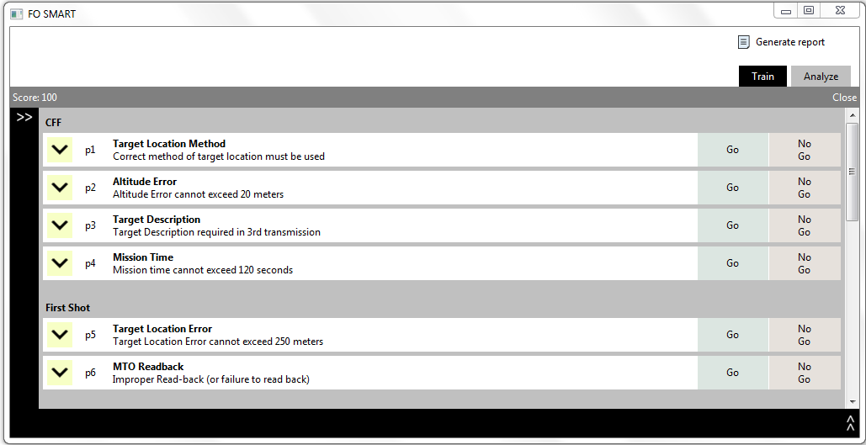
Squad SMART UI Components
SL
PL
FO
FDC
Simulated

Slide 8
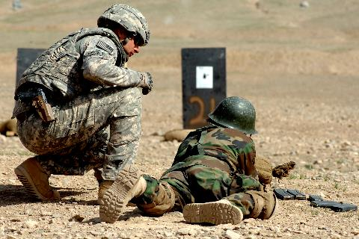
Velox, GIFT, and the OODA Loop
Velox was developed to cover the entire OODA Loop and is very good at aggregating and abstracting data in a domain independent manner.
GIFT is domain independent but focused on providing intelligent tutoring.
GIFT and Velox are both relevant to each stage of the OODA loop, but perhaps should focus on different aspects.
Observe
Orient
Decide
Act

Slide 9
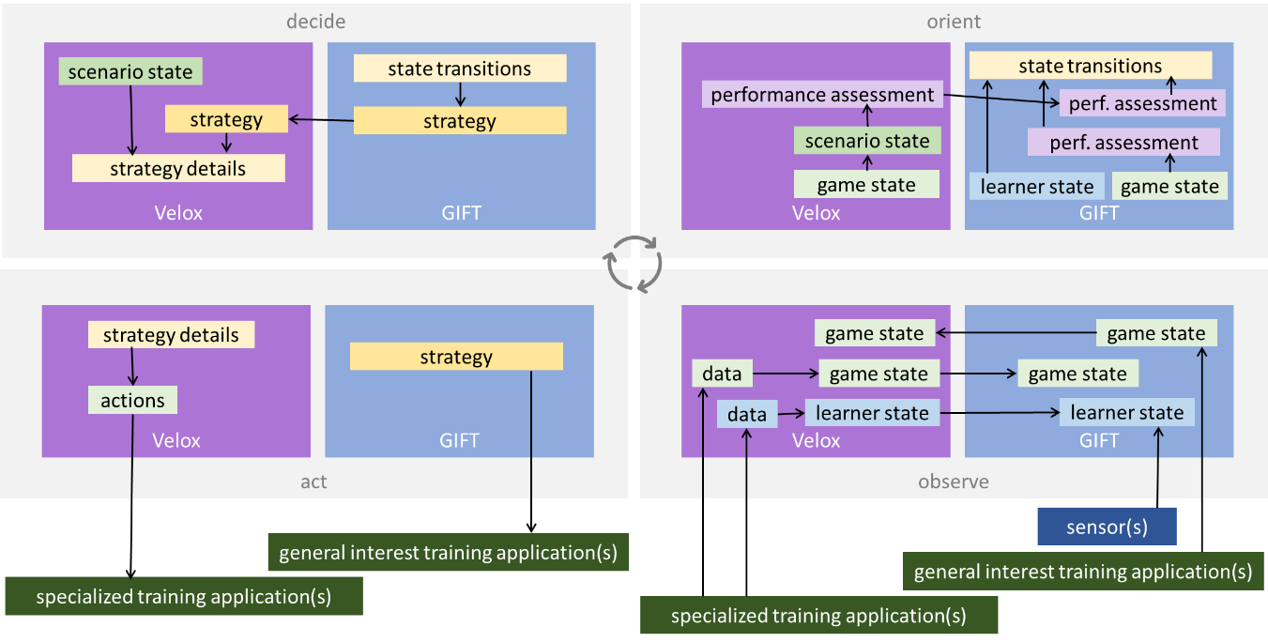
Potential Velox / GIFT OODA Loop Collaboration

Slide 10
Notional SMART GIFT Collaboration Examples
Observe: SMART detects a Forward Observer report Observer Target direction(OT direction) while under fire.
Orient: SMART assesses the correctness, timeliness, and necessity of the report. GIFT updates its models accordingly.
Act: GIFT modifies the scenario in VBS scenario as appropriate while SMART updates the ATAK display.
Decide: GIFT selects an instructional strategy to provide guided OT direction repetitions in a less stressful scenario environment.

