Slide 1
CbITS Authoring Tool in GIFT
Lijia Wang,
EECE, Institute for Intelligent System, the University of Memphis

Slide 2
Project Overview
What have been done?
GIFT local AutoTutor script editor added.
What is the problem to solve.
New and stable script editor
A new reliable local course component for GIFT user

Slide 3
The Conversation based ITS (CbITS)
AutoTutor

Slide 4
AutoTutor
A conversation based intelligent tutoring system (CbITS) to help students learn by holding a conversation.
The effectiveness of AutoTutor in delivering learning is proven (~ 0.8𝞼)

Slide 5
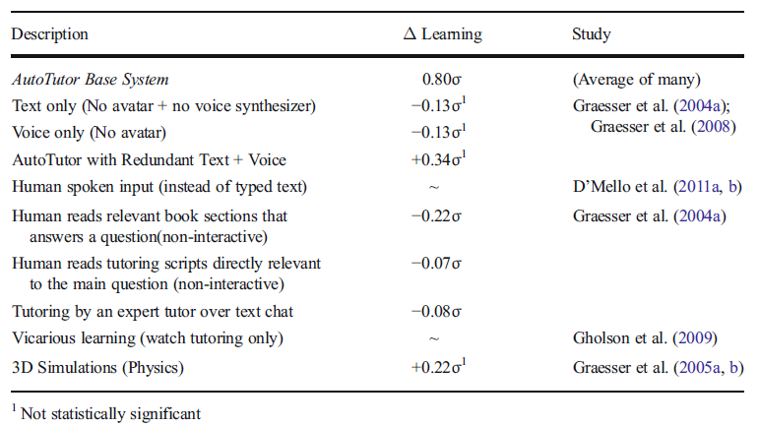
AutoTutor
AutoTutor learning gain under different condition
*Nye, B. D., Graesser, A. C. and Hu, X. (2014) ‘AutoTutor and family: A review of 17 years of natural language tutoring’, International Journal of Artificial Intelligence in Education. Springer New York, 24(4), pp. 427–469.

Slide 6
AutoTutor
A full functional Autotutor application consists three components:
Content (Script),
Interface,
and Engine
Interface
Engine
Script

Slide 7
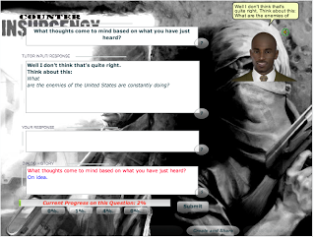
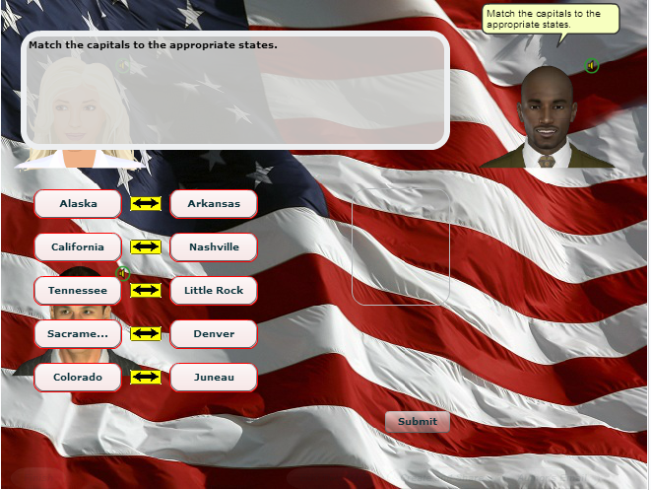
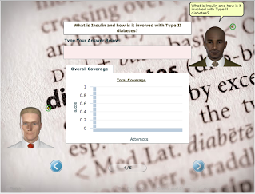
AutoTutor Example
Computer literacy
Conceptual physics
Biology
Critical thinking
Math
Electronics
Adult literacy
etc.

Slide 8
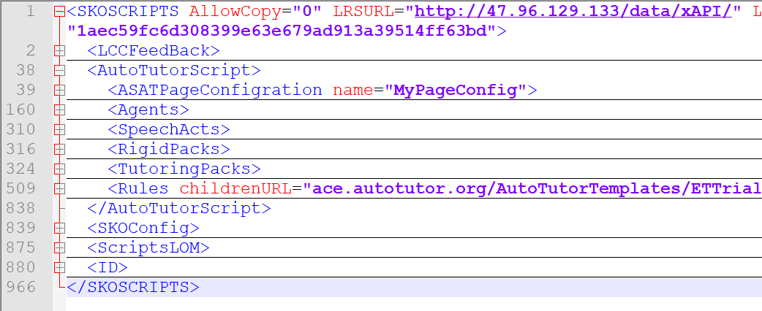
AutoTutor Script

Slide 9
AutoTutor Script

Slide 10
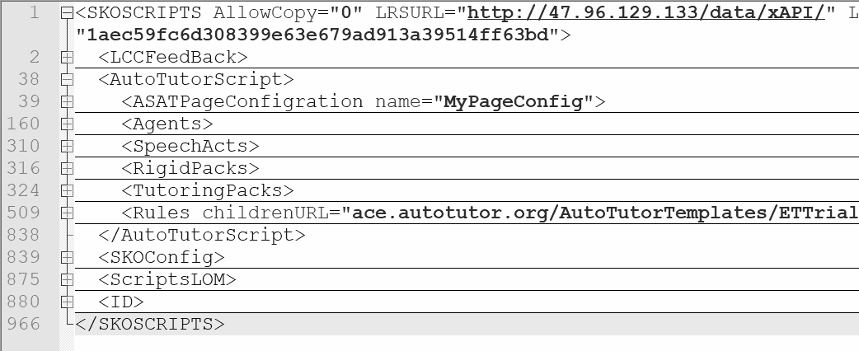
AutoTutor Script

Slide 11
AutoTutor Script
Agents: Define the personality of the avatars by stylistic languages used for feedback (positive, neutral, negative).
SpeechActs: The SpeechActs section defines the regular expression used to capture certain user feedback types with strong keywords like “Yes” and “No”.

Slide 12
AutoTutor Script
Rigid Packs: Specify pre-determined interactions such as opening or closing of tutoring sessions.
Tutoring Packs: implement Expectation-Misconception Tailored (EMT) dialog of AutoTutor.
Rules: A list of “if-then” that guide the interaction of AutoTutor when it interacts with learners.

Slide 13
AutoTutor Script Authoring
Developing a quality AutoTutor script requires a good understanding of how these components relate to each other and to the tutoring interactions as a whole.
UI loads Script
loads Rules
Extract Qs from TutoringPacks
LSA and Rules matching
Load Agents
Extract from RigidPacks
User Input
Conversation End

Slide 14
AutoTutor Script Authoring
Developing a quality AutoTutor script requires a good understanding of how these components relate to each other and to the tutoring interactions as a whole.
Expectation misconception tailored (EMT) conversation content in the Tutoring Packs.

Slide 15
AutoTutor Script Authoring
Ideally, at least domain experts, linguists, and instruction designers can work together as a team to do the content authoring.
Domain Experts:
Create knowledge structure and learning content
Linguists: Properly fix the language used.
etc..

Slide 16
AutoTutor Script Authoring
Extremely time consuming and high cost.
Lower the cost
Reuse the old content.
Lower the barrier to do the authoring
Improve script authoring training

Slide 17
AutoTutor Script Authoring in the GIFT

Slide 18
Current Authoring Process (Off-line)

Slide 19
Current Authoring Process (Off-line)

Slide 20
Current Authoring Process (Off-line)

Slide 21
Current Authoring Process (Off-line)

Slide 22
Current Authoring Process (Off-line)

Slide 23
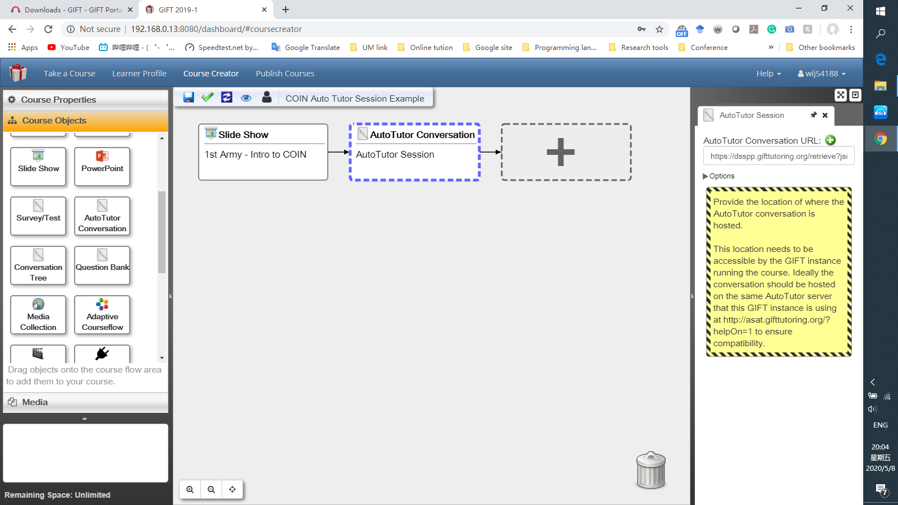
Current Authoring Process (Online)

Slide 24
Current Authoring Process (Online)

Slide 25
Current Authoring Process (Online)

Slide 26
Current Authoring Process (Online)

Slide 27
Current Authoring Process (Online)

Slide 28
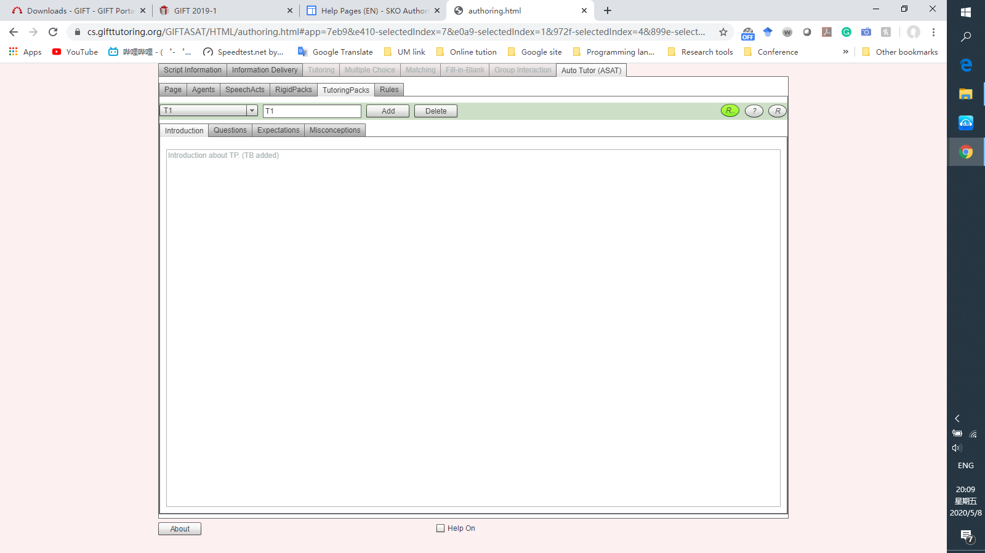
Current Authoring Process (ASAT Lite)
AutoTutor Script Authoring Tool (ASAT) Lite

Slide 29
Current Authoring Process (ASAT Lite)
AutoTutor Script Authoring Tool (ASAT) Lite

Slide 30
Problems of Current Process
Flash is not supported by any browners at the end of 2020.
-- ASAT Lite will no longer work after 2020 Dec.

Slide 31
Problems of Current Process
Flash is not supported by any browners at the end of 2020.
Not support teamwork simultaneously.
-- Script Authoring process and period are complex and long.

Slide 32
Problems of Current Process
Flash is not supported by any browners at the end of 2020.
Not support teamwork simultaneously.
Unstable server
-- Fixed server issue cause a lot of efforts.

Slide 33
New Implement

Slide 34
New Implement

Slide 35
New Implement

Slide 36
New Implement

Slide 37
New Implement

Slide 38
New Implement

Slide 39
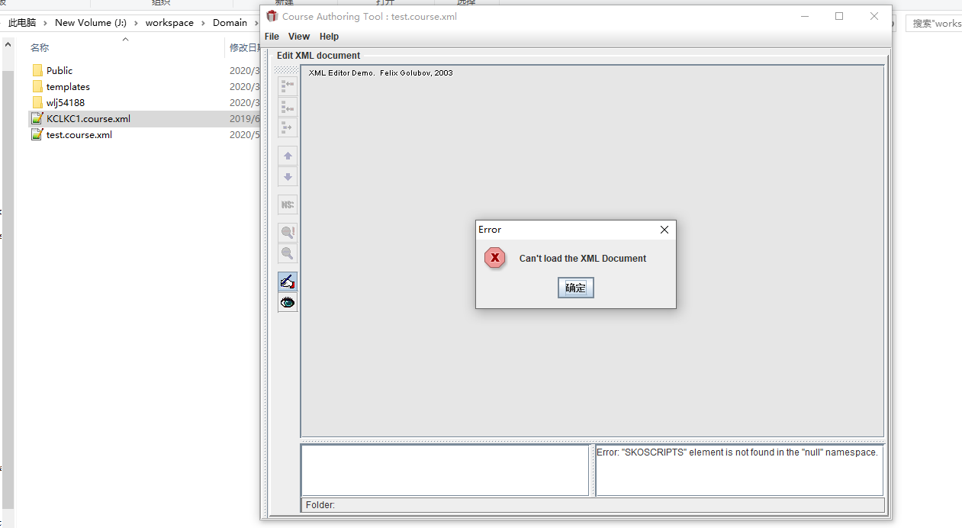
New Implement

Slide 40
Future Work
Improve the schema to adopt more modules and functions of AutoTutor
To support other functions such as learner characteristic curve (LCC) and multimedia interaction.
Adopt learning object metadata (IEEE 1484.12.1 – 2002 Standard)

Slide 41
Future Work
Re- design and make content authoring process to support collaboration.
Allow multiple people to contribute their own parts to the same script.
Use xAPI to track what has done by people

Slide 42
Future Work
Usability study and content quality
Use xAPI data collected to analysis the performance of the content author
Run survey to collect data.

Slide 43
Thank you for your attentions!

Slide 44
Questions?

