Slide 1


Using GIFT to
Develop Adaptive Remedial Courses
for Graduate Degree Programs in Data Science
Hong Liu, Timothy Bernard, and Keshav Acharya,
Embry-Riddle Aeronautical University
Daytona Beach , Florida, ERAU
GIFT Symposium 8,
May 28, 2020
Notes:
CSE is an interdisciplinary field
Short of resource

Slide 2
The Need
Two Remedial Math Courses: Matrix Algebra (MA) and Multivariable Calculus (MC)
Master of Science in Data Science Degree (MSDS) at ERAU with Five Tracks
https://erau.edu/degrees/master/data-science
MSDS Enrolls from diverse undergraduate majors
Most of the students for Aviation Business & Aviation Science have deficiencies in Matrix Algebra & Matrix Calculus (MS & MC).

Slide 3
The Need
The MOOC (Massive Open Online Courses
The students need the remedial courses before enter the MSDS program & campuses
Limited faculty resources available for mentoring
The deficiency in MA & MC is a ommon problem due to Interdisciplinary of DS,
A MOOC can share the resources and use crowdsources in future.

Slide 4
The Goals
Self-paced adaptive learning with faculty in loop
  Each course offers 1 credit hours with 12 lessons
  Focus the essential concepts of MA & MC only
  Use software tools to walk around the skills
  Connect peers for collaborative learning
  Faculty grade the homework & Test

Slide 5
The Approach
Reuse and package resource developed over an NSF sponsored program to multi-institution coalition
  Each of lesson covers 3-5 concepts and procedures
  lecture notes, 7-12 pages
  PowerPoint slides
  4-6 YouTube videos, around 10 m
  3-5 Quizzes in Google Form, immediate feedback
  Self-checked exercises following each procedure
  Homework Problems
Notes:
Conferencing tools, Smartboards, tracking camera, Konftel microphones and EagleVision virtual
The instructional design and assessment methods were aligned with a common idea: This project has been committed to course-based research experiences (CURE) aiming to connect math with reality .
Use the ACE, (Analysis, Computation, and Experimentation) REU Programs

Slide 6
The Approach
Student-Centered Pedagogy
Integrated Instructional Design (oli.cmu.edu)
to ensure an internally consistent structure
  Learning objectives
  Assessment, and
  Instructional activities
Objectives define student competence
e.g. The students should be capable of using the eigenvectors of a covariant matrix to identify principal components of a numerical data frame.
Notes:
Conferencing tools, Smartboards, tracking camera, Konftel microphones and EagleVision virtual
The instructional design and assessment methods were aligned with a common idea: This project has been committed to course-based research experiences (CURE) aiming to connect math with reality .
Use the ACE, (Analysis, Computation, and Experimentation) REU Programs

Slide 7
The Approach
Students lost in the hypertext, disoriented | Use the GIFT tutoring to identify and recommend learning activities based on their learning objectives and data-driven formative assessment.
Misconception, canonical vs. indiv. interpretation | Build libraries for the concepts and misconceptions for each lesson and course, and use GIFT surveys to assess the understanding of students. Peer-learning and blog discussion will be encouraged.
Preknowledge, past experience | The records in LMS and LRS for each learner, and GIFT surveys will be used to build and update the learner models.
Cognitive load | Students’ surveys and future work of sensor module of GIFT
Monitor affective trait & intervene | Use web-bot called BotCaptain to collect data and monitor teamwork to assess student affective traits.
Evaluate student motivation | Use the MUSIC (eMpower, Useful, Success, Interest, and Caring) Survey Inventory by Jones, B. D. 2020

Slide 8
The Implementation
TOOL CONFIGURATION :
  GIFT for Tutoring on “in-class” Exercises,
  xAPI and LRS for Competence/learner Data Exchange
  Moodle to manage student & course content interface
Installed and explored both cloud and local servers
  SCORM, GIFT, and Moodle Clouds
  Local server at http://ssia-vm.earu.edu
Two types of Configuration
  Provider/Consumer Key-Secret for Course Authoring for Moodle and GIFT
  XML based configuration for LRS

Slide 10
The Implementation
Domain Knowledge Files, Competence Model, and Learner State Transition
  Translating the quizzes and surveys from Google forms into GIFT surveys.
  Consider only the cognitive learner model currently
  Use the default pedagogical model.
  The learner state transition uses the three default levels below, meet, or exceed, for the students to change state and move on to the next learning activity.

Slide 11
Concept Tree for PCA Competence Model

Slide 12
xAPI statements & sub-statement
Use object cross references to track the dependence relationship
The xAPI currently only allows one level sub-statement
Work arounds can be made by using referencing instead of sub-statements
Sub-statements should be used when describing future intent and sequences

Slide 13
CONCLUSIONS
Existing adaptive learning are limited to serve K12 to low-level college mathematics subjects, MA & MC MOOCs extend to advanced mathematics.
Showcase how the interoperable, plug-and-play educational technologies centered on the GIFT system and xAPI data exchange.
Explore a new direction for the current NSF funded project for multiple courses and multiple institution.

Slide 14
Future Work
  Immediate future work
  Build a learner Competence Models with xAPI statements
  Explore an xAPI simulation tool from YetAnalytics to design and test the data-driven assessment models
  Learn the GIFT team model and explore how to incorporate our web-bot app into GIFT to collect affective and motivational data based on teamwork

Slide 15
Future Work
  https://stemforall2020.videohall.com/presentations/1733
Spread success and extend to new technology territory
    More institutions with STEM related challenges
    More STEM courses
    Learning Analytics and Educational Data Mining
Integrated the GIFT tutorial system with
iCycle - intelligent Computer-supported hybrid collaborative learning environment

Slide 16
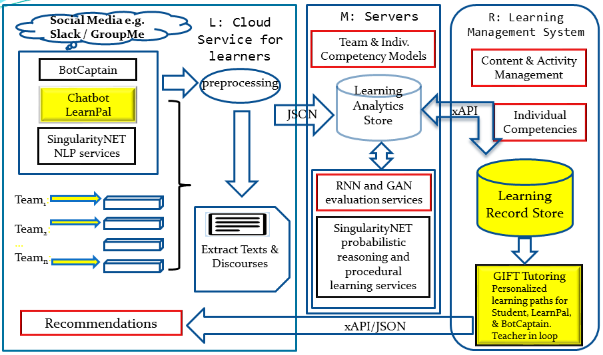
iCycle Component Design

