Slide 1



Integrating an Engagement Classification Pipeline into a GIFT Cybersecurity Module
Benjamin D. Nye, Mark Core,
Daniel Auerbach, Aviroop Ghosal,
Shikhar Jaiswal, & Milton Rosenberg
The work depicted here was sponsored by the U.S. Army. Statements and opinions expressed do not necessarily reflect the position or the policy of the United States Government, and no official endorsement should be inferred.

Slide 2
ICT Learning Science – Analytics Research Objectives
Actionable AI & Machine Learning
Algorithms: How to make better predictions with less data or cost?
Human Factors: What metrics help humans train better?
Processes & Prototypes: How to combine these so users benefit?

Slide 3
Introduction
Engagement: Action involving making a psychological investment in learning with heightened concentration and interest.
Why should we study engagement patterns?
  Lack of engagement - lower learning (Baker et al., 2010)
  Student engagement predicts dropout (Christenson et al., 2012)
Okay, but is it worth putting in the effort?
  Engagement can be induced (Lehman, Graesser, et al., 2011)
Notes:
Engagement in an activity is defined as simultaneous, heightened concentration, interest, and (usually) enjoyment.
Why engagement matters (empirically-speaking): There has been research
Learning: Lack of engagement 🡪 lower learning (Baker et al., 2010)
Persistence: Student engagement predicts dropout (Christenson et al., 2012)
Why bother putting in the effort?
Actionable: Can induce engagement (Lehman, Graesser, et al., 2011)
Sustained engagement is the key to learning. Learning sciences lacks standard measures of engagement presently. Our role in this larger body of research will be to identify generalizable techniques to measure and communicate engagement.

Slide 4
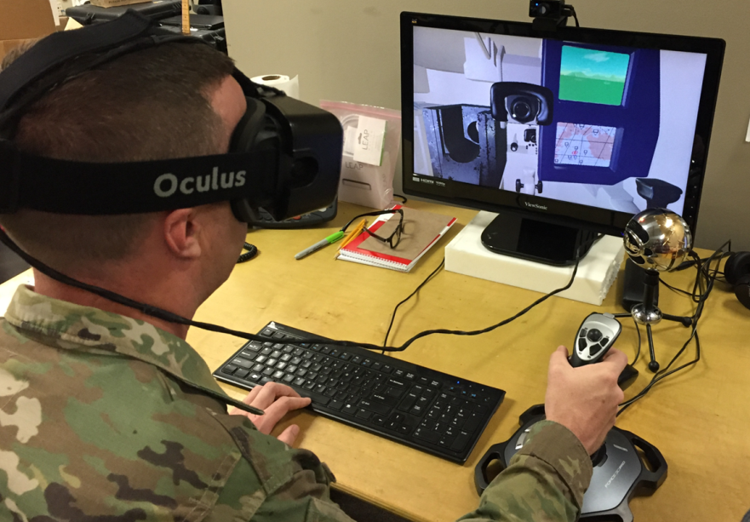

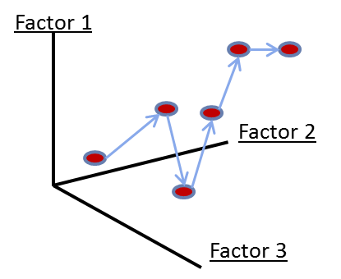
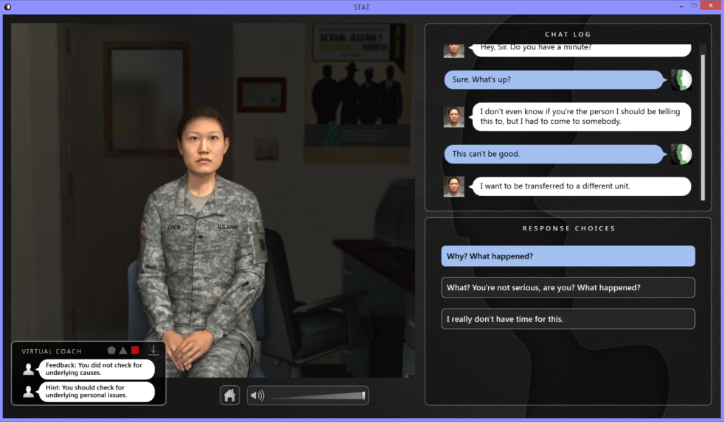


Goal : Constant Optimization of Engagement & Learning
Automating Exploration, Analysis & Improvement
SMART-E
TALK-ON (ARL)
Human Expertise
Stats
USMA - ELITE
Course Designers / Instructors
GIFT (ARL)
Notes:
To give a brief idea of what we wish to achieve, I’d say we aim to:
develop a framework that detects the engagement levels of users in real time as they interact with virtual learning environments.
the framework should be generalizable towards different tutoring systems (eg. should not go haywire when a new system is plugged in).
providing real time analysis in a way that course instructors and students can understand and benefit.

Slide 5
Challenges
Cold Start Problem: Issue that the system cannot draw any inferences for objects about which it has not yet gathered sufficient information.
Automated Annotation Problem: Can a purely algorithmic approach match human intuitions in annotating the level of a user’s engagement?
Notes:
The high level idea comes with a host of challenges, we’re focusing on two of those which I have primarily worked on. Talk about cold start problem. In our case, it asks that for a new system how many labelled and unlabeled users and their data do we need before we can start making confident predictions regarding a new users engagement level within that system. It is a big concern.
Automated annotation asks whether using some algorithmic approaches it is possible to mimic the effectiveness of a human in predicting a user’s level of engagement. The reason we work on this problem is because human annotation can be time consuming, expensive and often requires training an annotator.

Slide 6
Prior Work
ENGAGE: Promoting Engagement in Virtual Learning Environments
Empirical work on this model using the ELITE-Lite training system (FY15 - FY17)
  Interactive agents
    Scenario character
    Virtual coach
  Targets basic skills for counselling
subordinates with personal and
performance problems.
Notes:
To give a brief summary to what led us here, we focus on the ENGAGE Project. ENGAGE studied engagement and learning during training. Used a scenario-based intelligent tutoring system called ELITE_Lite which targets basic skills for counselling subordinates with personal and performance problems. Asks you a bunch of questions, and you have to select the appropriate answer from the given choices.

Slide 7
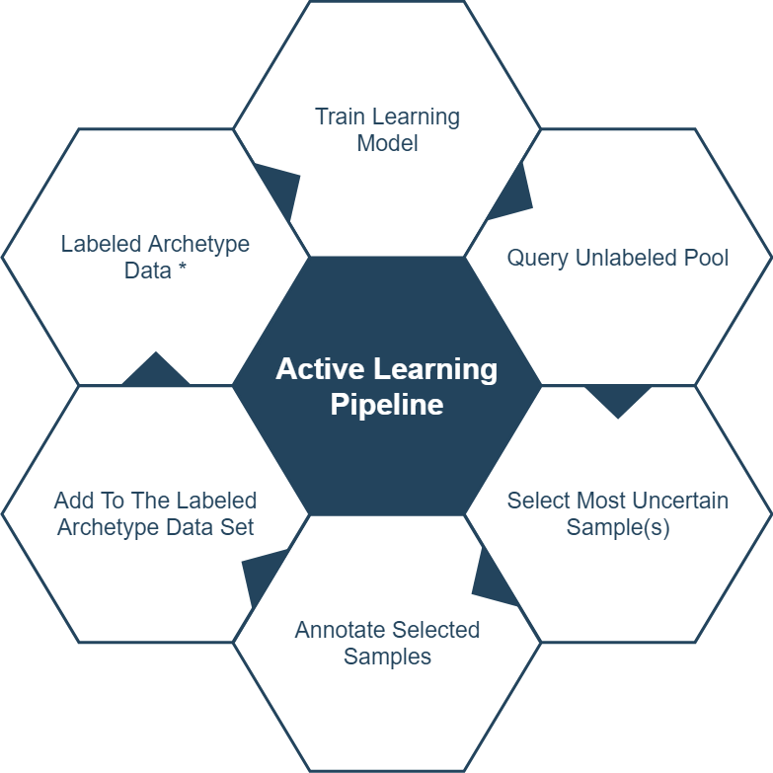
Current Work
Semi-Supervised Learning Approach
Notes:
So we adopt an Semi-Supervised Learning based approach. It is a growing research field within Machine Learning. So what we do is we start with the labelled archetype data initially, we train our model, and then scour through the unlabeled samples, to choose the sample for which we are most uncertain regarding its characteristic label. We annotate such a sample using the graph matching pipeline we saw in the last slide, and then add the sample to our training set. and repeat the cycle till we gain a good amount of confidence in predicting the characteristics for unseen samples.

Slide 8
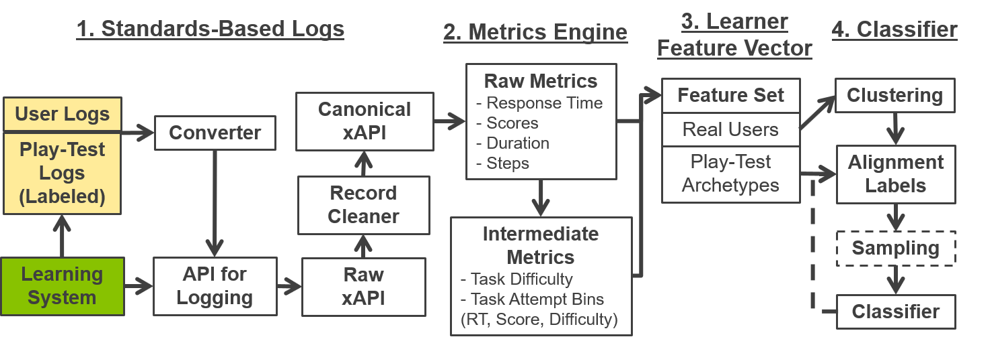
SMART-E Framework Architecture

Slide 9
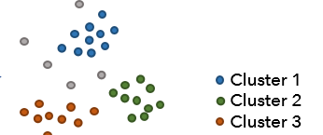
Cluster Alignment Process
a
a
a
b
b
b
b
=> a
=> b
c
c
c
=> c
c

Slide 10
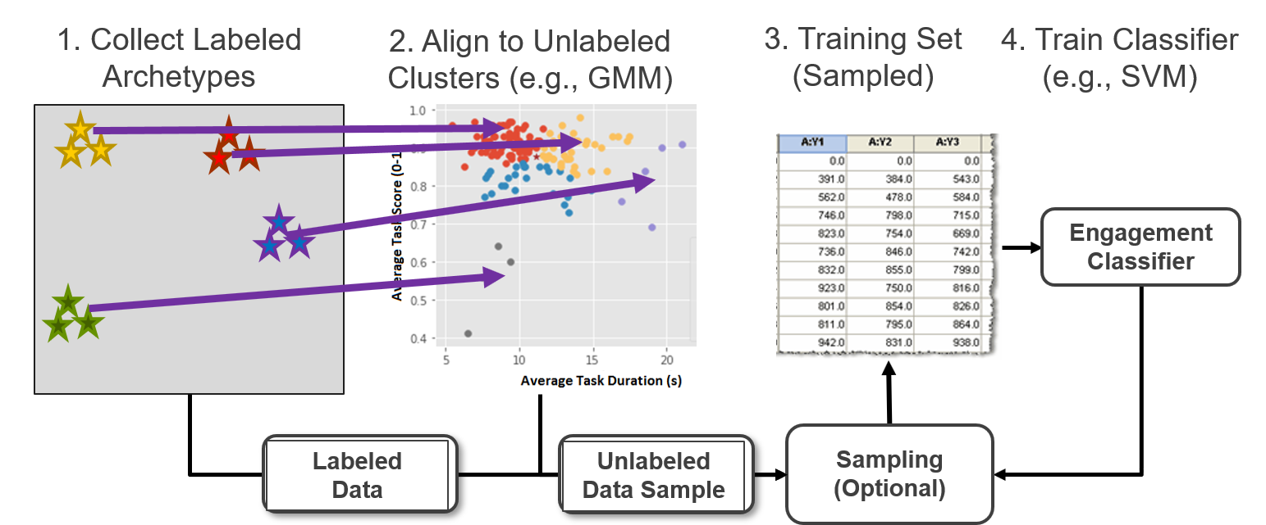
Semi-Supervised Approach

Slide 11
What is the cost of the data?
Data Costs (from high to low)
Pedagogical Expert: Reliable, trained annotators who review data
Expert User: Highly trained user who uses system to generate data
Novice User: Users who are barely ready for a task to generate data
Target Users: Users who would typically use system in their normal training, but whose skill levels may be unknown

Slide 12
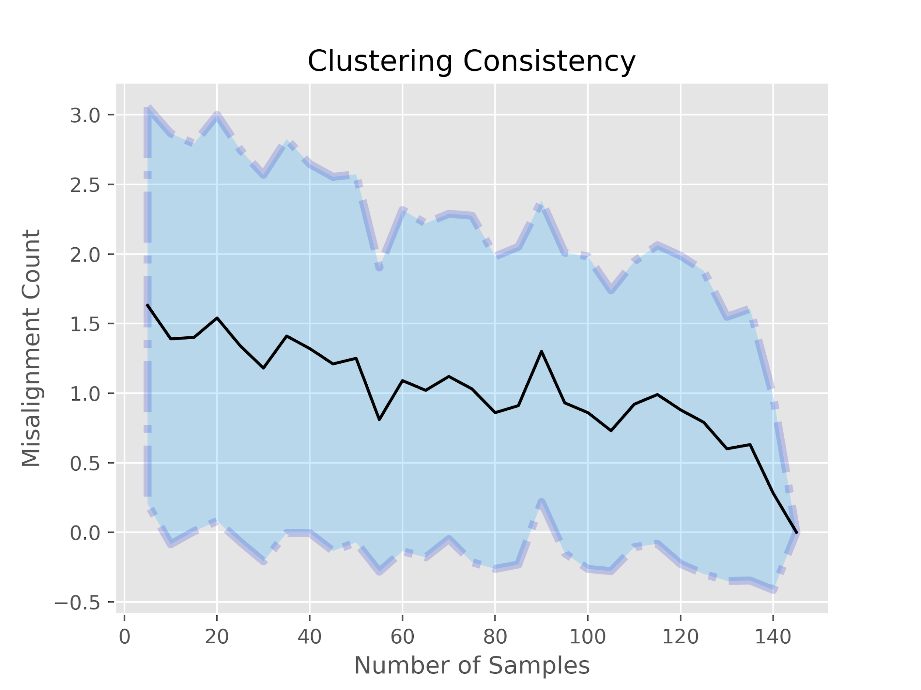
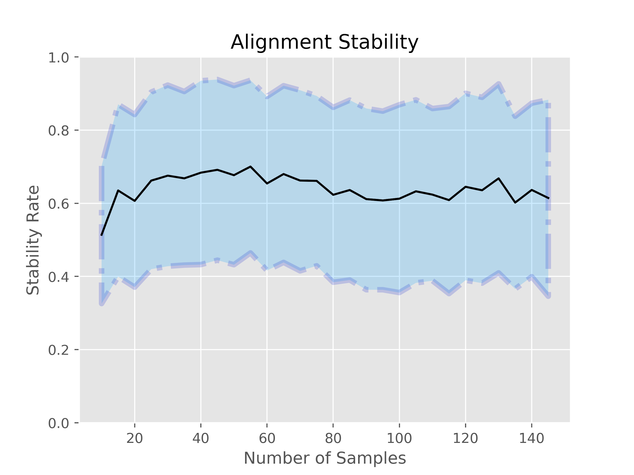
ELITE Results
Clustering and Alignment Analysis
Notes:
We did a whole bunch of analysis of how consistent (in terms of a sample being in the cluster where it belongs eventually and not in the cluster it is right now given the size of the dataset) and stable (the unlabelled sample gets assigned the right label) our clustering techniques are as the dataset grows (in order to simulate what we might see in the real world), as more and more users come in.

Slide 13
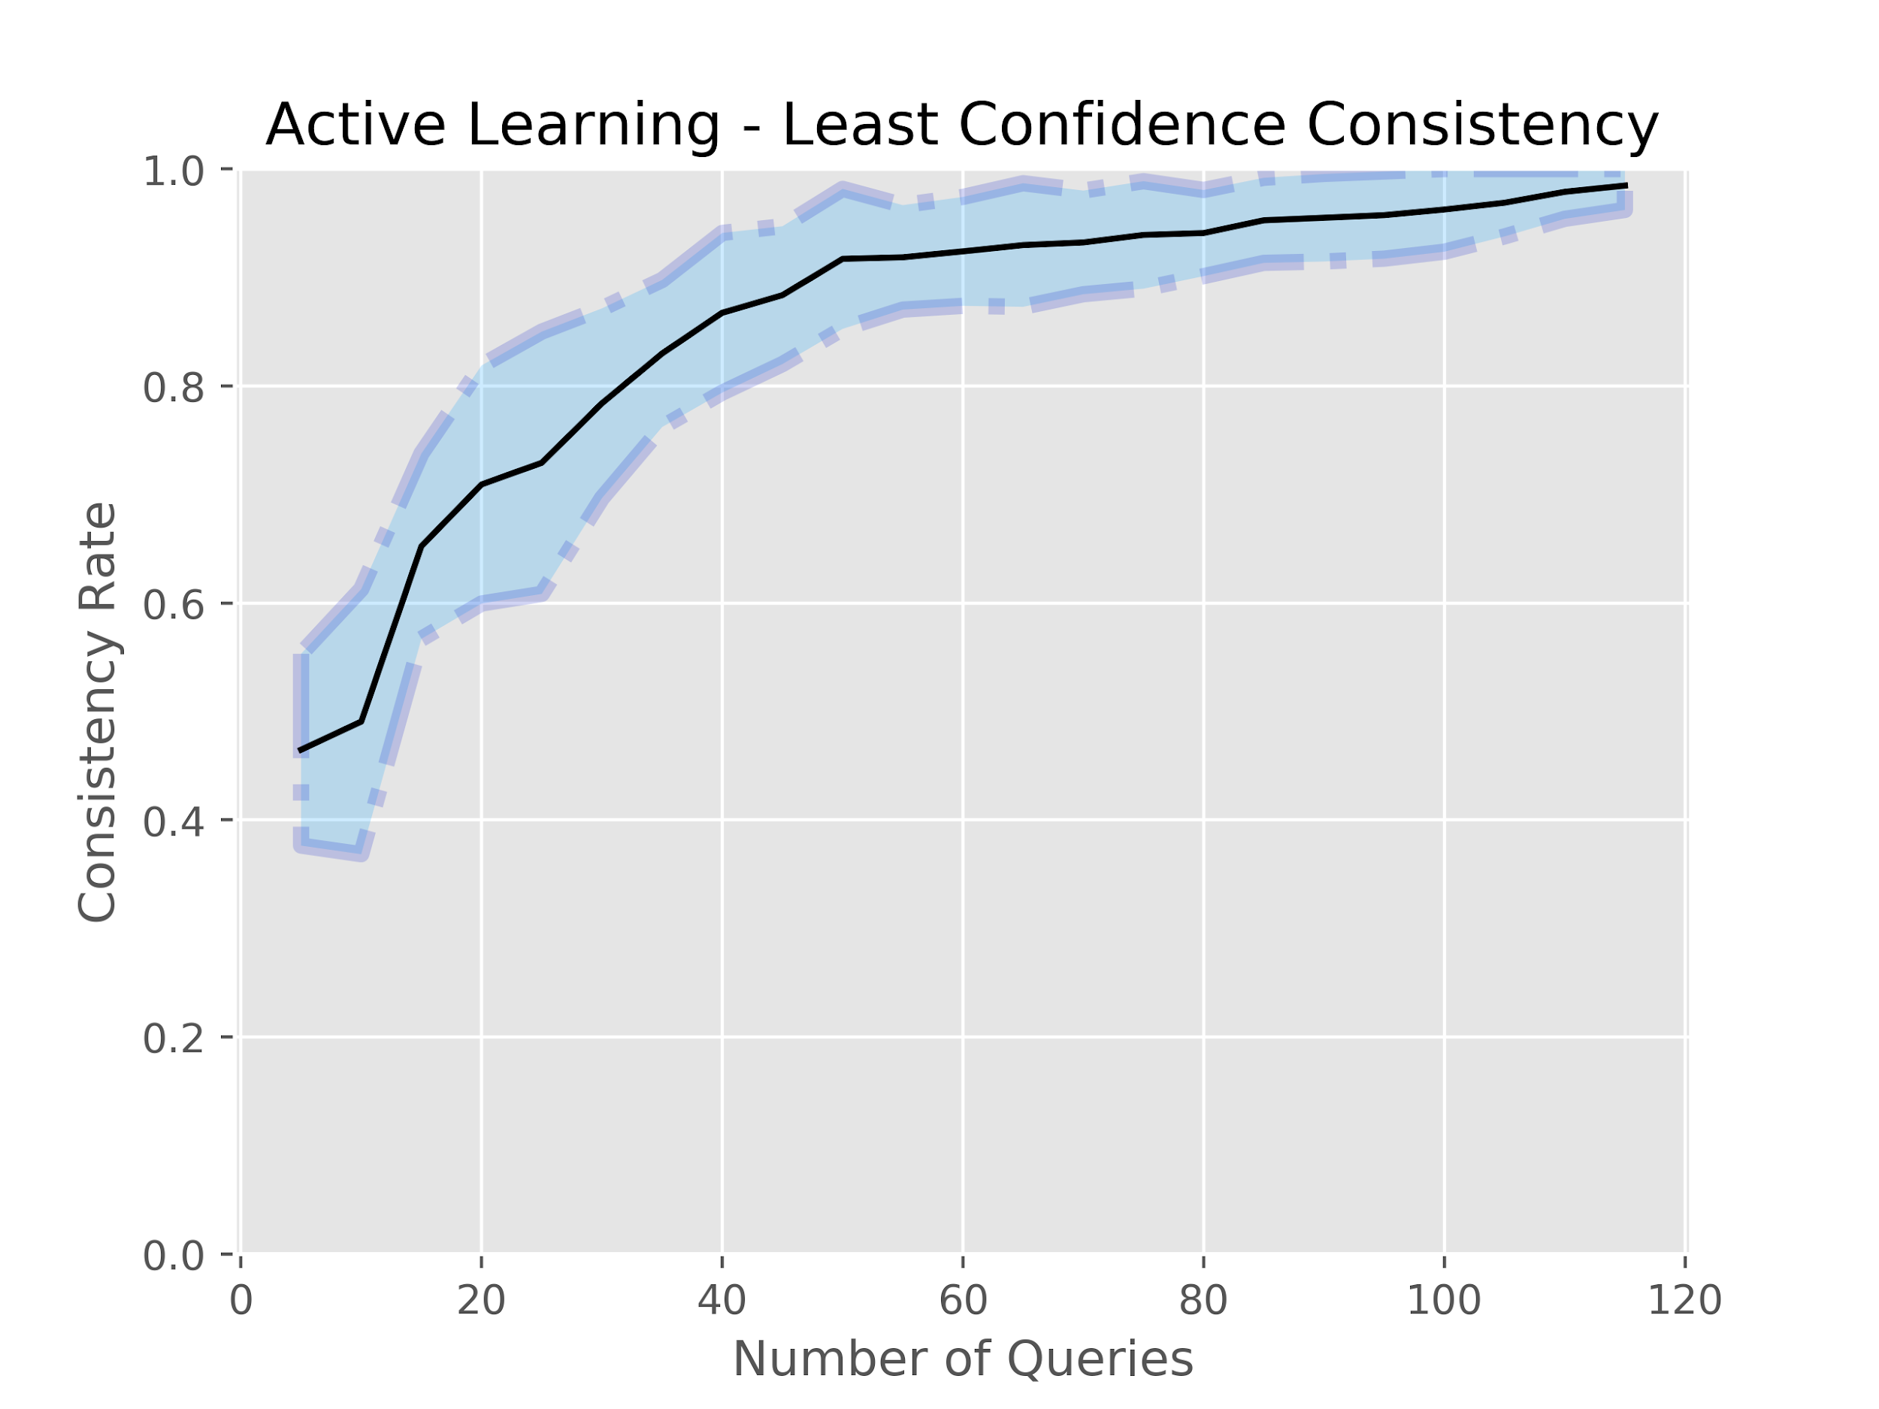
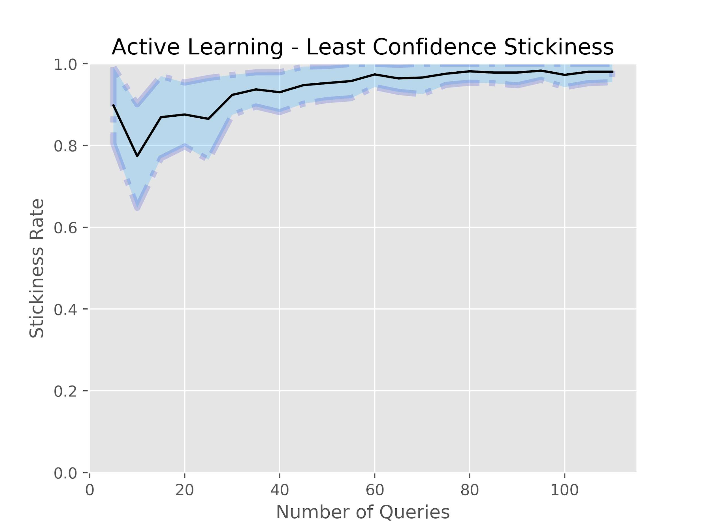
ELITE Results
Classification Analysis
Notes:
We did a whole bunch of analysis on our models. In the graph you see on the left, we check how consistent our results are when our total size of unlabelled pool is restricted to a fraction of the whole pool. In the graph to the right, we check how quickly do the initial assumptions that our model has about the data change as the size of the dataset increases.

Slide 14
GIFT Cybersecurity Mini-Course
& Integration

Slide 15
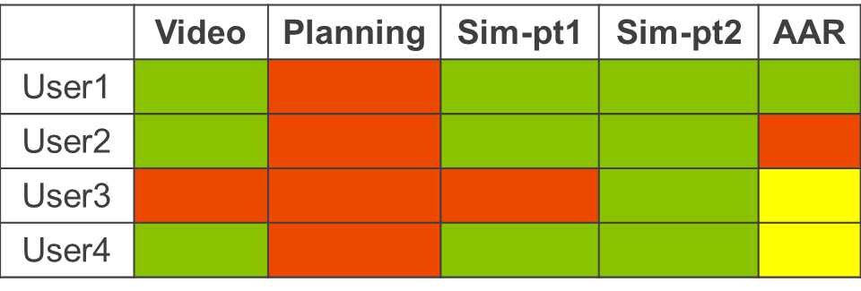
GIFT Integration
Classification
Learning System
Disengaged
Engaged
Agent Container
Module
xAPI Logging
Service
Raw xAPI
Canonical xAPI
Metrics Engine
Classifier Model
Record Cleaner
Archetype Benchmarks
Individual Metrics (Scores, RT, etc.)

Slide 16
GIFT Cybersecurity Mini-Course
Two modules: Phishing and HTTPS (lighter vs. drier)
Each module has 6 activities:
  Text Introduction
  Video Overview
  Basic Questions (3 multiple choice)
  Intermediate Questions (3 harder multiple choice)
  External URL
  Dialog-Based assessment

Slide 17
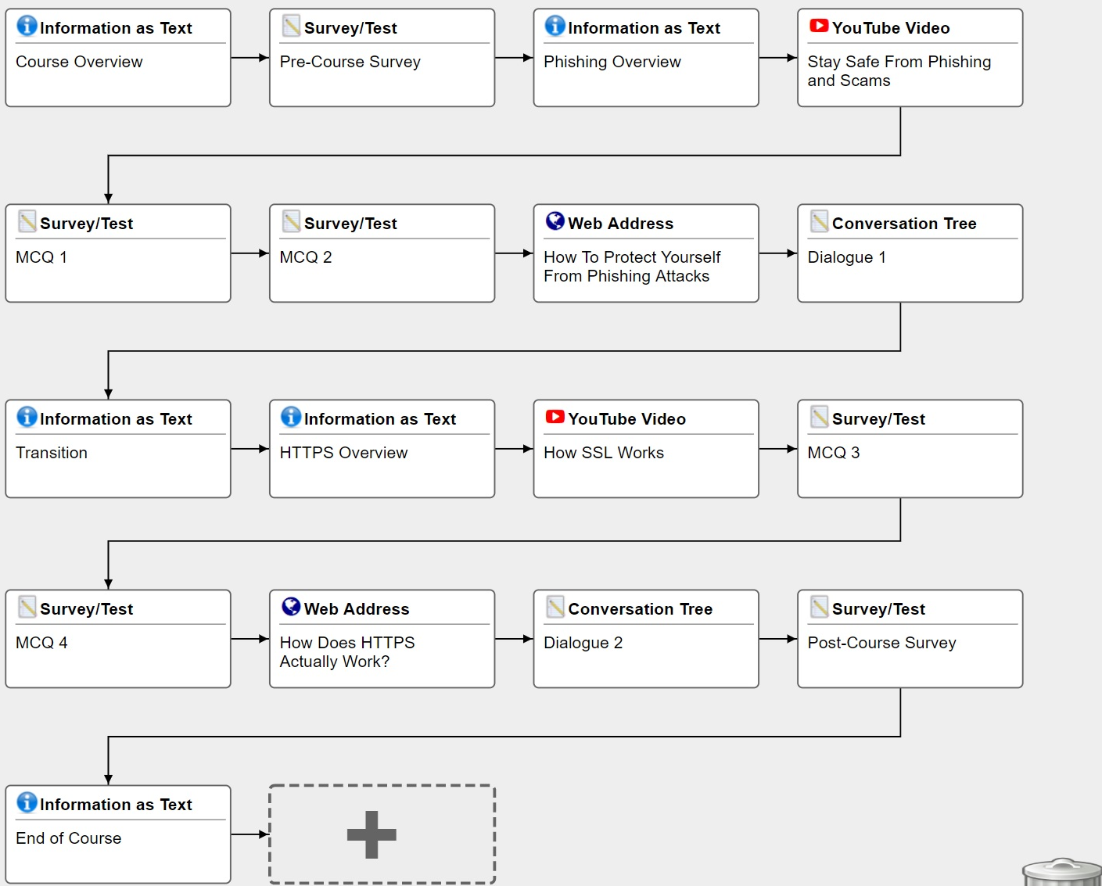
GIFT Course

Slide 18
Lighter (Phishing) vs. Drier (HTTPS)

Slide 19
GIFT Mini-Course Data Set
Collected 17 archetype data points
  Diligent, Distracted, Racing, Expert
Collected 100 real user data points
Surveyed pre-post interest and confidence/experience in topic

Slide 20
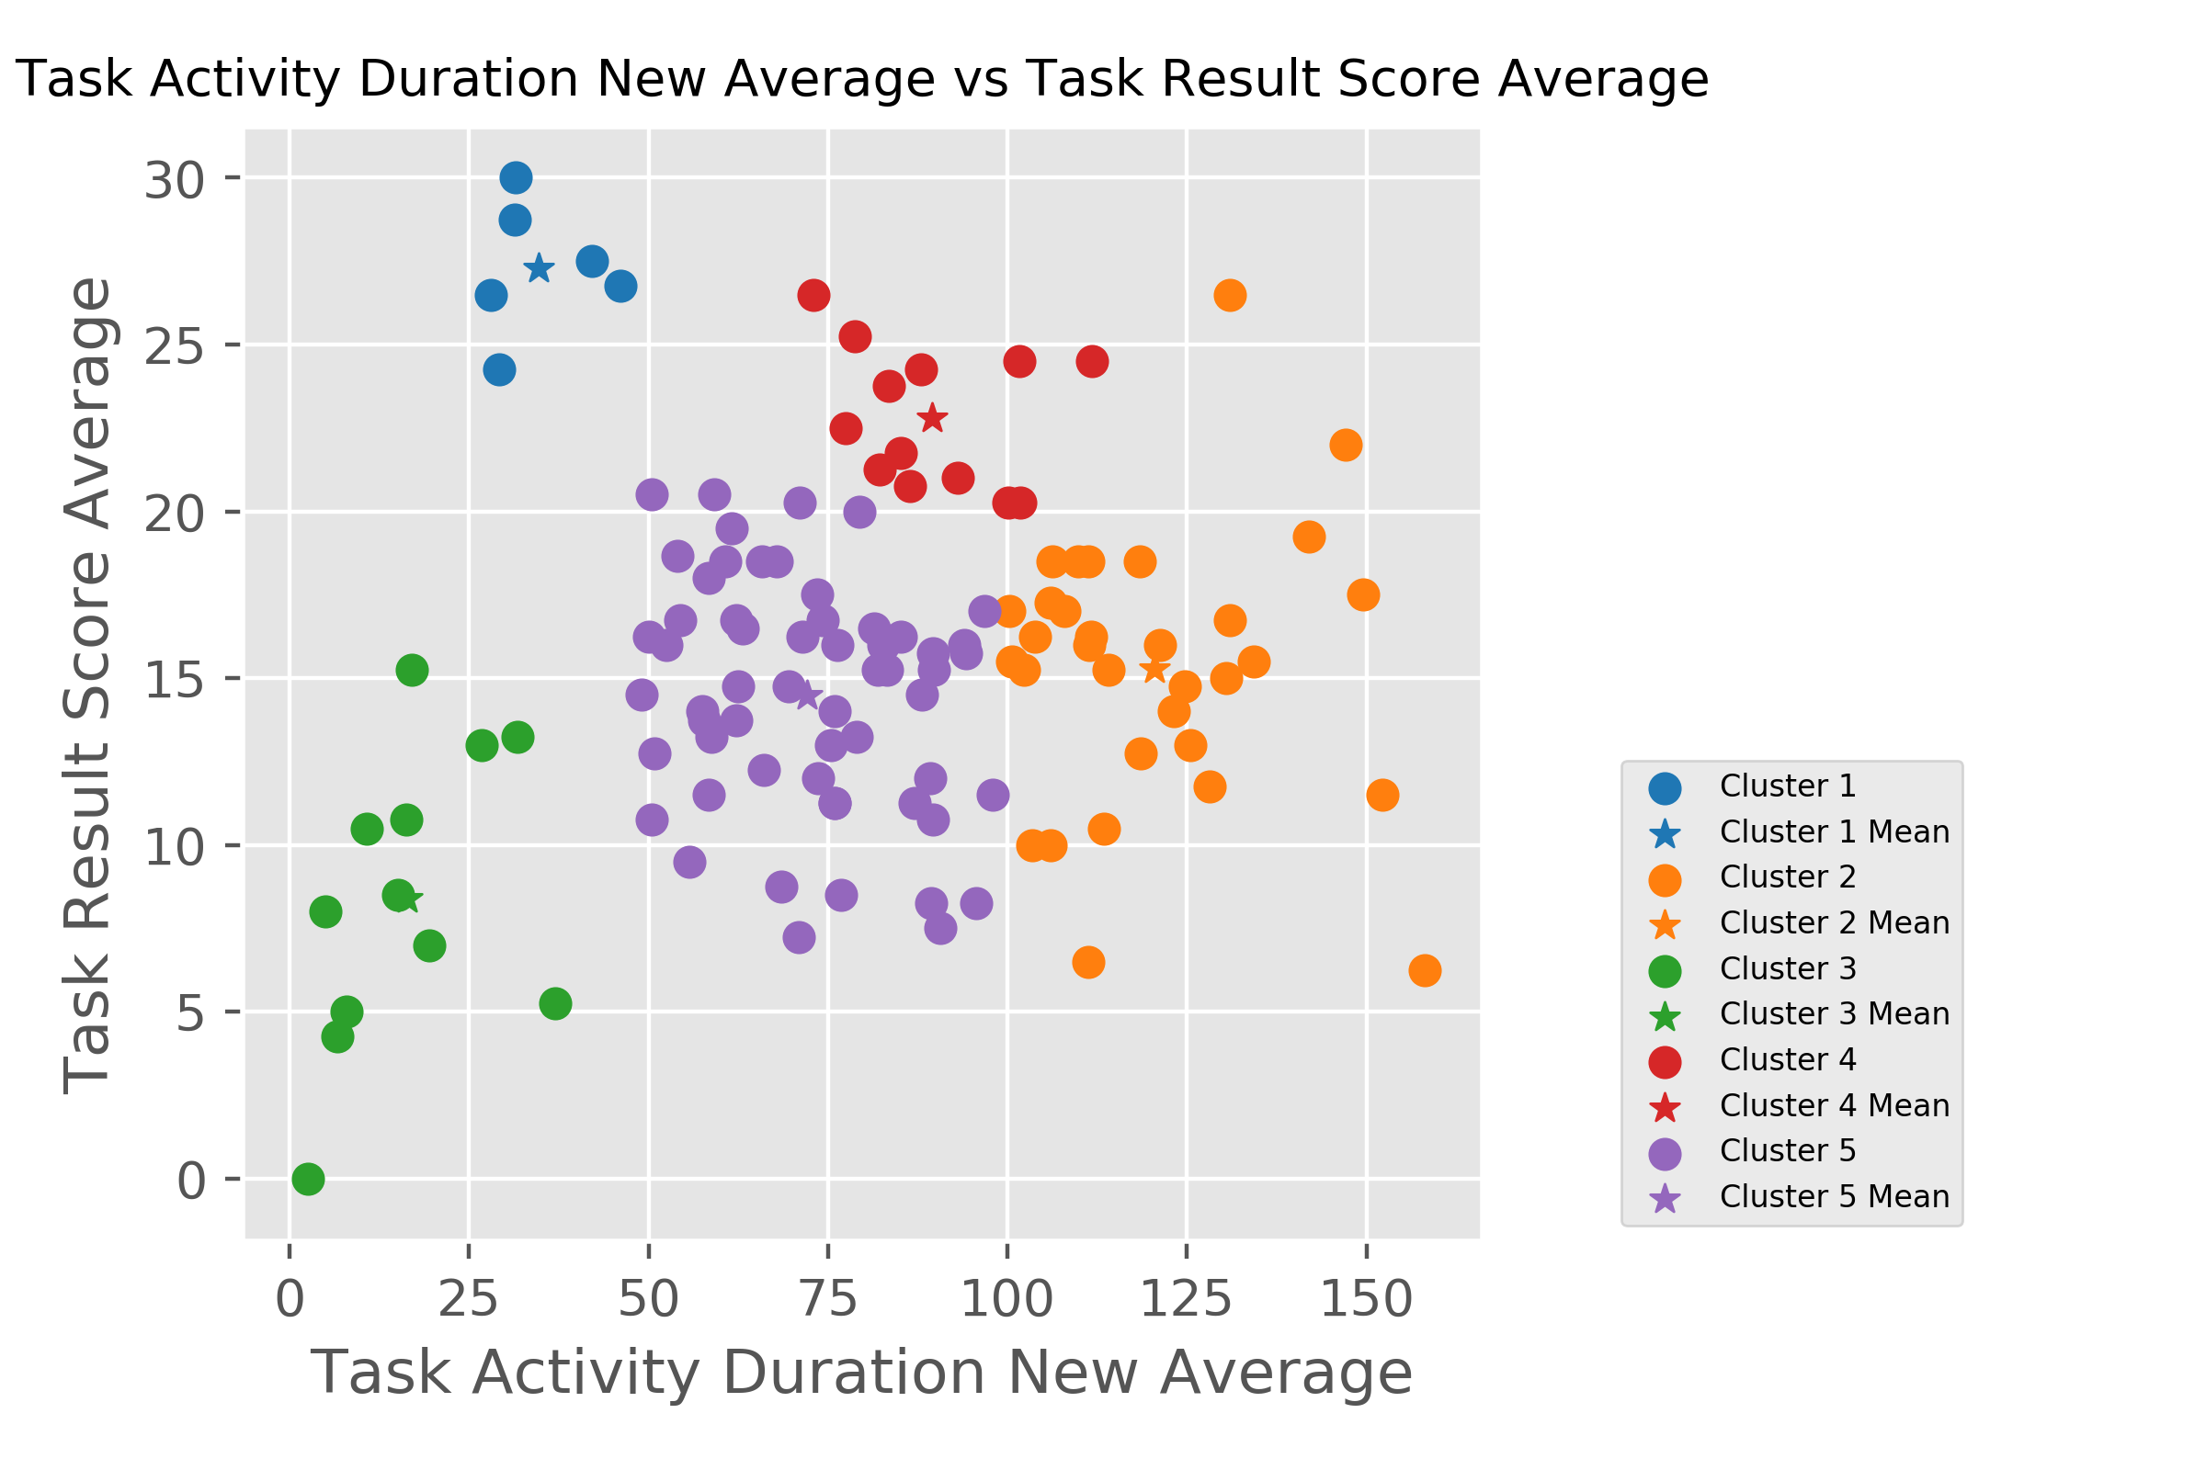
Preliminary Results (K-Means)

Slide 21
Conclusions & Next Steps
Integration Successful Overall
  100 subjects completed study with GIFT+SMART-E logging
  No notable data loss
  Logs have been processed into viable metrics
  Initial clusters look promising and similar to ELITE
Classification Research Ongoing
  Conduct a sweep for different amounts of user data
  Analyze classification results with self-reported engagement

Slide 22
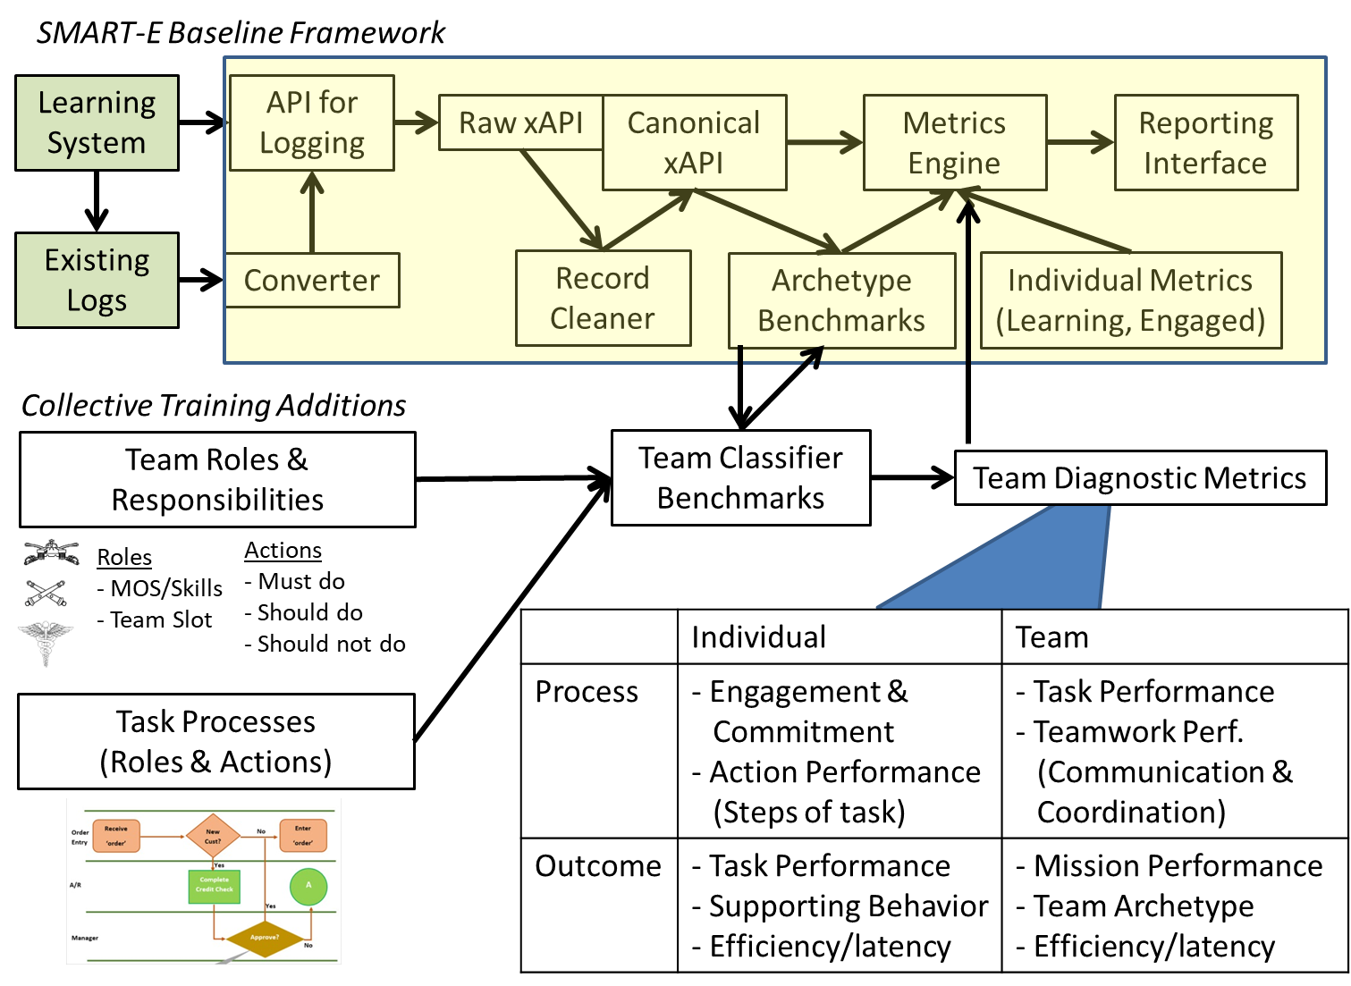
Next Steps
SLATS for STE
  Semi-Supervised team assessment
  Team metrics as inputs
Team Types:
  Expert Team
  Team of Experts
  Weak Link(s)
  Novices

Slide 23
SLATS service
Scenario Library
TMT General-Purpose
Framework
Remediation Priorities
Team Diagnostic
Indicators
Scenario Selection
Assessment
Simulation
Software
Simulation
Gateway Module
Team Performance Classifier
Feedback & Injects
Raw Data & Events
General
Metrics
Learner Record Store
Universal Trainee Record
Team Roles & Responsibilities
Specialized Metrics
Task Processes
Training Simulation
Software
Training Management
Tools
Extended from SMART-E
New SLATS
Services

Slide 24
Team Diagnostic Indicators (Input Categories)
 | Individual | Team
Process | - Engagement & Commitment - Action Performance (Steps of task) | - Task Performance - Teamwork Perf. (e.g., communication) - Backup Behavior
Outcome | - Task Performance - Supporting Behavior - Efficiency/latency | - Mission Performance - Efficiency/latency

