Slide 1
An Ontology for Motor Skill Acquisition Designed for GIFT
Laurențiu-Marian Neagu, Vincent Guarnieri, Eric Rigaud, Sébastien Travadel, Mihai Dascălu and Răzvan-Victor Rughiniș
GIFT Symposium 8, 28th May 2020

Slide 2
Overview
Introduction
GIFT and Motor Skill Acquisition
GIFT and Ontology Integration
Few words on ontologies
Ontology Development 101
Domain, scope and existing ontologies
Main ontology entities
Classes, Class Hierarchy, Slots and Facets
Conclusion and Recommendations for Future Research

Slide 3
Introduction
Our Research Goal: to develop an ITS, based on GIFT, centered on motor skills acquisition and injury prevention when practicing daily physical activities either at professional, sportive or recreational levels
Conducted a SLR to find usages of ITS in psychomotor domain. Such systems were developed in several domains, from medicine (surgery, radiology) to military (training marksmanship). No previous work focused on motor skill acquisition in sports for general health.
Ontologies are a formal, explicit description of concepts and relations in a domain. Are one of the most frequently employed and powerful approaches for domain, student and tutoring modeling in ITSs. Initial results of an ongoing process of designing a motor skills acquisition ontology.

Slide 4
GIFT and Motor Skill Acquisition
Learning a movement pattern is a complex process:
1. learners must elaborate on a suitable coordination pattern, by assembling the appropriate relative motions among relative body parts
2. learners must gain a tighter fit between the assembled coordinative structure and the performance environment
3. learners must be able to exploit environmental information sources to optimize the coordinative structure while enhancing efficiency and control
Factors influencing motor skill acquisition: individual, environmental, mechanical and physical
GIFT is particularly suited to motor skill acquisition, where a performer learns to control and integrate posture, locomotion and muscle activations
Necessity to consider learners’ characteristics such as prior experience, genetic attributes, anthropometry motivates the development of a GIFT
Notes:
Learning a movement pattern is a complex process (Button, 2021; Newell, 1985). First, learners have to elaborate on a suitable coordination pattern by assembling the appropriate relative motions among relevant body parts (e.g., legs, hips, trunk, and arms). Second, they have to gain a tighter fit between the assembled coordinative structure and the performance environment. Afterward, they have to be able to exploit environmental information sources to optimize the coordinative structure while enhancing efficiency and control. Various elements influence motor skill acquisition, namely: factors within the individual (neuromotor maturation, rate of growth, readiness, etc.), factors in the environment (parent to infant attachment, stimulation, and deprivation, etc.), and mechanical and physical factors (strength, endurance, speed, coordination, flexibility, etc.).

Slide 5
GIFT and Ontology Integration
Several recent works that enable GIFT architectures to be more ontology-driven
In tight relation, last GIFT Symposiums showed that developers are shifting towards this approach
GIFT offers a set of XML-based configuration tools for enhancing authoring capabilities and usability
Sottilare (2012) proposes 5 core authoring processes for building an ontology for GIFT: 1) authoring learner model, 2) authoring domain-specific knowledge, 3) authoring instructional strategies, 4) authoring user-tutor interfaces, 5) integrating tutor components

Slide 6
Few words on ontologies
Ontologies tend to be everywhere nowadays: peer-to-peer systems, database integrations, e-commerce, semantic web services. An ontology provides a vocabulary describing a domain and a specification of meanings of terms in that vocabulary.
Syntax notations, data serialization formats accomplished through Resource Description Framework (RDF). Data can be handled and queried using SPARQL in knowledge representation systems.
Data represented as triples <subject, predicate, object>, enabling the creation of knowledge graphs, such as RDF graphs

Slide 7
Few words on ontologies
Standard for defining ontologies is Ontology Web Language (OWL).
One of most common tools for constructing large electronic knowledge base is Protégé – which allows developers to create and edit domain ontologies through direct manipulation. WebProtégé is a more straightforward, simpler, web-based solution.
For visualization, we used a Protégé plugin called ProtégéVOWL and also WebVOWL (web version, better maintained by the community).

Slide 8
Ontology Development 101
Current Methodology used for development is Ontology Development 101 (OD101), proposed by one of Stanford Research Groups
Includes following key constituents:
Classes, known as concepts
Properties of classes (features, attributes), known as slots or roles
Restrictions on slots, known as facets or role restrictions
Other existing methodologies: Methontology, OnToKnowledge, NeON, OntoSpec, DiDOn, Melting Point

Slide 9
Ontology Development 101 – 7 Phases
Scope
determine the domain and scope of the ontology
Reusage
consider reusing existing ontologies
Key terms
enumerate essential terms in the ontology
Classes
define the classes and the class hierarchy
Slots
define the properties of classes – slots
Facets
define the facets of the slots
Instances
create instances

Slide 10
Domain, scope and existing ontologies
Ontology supports learning process by providing answers to requests associated with the following essential tasks:
1. Definition of trainee learning objectives:
What are the physical activities supported by GIFT?
For a given activity, what are the fundamental and specialized movements skills the trainee needs to learn?
2. Trainee initial evaluation:
For a given movement skill, what are the corresponding readiness requirements?
For a given readiness requirement, what are the corresponding tests supporting its assessment?
For a given test, what are its associated assessment level and performance criteria?

Slide 11
Domain, scope and existing ontologies
3. Training program definition:
For a given movement skill, what are the required qualities and minimum performance level?
What are the associated training modalities for a given quality?
4. Applying training program:
What are the workouts required to achieve a training method?
Existing psychomotor taxonomies - Dave (1970), Harrow (1972), and Simpson (1972)
Existing Ontologies - Ontologies for supporting motion recognition:
Ma and Kevitt (2004) proposed an ontology of verbs describing human motion
Video Movement Ontology (VMO) (Saad et al., 2012) provides classes describing movements
The Kinect ontology (Diaz-Rodriguez et al., 2013) provides classes describing bones and joint hierarchy and classes describing human activities and behavior

Slide 12
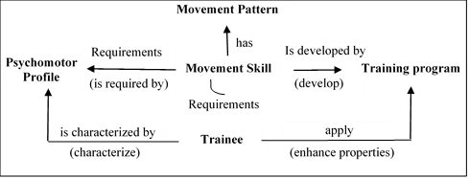
Main ontology entities
Movement Skill - Variables supporting assessment and development of a movement pattern;
Movement Pattern - Variables describing form, accuracy, and control in the performance of change in the position of any part of the body;
Psychomotor Profile - Variables describing psychomotor properties;
Training Program - Variables describing the different activities proposed to enhance the individual psychomotor profile to acquire movement skills.
Notes:
Movement Skill - Variables supporting assessment and development of a movement pattern: Readiness to Perform the Requirements, Leveling System, Skill Requirements to perform the Movement;
Movement Pattern - Variables describing form, accuracy, and control in the performance of change in the position of any part of the body: Goals, Rules, Complexity, Equipment, etc.;
Psychomotor Profile - Variables describing psychomotor properties: Weight, Body Mass Index (BMI), Low Body Size, Sagittal Balance, Maximal Speed, etc.;
Training Program - Variables describing the different activities proposed to enhance the individual psychomotor profile to acquire movement skills: Objectives, Training Period, Performance Factor, etc.

Slide 13
Classes, Class Hierarchy, Slots and Facets
Main Class | Subclasses in the hierarchy |  | Description
Movement Skill |  |  | Contains subclasses that categorize movements
 | Fundamental Movement Skill | Stability Movement Skill Locomotor Movement Skill Manipulative Movement Skill | Contains subclasses that categorize movements, in which one’s body orientation aims to gain and/or maintain a stable body orientation Contains subclasses that categorize movements, having the purpose of transporting the body from one point to another Contains subclasses that categorize movements, giving strength to an object or receiving strength from an object
 | Specialized Movement | Daily Life Movement Leisure Movement Professional Life Movement Sport Movement | Contains subclasses that categorize daily life movement patterns Contains subclasses that categorize movement patterns associated with leisure practices Contains subclasses that categorize movement patterns associated with professional activities Contains subclasses that categorize movement patterns associated with sports practices
Movement Skill Class Hierarchy

Slide 14
Classes, Class Hierarchy, Slots and Facets
Name | Type | Cardinality | Other Facets
hasGoals | String | Single | -
hasRules | String | Single | -
hasComplexity | String | Single | -
hasEquipment | Instance | Multiple | Class={Equipment}s
hasMuscularAspect | Symbol | Single | Allowed values={Grow Motor, Fine Motor}
hasTemporalAspect | Symbol | Single | Allowed values={Discrete, Serial, Continuous}
hasEnvironmentalAspect | Symbol | Single | Allowed values={Open, Closed}
Movement Pattern Properties

Slide 15
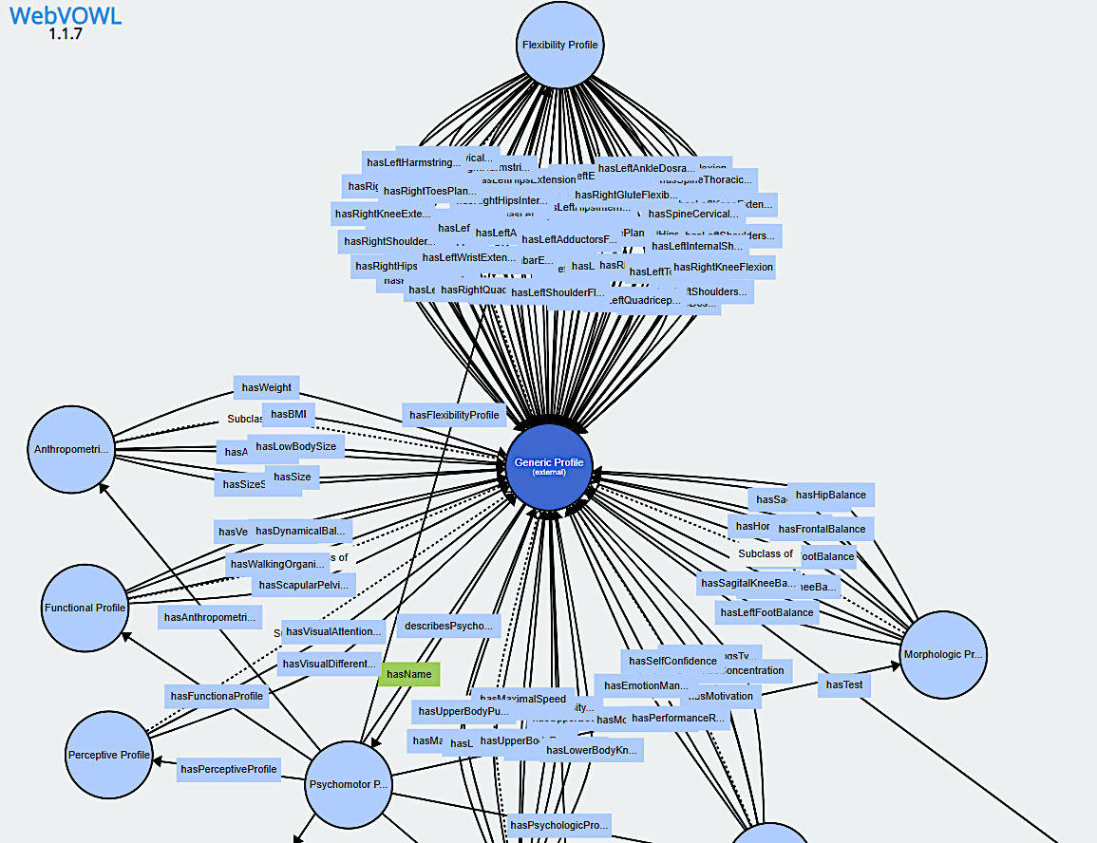
Classes, Class Hierarchy, Slots and Facets
Partial WebVOWL Visualisation of Generic Profile sub-classes properties

Slide 16
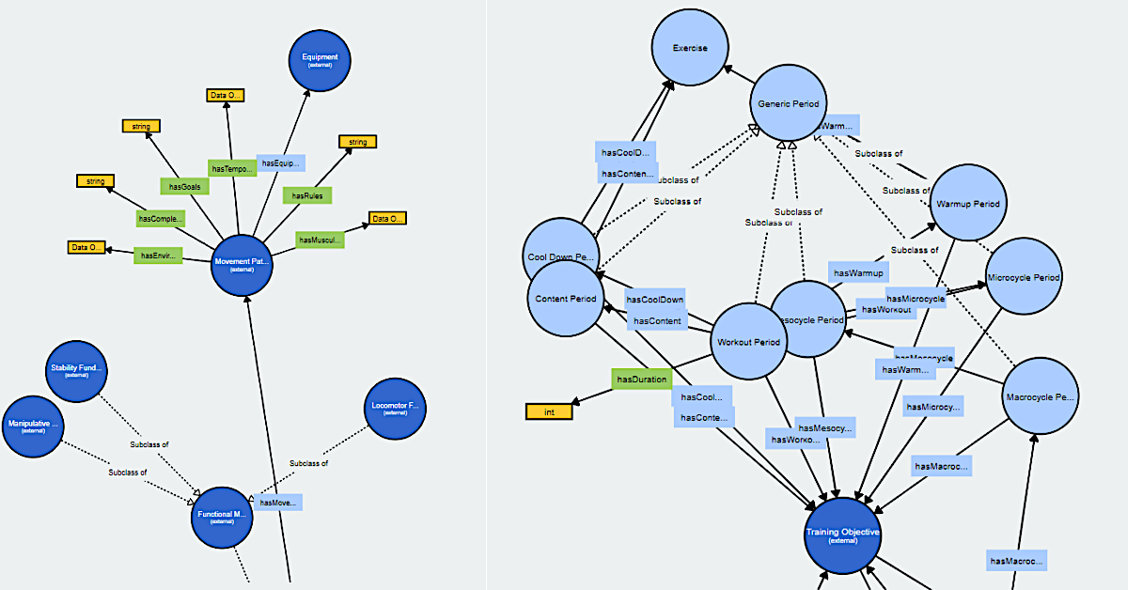
Classes, Class Hierarchy, Slots and Facets
Partial WebVOWL Visualizations corresponding to the Motor Skill Acquisition Ontology

Slide 17
Conclusion and Recommendations for Future Research
We presented an ongoing work for designing a comprehensive ontology to represent the motor skill acquisition domain. While following the OD101 methodology, we developed 6 out of 7 phases.
End goal is to integrate the ontology in a LE able to assess and enhance users progress in sport for general health activities.
Most suitable system for our goal was ITS. To overcome its limitations, we decided to use GIFT. We are at the stage of starting development of our own system, based on GIFT.
Final version of the ontology will be published online under an open-source license and integrated into Linked Open Vocabularies (LOV) initiative.
Notes:
Tell which is the 7th phase and about SPARQL queries

Slide 18
THANK YOU! Questions?

