Slide 1
The GIFT Architecture and Features Update:
2020 Edition
Benjamin Goldberg, Ph.D., Keith Brawner, Ph.D. & Michael Hoffman
DISTRIBUTION A: APPROVED FOR PUBLIC RELEASE
CCDC-SC, Simulation and Training Technology Center
28 May 2020 – GIFTSym8 – Day 1
12 MAR 2019

Slide 2
agenda
GIFT Introduction
New Features and Updates
Team Tutoring
Human Observer Tool (Game Master)
Training Applications and Extensions
Potpourri
Requested Features from GIFTsym7
User Roles and Experimenter Functions
Instructional Management Requests
Learner Modeling Requests
Misc. Requests
IEEE Standards
Adaptive Instructional Systems
eXperience Application Programming Interface (xAPI)

Slide 3
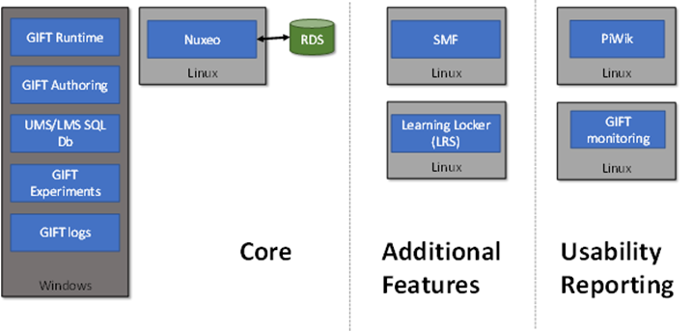
GIFT Deployments
GIFT Desktop … on your personal computer
GIFT Experiment … anonymous authentication
GIFT Cloud … hosted on a server
Production: Amazon Web Service (AWS)
cloud.gifttutoring.org
Development: GIFT server at Dignitas
cloud-dev.gifttutoring.org
Coming Soon…Headless GIFT!!
Run-time Assessment only version in support of STE modernization program

Slide 4
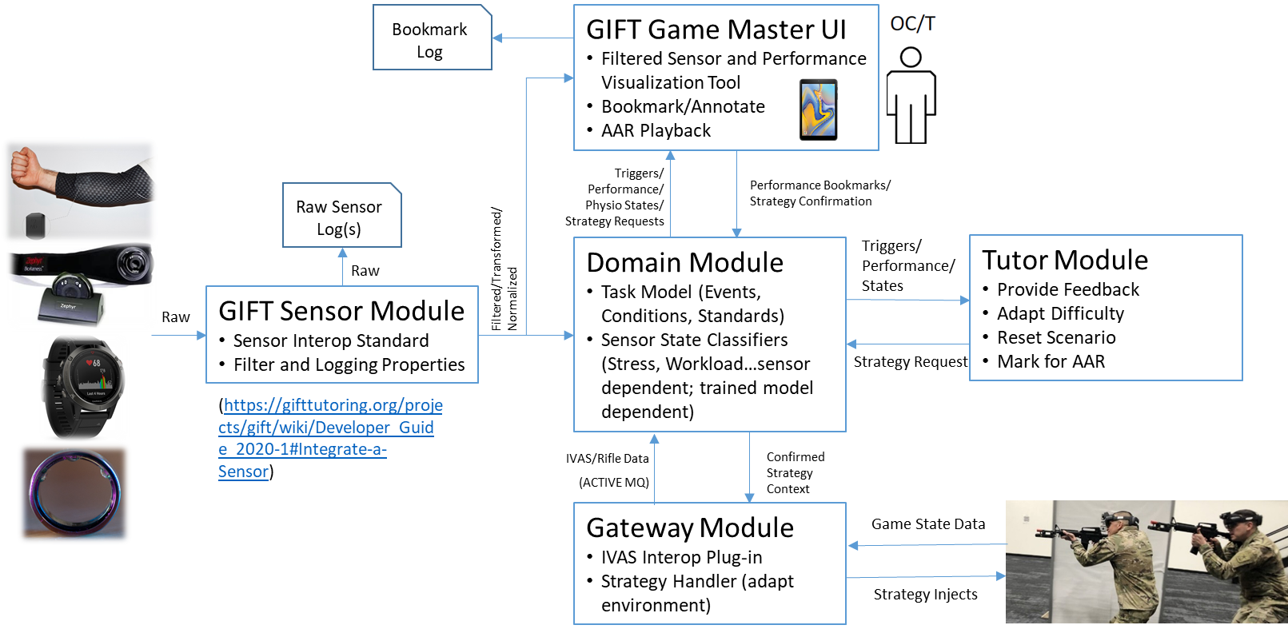
Run-time intelligent tutoring
Notes:
Enables time-synced logging of COTS sensors with training environment event logs
Real-time filtering and transformation for visualization and classification
Enable real-time bookmarking
Link to trained classifiers/models for real-time state detection (e.g., use HRV and breathing to classify stress; https://gifttutoring.org/projects/gift/wiki/Developer_Guide_2020-1#Configuring-GIFT-with-RapidMiner)
Links physio data with: (a) scenario events, performance outcomes and recorded bookmarks, (b) enabling analyses around events of interest (e.g., examine delta on physio/stress levels when contact is established, examine stress when OC/T marks aggressive comms from SQD Leader)
Structures AAR with explore-able scenario timeline and data overlays…highlights event triggers, performance outcomes, OC/T bookmarks, and physiology response

Slide 5
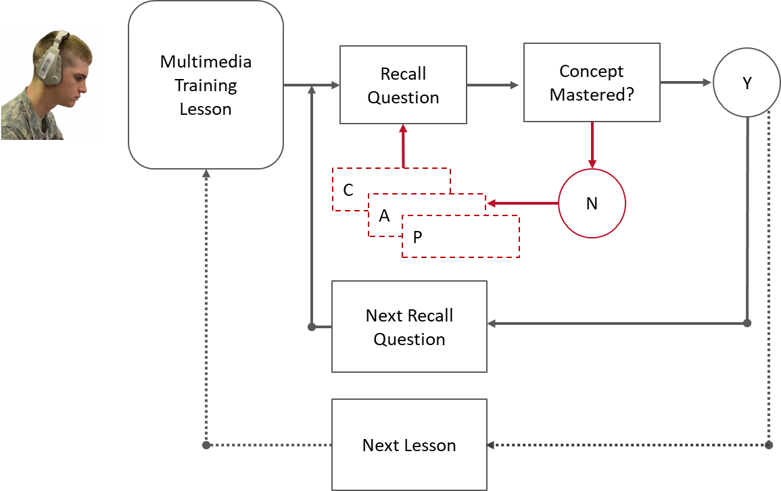
Gift data-driven tutorial planning

Slide 6
New GIFT Features and Updates

Slide 7
New GIFT Features and Updates
Team Tutoring

Slide 8
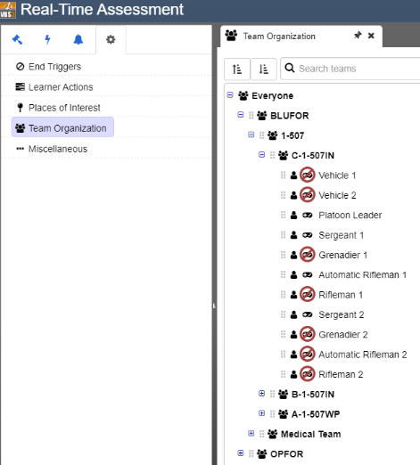
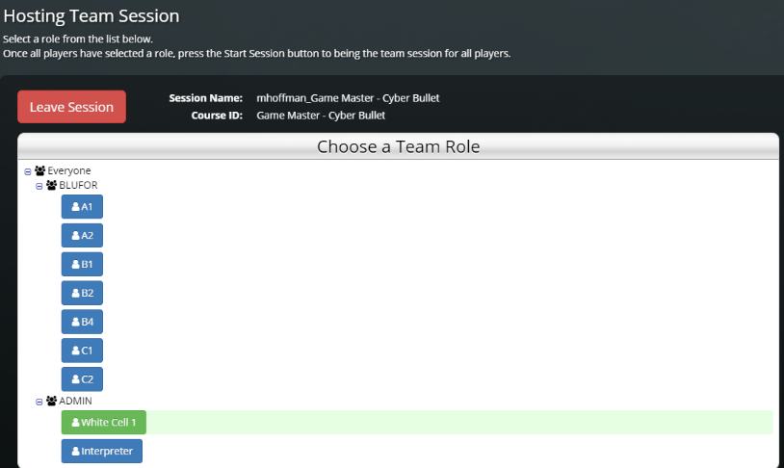
Team organization in domain knowledge file (DKF)
Notes:
GIFT architecture now calculates performance assessment and maintains learner state for an entire (author defined) team organization. These team-level assessments are established within the Domain Knowledge File (DKF; a.k.a. Real-Time Assessment) and operate on interaction data produced during a training exercise.

Slide 9
New GIFT Features and Updates
Human Observer Tool (Game Master)

Slide 10
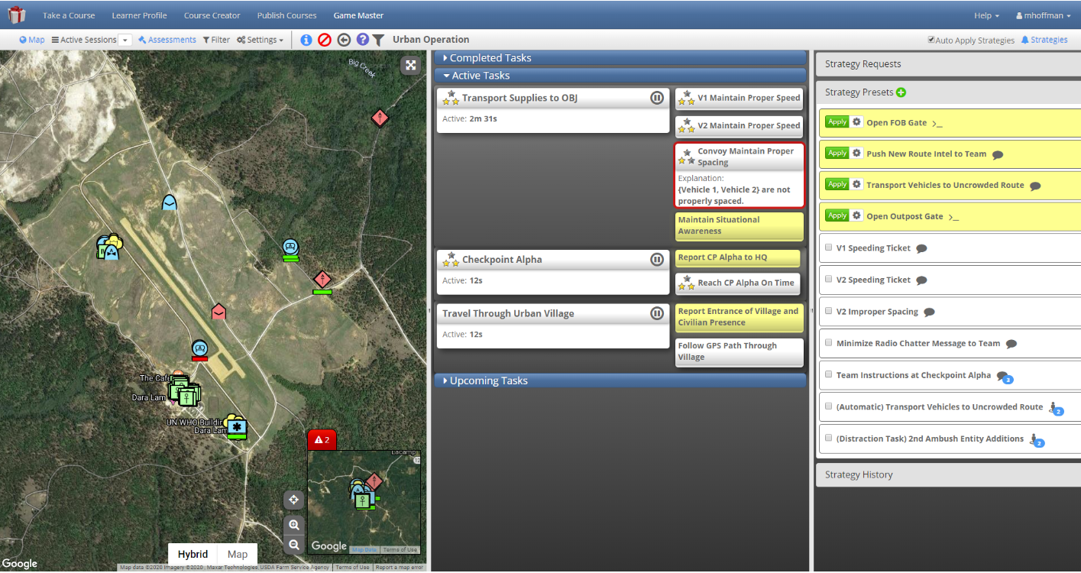
Run-time game master
Notes:
Improved usability…but not good enough
Integrated w/ Battle Space Visualization for 3-D and AR rendering of synthetic environment.
Need to study role of OC/T in STE tutoring chain.
Explore new visualization and cueing techniques.

Slide 11
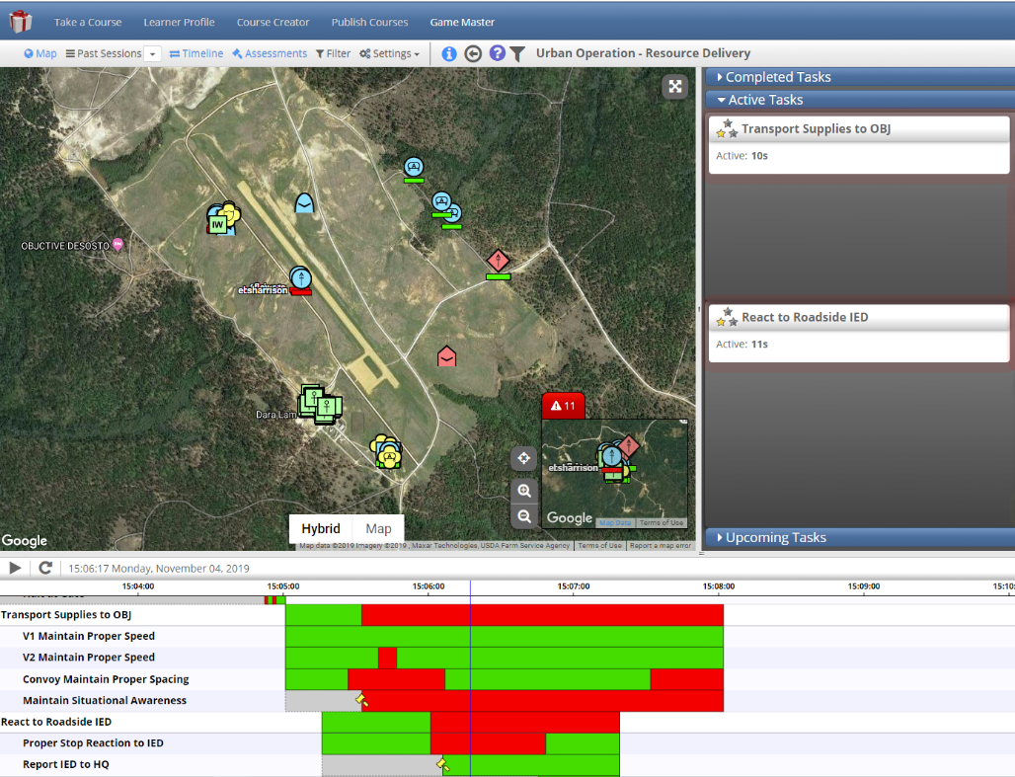
Aar playback game master

Slide 12
New GIFT Features and Updates
Training Applications and Extensions

Slide 13
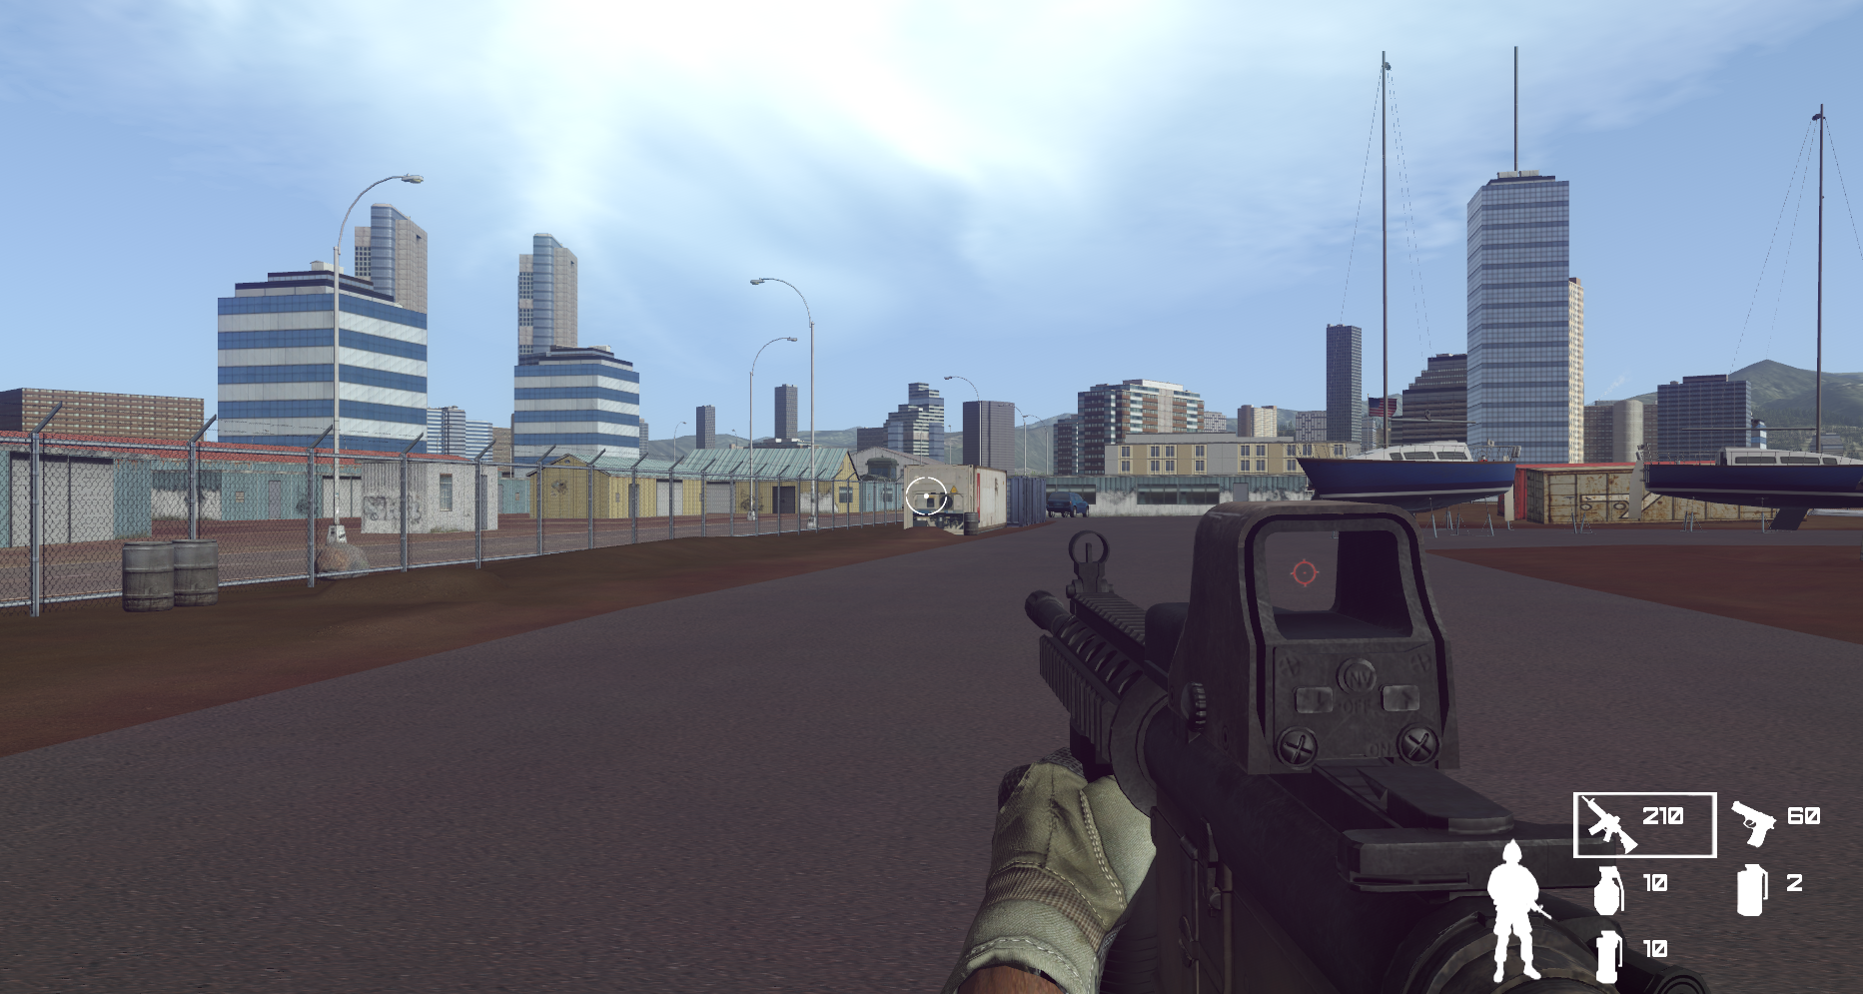
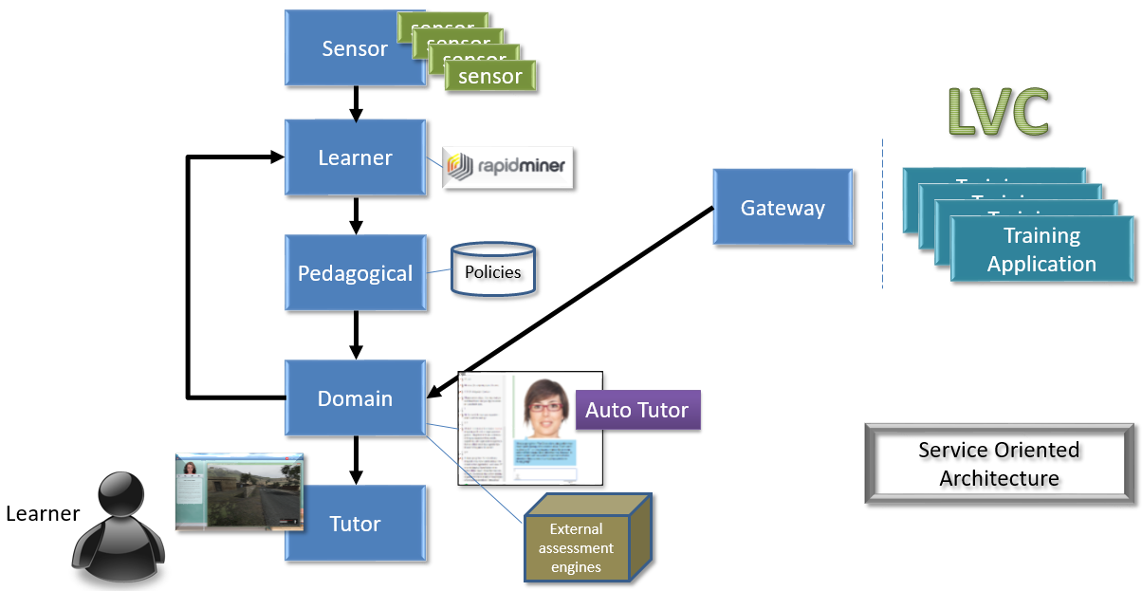

Slide 14
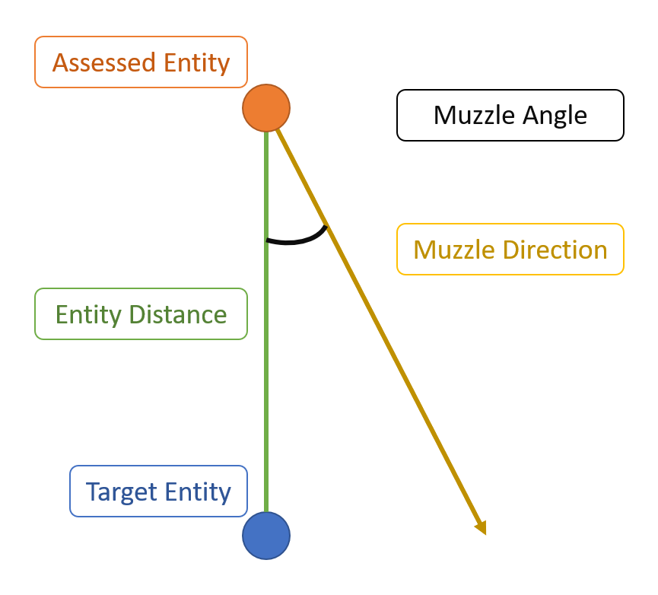
Muzzle Flagging condition class

Slide 15
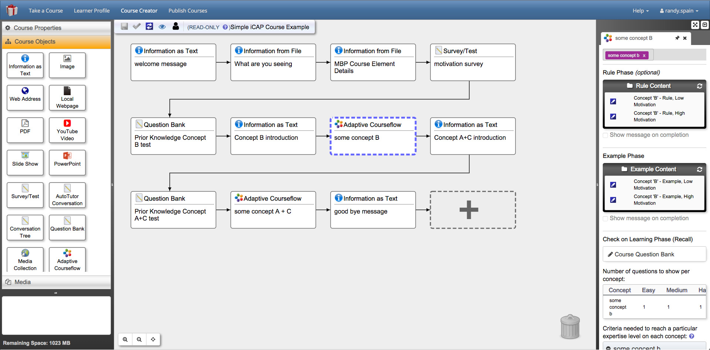
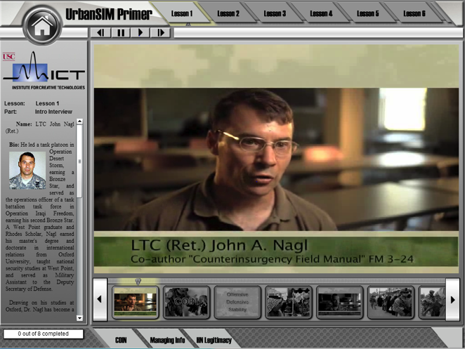
ICAP Examplar course: Counter insurgency (COIN)
(Rowe, Spain, Pokorny, Goldberg, Mott & Lester)

Slide 16
New GIFT Features and Updates
Potpourri

Slide 17
Potpourri
Motivational Assessment Tool (MAT) Surveys
GIFT Published Course Editing
Structured Review in Adaptive Courseflow Objects
Notes:
Other Feature Improvements
Better filtering of the types of overall scoring configurations a condition supports
Easy to author mid lesson surveys (i.e., less clicks and hunting)
Show images instead of file names when possible
Show embedded YouTube video instead of YouTube URL when possible

Slide 18
Requested Features from GIFTsym7

Slide 19
RECKONING

Slide 20
User Roles
Developer
Experimenter
Instructional User (Instructor, game master)
User (trainee, learner)

Slide 21
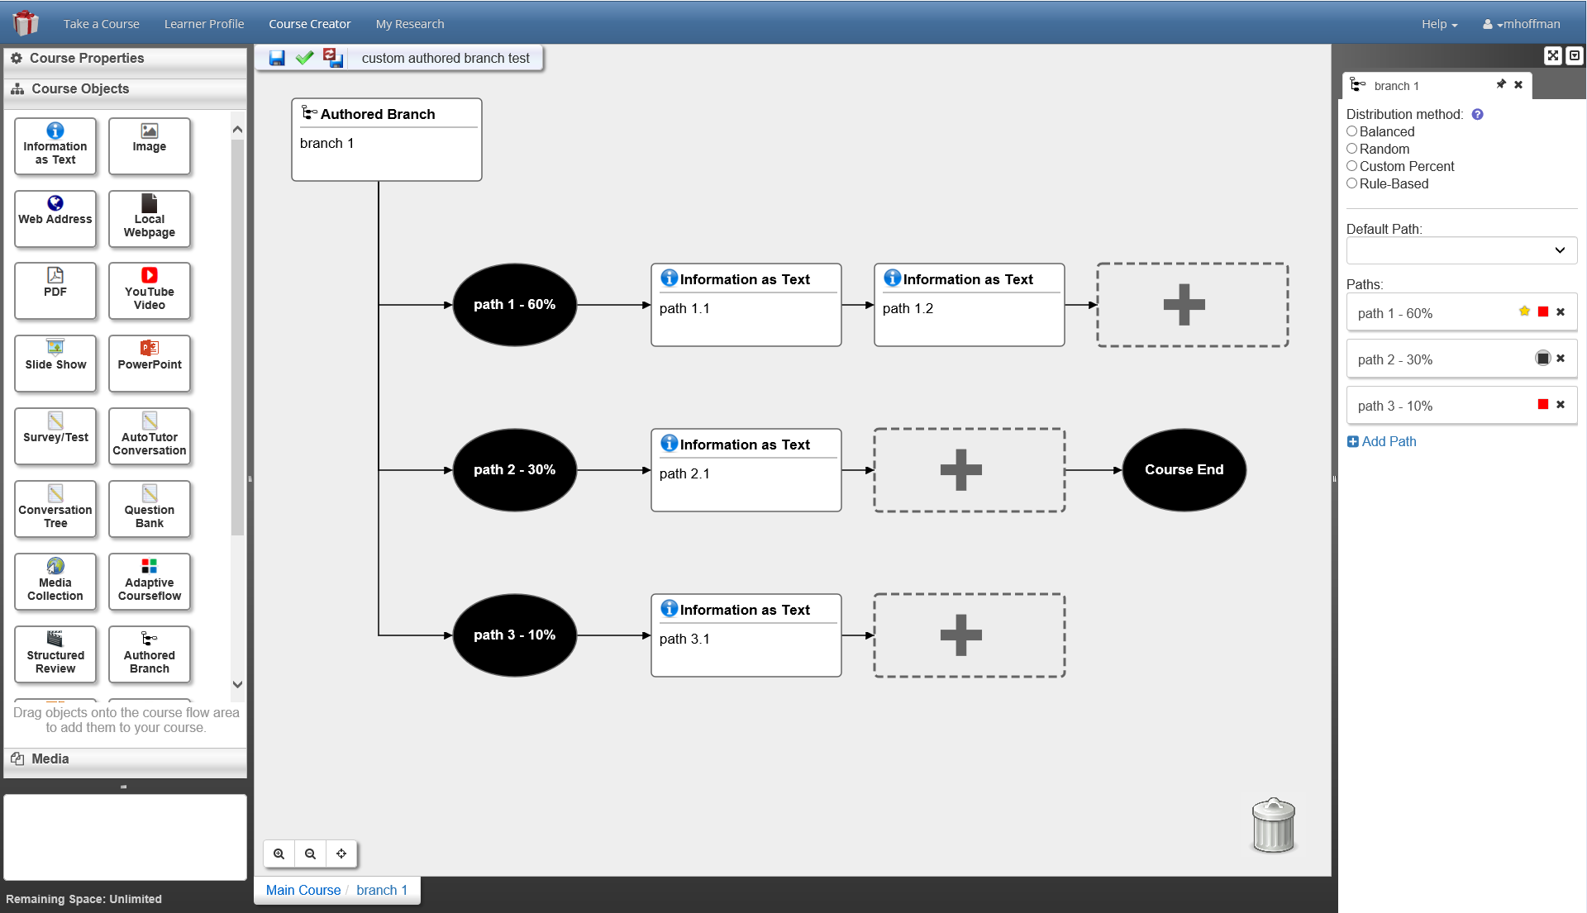
Experimentation REquests
Manual Branching (multiple, Sinatra)
Data Imputation (Henderson)
Arguably done at time of request (python, xml-RPC, LearnerMod)
Have to write code
Note: very cautious of this request
Data Slicing for experimental reporting
Still on the list

Slide 22
Instructional User Requests
Make authoring easier (Sottilare, many)
Have an authoring dashboard (Sinatra)
Streamline content tagging (Bell)
Dashboard of condition classes
(Sottilare, Davis, others)
Linking assessment to locations in (real world, MR, VR)
Davis, Mishra, others
Note:
Always available

Slide 23
Instructional User Requests (cont)
Population-level dashboard to run sample experimental population
Davis
Gradebook for Students
Sinatra
Fixed models of feedback intervention (Hu)
AMI API calls, see ICD
Custom instructional modes (Expectation Misconception Dialogue)
Left as an exercise in configuration

Slide 24
Learner User REquests
xAPI for tracking (Hu, Aleven, others)
Note – xAPI Profiles now available upon request
Affective State xAPI for LearnSphere
Note – the LearnSphere export tool should need only minor changes
Also export affective state, also export xAPI
Adaptive Courseflow Selectable Remediation (Matsada)
Configuration parameter

Slide 25
Other Requests
Integrate with SAM-T
Workable, in progress, available upon request
(bonus points for VTMAK/VRForces/VREngage integration, released)
Team Tutoring (McCormack, Swiecki)
See latest release
Team Tutoring Epistemic Network Analysis (Shaffer)
Not yet, not has a place to go, data to operate on

Slide 26
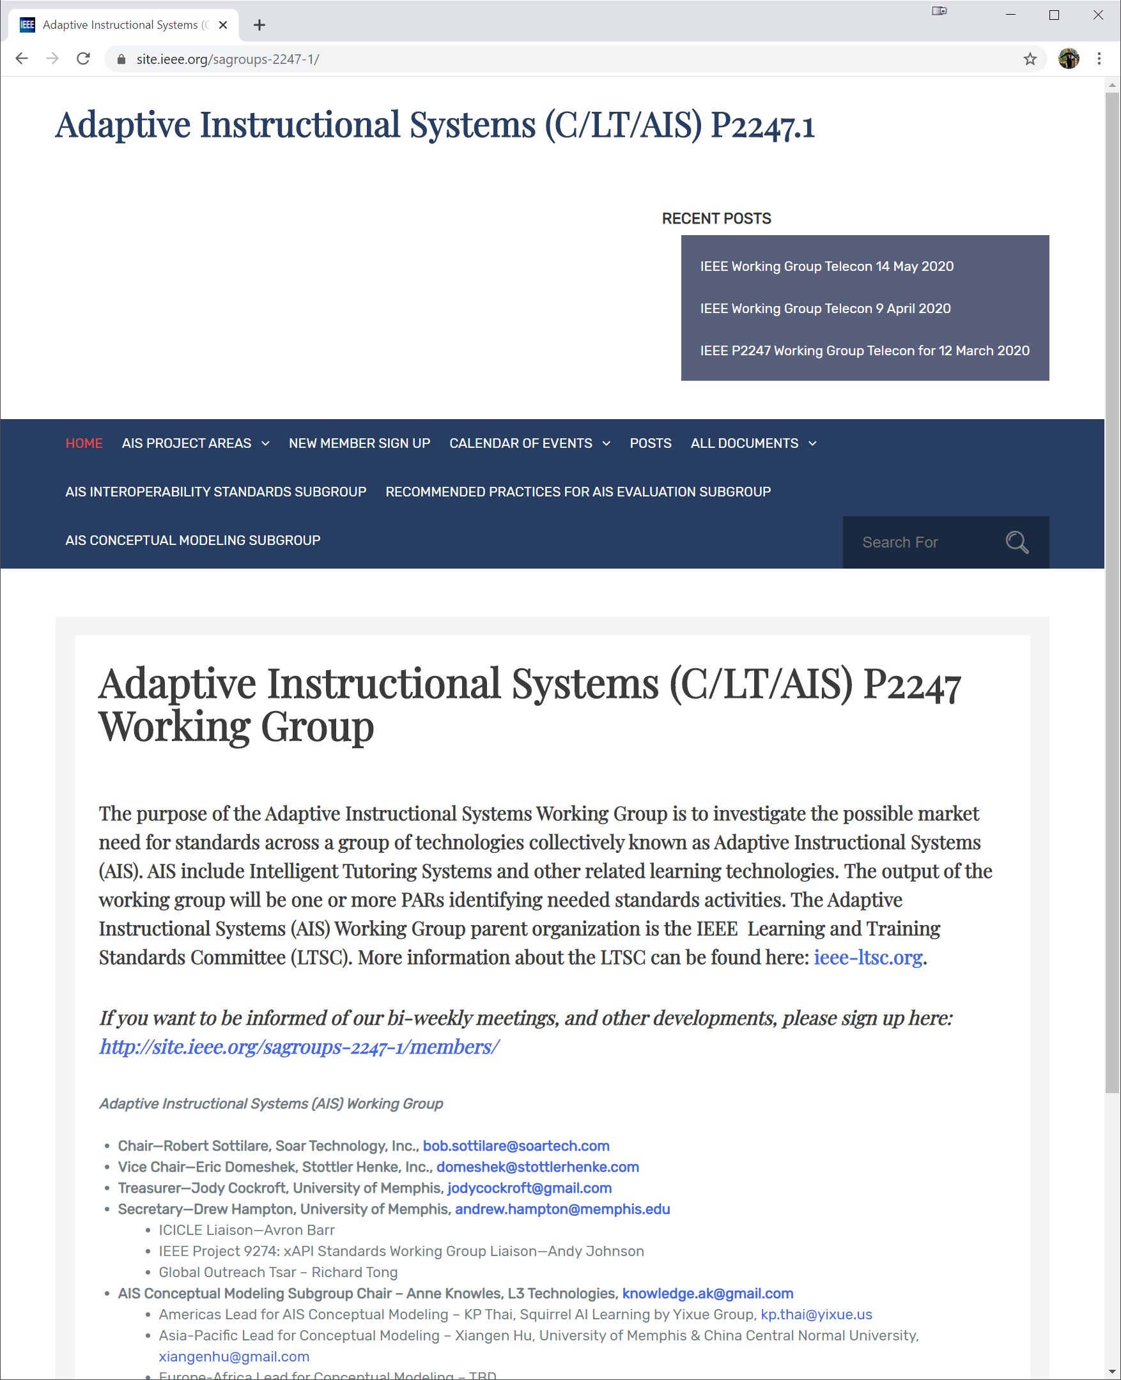
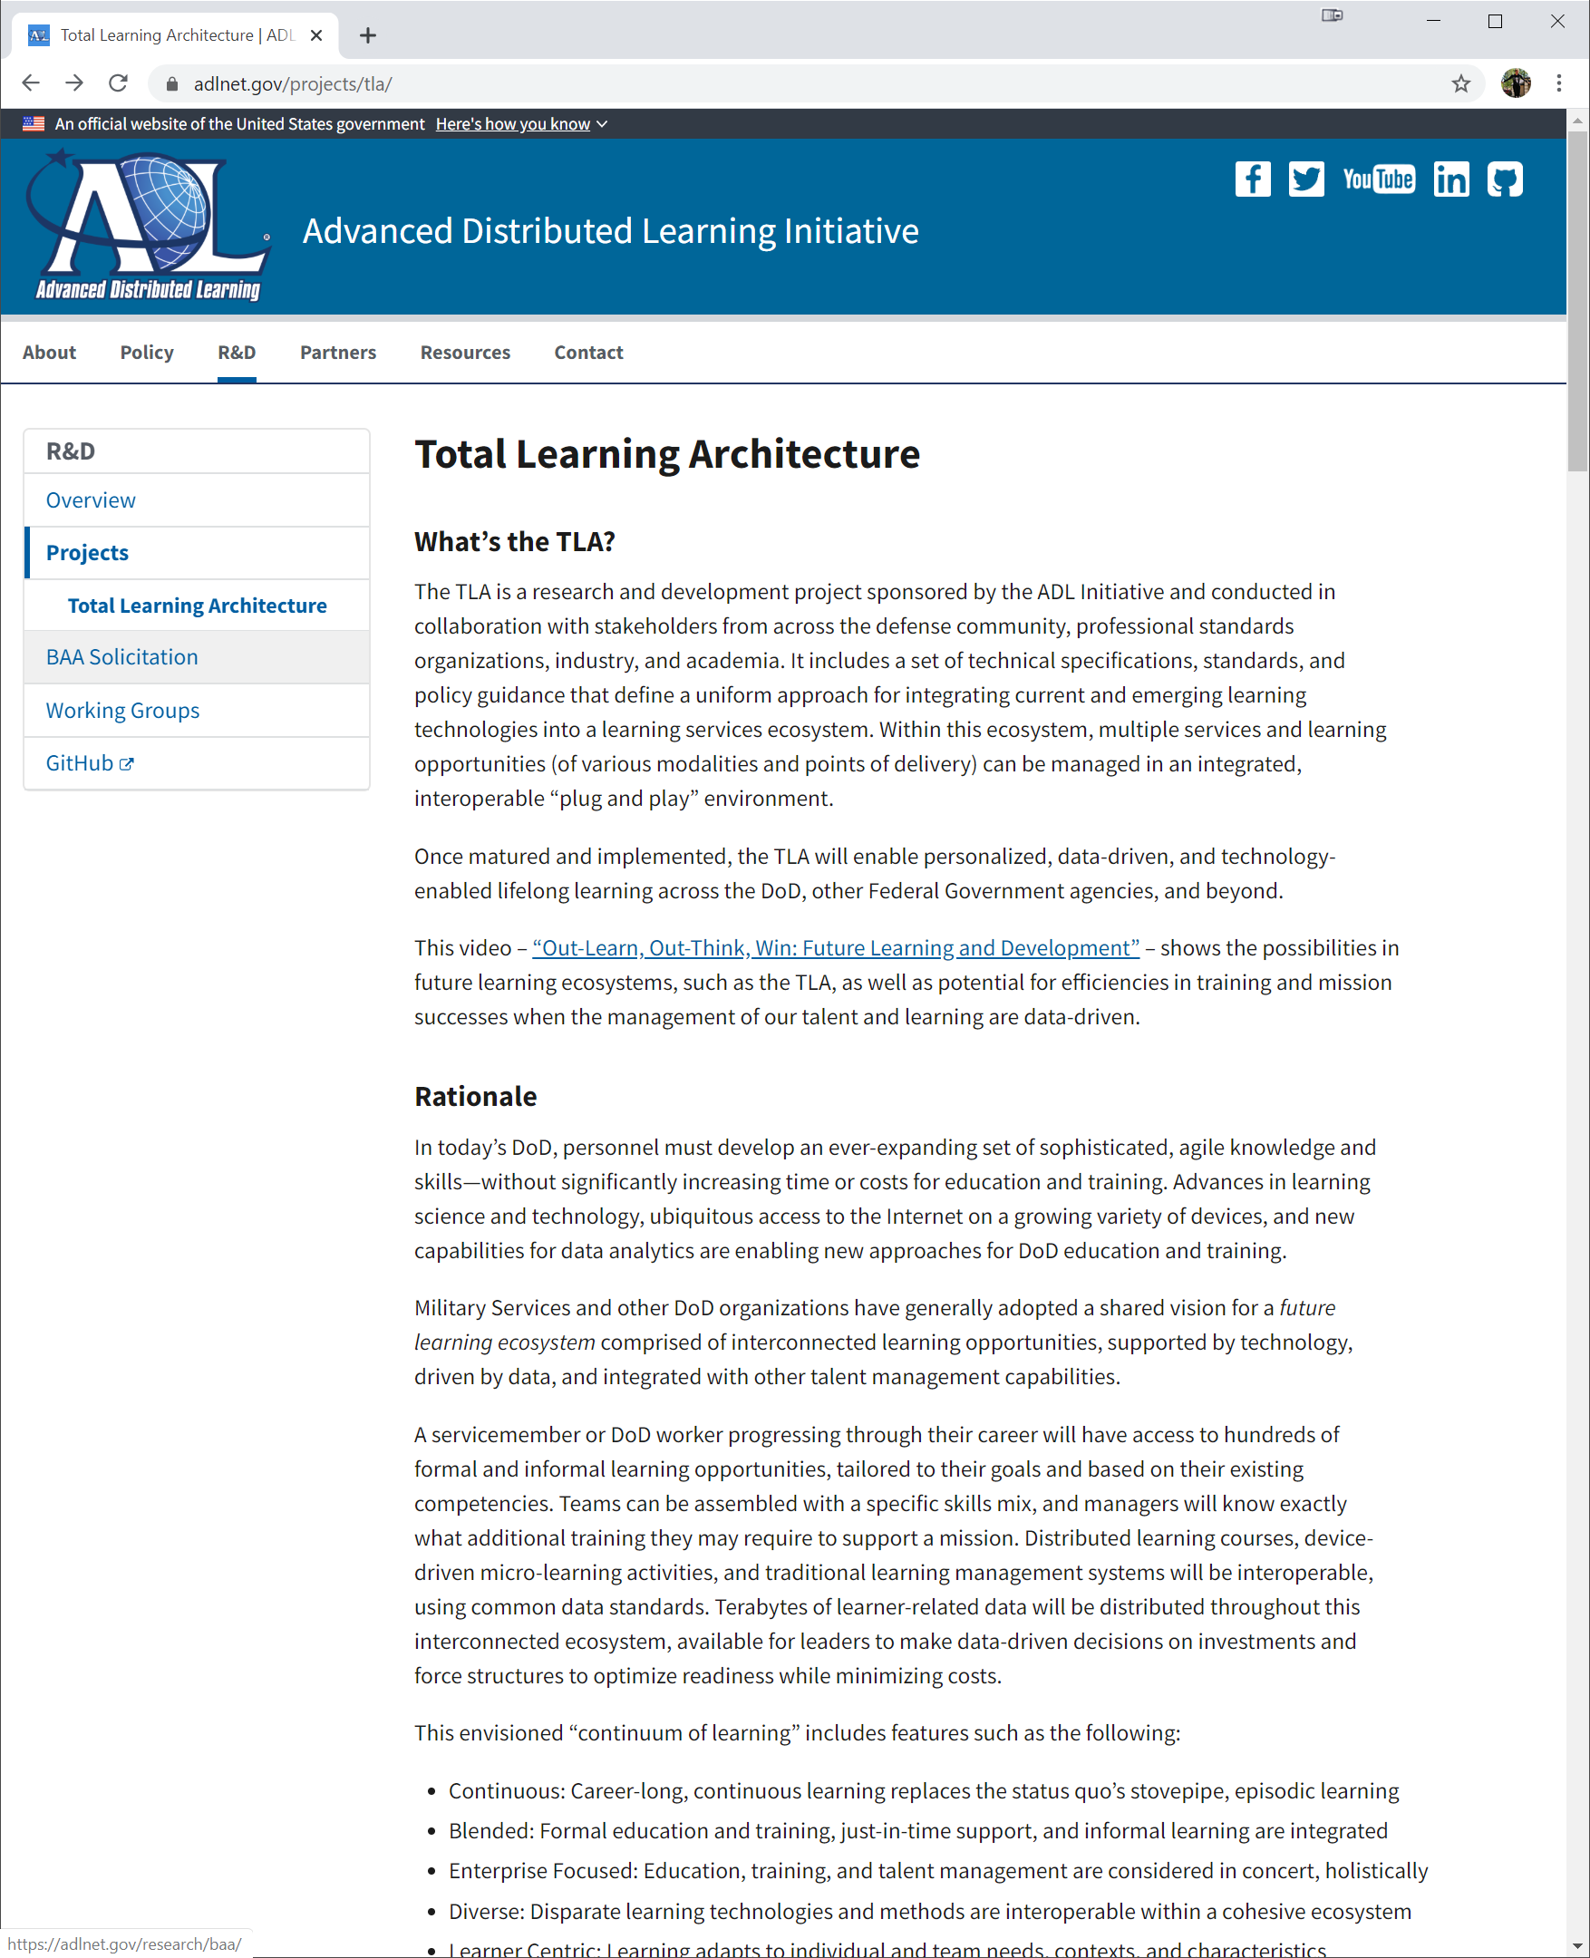
IEEE, TLA, and Standards

Slide 27
Pain points? Discussion

Slide 28
Thank you
Questions??

