Slide 1
An Effectiveness Evaluation of Blended Adaptive Learning Approaches
Cadet Joshua Rea¹, Cadet Payton Rengel¹, Barbara Buck, Ph.D.², Benjamin Goldberg, Ph.D.³ Ericka Rovira, Ph.D.¹
¹U.S. Military Academy West Point, NY 10996, USA
²The Boeing Company, St. Louis MO 63166, USA
³U.S. Combat Capability Development Command – Soldier Center’s (CCDC-SC) , Orlando FL 32826, USA

Slide 2
Agenda
Introduction/Background
Methodology
Results
Discussion
Future Research

Slide 3
Background
The U.S. Army has defined Adaptive Instructional Systems (AIS) as a critical priority for the future Synthetic Training Environment (STE) acquisition program

Slide 4
Background
As part of a three-year Cooperative Research and Development Agreement (CRADA), Boeing and CCDC-SC developed an integrated adaptive instructional system in which we combined the Army’s GIFT adaptive learning framework with the Boeing ITS capabilities.
A prototype was developed using the resulting architecture, which uses an aircraft maintenance scenario as the use case with aspects of troubleshooting and part replacement.
Notes:
It uses the Adaptive Course Flow Course Object (i.e. knowledge assessment functionality and individual difference categorization) within GIFT to sequence course content to the student and to adapt course content based on ongoing student parameter characterization (Goldberg, Hoffman & Tar, 2015).

Slide 5
Applied Problem
The goal of the study is to assess these three implementations of overall curriculum adaptation to determine which are best utilized to optimize:
student performance
using measures of time to competence
performance outcomes
training transfer and knowledge retention

Slide 6
Applied Problem
The goal of the study is to assess these three implementations of overall curriculum adaptation to determine which are best utilized to optimize:
student performance
using measures of time to competence
performance outcomes
training transfer and knowledge retention
How can we improve the way we train?

Slide 7
Theoretical Underpinning #1
Training
What is the best way to train? (Johnston, 2015)
One-on-one specialization
How do we evaluate training? (Kilpatrick, 1994)
Reaction
Learning
Behavior
Results

Slide 8
Theoretical Underpinning #2
Intelligent Tutoring Systems
What makes an ITS? (Sotiliare, 2018)
Model of instruction
Model of the learner
Model of instruction
Is it more effective than traditional tutors? (Koedinger, 1997)
Yes, better retention rates

Slide 9
Theoretical Underpinning #3
Synthetic Training for Applied Tasks
Does ITS help with applied tasks? (Kulik, 2016)
Yes, ITS that strayed from academic-based tutoring showed an increase in scores.
Will ITS work for everyone? (Whittington, 1999)
Yes and No, it shows significant increase in retention; however, people who are not comfortable with technology may be at a disadvantage and less likely to trust the tutoring system.

Slide 10
Hypothesis
A combination of the two training platforms (the Hybrid condition) will result in the greatest amount of knowledge retention on the virtual reality post-test, due to increased exposure to the material and multiple approaches (academic-focused and task-oriented) to tutoring.

Slide 11
Hypothesis
A combination of the two training platforms (the Hybrid condition) will result in the greatest amount of knowledge retention on the virtual reality post-test, due to increased exposure to the material and multiple approaches (academic-focused and task-(oriented) to tutoring.
Participants who take more time to complete the training will have greater amounts of knowledge retention, resulting in higher scores on the virtual reality post-test.

Slide 12
Agenda
Introduction/Background
Methodology
Results
Discussion
Future Research

Slide 13
Participants
51 Participants (39 usable sets of data)

Slide 14
Participants
51 Participants (39 usable sets of data)
USMA Cadets
Notes:
. USMA cadets were targeted because they represent a population of future Officers who will possibly interact with ITS integrated platforms. They also represent a university student population who lack specific skill sets, which is a key focus of operational ITSs

Slide 15
Participants
51 Participants (39 usable sets of data)
USMA Cadets
44 males and 7 females

Slide 16
Participants
51 Participants (39 usable sets of data)
USMA Cadets
44 males and 7 females
Age range of 18-24

Slide 17
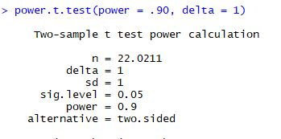
Power Analysis
For power of 0.90, with significance level of 0.05, we need to run 22 participants per group, for a total of 66 participants.

Slide 18
Apparatus
Single room with in station configured for data collection

Slide 19
Apparatus
Single room with in station configured for data collection:
Commercial off the shelf laptop with a 15” display

Slide 20
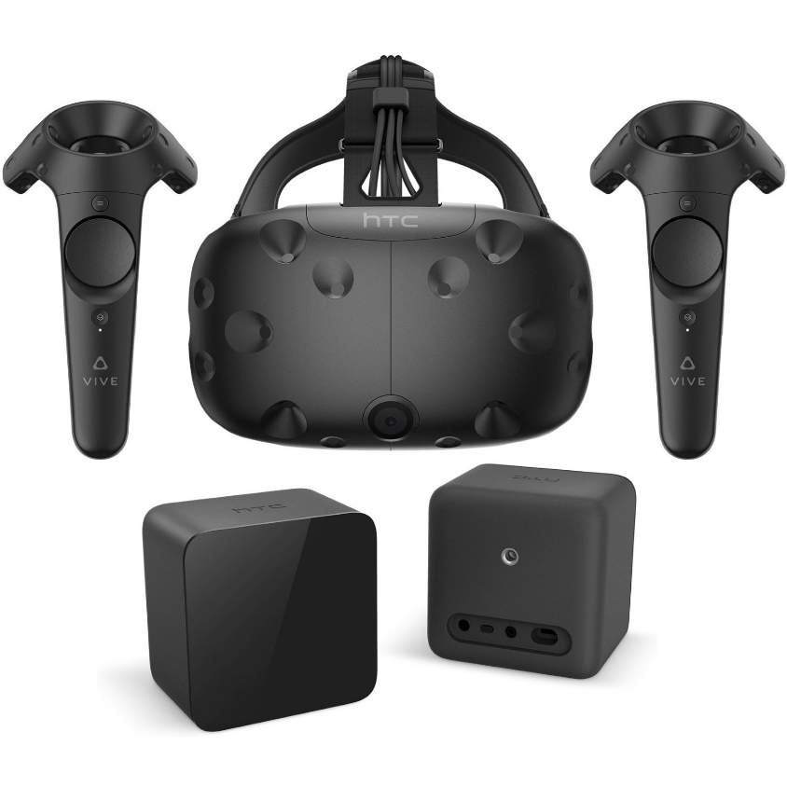
Apparatus
Single room with in station configured for data collection:
Commercial off the shelf laptop with a 15” display
HTC Vive Virtual reality headset
Two 3D VR hand controllers

Slide 21
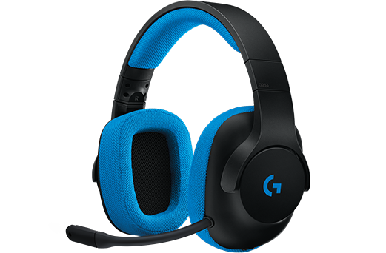
Apparatus
Single room with in station configured for data collection:
Commercial off the shelf laptop with a 15” display
HTC Vive Virtual reality headset
Two 3D VR hand controllers
Over the ear headphones

Slide 22
Apparatus
The Generalized Intelligent Framework for Tutoring (GIFT)
The Boeing Intelligent Tutoring System (ITS)
The Integrated GIFT/Boeing-ITS Hybrid Prototype (Hybrid)
Extended Reality learning Framework (XRLF)

Slide 23
Apparatus
The Generalized Intelligent Framework for Tutoring (GIFT)
The Boeing Intelligent Tutoring System (ITS)
The Integrated GIFT/Boeing-ITS Hybrid Prototype (Hybrid)
Extended Reality learning Framework (XRLF)

Slide 24
Apparatus
The Boeing Intelligent Tutoring System (ITS)
The Boeing ITS features 3 components:
Student Model
changes due to learning are reflected across exercises, as the score increases due to correct performance, or decreases as errors are made.
Instructional Model
provides within-scenario feedback to guide the student, as well as performance summaries across all learning objectives at the end of the lesson scenario.
Expert Model
captures the expert’s summary of the situation (representation of the problem) and the rationales for the possible next steps.

Slide 25
Apparatus
The Generalized Intelligent Framework for Tutoring (GIFT)
The Boeing Intelligent Tutoring System (ITS)
The Integrated GIFT/Boeing-ITS Hybrid Prototype (Hybrid)
Extended Reality learning Framework (XRLF)

Slide 26
Apparatus
The Generalized Intelligent Framework for Tutoring (GIFT)
The Boeing Intelligent Tutoring System (ITS)
The Integrated GIFT/Boeing-ITS Hybrid Prototype (Hybrid)
Extended Reality learning Framework (XRLF)

Slide 27
Experimental Design
Between Subjects Design

Slide 28
Experimental Design
Between Subjects Design
3 Level Single Factor Independent Variable
GIFT: Academic focused approach
Boeing: Task-oriented approach
Hybrid: A mixture of the two approaches
Notes:
The independent variable for this study is the type of ITS that is interacted with. This means that the independent variable is a single factor with three levels (GIFT, Boeing ITS, and hybrid). This was chosen to be the manipulated variable since we are trying to test the effectiveness of the three different tutoring systems

Slide 29
Experimental Design
Between Subjects Design
3 Level Single Factor Independent Variable
GIFT: Academic focused approach
Boeing: Task-oriented approach
Hybrid: A mixture of the two approaches
Notes:
Level one is the GIFT system, The GIFT-alone lesson uses the pre-test to tailor student content by implementing a within-module adaptation and remediation afforded by built-in knowledge checks.

Slide 30
Experimental Design
Between Subjects Design
3 Level Single Factor Independent Variable
GIFT: Academic focused approach
Boeing: Task-oriented approach
Hybrid: A mixture of the two approaches
Notes:
Level two is the Boeing ITS, the Boeing-alone lesson had the students complete all modules of the training curriculum, without the tailoring of content based on an initial pre-test. It uses the ITS capability to maximize training effectiveness and efficiency as students complete individual modules.

Slide 31
Experimental Design
Between Subjects Design
3 Level Single Factor Independent Variable
GIFT: Academic focused approach
Boeing: Task-oriented approach
Hybrid: A mixture of the two approaches
Notes:
Lastly, level three is the hybrid training, which is a combination of the GIFT and ITS systems which uses the remediation aspects of GIFT and allows users to receive the task-oriented aspects of ITS.

Slide 32
Experimental Design
GIFT Only
Boeing Only
Hybrid/Combination
Pre-Test with Validation
Pre-Test without Validation
Pre-Test with Validation
Training with Remediation; No Practice Phase
Training without Remediation; Practice Phase
Training with Remediation; Practice Phase
VR Familiarization
VR Familiarization
VR Familiarization
VR Simulation
VR Simulation
VR Simulation

Slide 33
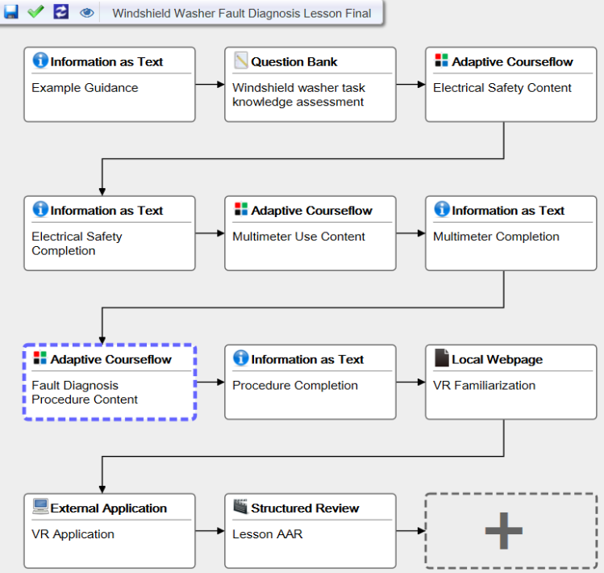

Slide 34
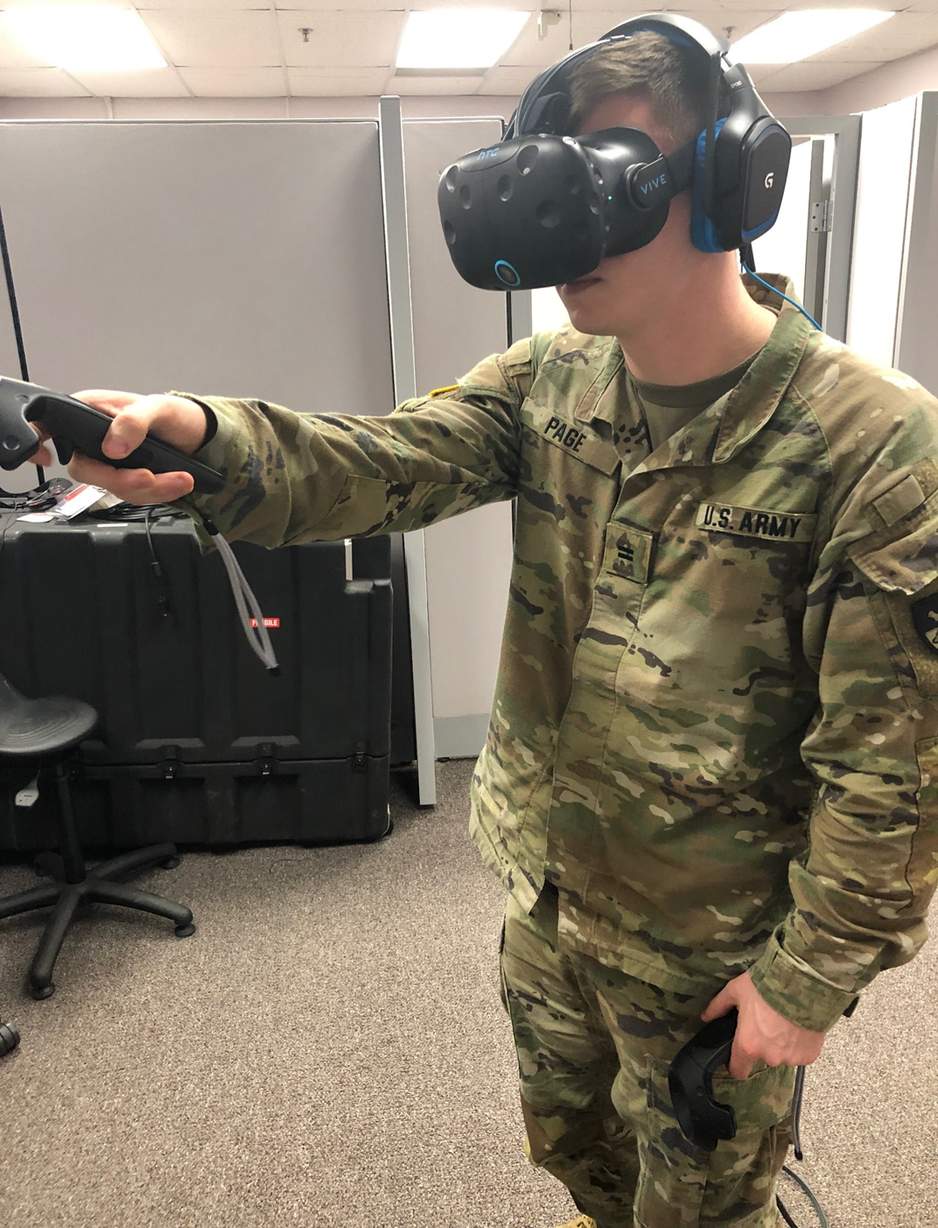
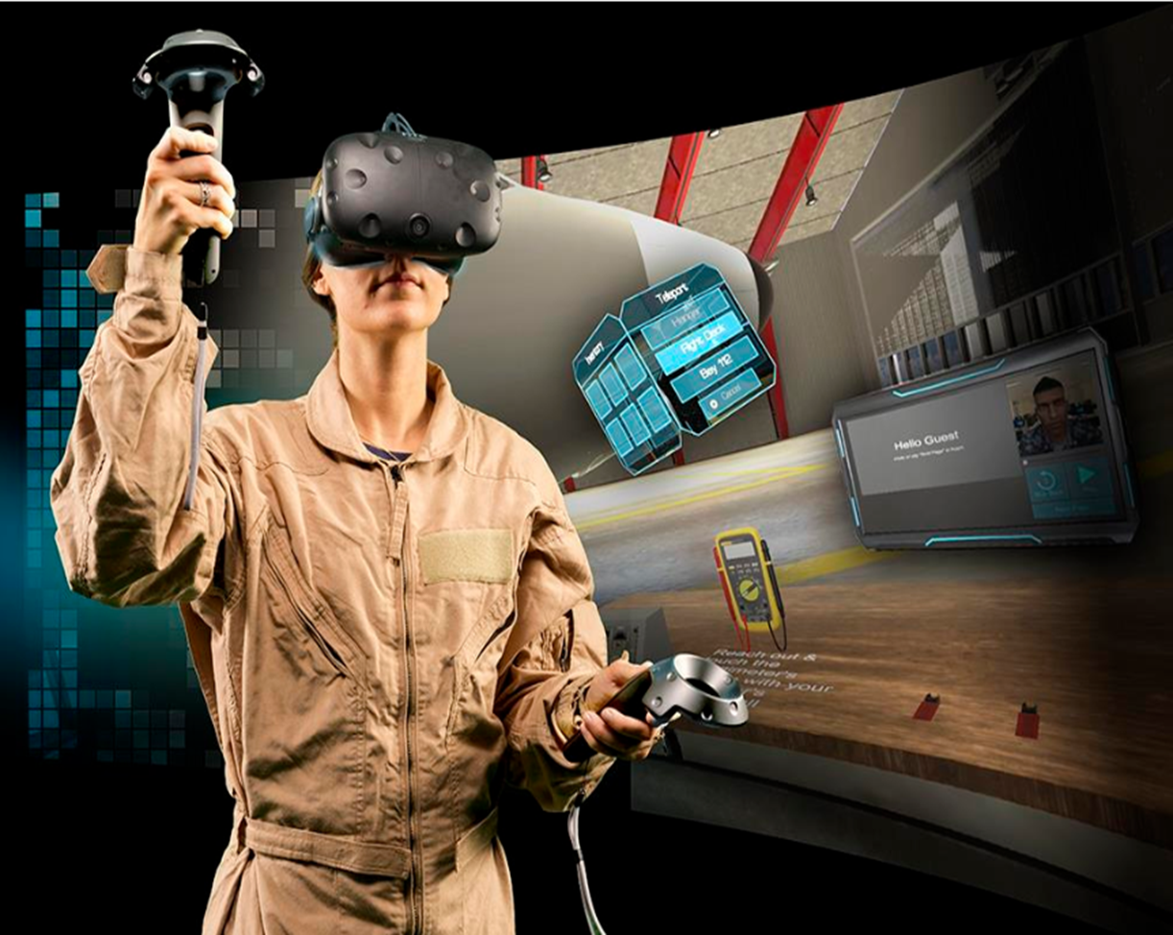
Experimental Design
The Dependent variable for the experiment was the participant’s performance in the VR Scenario
Time on task
Completion of key tasks
Overall performance
Notes:
This will allow us to determine effects of the three different training scenarios on the performance of the task, allowing us to determine training effectiveness. Due to a 55-minute time constraint, we used the VR scenario as the post-test metric to determine system effectiveness. In an ideal situation, a multiple-choice post-test which closely matched the pre-test would have been administered

Slide 35
Experimental Design
Participant arrives and Signs Informed Consent Form (2-3 Min)

Slide 36
Experimental Design
Participant arrives and Signs Informed Consent Form (2-3 Min)
Participant is assigned one of the 3 Control groups

Slide 37
Experimental Design
Participant arrives and Signs Informed Consent Form (2-3 Min)
Participant is assigned one of the 3 Control groups
Participant begins the tutoring session.

Slide 38
Experimental Design
Participant arrives and Signs Informed Consent Form (2-3 Min)
Participant is assigned one of the 3 Control groups
Participant begins the tutoring session.
Participant completes the tutoring session.(35-45 Min)

Slide 39
Experimental Design
Participant arrives and Signs Informed Consent Form (2-3 Min)
Participant is assigned one of the 3 Control groups
Participant begins the tutoring session.
Participant completes the tutoring session.(35-45 Min)
Participant begins the VR Scenario

Slide 40
Experimental Design
Participant arrives and Signs Informed Consent Form (2-3 Min)
Participant is assigned one of the 3 Control groups
Participant begins the tutoring session.
Participant completes the tutoring session.(35-45 Min)
Participant begins the VR Scenario
Participant Completes the VR Scenario (15-20 Min)

Slide 41
Experimental Design
Participant arrives and Signs Informed Consent Form (2-3 Min)
Participant is assigned one of the 3 Control groups
Participant begins the tutoring session.
Participant completes the tutoring session.(35-45 Min)
Participant begins the VR Scenario
Participant Completes the VR Scenario (15-20 Min)
Experiment should last no more than 55 minutes.

Slide 43
Agenda
Introduction/Background
Methodology
Results
Discussion
Future Research

Slide 44
Results
2 Two-Factor ANOVA’s were run to try and find significance

Slide 45
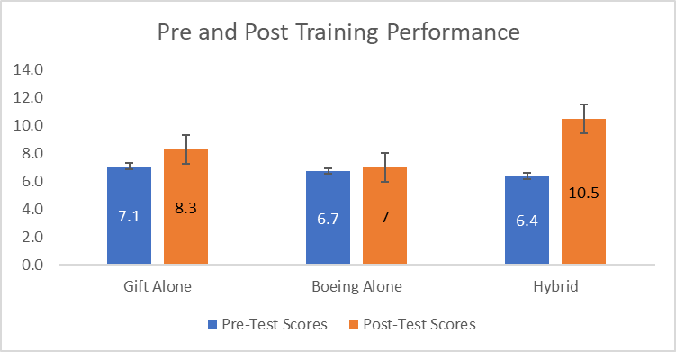
Results
2 Two-Factor ANOVA’s were run to try and find significance
The first was to compare Pre and Post-Test performance for each condition to test our 1st hypothesis (note the scores were normalized)
ANOVA [F (2, 25) =2.771, p<0.082]

Slide 46
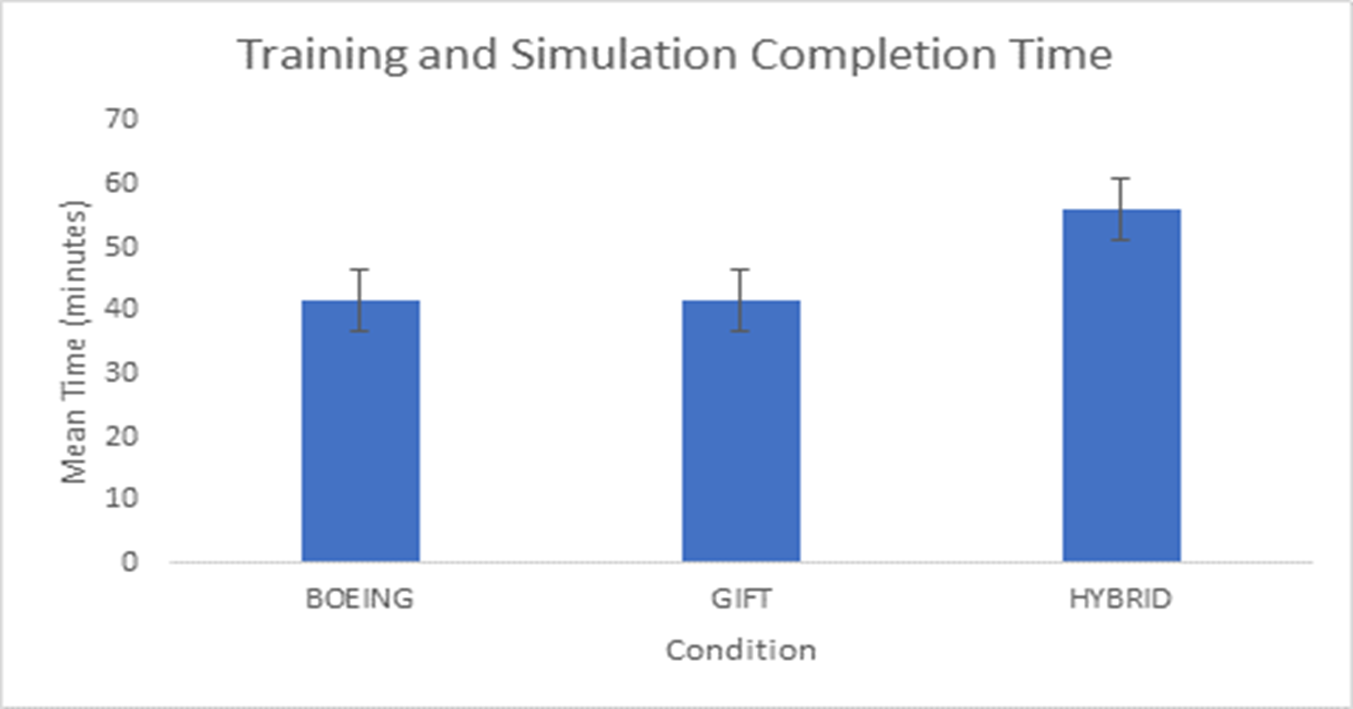
Results
2 Two-Factor ANOVA’s were run to try and find significance
The second was the same test but this time we used time as a covariant to test our 2nd hypothesis
ANOVA [F (2, 24) =0.054, p<0.181]

Slide 47
Agenda
Introduction/Background
Methodology
Results
Discussion
Future Research

Slide 48
Discussion
Although neither of the hypothesis were supported by the data analysis, there is reason to believe that significant results would have been found had there been higher numbers of participants in each group.
The Hybrid condition outperformed the other two conditions
The Hybrid condition on average took longer to complete

Slide 49
Discussion/Limitations
Lost data due to experimental complications
Time to execute study (~55 min procedure required)
Prevented collection of post-test knowledge scores
More performance data needed to understand impact on knowledge/skill acquisition

Slide 50
Agenda
Introduction/Background
Methodology
Results
Discussion
Future Research

Slide 51
Future Work
Integrate Boeing ITS functions in GIFT via a new Course Object
Study impact of integrated capabilities across new domains to better understand utility in training
Build automated methods to gauge condition effectiveness for training and education
Notes:
The analysis that we did is common among experiments and would benefit by adding an automated function to do it for you

Slide 52
Questions?

