Slide 1
GIFT as a Framework for Self-Improvable Digital Resources in SIAIS
Xiangen Hu, Zhiqiang Cai,
Art Graesser, Jody Cockroft

Slide 2
Background

Slide 3
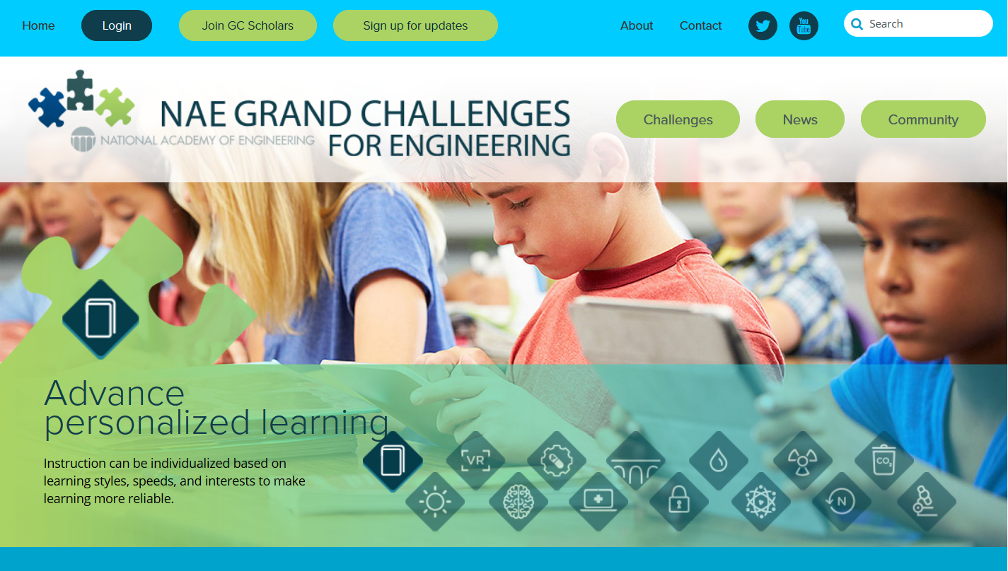
Background: Advanced Personalized Learning
http://engineeringchallenges.org/challenges/learning.aspx

Slide 4
Background: Advanced Personalized Learning

Slide 5
Background
Intelligent Tutoring Systems (ITS)
Advanced Personalized Learning Systems (APLS)

Slide 6
Background: Intelligent Tutoring Systems (ITS)

Slide 7
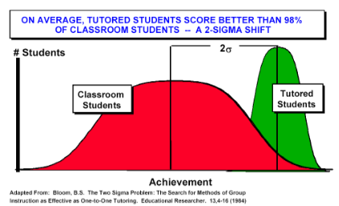
Background: Intelligent Tutoring Systems (ITS)
Bloom, B. S. (1984). The 2 sigma problem: the search for methods of group instruction as effective as one-to-one tutoring. Educational Researcher, 13(6), 4-16.

Slide 8
Background: Intelligent Tutoring Systems (ITS)

Slide 9
Background
Intelligent Tutoring Systems (ITS)
Advanced Personalized Learning Systems (APLS)
Adaptive Instructional System (AIS)

Slide 10
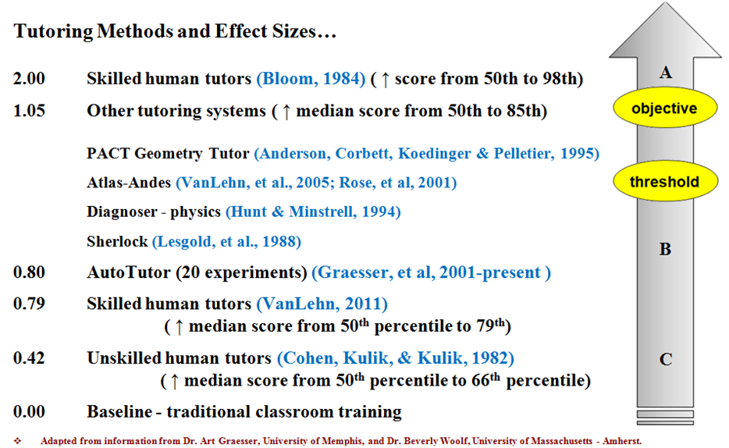

Slide 11
Extremely hard to produce.
self-improve?
Disappeared (Out-dated)

Slide 12
Self-Improvable Adaptive Instructional Systems
SIAIS

Slide 13
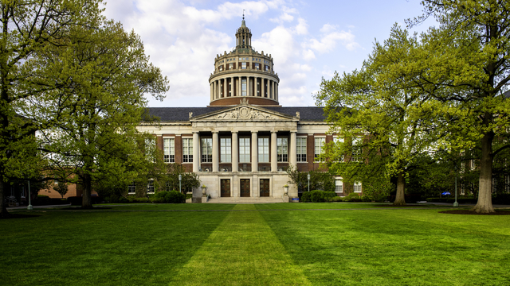
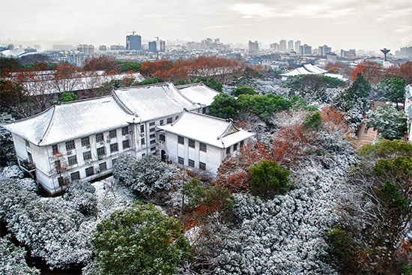
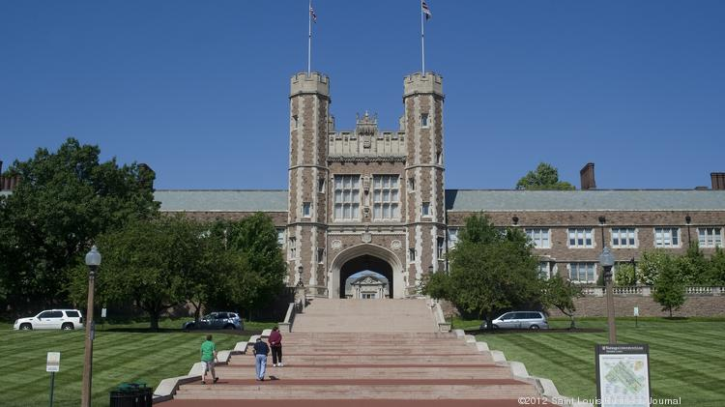
SIAIS in general Sense
Example of Learning Systems

Slide 14
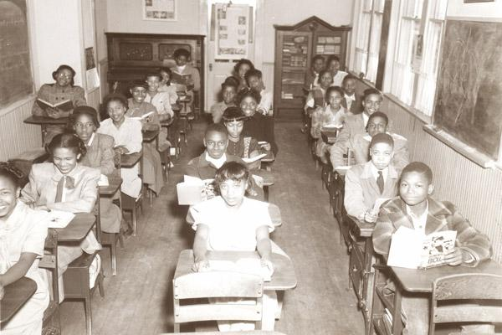
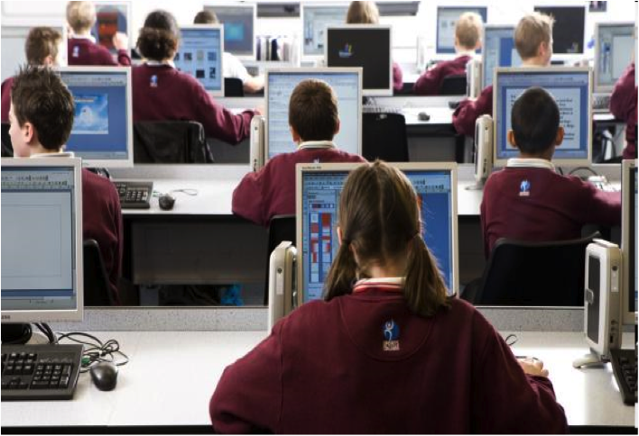
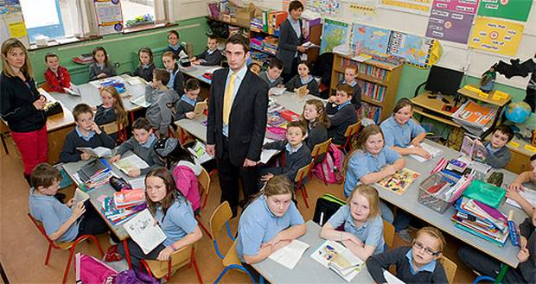
SIAIS in general Sense
Example of Learning Systems
All Learning Systems as whole are SILS
Innovations of the generations

Slide 15
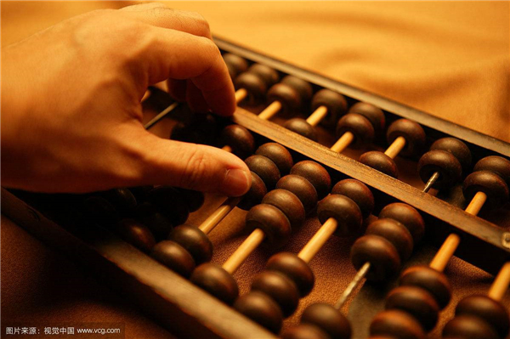
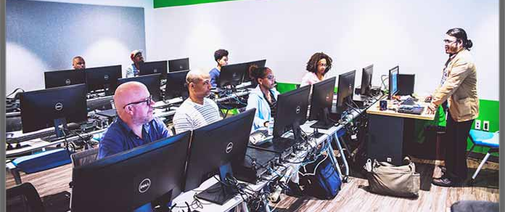
SIAIS in general Sense
Example of Learning Systems
All Learning Systems as whole are SILS
Innovations of the generations

Slide 16
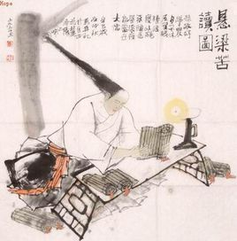
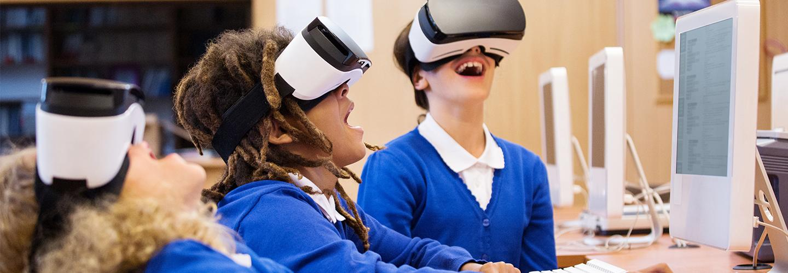
SIAIS in general Sense
Example of Learning Systems
All Learning Systems as whole are SILS
Innovations of the generations

Slide 17
SIAIS in general Sense
Example of Learning Systems
All Learning Systems as whole are SILS
Innovations of the generations
Improving in different paces

Slide 18
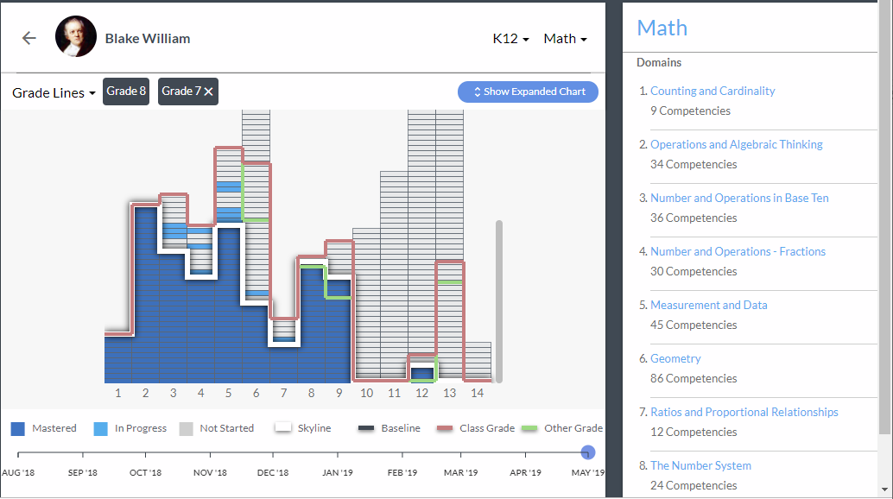
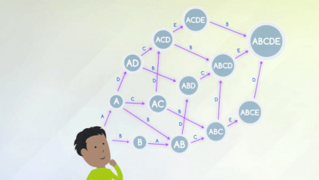
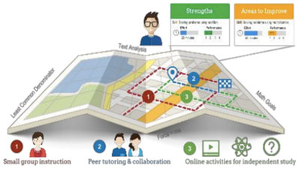
SIAIS in today’s context

Slide 19
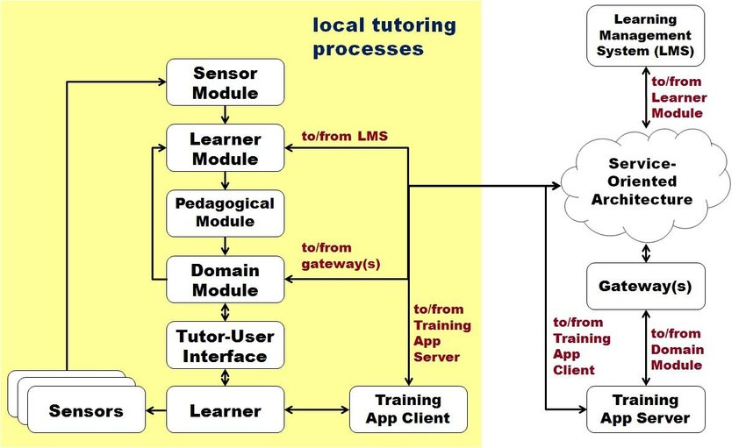
SIAIS in today’s context

Slide 20
SIAIS in today’s context
Self-Improvable Components of Learning Systems
Human Learners
Learning Environments,
Learning Processes
Learning Resources

Slide 21
SIAIS in today’s context
Self-Improvable Components of Learning Systems
Human Learners
Learning Environments,
Learning Processes
Learning Resources

Slide 22
SIAIS in today’s context
Self-Improvable Components of Learning Systems
Human Learners
Learning Environments,
Learning Processes
Learning Resources

Slide 23
SIAIS in today’s context
Self-Improvable Components of Learning Systems
Human Learners
Learning Environments,
Learning Processes
Learning Resources
Human resource: teachers, study mates, etc.
Physical resources: schools, laboratories, books, computer hardware
Digital Resources: online contents, software, etc.

Slide 24
SIAIS in today’s context
Self-Improvable Components of Learning Systems
Human Learners
Learning Environments,
Learning Processes
Learning Resources
Human resource: teachers, study mates, etc.
Physical resources: schools, laboratories, books, computer hardware
Digital Resources: online contents, software, etc.

Slide 25
SILS in today’s context
Self-Improvable Components of Learning Systems
Human Learners
Learning Environments,
Learning Processes
Learning Resources
Human resource: teachers, study mates, etc.
Physical resources: schools, laboratories, books, computer hardware
Digital Resources: online contents, software, etc.
Static digital contents: recorded lectures, non-interactive media, etc.
Dynamic contents: educational games, intelligent tutoring systems, etc.

Slide 26
SIAIS in today’s context
Self-Improvable Components of Learning Systems
Human Learners
Learning Environments,
Learning Processes
Learning Resources
Human resource: teachers, study mates, etc.
Physical resources: schools, laboratories, books, computer hardware
Digital Resources: online contents, software, etc.
Static digital contents: recorded lectures, non-interactive media, etc.
Dynamic contents: educational games, intelligent tutoring systems, etc.

Slide 27
SILS in today’s context
Self-Improvable Components of Learning Systems
Human Learners
Learning Environments,
Learning Processes
Learning Resources
Human resource: teachers, study mates, etc.
Physical resources: schools, laboratories, books, computer hardware
Digital Resources: online contents, software, etc.
Static digital contents: recorded lectures, non-interactive media, etc.
Dynamic contents: educational games, intelligent tutoring systems, etc.

Slide 28
SIAIS in today’s context
Self-Improvable Components of Learning Systems
Human Learners
Learning Environments,
Learning Processes
Learning Resources
Human resource: teachers, study mates, etc.
Physical resources: schools, laboratories, books, computer hardware
Digital Resources: online contents, software, etc.
Static digital contents: recorded lectures, non-interactive media, etc.
Dynamic contents: educational games, intelligent tutoring systems, etc.

Slide 29
SIAIS in today’s context
Human Learners
Learning Environments
Self-Improvable Components of Learning Systems
Human Learners
Learning Environments,
Learning Processes
Learning Resources
Human resource: teachers, study mates, etc.
Physical resources: schools, laboratories, books, computer hardware
Digital Resources: online contents, software, etc.
Static digital contents: recorded lectures, non-interactive media, etc.
Dynamic contents: educational games, intelligent tutoring systems, etc.
Self-improvable learning resources
Learning Processes

Slide 30
SIAIS in today’s context
Human Learners
Self-Improvable Components of Learning Systems
Human Learners
Learning Environments,
Learning Processes
Learning Resources
Human resource: teachers, study mates, etc.
Physical resources: schools, laboratories, books, computer hardware
Digital Resources: online contents, software, etc.
Static digital contents: recorded lectures, non-interactive media, etc.
Dynamic contents: educational games, intelligent tutoring systems, etc.
Self-improvable learning resources

Slide 31
A model for SIAIS

Slide 32
A model for SIAIS with four components
Human Learners
Learning Environments
Self-improvable learning resources
Learning Processes

Slide 33
An inspiring Example from IRT
N learner, M problems:
Parameters:
Ability of the learners
Difficulty of the problems
Rasch Model:

Slide 34
An inspiring Example from IRT
Mathematically, P and Q are “symmetric”

Slide 35
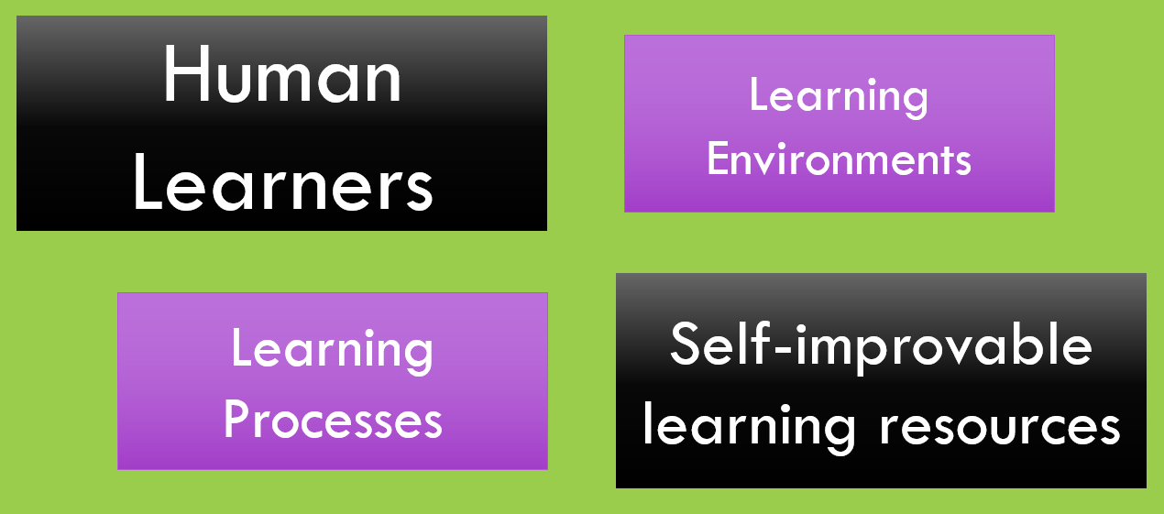
An inspiring Example from IRT
Mathematically, P and Q are “symmetric”

Slide 36
An inspiring Example from IRT
Mathematically, P and Q are “symmetric”
Consider Self-improvable learning resources as Q

Slide 37
A model for SIAIS with four components
A model for SILS where Human Learners and Self-improvable learning resources are mathematically symmetric

Slide 38
A model for SIAIS with four components
The “Symmetric Model” implies
All research (technique, methods, analysis) on human learners are applicable to applicable to Self-improvable learning resources.
Study the behavior of Self-improvable learning resources.

Slide 39
A model for SIAIS with four components
Human learners are special components in SIAIS that is assumed constantly self-improving (i.e., learning).
Self-improvable learning resources are human resources (trainers/teachers, for example) and some digital resources such as digital tutors. They can change (improving) constantly.
Learning environments are the diverse physical or virtual locations, contexts, and cultures in which students learn.
Learning processes are the instructional sequence for any given domain for a particular learner groups (such as grades).

Slide 40
A model for SIAIS with four components
Human Learners and Self-improvable learning resources are symmetric in the context of learning environments and processes
Fundamental Assumption
For each human learner, there exist individualized Self-improvable learning resources and learning environments and learning processes, so the learning for the human learner is optimized

Slide 41
A model for SIAIS with four components
Human Learners and Self-improvable learning resources are symmetric in the context of learning environments and processes
Research & Development Framework
Human Learners : Change Knowledge Structure: Learn and Improve
Self-improvable learning resources : Knowledge Object: Learn and Improve

Slide 42
A model for SIAIS with four components
Human Learners and Self-improvable learning resources are symmetric in the context of learning environments and processes
Current Research Focus
Interaction Mechanism between Human Learners and Self-improvable learning resources as function of learners, contents, environments, and processes.

Slide 43
Self-Improvable Learning resources
Existence of “master” memory (Data Store) that capture system behavior.
Existence of variable controllable components.
APIs that connect variable controllable components with Data Store
A collection of ideal (effective and efficient) tutoring strategies to guide use of the APIs

Slide 44
Self-Improvable Learning resources
Existence of “master” memory (Data Store) that capture system behavior.
Existence of variable controllable components.
APIs that connect variable controllable components with Data Store
A collection of ideal (effective and efficient) tutoring strategies to guide use of the APIs

Slide 45
Self-Improvable Learning resources
Existence of “master” memory (Data Store) that capture system behavior.
Existence of variable controllable components.
APIs that connect variable controllable components with Data Store
A collection of ideal (effective and efficient) tutoring strategies to guide use of the APIs

Slide 46
Self-Improvable Learning resources
Existence of “master” memory (Data Store) that capture system behavior.
Existence of variable controllable components.
APIs that connect variable controllable components with Data Store
A collection of ideal (effective and efficient) tutoring strategies to guide use of the APIs

Slide 47
Self-Improvable Learning resources
Existence of “master” memory (Data Store) that capture system behavior.
Existence of variable controllable components.
APIs that connect variable controllable components with Data Store
A collection of ideal (effective and efficient) tutoring strategies to guide use of the APIs

Slide 48
GIFT ITS are self-improvable
Connecting to LRS

Slide 49
GIFT ITS are self-improvable
Connecting to LRS
Modular design with individually controllable components
Domain knowledge file (DKF)
Learner Configuration File
SensorConfigurationFile
PedagogicalConfigurationFile
common.properties

Slide 50
GIFT ITS are self-improvable
Existence of “master” memory (Data Store) that capture system behavior.
Existence of variable controllable components.
APIs that connect variable controllable components with Data Store
A collection of ideal (effective and efficient) tutoring strategies to guide use of the APIs

Slide 51
GIFT ITS are self-improvable
Existence of “master” memory (Data Store) that capture system behavior.
Existence of variable controllable components.
APIs that connect variable controllable components with Data Store
A collection of ideal (effective and efficient) tutoring strategies to guide use of the APIs

Slide 52
GIFT ITS are self-improvable
Existence of “master” memory (Data Store) that capture system behavior.
Existence of variable controllable components.
APIs that connect variable controllable components with Data Store
A collection of ideal (effective and efficient) tutoring strategies to guide use of the APIs
self-improvability

Slide 53
Making GIFT ITS self-improving?
Existence of “master” memory (Data Store) that capture system behavior.
Existence of variable controllable components.
APIs that connect variable controllable components with Data Store
A collection of ideal (effective and efficient) tutoring strategies to guide use of the APIs

Slide 54
Questions?
xhu@memphis.edu
xiangenhu@gmail.com

