Slide 1
Intelligent, Adaptive Training in The Synthetic Training Environment
Gregory A. Goodwin
Approved for Public Release: Distribution Unlimited
Senior Research Scientist
CCDC-SC-STTC
17 MAY 2019

Slide 2
The Problem
“As Is”
1980s technology – limits ability to train Combined Arms operations
57 terrain formats
Concurrency challenges and not designed to meet compliancy directives
Facilities-based TADSS
High overhead and long exercise lead times
Stove pipe systems
Requires increased resources
for TADSS
Cannot replicate the Operational Environment
No Joint/UA integration
1ID Danger Focus
“To Be”
Common Synthetic Environment that fully enables Combined Arms maneuver in a multi-domain environment
Dynamic one-world terrain Software-enabled updates
Less fixed infrastructure reliance –
point of need delivery
Fewer contractors, less hardware, &
faster exercise design
Reconfigurable trainers
Uses ongoing commercial innovation
for updates
Full replication of the Operational Environment
Joint and Unified Action (UA) integration
ITE Terrain formats
Virtual: 29
Constructive: 28
Simplify Process
Integration to Convergence
7
7

Slide 3
STE Framework
SOLDIERS AND LEADERS - OUR ASYMMETRIC ADVANTAGE
Mission Command Information Systems (MCIS)
Temporary Interface to
Legacy Systems
(LVC-IA)
Synthetic Training Environment (STE)
Common Synthetic Environment (CSE)
Training Management Tool (TMT)
Big Data, Intelligent Tutors, Training Effectiveness, Human Dimension
Global Terrain
Standard, Shareable Geospatial Foundation
Training Simulation Software (TSS)
“the engine”
Scale & Entity Count Open Software PoN / Network Virtual Humans / AI
Plan Prepare* Execute Assess
*Includes OE/Red Force
Virtual Semi- Immersive
User Interface and Hardware
Virtual Immersive User Interface and Hardware Mixed Reality Haptics Physiological Affects Simulator Sickness Reconfigurable Transportable
S/SVT | Reconfigurable Virtual Collective Trainers
Staff Training User Interface and Hardware
Live TADSS
For example, HITS, MILES
Authoritative Data Sources
For example, JLCCTC
For example, VBS3
For example, Army Training Information System (ATIS)

Slide 4
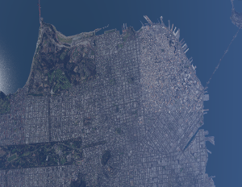
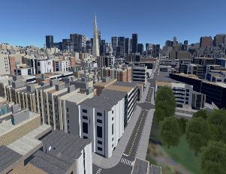
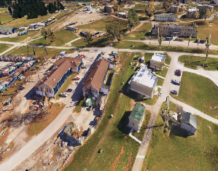
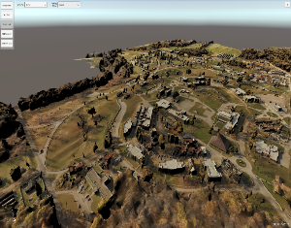
One World Terrain
Cloud-based service that delivers a common synthetic representation of the whole Earth
Includes air, land (subterranean), sea (undersea), space (up to geosynchronous), and cyber domains
The ability to export 3D mesh-based terrain to 2D vector- and raster-based terrain systems
Includes dynamic terrain capabilities

Slide 5
Reconfigurable Virtual Collective Trainers
Future Virtual Interfaces
Software-centric, Capitalize on Commercial Technology, Reconfigurable, Low Sustainment $$, One World Terrain, Common Synthetic Environment, Scalable Interfaces – Point of Need, Responsive to Updates – Most will take place with software changes, Transportable, OFP for AVN Platforms
Minimal Hardware – Virtual Reality
Common One World Terrain Virtual Environment
High Fidelity Interactive Virtual Models

Slide 6
Soldier/Squad Virtual Trainer

Slide 7
Integrated Visual Augmentation System (IVAS)

Slide 8
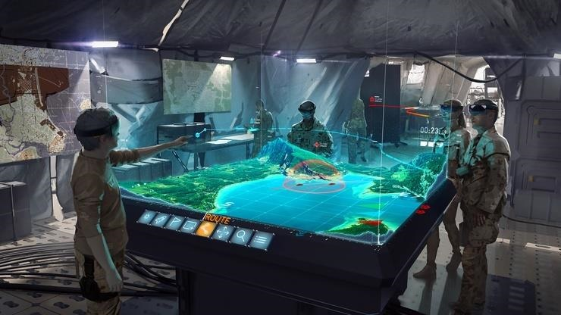
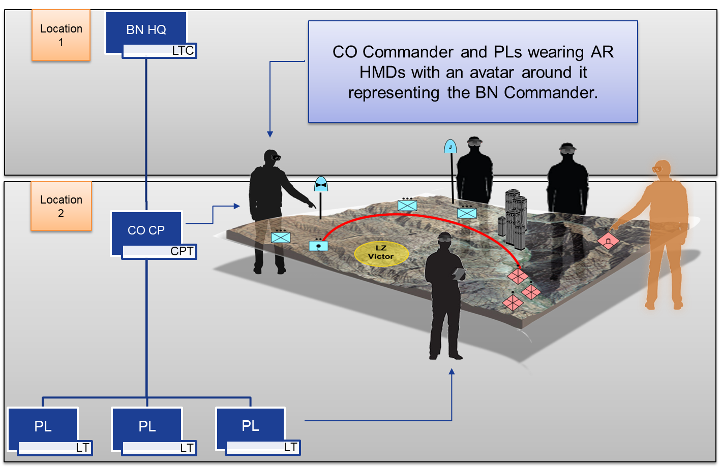
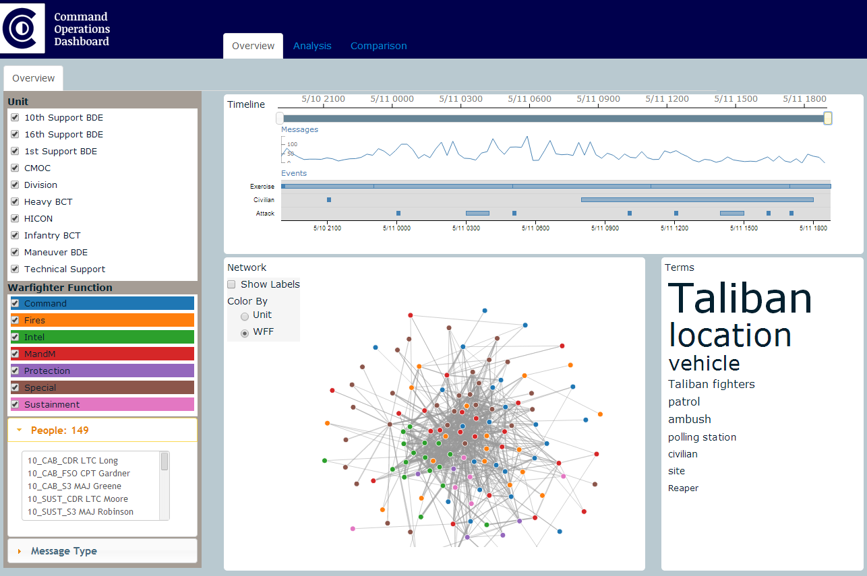
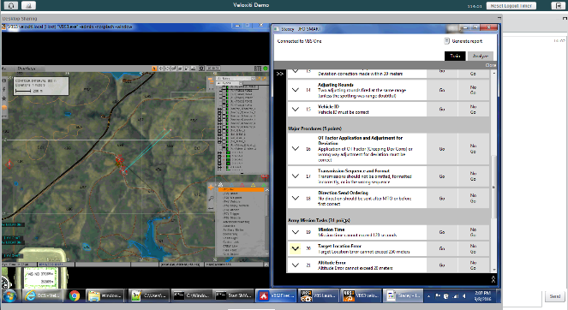
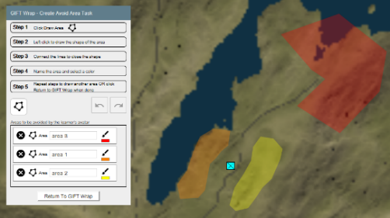
TMT vision
An intuitive easy to use capability that allows Commanders and Exercises Developers to efficiently plan, prepare, execute, and assess training
A tool that automatically retrieves and transforms authoritative data
Automatically generate and populate simulation inputs (databases)
Provides intelligent tutor capabilities
Provides methodologies to assess training effectiveness
Interface with all virtual, constructive and live training systems

Slide 9
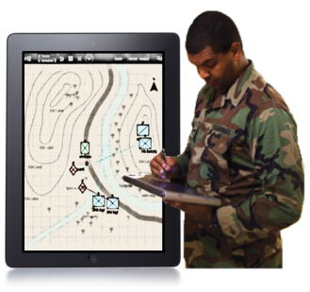
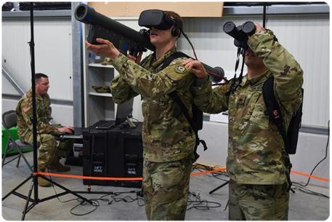
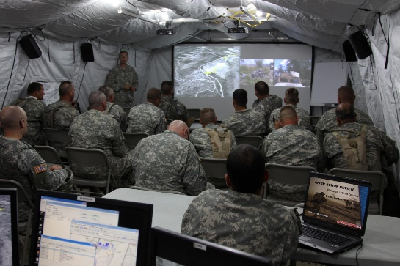
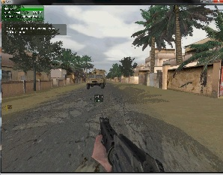
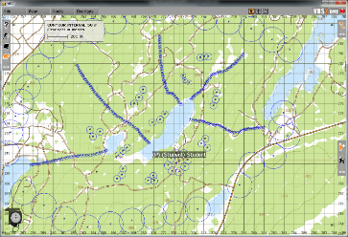
TMT Core Capabilities
PLAN
PREPARE
TRAINING EXECUTION
ASSESS
TMT Phase
Capability
Tailored Scenario Generation
Real-time Feedback and Adaptation
Rapid Assessment and AAR
Automated Performance Assessment for Individual and Teams
Automated Feedback and AAR for Individuals and Teams
Supporting Tech.
Intelligent, Adaptive Training for Individuals and Teams

Slide 10
Automated Performance Assessment for Teams
What is it & why does it matter?
STE’s team performance assessments need to be GENERALIZABLE.
Teamwork assessments need to be automatically collected during scenario execution and diagnosed in real time.
Event-based automated teamwork assessments increase quantity, quality and type of feedback, AAR, and training adaptation possible.
What is available from govt/industry/academia?
Current collective training assessments for simulations are SUBJECTIVE, GO/NO-GO hand-held checklists.
These limit the training effectiveness of AARs that can improve team performance, and tracking/documenting training effectiveness of simulations over time.
Drives up the cost of labor for Observer/Controllers to run the assessments.
What are the S&T challenges?
Natural Language Processing for Team Assessments.
Methods for developing valid generalizable assessments in complex scenarios developed with SME input.
Rapidly contextualizing interaction and communication data within a set of scenario tasks/conditions/standards.
Tracking teams across scenarios and domain spaces through persistent modeling techniques.
Deriving data sources that inform team communication protocols void of natural language (gestures and signaling).

Slide 11
Automated Feedback and AAR for Teams
What is it & why does it matter?
Providing data that is too raw or granular does not support learning. Assessment entails interpreting data to learners/trainees so that they understand their mistakes through effective AARs.
Automated real-time feedback for teams with little or no experience and objective, validated performance assessment to enable rapid AAR at any point of need.
Enables rapid identification of key scenario events relevant to conduct the AAR.
What is available from govt/industry/academia?
Current AAR systems can automatically generate Powerpoint charts and provide recordings (with playback/pause) that can be bookmarked by SME’s.
Data/Metrics require significant work to analyze and summarize.
Systems lack an automated objective team assessment capability.
What are the S&T challenges?
Data Visualization for Team Performance
Personalizing feedback across the roles and tasks performed within a team structure
Tailoring feedback based on team skill acquisition over time.
Establishing a pedagogical strategy for managing real-time instructional support versus AAR and post-exercise remediation.

Slide 12
Intelligent Adaptive Training for Teams
What is it & why does it matter?
The ability to automatically adapt training difficulty, provide prompts, recommend remedial training to enable teams to achieve training goals effectively and efficiently.
Current approaches to adapting collective training events require a great deal of preparation and control by human trainers. This level of support is available at large simulation training centers. AI based adaptive training will enable STE to have this capability at any point of need.
What is available from govt/industry/academia?
Individual tutoring systems for specific to domains/skills. These are very expensive to build.
Few team tutors exist (e.g., collaborative problem solving).
Only rudimentary tutoring systems exist for military teams.
What are the S&T challenges?
Creation of domain independent tutoring systems that are flexible enough to work across team types, sizes, and missions.
Pedagogical models that can determine optimal feedback and interventions at both individual and team levels to produce effective training.
Selecting an optimal training strategy and scenario based on team needs (varying based on echelon structure).

Slide 13
Research Goals
Visualization of real-time team performance for exercise control
Visualization of projected training outcomes.
Visualization of battlefield effects (e.g., cyber, kinetic, non-kinetic) on physical, social, cultural, etc. elements of OWT.
Tools for rapid creation of AAR
Management of information complexity during execution
Exercise control tools/interfaces for training managers
Visualization of projected impact of scenario adaptation on training outcomes.
xAPI formats for reporting Team performance
TMT TESTBED
Data requirements for TSS to support TMT analysis, visualization, feedback and scenario adaptation
MR Visualization
Adaptive Training
Persistent competency frameworks for military teams
Policies for automating real-time scenario adaptation/injects
Techniques for automating assessments for Armored PLTs
Techniques for automating assessments for BN-BDE CP teams
Techniques for automating assessments for dismounted squads
NLP for team verbal comms
Policies for automated feedback to individuals vs teams
Automated AAR for diverse teams/missions

Slide 14
Questions?

