Slide 1
Integrating GIFT, Competencies, Virtual Reality, and Biometrics to Present Training Perspectives on Gauging Current Squad Capability
May 17 – GIFTSym7 – Day 2
GIFTSym7 - Paper #17 Presentation

Slide 2
Presentation Outline
Author and Presenter Introduction
Zach Heylmun, Mike Kalaf, Chris Meyer, Christofer Padilla, Lucy Woodman
Project Summary
Project Details
GIFT, CASS, Communication Servers, VR, and IOT Devices
New GIFT Adaptive Tutoring Principals
Conclusions and Future Work
DIY References and Contact Information
Notes:
Work for Synaptic Sparks and Dignitas Technologies, Local Orlando Nonprofit and Small Business
Presenters today will be Lucy Woodman explaining the project as a whole and
Christofer Padilla who will explain how GIFT Adaptive Tutoring can be applied today and in the future
Volunteer effort from companies in support of GIFT

Slide 3
Presentation Outline
Author and Presenter Introduction
Zach Heylmun, Mike Kalaf, Chris Meyer, Christofer Padilla, Lucy Woodman
Project Summary
Project Details
GIFT, CASS, Communication Servers, VR, and IOT Devices
New GIFT Adaptive Tutoring Principals
Conclusions and Future Work
DIY References and Contact Information

Slide 4
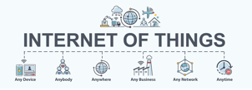
Project Summary
Goals
Demonstrate GIFT Acting as an ITS in a Distributed System of Systems
Includes ADL CASS web service, Mosquitto/MQTT server device, VR training scenario, and IOT devices
Intelligent Tutoring System
Local or Virtual Machine
Maintains its own ActiveMQ server and services
Accessible (MQTT) Server
Lightweight Messaging
No special processing – may be replaced quickly
Competency Database
VR Training
Low-cost Sensor and Indicator Devices
Etc.
Notes:
Authors wanted to further prove that these interfaces are not only possible, but easy to implement with new IOT advances.
GIFT Maintains its own ActiveMQ Server.
By distributing communications, allows each node to bring up or down its own services with its own PC/VM configurations
GIFT already has interfaces to many applications it launches as part of an authored course, but it can also communicate in the diagram’d fashion.
And development team can always add direct support for any specific customer need such as Virtual Battle Space or Unity WebGL that are already GIFT Course Objects.

Slide 5
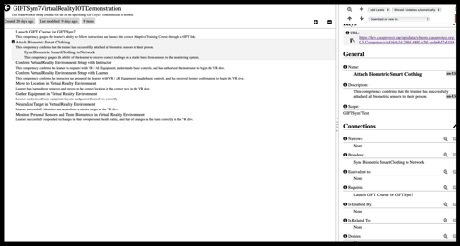
Project Summary
Goals
Further Develop Interfaces for Systems Communicating with GIFT
Additional REST web service calls to access online CASS test server
https://cassproject.github.io/cass-editor/
Notes:
Able to read in CASS Competencies
Wanted to do this for GIFT to be able to read in relevant competency metadata to be able to tag GIFT training content for better adaptation and potentially LRS/LMS integration
ADL CASS Team has a test server at https://cassproject.github.io/cass-editor/

Slide 6
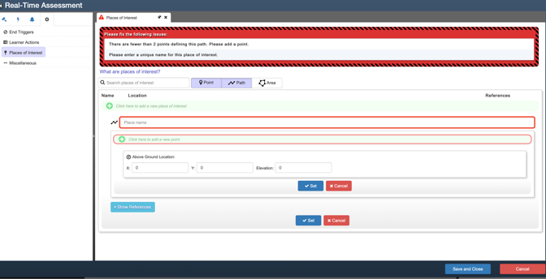
Project Summary
Goals
Showcase Additional Use Cases for GIFT Adaptive Training and Real Time Assessment
Notes:
Connecting GIFT with more systems allows for even more robust frameworks that the community can use to experiment with
GIFT can already connect to many VBS events, and there are several precanned events in Unity WebGL apps that GIFT can be hooked to if a Unity WebGL build is included as part of a GIFT course
Christofer will cover more detail on this topic later

Slide 7
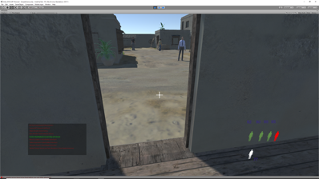
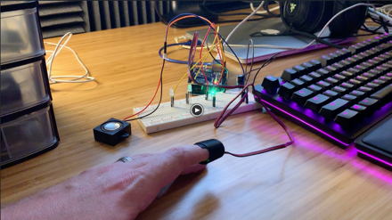
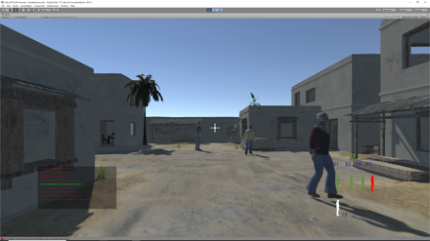
Project Summary
Goals
Explore Opportunities to Extend GIFT Functionality to Process and/or Provide Simultaneous Multiuser Experiences
Notes:
By linking “Multiplayer” systems and sensors and indicators to flexible platforms, it becomes possible for GIFT to not only launch simultaneous single trainee experiences, which it does today,
but possibly (in the future) have results from one trainee impact another from within a course, not just in a hypothetical simulated environment
Didn’t fully make the multiplayer course goal in this volunteer project, but that is a HUGE amount of effort and we just wanted to prove at least the other systems could all talk to each other over multiple instances aka many Unity worlds all running at once but talking to the same server, basic multiplayer nothing special
Most game engines enable multiplayer scenarios easily, the trick is hooking that part up to everything else we’re discussing

Slide 8
Presentation Outline
Author and Presenter Introduction
Zach Heylmun, Mike Kalaf, Chris Meyer, Christofer Padilla, Lucy Woodman
Project Summary
Project Details
GIFT, CASS, Communication Servers, VR, and IOT Devices
New GIFT Adaptive Tutoring Principals
Conclusions and Future Work
DIY References and Contact Information

Slide 9
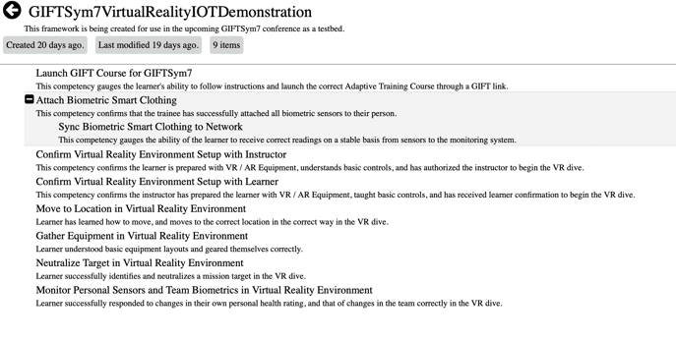
PROJECT DETAILS
ADL CASS Competencies for GIFTSym7 Prototype
Comment for Group: GIFT Team to Add a CASS Server to AWS? Value to Community?
Notes:
Competencies allow for metatagging multiple entities – these are some samples
Learners and their progress towards goals (needs an LMS or LRS)
GIFT as an ITS, and its Adaptive Ability combined with its Courses and their topics/concepts (when and what relevance can we tag content with to better teach learners?)
Course Content or VR Scenarios and their focus (what are we trying to provide training value on?)
IOT Devices and their purpose (why and what are we measuring)
All of these elements together bubble up to helping to evaluate Squad Lethality, an Army Modernization Priority

Slide 10
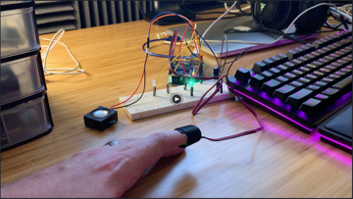
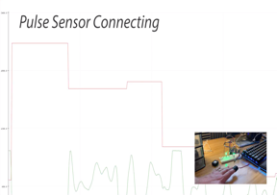
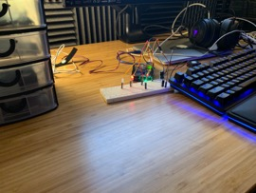
PROJECT DETAILS
IOT Devices (Sensors and Indicators)
LEDs – Visual Indicators of Progress, Danger, Heartrate
Pulse Sensor – Cheap, but Effective When Operational
Haptic Motors – Turns Sensation of Touch into Information
Notes:
IOT Framework
The IOT evolution of technology is taking your average COTS device and providing enough computational power and communication ability to mix these devices in easily to modern software
GIFT has an External Sensor capability that can read in data directly if sensors are plugged into a course
However, we had sensors/the Arduino board communicating their data to a pub/sub server, Mosquitto, that then could send information to GIFT AND every other source subscribed to the message.
This is the essence of a distributed system and how IOT devices fit in.

Slide 11
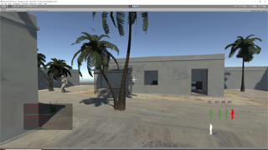
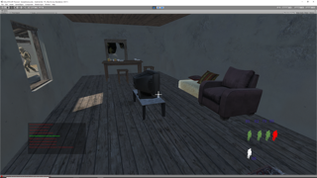
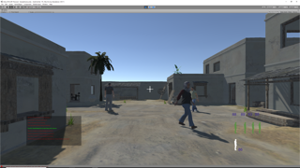
PROJECT DETAILS
Unity Scenario
CASS Goals Hardcoded for Simplicity
Proved UnityWebRequest /REST calls from GIFT can dynamically access CASS data
Biometrics Data Passed to Mosquitto Server
Messages *sometimes* made it to or from sensors – would require more powerful server and safety critical pub/sub
Notes:
Can talk about configuration of scenario, linkages to GIFT through messaging, events, and the GIFT UnityWebGL Course Object in the GIFT Authoring Tool
This Scenario had VR at some point, but if asked we can let them know we just needed to add it back in to this final version using the Vive VR Headset and Controller Libraries
CASS Goals, just like Quests in a video game, can be objectives and acquired masteries. As much guidance could be given as necessary based on inputs and assessments from GIFT.
You can tell them messages needed some work to make safety-critical, but we can represent “Competency Progress” any way the community sees fit. Squad health is the last topic to cover – simulated pulse rates and status of team members was mocked up in the HUD with the bottom right picture.
Very easy to add in monitoring of multiple systems across squads of trainees – all a matter of creating a reliable pipeline of data and training on how to use it with an ITS like GIFT.

Slide 12
Presentation Outline
Author and Presenter Introduction
Zach Heylmun, Mike Kalaf, Chris Meyer, Christofer Padilla, Lucy Woodman
Project Summary
Project Details
GIFT, CASS, Communication Servers, VR, and IOT Devices
New GIFT Adaptive Tutoring Principals
Conclusions and Future Work
DIY References and Contact Information

Slide 13
New GIFT Adaptive Tutoring Principles
Current GIFT Capabilities with Training Scenarios
Assessments, Tasks, Concepts, Conditions, Transitions, Strategies
Notes:
Great slide for Christofer to reiterate all the items that GIFT already covers, then
Next slide tells where it *could* go

Slide 14
New GIFT Adaptive Tutoring Principles
Future GIFT Capabilities with Training Scenarios and Adaptive Training
Individual and Squad Assessments
Competencies / Masteries and Gauging Squad Lethality as a Modernization Priority
Training Tailored and Adapting to Individual / Squad Needs
Courses Containing a “Game Master” Controller in the GIFT Environment
Multiplayer Assessments with Tailored Training Content in a Real-Time Experiment
Notes:
Basically trying to convey everything Chris and Chris talked about in the SSI / Escape Room offices

Slide 15
Presentation Outline
Author and Presenter Introduction
Zach Heylmun, Mike Kalaf, Chris Meyer, Christofer Padilla, Lucy Woodman
Project Summary
Project Details
GIFT, CASS, Communication Servers, VR, and IOT Devices
New GIFT Adaptive Tutoring Principals
Conclusions and Future Work
DIY References and Contact Information

Slide 16
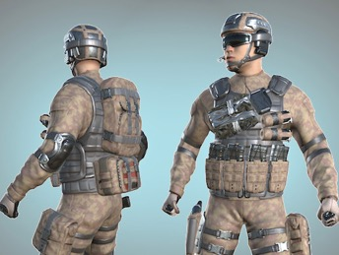
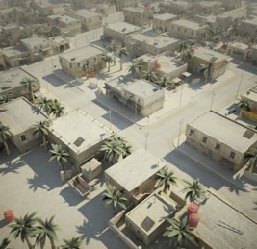
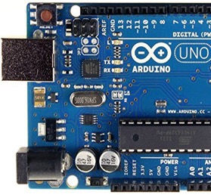
Conclusions and Future Work
Completed Breadth-First Integration Between:
GIFT
CASS
New Communication Server
IOT Devices
Unity External Application
Notes:
Back to Lucy probably?
Talk about all the different topics that got covered, probably not much time left at this point
All will be made available to the public as the GIFT team continues working with us

Slide 17
Presentation Outline
Author and Presenter Introduction
Zach Heylmun, Mike Kalaf, Chris Meyer, Christofer Padilla, Lucy Woodman
Project Summary
Project Details
GIFT, CASS, Communication Servers, VR, and IOT Devices
New GIFT Adaptive Tutoring Principals
Conclusions and Future Work
DIY References and Contact Information

Slide 18
Project Links
www.gifttutoring.org
https://unity.com
https://www.vive.com/us/
Speakers:https://www.deviceplus.com/how-tos/arduino-guide/entry019/
LEDs:https://www.deviceplus.com/how-tos/arduino-guide/entry_002/
Long_Range_Communication:https://www.deviceplus.com/how-tos/arduino-guide/arduino-long-range-communication-tutorial-lorenz-shield/
Pulse_Sensor:https://pulsesensor.com/pages/installing-our-playground-for-pulsesensor-Arduino
https://test.mosquitto.org/

Slide 19
CASS Project Links
Member of SLACK Chat
https://cassproject.slack.com/
GitHub Repo Links
https://github.com/cassproject/schema.cassproject.org
https://github.com/cassproject/docs.cassproject.org
https://github.com/cassproject/devs.cassproject.org
CASS Sandbox Instances (Requires Account)
https://docs.google.com/a/eduworks.com/forms/viewform?bc=transparent&embedded=true&f=Arial%252C%2BVerdana%252C%2Bsans-serif&hl=en&htc=%2523666666&id=1BMaboapV0IaS8iGnCJut2obPZ9y3CWkxXuvy-7krcgE&lc=%2523003965&pli=1&tc=%2523444444&ttl=0
https://sandbox.cassproject.org/
https://dev.cassproject.org/

Slide 20
Questions and Comments

