Slide 1

Learner Modeling of Cognitive and Psychomotor Processes for Dismounted Battle Drills
Gautam Biswas¹, shitanshu mishra¹, naveed mohammed¹, & Ben Goldberg²
¹Vanderbilt University &
²U.S. Army Combat Capabilities Development Command
SOLDIER CENTER
supported by funds from ARL grant number W911NF-14-2-0050 & W911NF-18-2-0081

Slide 2
Outline
Situate learner modeling in Learning Environments
Shift to Team Training – Battle Drills
Coordinated Movement – focus on psychomotor skills
  Changes modalities for sensing and measurement
Case study: Enter and Clear Room
Team Training – SAM-T + GIFT: Architecture
Metrics for performance and effectiveness
Learner Modeling for Team Training

Slide 3
Learner Modeling for Traditional Learning Environments (Tutors)
Cognitive skills – linked to learner’s observable actions through which they can accomplish subtasks and tasks toward achieving their overall problem solving goal
Strategies - Conditional – describe when individual actions (cognitive skills) or sequences of actions (skills) need to be invoked to work toward a problem solving task
Metacognitive processes – covers goal setting, planning, awareness, monitoring, evaluation and reflection

Slide 4
Learner Modeling for Training in Complex Decision Making
Our previous work on UrbanSim – decision making in counterterrorism operations (Biswas, et al., 2019, in review)
Cognitive skills
Strategies
    Situation Awareness
    Tradeoff Analysis
    Second and Third Order Effects
  Metacognitive processes

Slide 5
Learner Modeling for Training in Complex Decision Making
Strategies
  Situation Awareness − ability to identify and interpret key information in the regions of interest and develop a common operating picture (COP)
  Tradeoff Analysis − systematic approach to comparing alternatives and selecting the most effective operations when resources are limited
  Second and Third Order Effects − looking ahead to determine the consequences of actions by performing mental simulations, and analyzing the direct and indirect effects these operations may have on future

Slide 6
Learner Modeling for Training of Battle Drills in Synthetic Training Environments
Training of soldiers (infantrymen) in individual and team skills
  Primary focus on mounted and dismounted battle drills
Battle Drill
  Infantry battle drill describes how platoons and squads apply fire and maneuver to commonly encountered situations
  A collective action rapidly executed without applying a deliberate decision-making process
Army Battle Drills
  BATTLE DRILL 1. PLATOON ATTACK.
  BATTLE DRILL 1A. SQUAD ATTACK.
  BATTLE DRILL 2. REACT TO CONTACT.
  BATTLE DRILL 3. BREAK CONTACT.
  BATTLE DRILL 4. REACT TO AMBUSH.
  BATTLE DRILL 5. KNOCK OUT BUNKERS.
  BATTLE DRILL 6. ENTER BUILDING/CLEAR ROOM.

Slide 7
Training of Battle Drills in Synthetic Training Environments
What is different?
Individual skills + team training exercises
  Sinatra, et al., 2018: “team’s execution of coordinated movement is a critical factor for success in these high performance and high stress environments”
  Salas, et al., 2015: guiding principle for effective team training – ensure individual skills are developed first, then train and develop teamwork skills
  Individual marksmanship training must precede any of the battle drills (team-oriented)

Slide 8
Learner Modeling for Training of Battle Drills in Synthetic Training Environments
What is different?
Still require
  Cognitive, Strategic, and Metacognitive processes
But the requirement for coordinated movement requires
  Psychomotor skills – pertain to “physical skills such as movement, coordination, manipulation, dexterity, grace, strength, speed—actions which demonstrate the fine or gross motor skills”
  Measured by accuracy and speed (reaction time)
In reality there is a dependency between execution of psychomotor processes cognitive skills, and affect

Slide 9
Case Study: Training for Battle Drill 6: Enter and Clear a Room
Battle Drill 6 involves a larger goal – secure area and surroundings of building where enemy combatants are assumed to be present – involves platoons
Enter building and clear rooms with enemy combatants – involves squads and a squad leader
Our focus: Enter and clear a room – involves a squad (+ squad leader and backup squad)
Squad (team of 4) conducting operations in a live training environment – receives order to clear a room; enemy combatants and non combatants in building (room)
Drill begins with order from squad leader to enter an clear the room

Slide 10
Enter and Clear Room
Five major task segments (Sinatra, et al., 2018)
  Prepare to Enter
    Squad leader position; secure corridors
  Enter the Room
    Team leader (#2, or #3 soldier) gives command; method of entry
  Clear the Room
  Secure the Room
    Threats neutralized, non combatants secured; announce CLEAR
  Completion and move on to next assigned operation
    Squad leader assessment, report to team leader, sustainability of next steps, reload; mark entry point

Slide 11
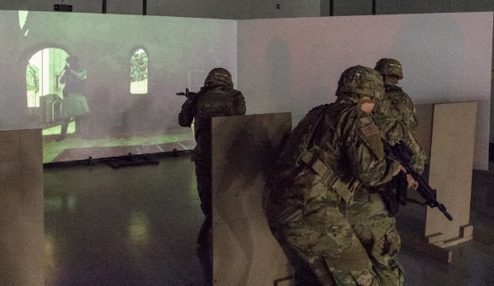
Clear room
Enter, clear, and secure room
  Kill/capture enemy
  Minimize friendly and noncombatant casualties
  Minimize collateral damage
Soldiers being trained must know and follow
  Standard operating procedures (SOP)
  Compile with rules of engagement (ROE)
  Maintain sufficient force to repel counterattacks by enemy
  Possess sufficient marksmanship skills

Slide 12
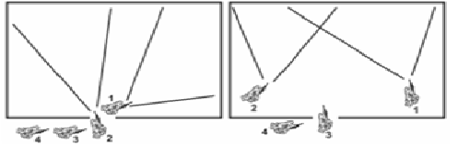
Enter and Clear Room (1)
Doorway – fatal funnel
  Soldier 4 – quick check for booby traps; kick down door
  Enter quickly, keep disclosure to minimum before entering
  Lead soldiers 1 &2 move
  in quick succession along
  path of least resistance
  (wall) to positions of
  domination (POD) –
  usually two opposite corners)
  Keep moving contain (kill) enemy as quickly as possible

Slide 13
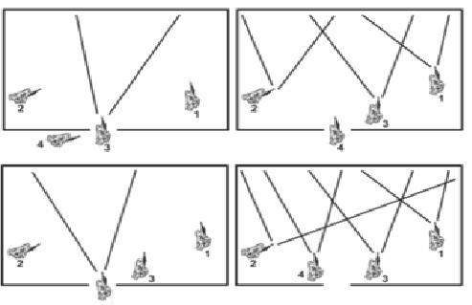
Enter and Clear Room (2)
3rd soldier opposite direction of soldier 2
4th opposite direction of soldier 3
Establish POD clear room of combatants
Clear, assess, report, re-orient, move on
Clearing room is a 3-D process
Additional maneuvers if other objects in
room
Time is of the essence – both for surprise and to ensure that enemy does not have time to regroup

Slide 14
Key Takeaways (preliminary …)
From documents, Subject Matter Experts (SMEs) – SFC Roger Ordish (CCDC), Jake Werner, SFC Shaver & Davis (Fort Benning)
  Speed (time) is a key factor – requires muscle memory – acquired through multiple practice scenarios
  Rapid decision making – who is a combatant, who is not
  Individual Psychomotor skills essential – speed, accuracy, marksmanship
  Team effort – follow SOP, ROE, communicate, avoid disastrous fratricide
  Maintain 360 degree, 3D security at all times

Slide 15
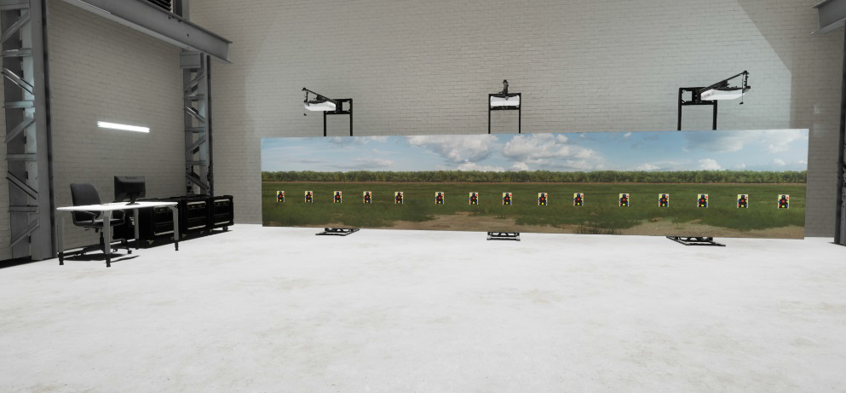
Training Environment
SAM-T – Squad Advanced Marksmanship Trainer – Training as a service (TaaS) system (Pargett, 2019)
  Developed by Meggitt (Oak Grove Systems)
  Augmentation of Engagement Skills Trainer (EST) II -- weapons training and marksmanship
  SAM-T augment, accelerate, and improve soldier and team close combat skills
    Weapons Skills Training (individual tasks up to 15 soldiers)
    Use of Force (rapid decision making)
    Battle Drill Training (up to teams of 5)

Slide 16
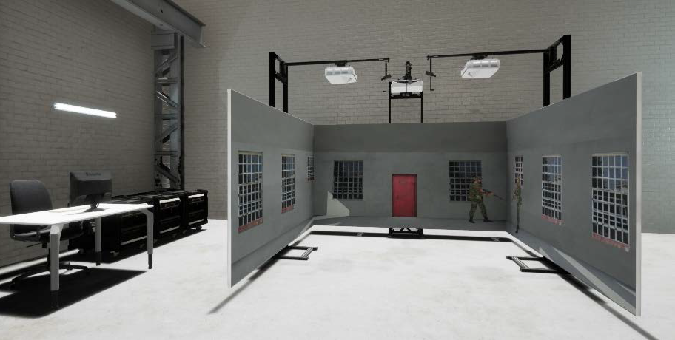
SAM-T: Battle Drill Training

Slide 17
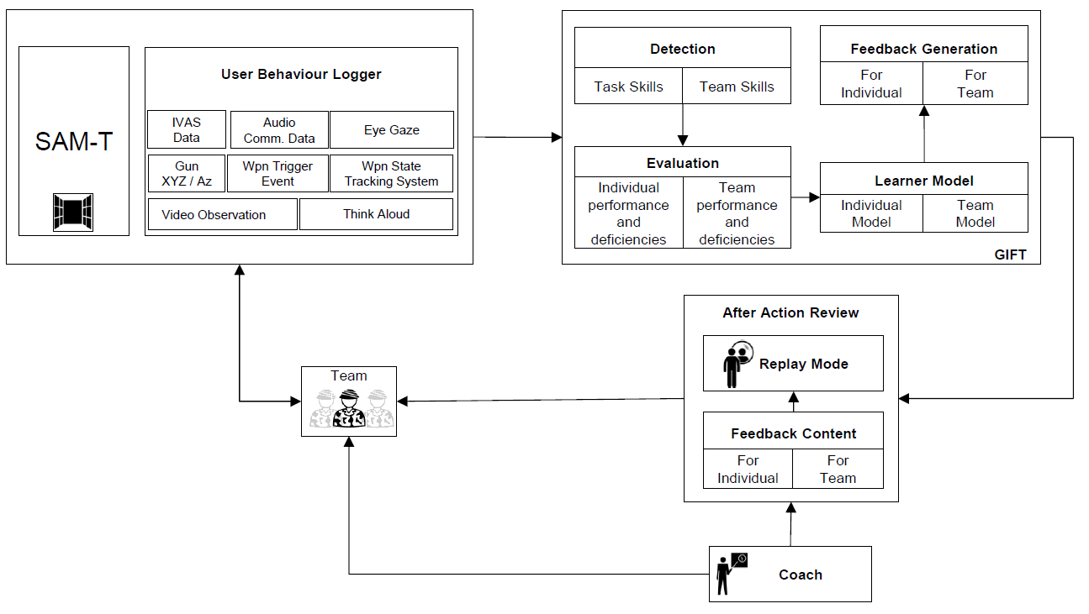
Team Tutoring: SAM-T + GIFT
Integrated visual augmentation system (IVAS)
Video Data
Head mounted eye trackers
Audio communication data
Gun position/angle
weapon trigger events weapon states
Bio harness

Slide 18
Team Tutoring
GIFT
  Multimodal Raw Data →
  Extract Relevant Information (Feature Extraction) →
  Analyze, derive values for individual and team metrics (MOP, MOE) →
  Compute metrics →
  Identify feedback events (positive, negative) →
  Locate relevant segments on video →
  Present to Instructor for After Action Review (AAR)

Slide 19
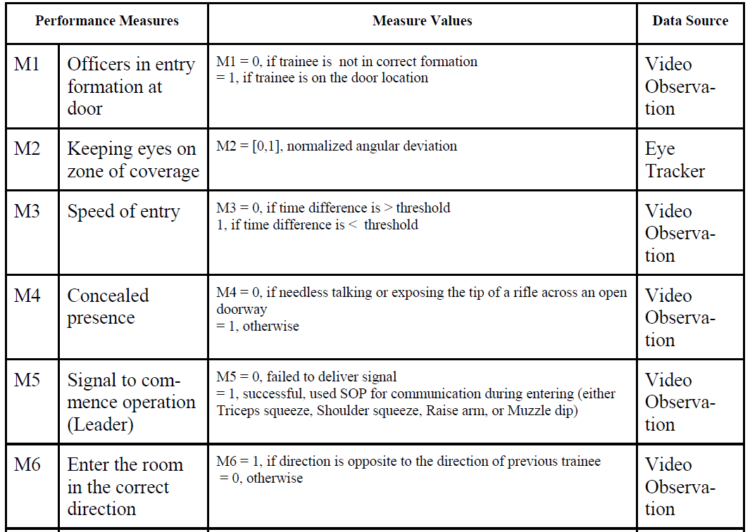
Metrics – measures of performance (1)
From:
Army Training Registry
Central Army Registry

Slide 20
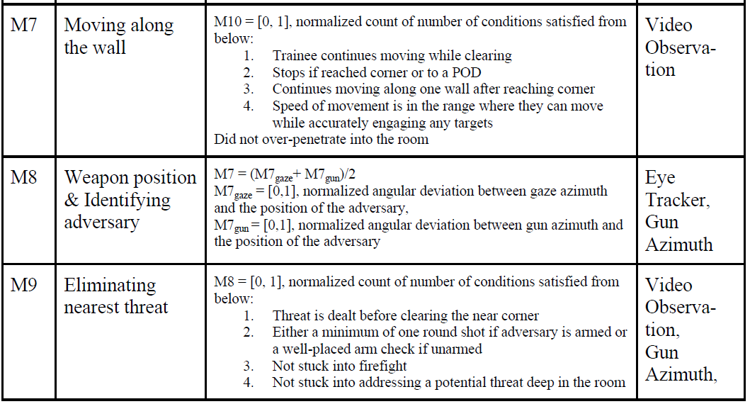
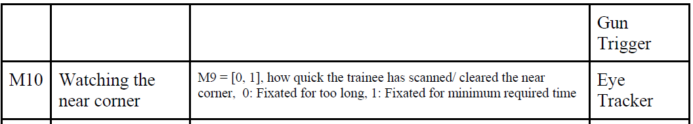
Metrics – measures of performance (2)

Slide 21
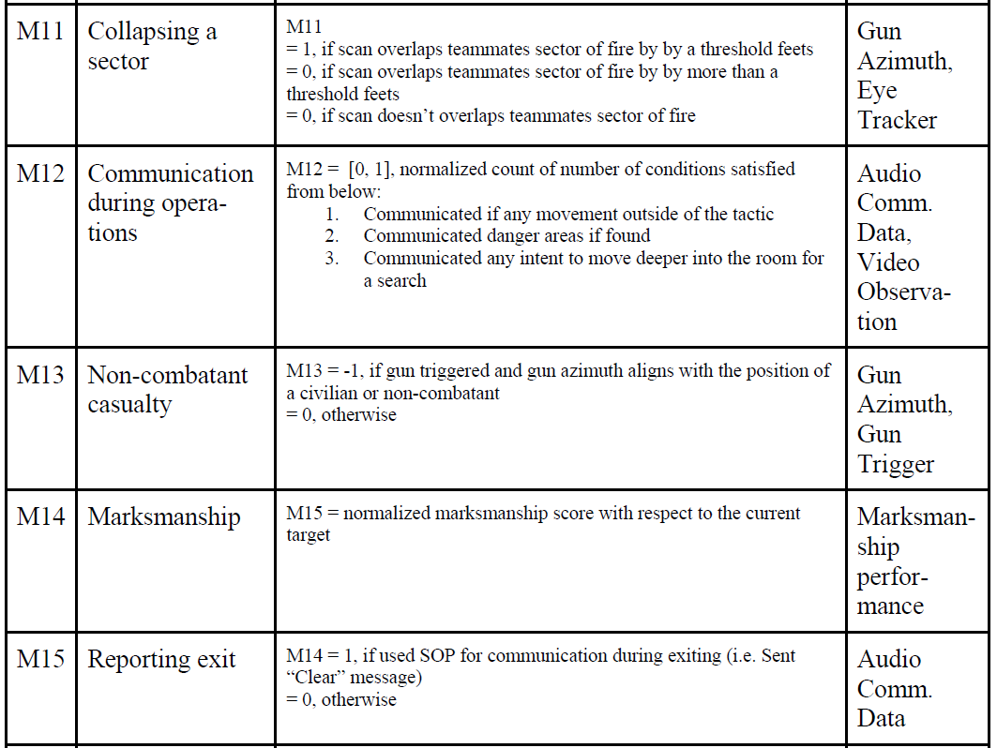
Metrics – measures of performance (3)

Slide 22
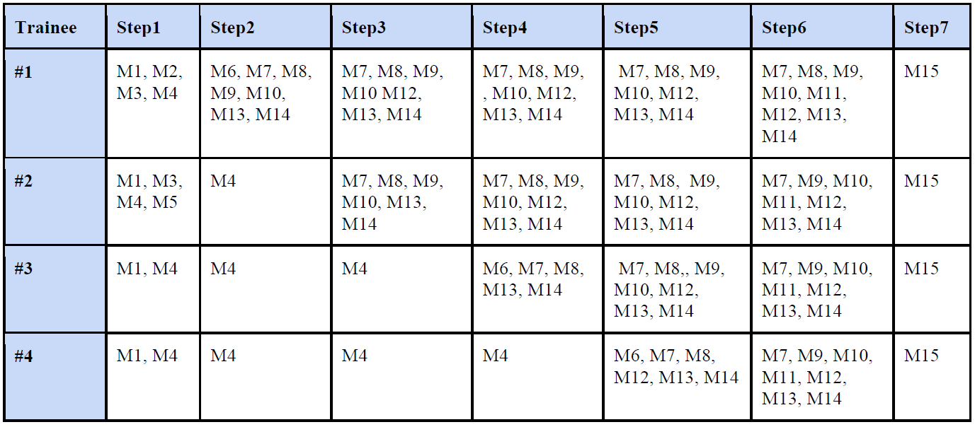
Aggregating individual and team performance

Slide 23
Takeaways – metrics and assessments
Multi-modal data analysis
  Alignment of video, eye tracking, voice and data already being logged by SAM-T
  Analytics for deriving assessments
  Learner modeling – aggregation of metrics over multiple trials
  Video search to identify events for AAR

Slide 24
Learner Modeling
Example Learner Model: UrbanSim-GIFT
Metacognition Processes
Refine
Goal Setting
Planning
Monitoring
Reflection
Cognitive Strategies
Multi-level User Model
Situational Awareness
Tradeoff Analysis
Second and Third order Effects
Clear-Hold- Build (CHB)
Cognitive Skills
Learner’s performance on goals.
Identify
Devise Approach
Plan Execution
Clear
Hold
Collected by observing user activities in system
(e.g., video, logs, etc.)
Apply
Evaluate
Analyze
Interpret
Build
Task Model
Learner’s interactions in system

Slide 25
Task Model – UrbanSim-GIFT

Slide 26
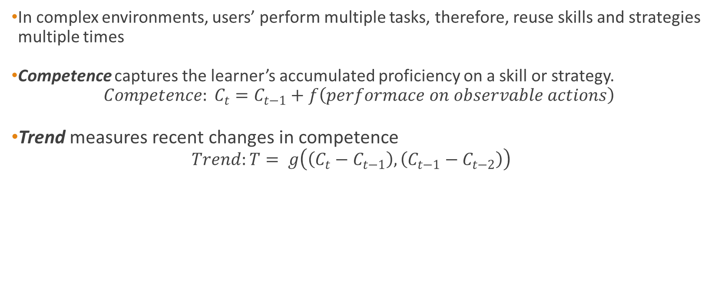
Performance Metrics in Hierarchical User Model
In complex environments, users’ perform multiple tasks, therefore, reuse skills and strategies multiple times
Competence captures the learner’s accumulated proficiency on a skill or strategy.
  $$Competence: C_{t}=C_{t−1}+f\left(performace on observable actions\right)$$
Trend measures recent changes in competence
  $$Trend:T= g\left(\left(C_{t}−C_{t−1}\right),\left(C_{t−1}−C_{t−2}\right)\right)$$
Performance on task or sub-goal
+
−
+
+
-
Updating learner’s Competence on Strategies
Performance on
Cognitive Skill
−
No Change
-
Notes:
In complex environments, users’ perform multiple tasks, therefore, reuse skills and strategies multiple times. Hence we need to accumulate user’s performance over a period of time;
We introduce two performance metrics for the learner model. Competence and Trend.
When learners’ competence in relevant cognitive skills are above a pre-specified threshold (+), and their performance on relevant tasks and subtasks are also above the threshold, then we increment the learner’s competence on the cognitive strategy using their performance in the corresponding cognitive skills. If the learners’ performance on relevant cognitive skills, tasks, and subtasks are below the threshold (-), then the learners’ competence on the cognitive strategy during that time interval is decreased. However, if the learners’ competence on the relevant cognitive skills is (+) and their performance on a task is (-), then the learner may lack knowledge of the strategy, i.e., how to combine skills to make them beneficial to the overall task. Hence, their competence on the particular cognitive strategy will be decreased. When the learners’ performance on a task is above the threshold, and the learner seems to lack
requisite cognitive skills (-), then the learner’s success in performing the task may be attributed to chance, or to other skills/strategies that are currently not being monitored.
Hence, their competence on the particular cognitive strategy will not be changed

Slide 27
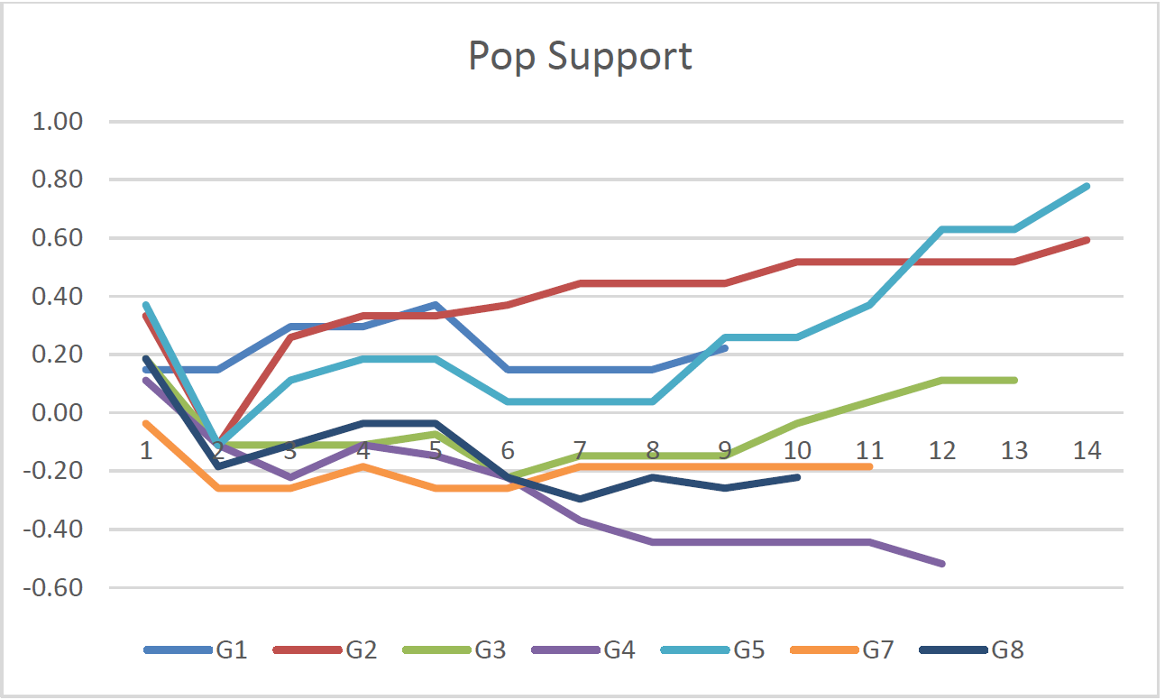
Tracking Learner Behaviors in UrbanSim-GIFT
Best Performers: G2, G5
  G5: up and down through turn 8, good performance in turns 9-14
  Good use of CHB strategy throughout
  Situation Awareness (SA); Tradeoff Analysis (TA)
  got better with time; was good from Turn 9 on
  G2 – dip after turn 1, jump at turn 2, steady increase from turn 3 on; steady use of SA and TA, but not as good as G5 in CHB
G1, G3 – low PS scores but positive
  Low competence in SA and TA; CHB improved as turns progressed
G4, G7, G8 – negative PS scores
  Low competence in CHB, SA, and TA strategies

Slide 28
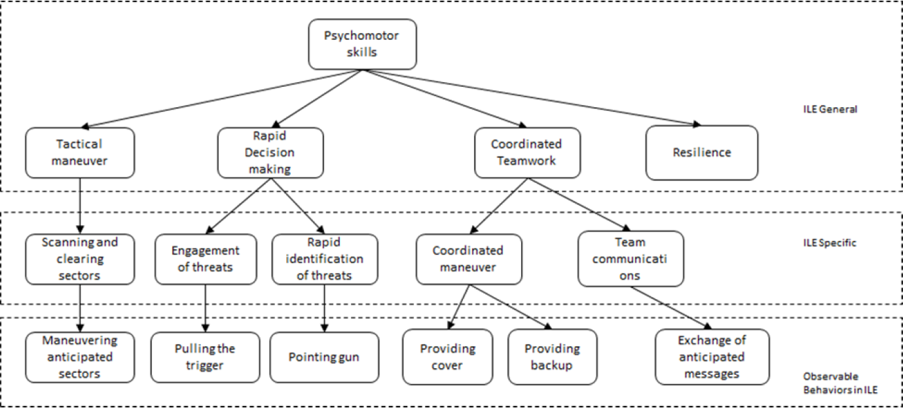
Learner Modeling for ECR & SAM-T

Slide 29
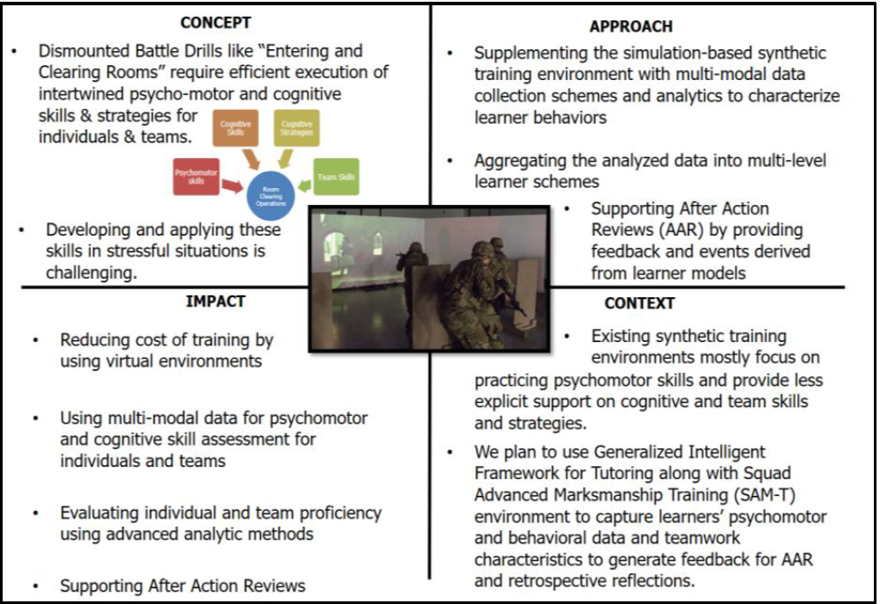
Quad Chart

Slide 30
Thank You

