Slide 1
Towards Deeper Integration of Intelligent Tutoring Systems: One-way Student Model Sharing between GIFT and CTAT
Presentation at the 7th Annual GIFT Users Symposium (GIFTSym7)
May 16, 2019
Vincent Aleven¹, Jonathan Sewall¹, Juan Miguel Andres², Octav Popescu¹, Robert Sottilare³, Rodney Long⁴, Ryan Baker²
¹Human-Computer Interaction Institute, Carnegie Mellon University
²Graduate School of Education, University of Pennsylvania
³Formerly: US Army Research Laboratory
⁴US Army Research Laboratory
Research sponsored by ARL Award No. W911NF-16-2-0122: PI: Vincent Aleven, co-PI: Ryan Baker. “Integrating edX, GIFT, and CTAT.”
Notes:
Although I am a technologist at heart and I love to build new things; in fact I love to build tools with which to build new things. But I also want to know what is worth building. So this talk is not about how to build things, but about what is worth building for learners.

Slide 2
Overview
ITS integration is desirable, but rare
Some isolated instances, such as “detector” sharing
The major ITS paradigms are not interoperable
We achieved one-way student model sharing between GIFT and CTAT
Show a proof-of-concept in edX MOOC “Big Data in Education”

Slide 3
Main Questions
What is gained by integrating ITSs?
How was the integration of GIFT and CTAT accomplished?
What are the contributions?
What limitations and interesting possibilities for future work remain?

Slide 4
Advantages of Integrating ITSs
ITSs are complex creatures, with different characters and strengths
So, combining them could potentially lead to
More sophisticated tutors
More adaptive tutoring behaviors
More efficient authoring
Substantial set of potential advantages

Slide 5
Comparing GIFT and CTAT
GIFT and CTAT both support non-programmer approaches to ITS authoring
GIFT: Adaptive course flow objects can implement a broad adaptive pedagogy that includes declarative instruction, recall, and practice
CTAT: Non-programmer authoring of tutor interface and inner loop – many forms of adaptivity within complex problem solving

Slide 6
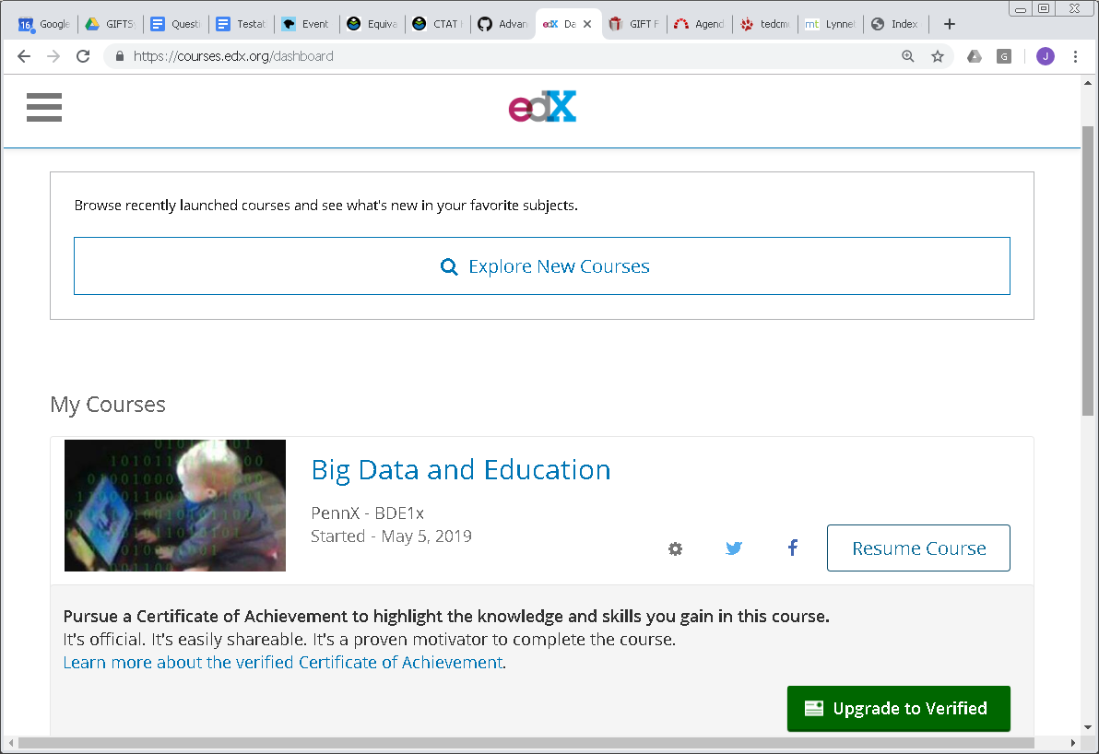
Context
We create an edX MOOC that is adaptive to students’ knowledge growth
To this end, we integrate GIFT and CTAT, and embed the combination in edX

Slide 7
Our Past Work in this Project
edX and other LTI consumers can invoke GIFT
GIFT can invoke CTAT tutors & other LTI tools
Result: Wider range of practice apps in GIFT
Demonstrated in BDEMOOC last year
Limitation
GIFT “knows” little about what happened in the CTAT tutor
If GIFT knew how much the student might have learned in the CTAT tutor, it could select remedial activities based on that information
Notes:
Can be adaptive to the student knowledge growth, as assessed by GIFT activities (e.g., CTAT tutor invoked as remedial practice)
Especially considering that CTAT tutors can support elaborate problem solving scenarios

Slide 8
New Scenario
GIFT Adaptive CourseFlow Object invokes CTAT tutor as primary practice
Student works with CTAT tutor – CTAT updates its student model based on student performance
When student finishes the CTAT tutor, CTAT passes the student model to GIFT
New!
GIFT uses the updated student model to select (as needed) remedial examples and practice
Choices reflect what happened in the CTAT tutor!
GIFT invokes a CTAT tutor as remedial practice

Slide 9
How Did We Make That Happen? The Short Answer
CTAT student model is sent to GIFT via LTI
One KC at a time – since LTI 1.1 does not allow sending more than a single labeled number in range 0-1
Mapping of the student models:
CTAT KCs map 1:1 to GIFT Skill Concepts
Probability of knowing is “translated” into Novice/Journeyman/Expert categories
Has some limitations, which we will discuss

Slide 10
Background
GIFT and CTAT are complementary, have different foci
More broadly, you’d expect that to be true for many ITSs pairs

Slide 11
CTAT
Non-programmer development of tutors for complex, multi—step problems solving
Custom-built tutor GUI
Multiple solution paths
Knowledge assessment
Personalized problem selection based on knowledge assessment
Also supports building tutors with a rule-based cognitive model (but requires programming)
Like the original Cognitive Tutors
Can handle problems with large solution spaces
Notes:
Programmer

Slide 12
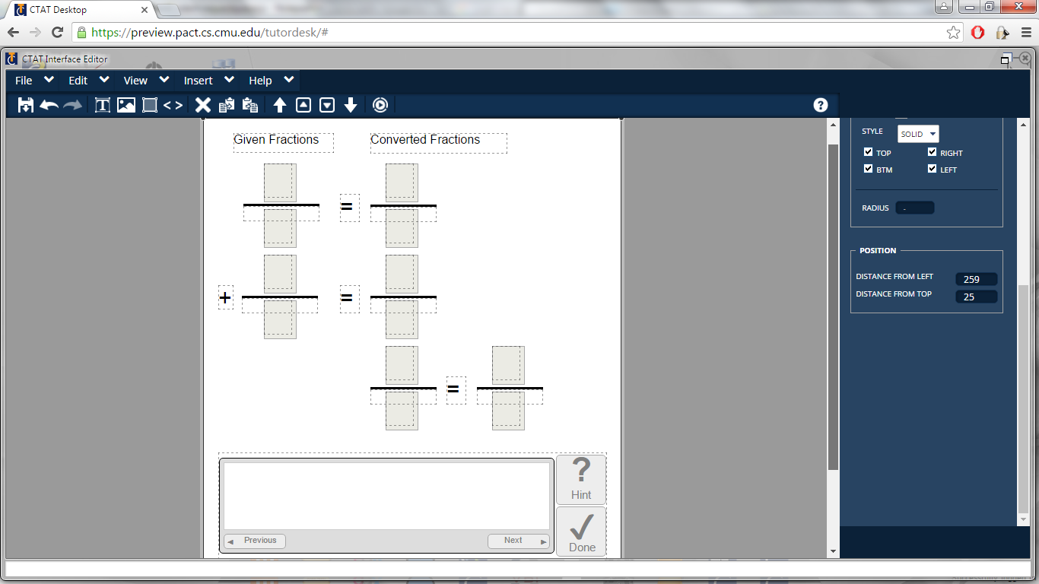
Notes:
Learning by doing is very powerful!
CTAT lets you craft complex learner-adaptive learn-by-doing activities.
When problems are complex, students benefit from having guidance along the way to a solution, not just at the end.
Many interesting problems have multiple solution paths, so an authoring tool should support multiple solution paths.
CTAT-authored learn-by-doing activities have both: Help along potentially many different solution path.
As an additional form of adaptivity, it also supports personalized problem selection – every learner gets the right amount of practice.
You might think that authoring complex learn-by-doing activities is always a complex process, but CTAT beats that curve handily!
CTAT-authored learn-by-doing activities give great bang for the buck: Students learn very effectively!
They can be embedded easily in many LMSs.

Slide 13
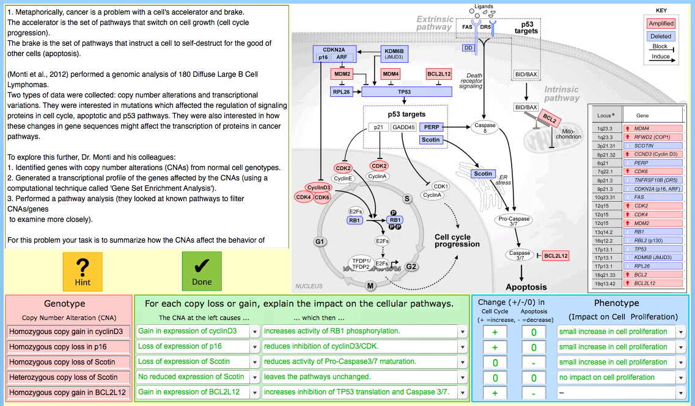
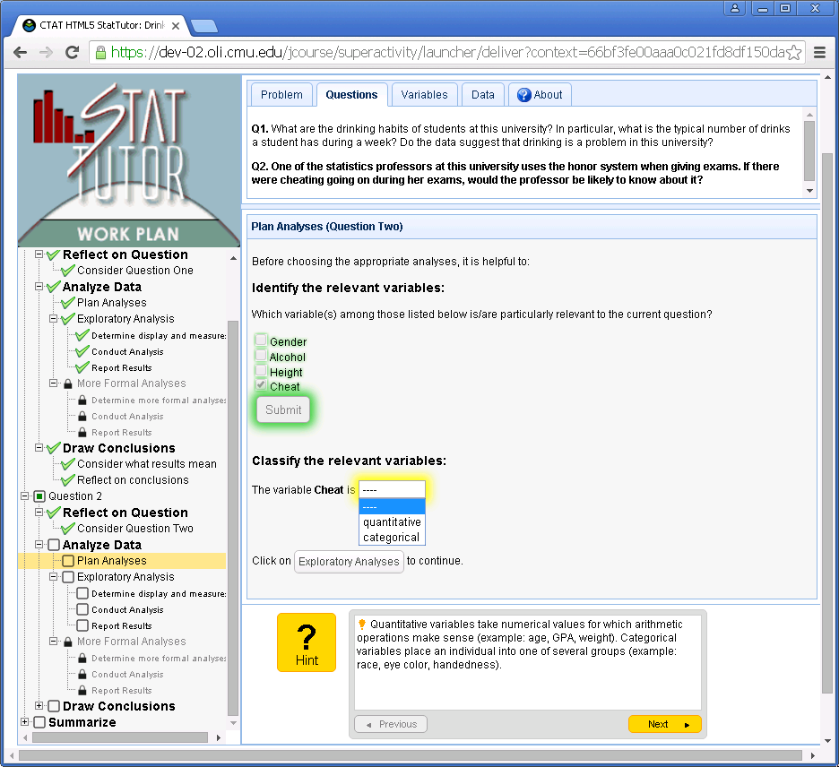
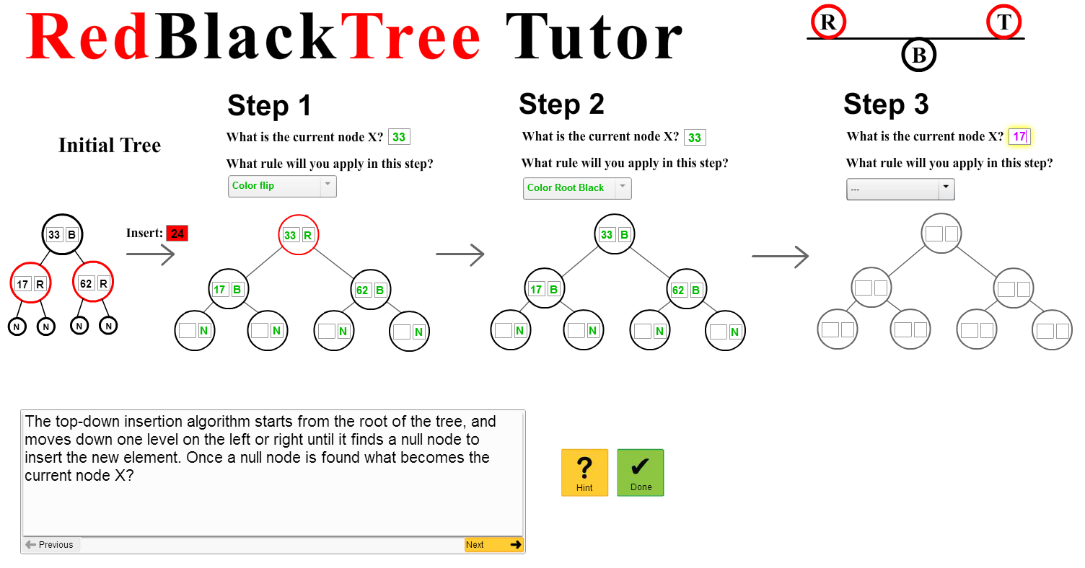
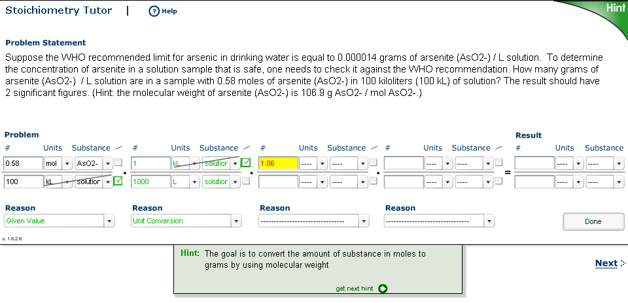
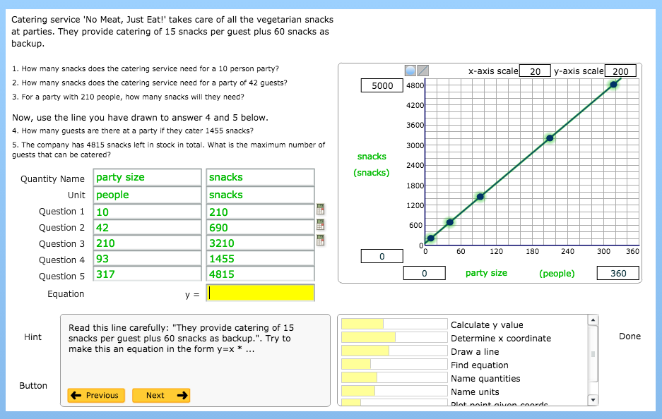
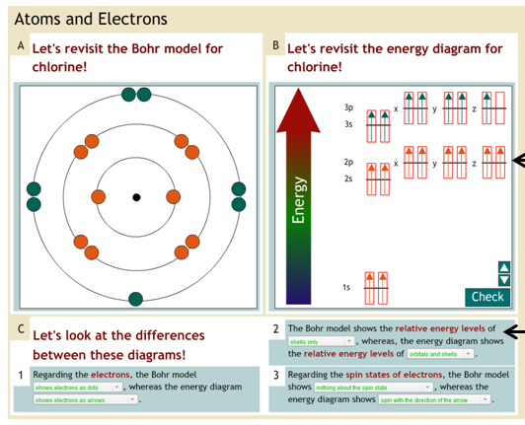
A small sampling of the many real-world tutors built with CTAT

Slide 14
GIFT
Student model includes
cognitive knowledge and skill, by concept
student variables other than domain knowledge
Outer loop (within a GIFT course) can choose
direct instruction, both concepts and examples (separately)
recall questions
practice applications
remedial concepts, examples and practice
Outer outer loop can choose to skip a course?
based on prior student experiences recorded in an LRS

Slide 15
Student view
First part: from 1 of 6 GIFT courses in week 1
Does not capitalize on new GIFT/CTAT integration, but sets the stage
Then: 7th GIFT course, with CTAT, from week 1
This is where the new GIFT/CTAT integration happens
GIFT first invokes CTAT tutor as regular practice
GIFT may later invoke a different CTAT tutor as remedial practice

Slide 16
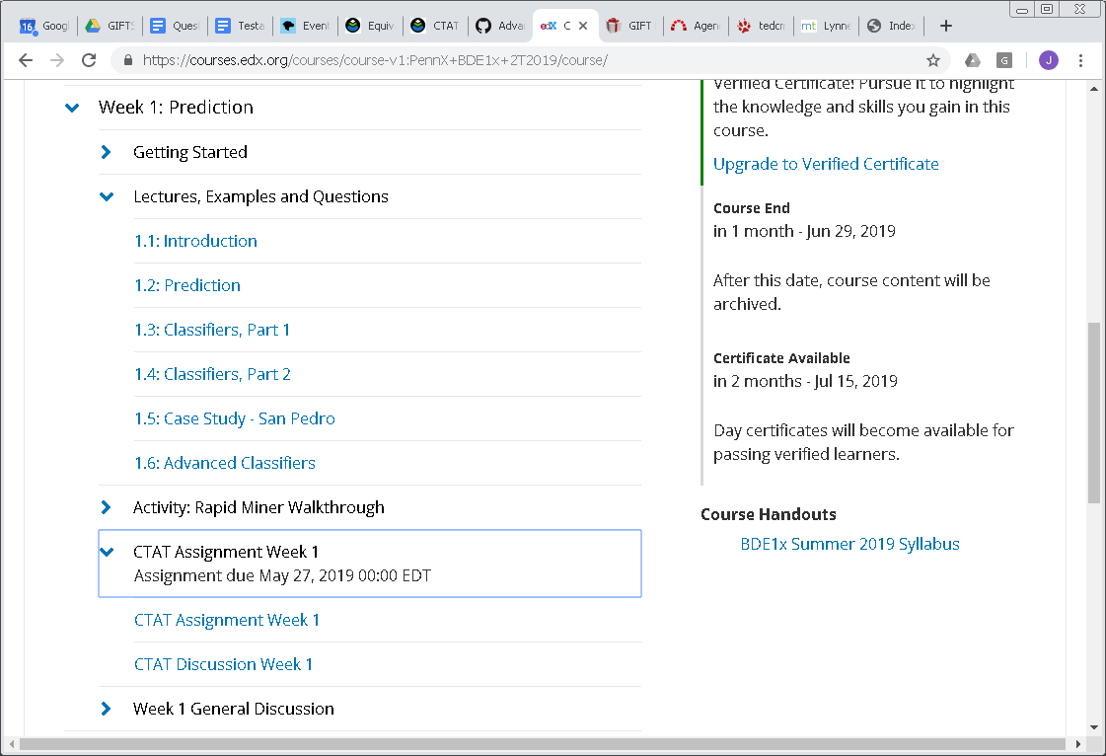
BDEMOOC week 1 in edX

Slide 17
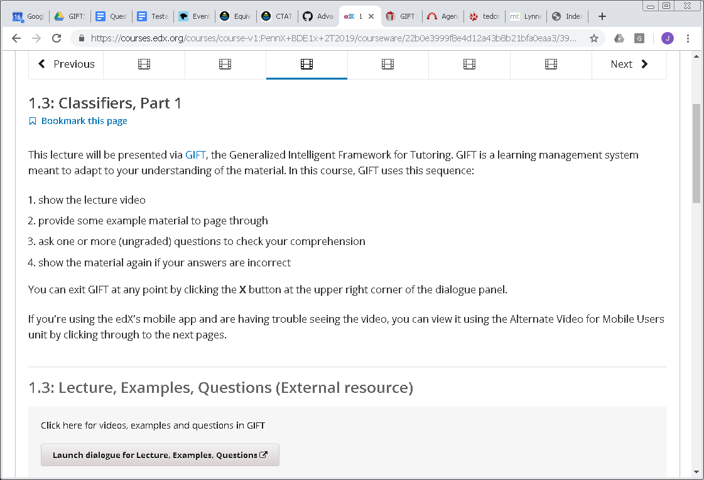
Week 1 lecture 3: GIFT for Decision Trees
Launch GIFT course

Slide 18
1 of 6 GIFT courses in week 1: Decision Trees
Examples
Recall
Example slides for concept Decision Trees
Recall Questions assessing understanding of Decision Trees & other concepts
During week 1, 6 short GIFT courses provide Rule content (a videotaped lecture, with handouts) and Example content (slides illustrating application) for several concepts, including kNN and Decision Trees. Each course includes Recall questions on the concepts in the video and slides.
Expert
Still Novice
Completion
Rules
Remedial video for Decision Trees
Rule Content: video lecture with handouts on Decision Trees & other concepts
Journeyman for Decision Trees
Remediation
Remedial slides for Decision Trees
Start
Note:

Slide 19
Rule Content: Decision Tree Video

Slide 20
Example Content: Decision Tree Slides

Slide 21
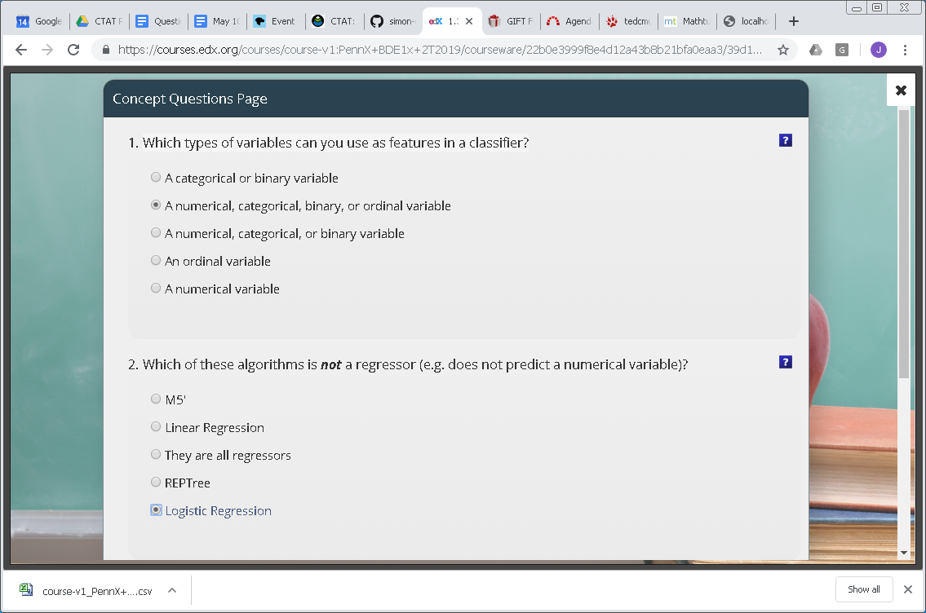
Recall questions

Slide 22
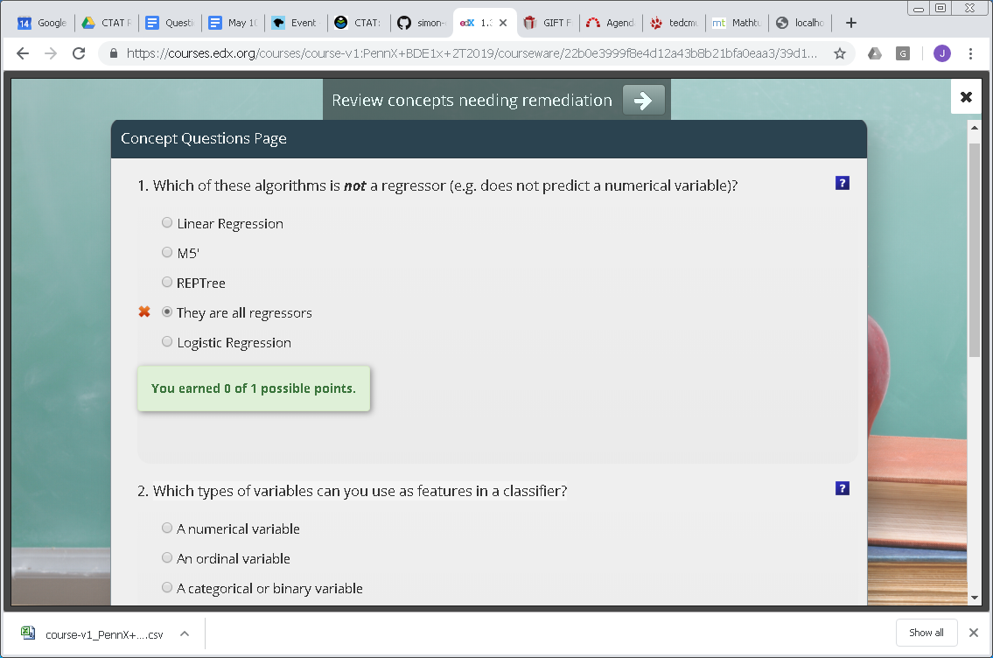
After-Action Review

Slide 23
Remediation for missed Recall questions

Slide 24
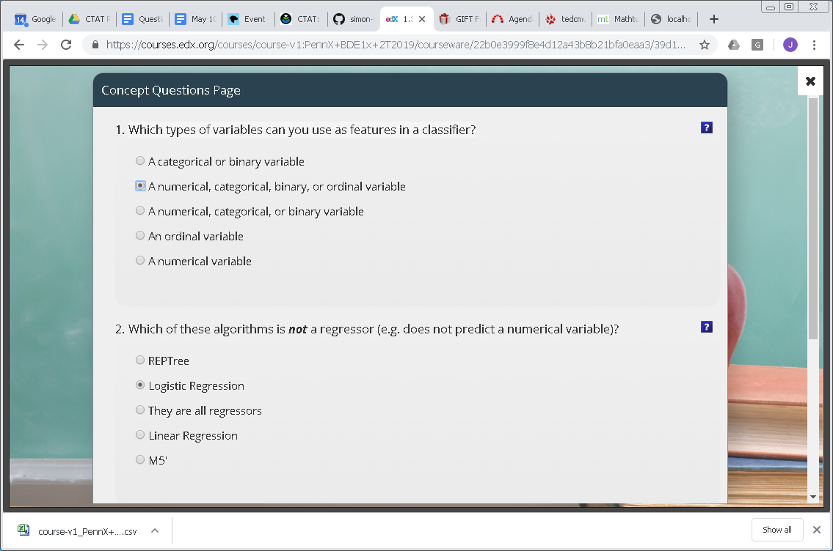
Retry Recall questions

Slide 25
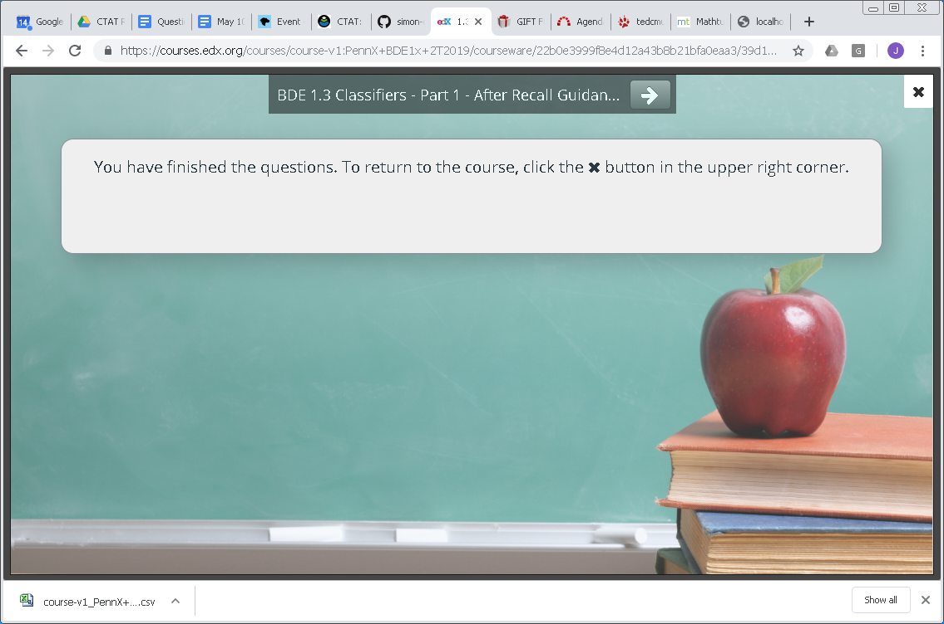
Return to edX for next section

Slide 26
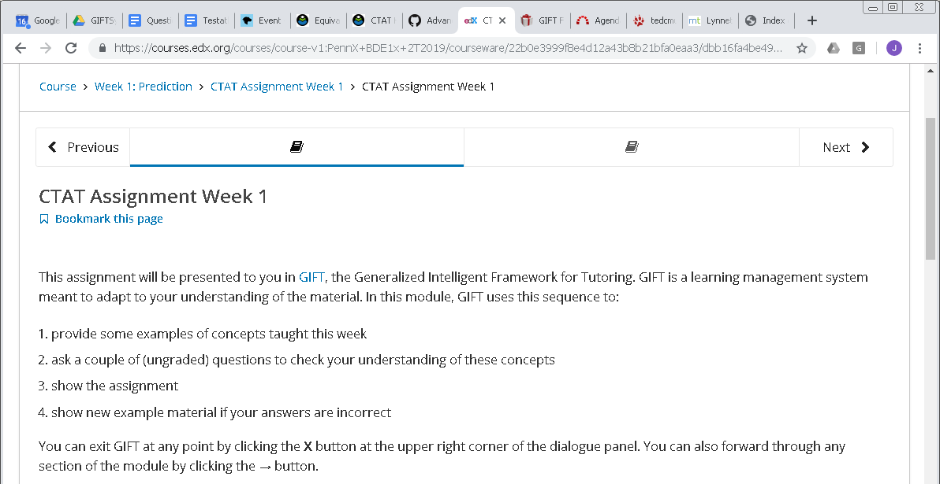
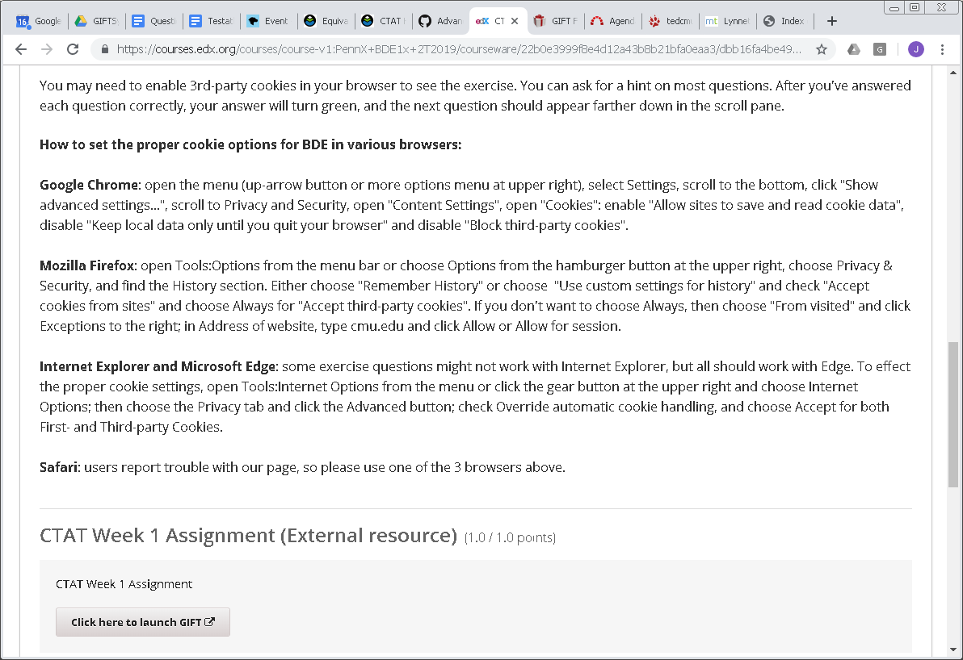
Week 1 section 7: GIFT with CTAT
Launch GIFT with CTAT Practice Application

Slide 27
7th GIFT Course in Week 1
Adaptive Courseflow object with
2 concepts: Decision Trees, kNN (k Nearest Neighbor)
No Rule content: covered in previous 6 courses
2 slides decks of Example content
Survey-only Recall questions
CTAT tutor as Primary Practice application
assess both concepts
Remedial slides if conceptual skill still at Novice
2nd CTAT tutor as Secondary Practice application

Slide 28
Targeted tutoring behaviors
Examples
Recall
Example slides for concept Decision Trees
Click-through Recall Question: assessed in prior courses
In a new 7th course, a primary practice application guides & tests students in applying the concepts kNN and Decision Trees. If still at novice level on either, then show proper remedial slides & launch a second practice application.
Example slides forconcept kNN
No Rule Content: provided in prior courses
Start
Primary CTAT tutor assesses all concepts
Remediation
Practice
Still Novice for kNN or Decision Trees
At least Journeyman for all concepts
Remedial slides for Decision Trees
Remedial slides for kNN
Secondary CTAT Tutor for all concepts
Completion

Slide 29
Example Content for Decision Trees

Slide 30
Example Content for kNN

Slide 31
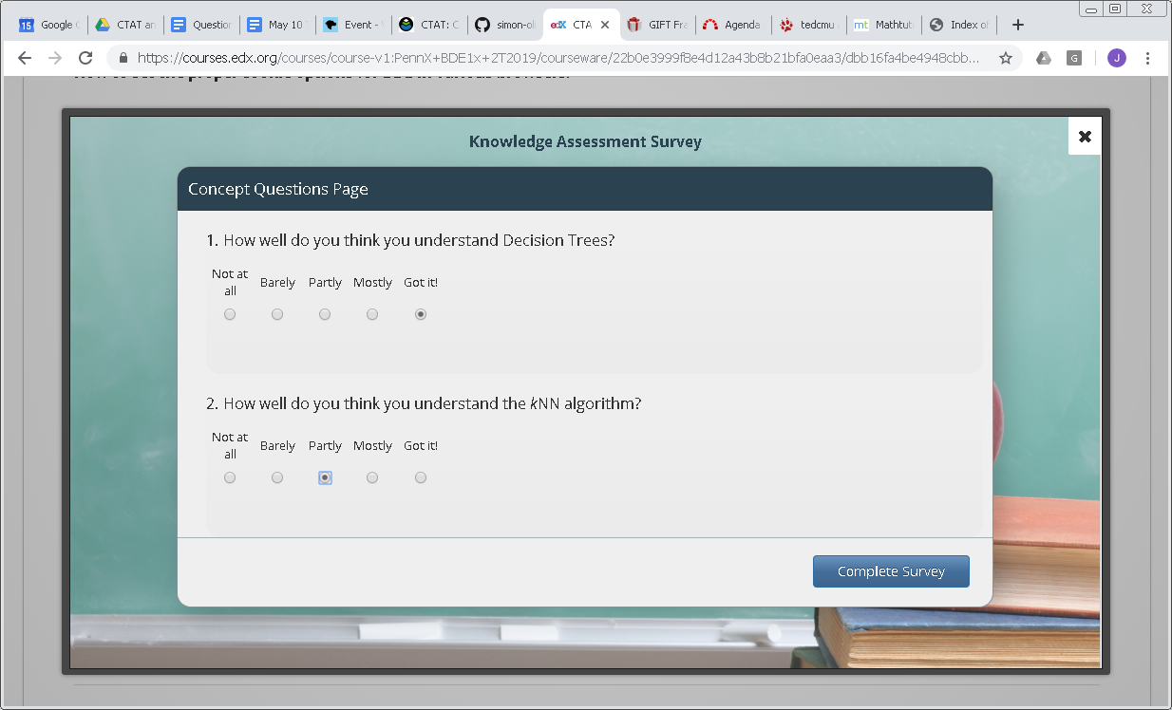
Survey-only Recall questions (Rule & Recall quadrants earlier in week)

Slide 32
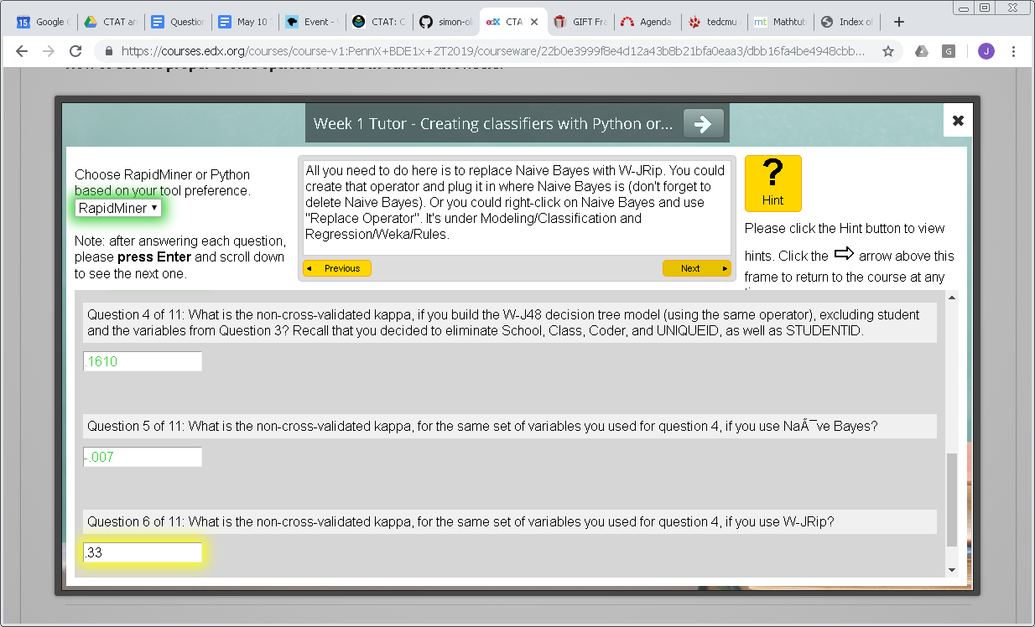
CTAT tutor as Primary Practice application Multiple-step practice with learning algorithms, with feedback and hints

Slide 33
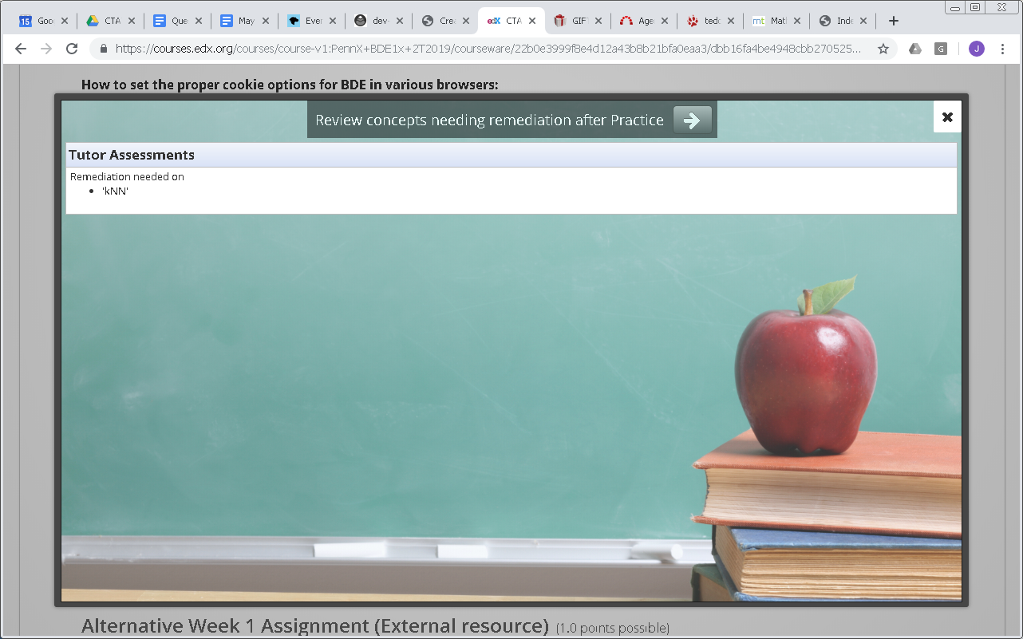
LTI Practice application reports concept-specific levels for remediation (new)

Slide 34
Different Remedial Example slides on kNN only (since kNN level still Novice)

Slide 35
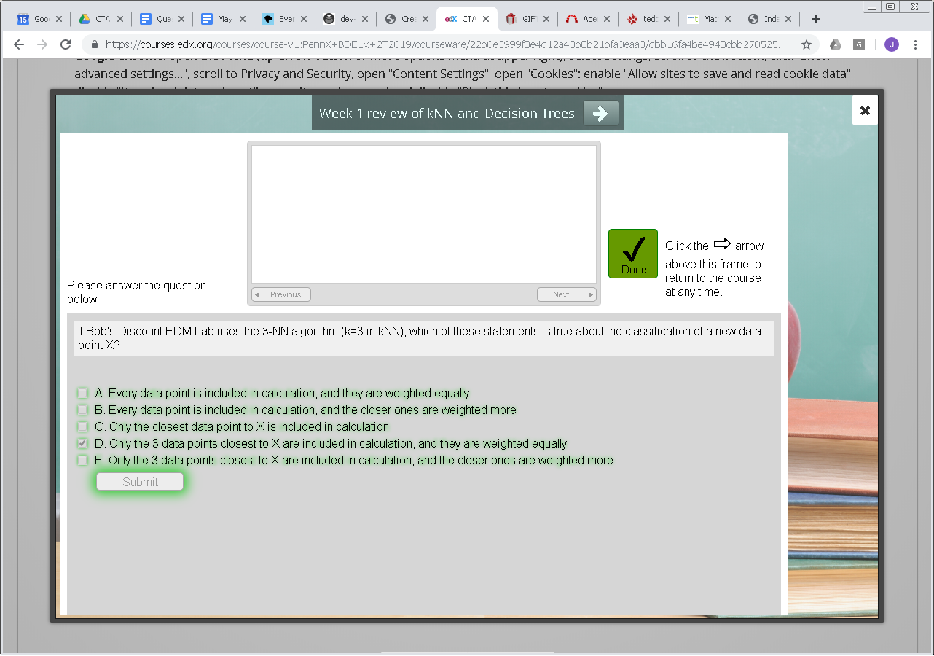
2nd CTAT tutor as secondary Practice app (but currently each Practice app must cover all concepts)

Slide 36
Return to Example if student still Novice after Practice

Slide 37
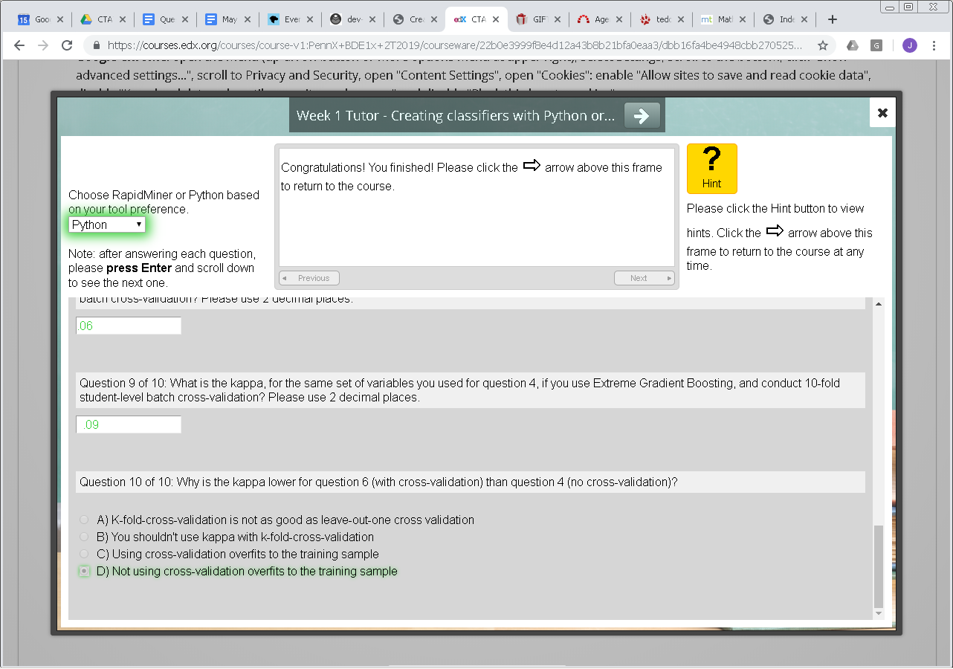
Return to Practice App (CTAT) to complete training on concept still at Novice

Slide 38
A Tale of Two Student Models?
GIFT’s Student Model (partial description)
Cognitive Knowledge (Novice; Journeyman; Expert)
Cognitive Skill (Novice; Journeyman; Expert)
Used to differentiate ‘knowledge’ from ability to execute
Aligns with Knowledge/Skills/Abilities (KSAs), makes competency badging within a domain more granular
CTAT’s Student Model
Models procedural knowledge
Overall competence is decomposed into smaller “knowledge components” – atoms of skills
Has roots in ACT-R and cognitive theory, as well as in a great deal of recent EDM work
Bayesian Knowledge Tracing (BKT) computes an up-to-date probability of knowledge for each KC, based on student performance
Not similar, but maybe compatible! Broad competence categories v. probabilities
Similar! Student models of both GIFT and CTAT have small pieces of “how to” knowledge

Slide 39
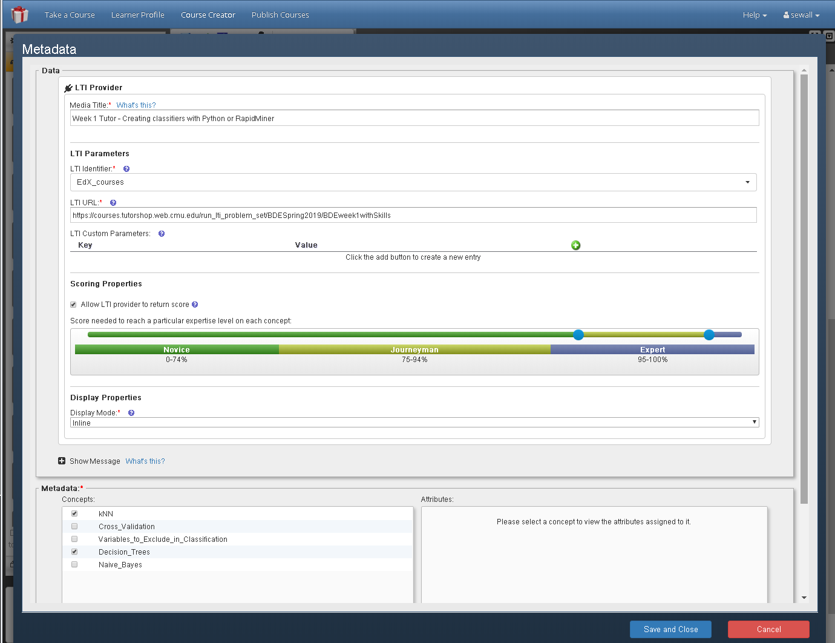
Mapping
Can map 1:1 between GIFT Cognitive Skills and CTAT knowledge components
Translate CTAT p_{Know} to GIFT expertise level
p_{Know} < 0.95: Novice
p_{Know} > 0.95: Expert

Slide 40
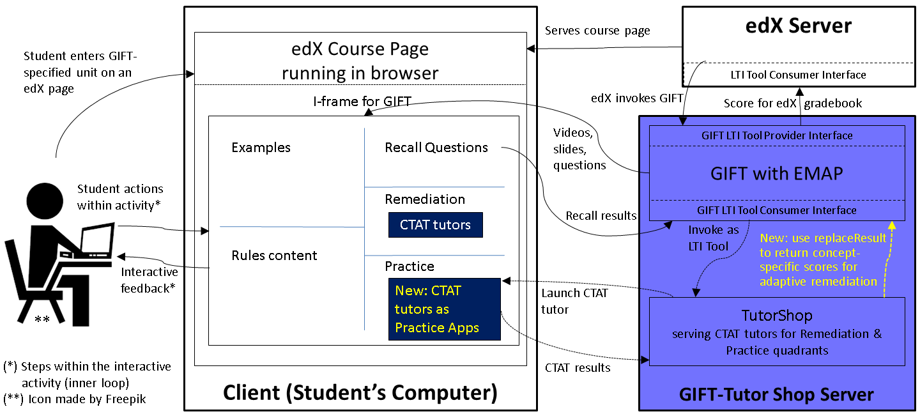
Technical Integration

Slide 41
Technical Integration: LTI replaceResult
Configuration:
GIFT Practice application assessing the concepts Decision_Trees, kNN
CTAT-Tutorshop problem set with knowledge components Decision_Trees, kNN
Interaction:
LTI Tool Consumer (GIFT)
LTI Tool Provider (Tutorshop)
CTAT in browser
launch request with sourcedid
Tutor content with 1 knowledge component per concept
HTML rendered for student
replaceResult score 0.66 for sourcedid_Decision_Trees
Tutor reports correct step for Decision_Trees, pknown 66%
update skill level for Decision_Trees: still at Novice (range 0-74%)
replaceResult score 0.89 for sourcedid_Decision_Trees
Tutor reports 2nd correct step for Decision_Trees, pknown 89%
update skill level for Decision_Trees: now Journeyman (range 75-94%)
Student exits tutor
Result:
GIFT initiates remediation with Example content on concept kNN

Slide 42
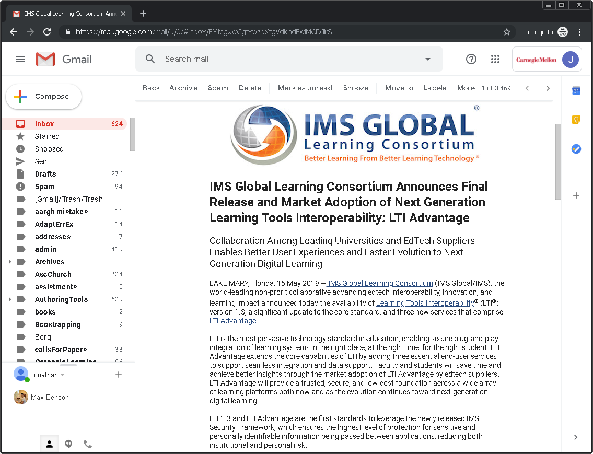
News: LTI Advantage released 15 May

Slide 43
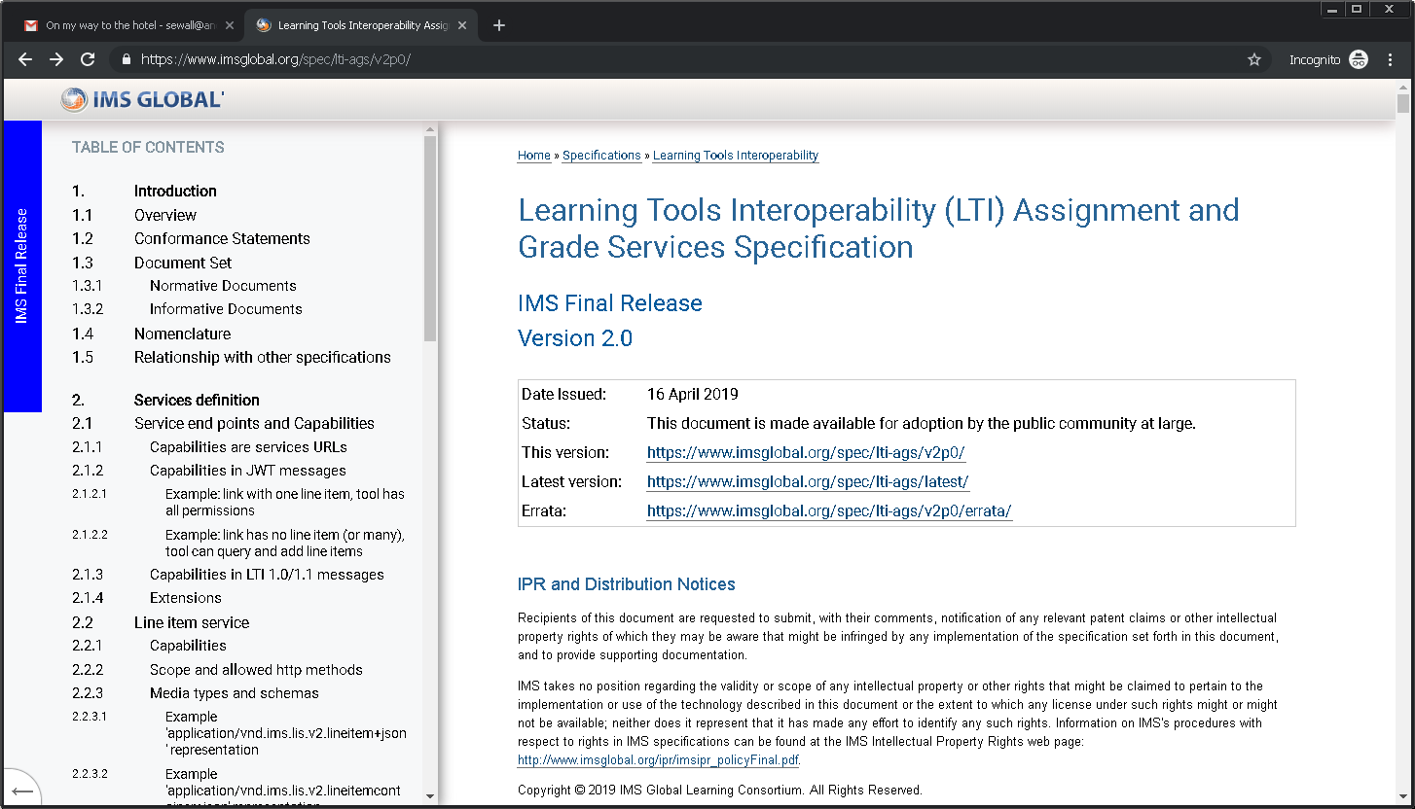
Now publicly available: https://www.imsglobal.org/spec/lti-ags/v2p0/
More to come on this…

Slide 44
Recommendation 1: per-concept scoring
Permit individual scoring properties for each concept assessed by an LTI Practice application, not just a single set of properties for all concepts.

Slide 45
Recommendation 2: targeted practice
Examples
Recall
Example slides for Decision Trees
Click-through Recall Question: assessed in prior courses
Example slides for kNN
No Rule Content: provided in prior courses
Start
Primary tutor assesses all concepts
Remediation
Practice
Still Novice for kNN or Decision Trees
Enable Practice applications that cover single concepts, to permit remedial practice on just the unmastered concepts.
At least Journeyman for all concepts
Remedial slides for Decision Trees
Tutor for Decision Trees
Remedial slides for kNN
Single secondary Tutor for all concepts
Tutor for kNN
Completion
45
Towards Deeper Integration of Intelligent Tutoring Systems:One-way Student Model Sharing between GIFT and CTAT

Slide 46
Contributions
Proof-of-concept of one-way student model sharing between two ITSs
Enables wider range of adaptive tutor behaviors, by drawing on the strengths of each ITSs
We are not aware of any prior instances of student model sharing in the literature
sSmall step towards greater ITS integration

Slide 47
Limitations
Evidence that it works? Currently being used in BDEMOOC; so far so good
Integrating ITSs built separately may be harder
May not allow for 1:1 mapping of knowledge components
One-way sharing only – CTAT remains agnostic of what student does in GIFT activities
Therefore, it cannot be adaptive to student knowledge gain in GIFT activities
Mapping has arbitrary thresholds and some “semantic friction”

Slide 48
Future Work (1)
Two-way communication
GIFT passes student model to CTAT
Technically already possible, but how to translate Novice/Journeyman/Expert into probabilities?
Alternative
GIFT and CTAT each maintain their own student models, but exchange student model updates (i.e., “events”)
Both systems update their student models based on events in either
Elegant but harder to implement
Might generalize better to other ITS pairs

Slide 49
Future Work (2)
What about using BKT skill probabilities for mastery learning?
Well-studied by the field of EDM, proven to be effective (mostly)
CTAT supports mastery learning based on BKT in its outer loop, but GIFT as far as we understand cannot
GIFT could invoke a CTAT “adaptive problem set” for this purpose
Would require that CTAT keeps its own student model, so may work better with event sharing than with student model sharing
If 1:1 mapping is hard, should all activities be tagged with two sets of knowledge components?

Slide 50
Future Work (3)
Would be interesting to explore and compare student model sharing and event sharing
Would generate useful knowledge for the field of ITS as a whole

Slide 51
The End

Slide 52
Opportunity to participate in research
We would be grateful to hear your unique perspective!
We are doing research to find out how we might design authoring tools for ed tech that are maximally useful for a broad range of users.
The survey takes about 12 minutes.
Participation is voluntary and of course you could drop out at any point in time that is convenient for you. There will not be compensation, but we’d be very grateful if you would be willing to participate.
Please access the survey here: https://tinyurl.com/edTechToolsSurvey

