Slide 1
Understanding Novelty in Reinforcement Learning-Based Automated Scenario Generation
Jonathan Rowe¹ | Andy Smith¹
Randall Spain¹ | Bob Pokorny²
Bradford Mott¹ | James Lester¹
¹ North Carolina State University ² Intelligent Automation Inc.

Slide 2
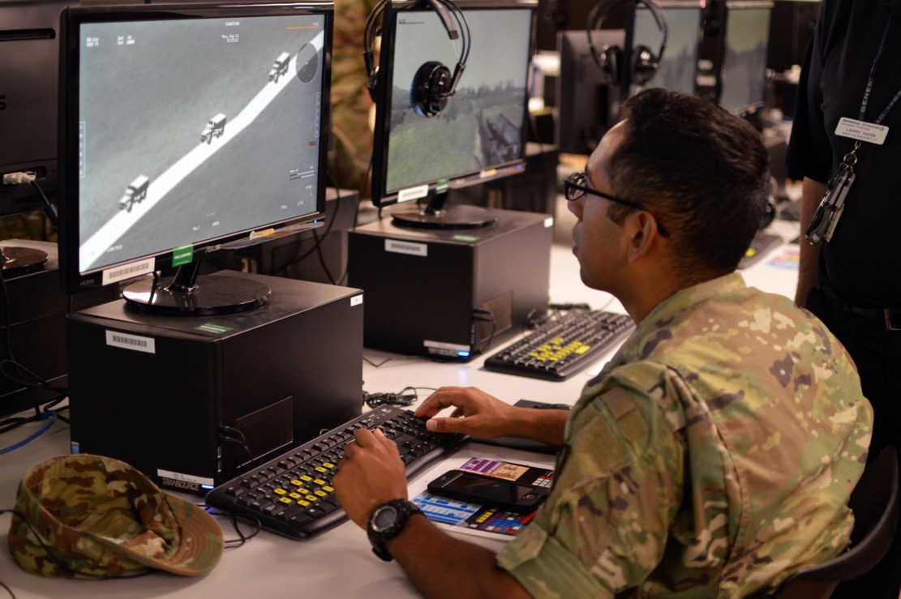
Simulation-Based Training
Notes:
Focus on simulation-based training environments, and in particular scenarios
Realistic.
Difficult to author.
25 bloodless battles
Points toward for tools to increase access to new scenarios

Slide 3
DeepGen Scenario Generation Framework
Notes:
Last year, we presented DeepGen.
The goal of DeepGen is to utilize Deep RL to systematically adapt elements of an example training scenario to optimize instructor-specified training objectives
This work is ongoing, MCOE demo

Slide 4
Novelty in Scenario Generation
Novel training scenarios are:
  Different from previously experienced scenarios
  Aligned with relevant training objectives

Slide 5
Novelty in Scenario Generation
Novel training scenarios are:
  Different from previously experienced scenarios
  Aligned with relevant training objectives
But how do we know when a scenario is meaningfully different and useful?

Slide 6
Four C Model of Creativity
Big-C
Pro-C
Little-C
Mini-C
Kaufman, J. & Beghetto, R. (2009). Beyond Big and Little: The Four C Model of Creativity.
Review of General Psychology, 13(1), 1-12.
Notes:
Developmental progression
Different standards of creative output, different approaches to measurement.

Slide 7
Outline
DeepGen Scenario Generation Framework
Four C Model of Creativity
Four C-Based Novelty in Scenario Generation
Conclusions and Future Work

Slide 8
Outline
DeepGen Scenario Generation Framework
Four C Model of Creativity
Four C-Based Novelty in Scenario Generation
Conclusions and Future Work

Slide 9
Deep Reinforcement Learning
Reinforcement Learning
Deep Neural Networks
G1
G2
…
Action at (t-(n-1))
Action at (t)
Notes:
Combine deep neural networks and reinforcement learning agents. Specifically, we utilize deep neural networks to approximate a value function that is learned iteratively within the reinforcement learning process in which a software agent performs actions according to a control policy with the objective of maximizing a reward signal.
In our context, the actions are decisions about introducing adaptations to an example training scenario, and the reward is maximizing student learning or performance assessment on target training objectives.

Slide 10
RL-Based Narrative Generation
Modular RL-based interactive narrative (Rowe, Mott, & Lester, 2014; Rowe & Lester, 2015)
Multi-objective reinforcement learning (Sawyer, Rowe, & Lester, 2017)
Deep RL-based interactive narrative personalization (Wang, et al., 2017a; b; 2018)
Reinforcement
Learning
Q-Network
*
Policy
*
†
Narrative
Adaptation
*
*
Interactive Narrative Planner
*
†
Player
Simulation
Player
Action
Simulator
*
Player
Outcome
Simulator
Player
Action
Simulator
†
Player
Outcome
Simulator
Dataset
*
*
†
†
Training Set
Test Set
Game Interaction
Data
Questionnaire
Data
Game Interaction
Data
Questionnaire
Data
*
Policy Learning
†
Policy Evaluation
Notes:
Mention existence of narratology and computational field of INT

Slide 11
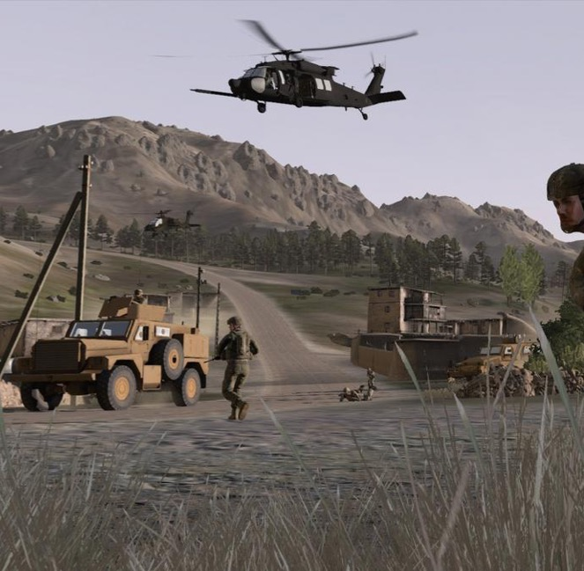
Virtual Battlespace 3
Simulation platform for small-unit training
Developed by Bohemia Interactive Simulations
Provides developer tools for scenario/mission editing
Integrated with GIFT
Initial Task Domain:
Call for Fire Training
Notes:
Closed source
Integration with GIFT ensures that we can spend maximum time on advancing scenario generation rather than creating software infrastructure
Call for Fire:
Infantry soldier requests indirect fire from supporting artillery (e.g., unmanned aircraft) on an identified target
Steps: Identify the target, wait for artillery to move into position, call for artillery fire using comm protocol, adjust fire, provide damage assessment
IAI has prior experience in assessment for IED Identification task in VBS

Slide 12
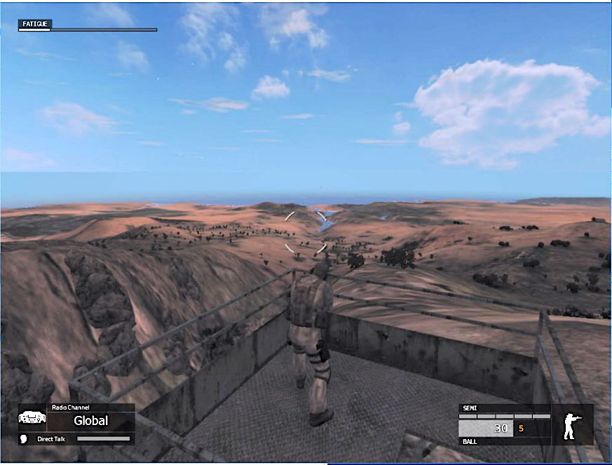
Call for Fire Training
Call for/Adjust Indirect Fire:
  Observer identification and warning order
  Target location
  Target Description, Method of Engagement, and Method of Fire and Control
Realized in VBS3 using VBS2Fires plug-in

Slide 13
Scenario Adaptation Library
Adaptable Elements of Scenarios | Scenario Adaptations
Target type | Bunker Transport vehicle Tank (T72)
Initial target behavior | Stationary Patrol Move to waypoint
Target reaction to fire | No reaction Stop movement Flee to cover Return to base
… | …
Note: We have defined 16 possible dimensions for scenario adaptation,
corresponding to more than 1,000,000 possible scenario variations

Slide 14
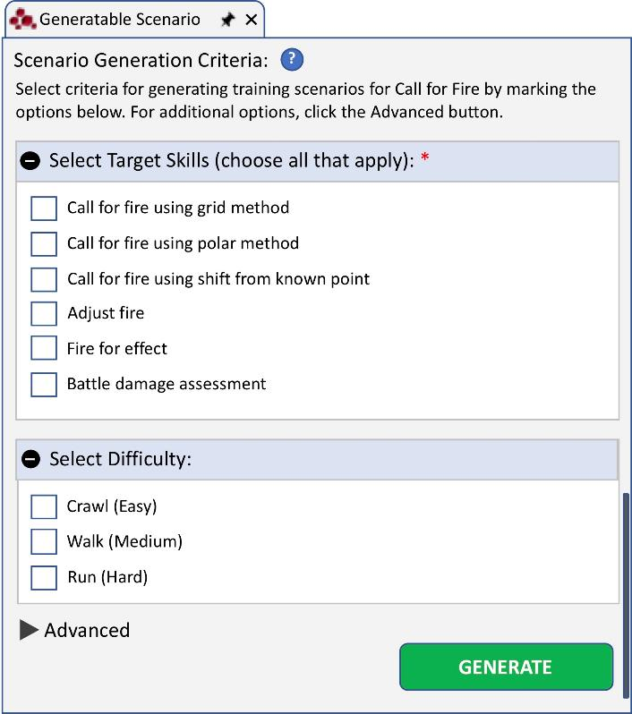
User Experience:
Instructor & Content Developer
Provide example scenarios as input
Select criteria for automated scenario generation
  Generate only night-time scenarios
  Omit high difficulty scenarios
Preview generated scenarios prior to running in VBS3

Slide 15
User Experience:
Instructor & Content Developer

Slide 16
User Experience:
Trainee
Automated scenario generation is invisible to learners
Training scenarios can be dynamically tailored to learner traits, knowledge, and performance
Scenario generation improves as more data is provided to DeepGen

Slide 17
Outline
DeepGen Scenario Generation Framework
Four C Model of Creativity
Four C-Based Novelty in Scenario Generation
Conclusions and Future Work

Slide 18
Four C Model of Creativity
Big-C
Pro-C
Little-C
Mini-C
Kaufman, J. & Beghetto, R. (2009). Beyond Big and Little: The Four C Model of Creativity.
Review of General Psychology, 13(1), 1-12.
Notes:
Represents a developmental trajectory of creativity in a person’s life.
Model for conceptualizing and classifying different levels of creative expression.
The way we conceptualize creativity has implications for how we approach measurement of creativity.
For RL-based scenario generation, which depends upon an optimization process guided by reward, how we measure creativity influences how RL task is configure.

Slide 19
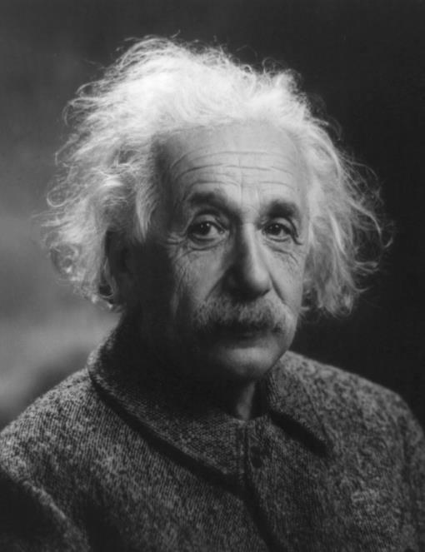
Big-C Creativity
Creativity that is historically significant and lasting
  Scientific discoveries
  Pulitzer Prize-winning novels
Big-C output often begins in 20s and peaks near 40 (Simonton, 1997)
Idea of Faustian bargain to sacrifice everything for use of creative gifts (Gardner, 1993)

Slide 20
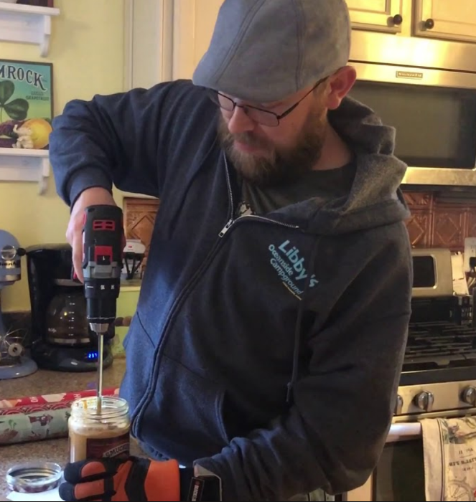
Little-C Creativity
Everyday-focused creativity
  Inventive problem solving
  Creative hobbies
Creative potential that is
widely distributed
Layperson theories of creativity
  Unconventionality
  Inquisitiveness
  Imagination
  Freedom
Notes:
Emphasize non-expert nature
Everyday moniker is a misonomer, since Little-C, Mini-C, and Pro-C are all “everyday” in a sense.

Slide 21

Pro-C Creativity
Developmental and effortful progression beyond Little-C
Antecedent to Big-C status
Consistent with expertise acquisition approach of creativity (Ericsson, 1996)
Notes:
Antecedent to Big-C, step in progression toward Big-C
Big-C and Little-C designations insufficiently acknowledges individuals who make a solid, professional creative contribution.

Slide 22

Mini-C Creativity
Creativity inherent in the learning process
Unique and personally meaningful interpretations of experiences and events
Mini-C implies different standards for creative insight than Little-C
Notes:
Knowledge construction

Slide 23
Outline
DeepGen Scenario Generation Framework
Four C Model of Creativity
Four C-Based Novelty in Scenario Generation
Conclusions and Future Work

Slide 24
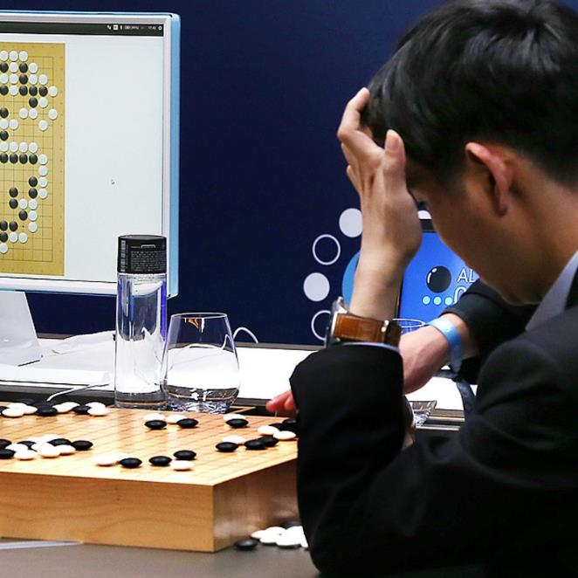
Big-C in Automated Scenario Generation
Scenarios that introduce fundamental, long-lasting changes to the rules or performance expectations of a target domain
Support anticipatory thinking
Examples:
  AlphaGo vs. Lee Sedol:
  Game 2, Move 37
  Millennium Challenge 2002 wargaming exercise
Notes:
AlphaGo: Move 37 by AlphaGo, Lee Sedol left the table and match room for close to 15 minutes while his game clock kept ticking. Commentators remarked about the creativity of the move, and indicated that it hadn’t been seen before in professional play.
Millennium Challenge: large-scale $250M wargaming exercise involving US (BLUE) vs. middle eastern adversary (RED)
Retired Marine Corps General led RED force. Asymmetric strategy. WWII era light signals for launching planes. Motorcycle messengers to transmit orders. Avoid sophisticated Blue team surveillance network. RED pre-emptive strike destroyed 16 BLUE warships, analogous to deaths of over 20,000 service personnel.
Stopped and restarted the wargaming exercise. Rules of engagement changed.
Note: Only selects innovative scenarios if they are more effective than competing options according to optimization process

Slide 25
Big-C in Automated Scenario Generation
Computational requirements:
  Broad freedom to explore space of possible scenarios
  Direct access to high-fidelity simulation to produce emergent behavior
  Mechanism for automated evaluation of scenario quality
Contrasts with ML approaches designed to mimic expert human performance
Only selects innovative scenarios if they are more effective than competing options according to optimization process
Notes:
Key component is emergent behavior

Slide 26
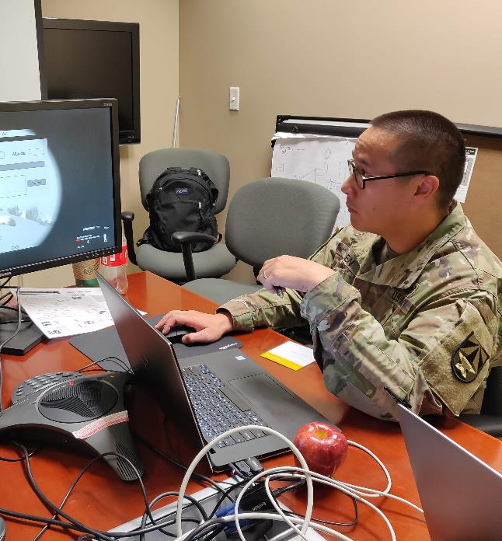
Pro-C in Automated Scenario Generation
Scenarios meet requirements for value and distinctiveness held by domain expert
Offer value to commanders, instructors, and advanced trainees
Pro-C is a target level for DeepGen

Slide 27
Pro-C in Automated Scenario Generation
Computational requirements:
  Expansive scenario adaptation library that addresses a broad range of pedagogically relevant aspects of a scenario
  Augment both initial configuration and run-time events in scenario
Scenario adaptation library can be designed to ensure that generated scenarios are realistic, useful, and qualitatively different.
Introduce experiential novelty without requiring complex orchestration of simulation entities and/or events
  Modify assigned objective for the forward observer in CFF scenario
  Introduce a target of opportunity

Slide 28
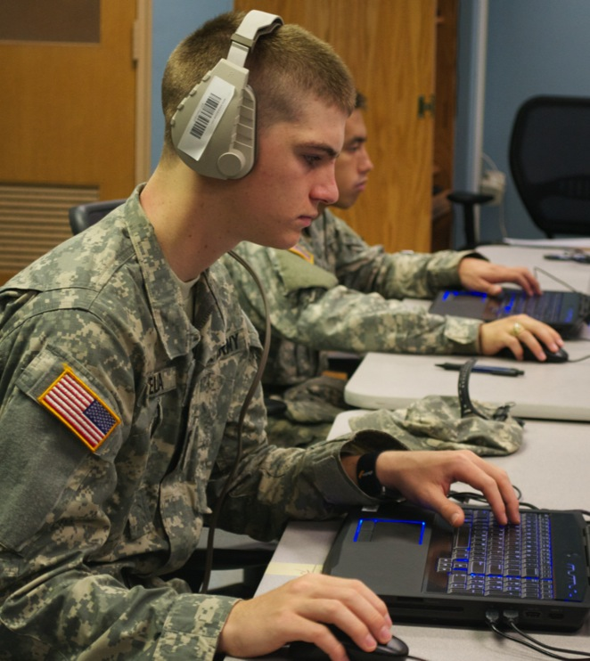
Little-C in Automated Scenario Generation
Generate scenarios to support acquisition of basic proficiency
  Move units to different locations
  Change weather
Facilitate drill & practice while addressing concern about memorization in replayable scenarios
Little-C is also a target level for DeepGen

Slide 29
Mini-C in Automated Scenario Generation
Novelty that is perceived by novice learners as they begin to learn a new domain
Generate “introductory” scenarios
  Scaffold performance through prompts and cues
  Provide immediate feedback within simulation
Maintain low complexity of mission and scenario events
Scaffolding features are included in DeepGen Scenario Adaptation Library

Slide 30
Demo Video

Slide 31
Outline
DeepGen Scenario Generation Framework
Four C Model of Creativity
Four C-Based Novelty in Scenario Generation
Conclusions and Future Work

Slide 32
Conclusions
Automated scenario generation has significant promise for meeting the objectives of simulation-based training
We are investigating deep RL-based scenario generation for Call for Fire training in the VBS3 simulation environment
The Four C Model of Creativity provides a useful framework for conceptualizing novelty in automated scenario generation
Each level of Four C-based novelty suggests different standards and computational requirements for automated scenario generation

Slide 33
Future Work
Investigate how instructors and learners interact with DeepGen tools and scenarios
Train deep RL scenario generation models with data from humans rather than simulated students
Investigate generalizability of DeepGen framework to additional training domains beyond CFF
Explore integration of deep RL-based scenario generation in GIFT
Notes:
Expand implementation of SAL in DeepGen Prototype
Initial demo and focus group-like meeting with Soldiers at MCOE at Ft. Benning
GIFT Integration: Practice Quadrant of EMAP

Slide 34


Keith Brawner (CCDC STTC)
Matthew Lee (IAI)
Wookhee Min (Comp. Science)
Yonatan Vaknin (IAI)
Pengcheng Wang (Comp. Science)
ARL cooperative agreement
W911NF-18-2-0020
jprowe@ncsu.edu

