Slide 1
Multimodal Machine Learning in Adaptive Instructional Systems: A Survey
Nathan Henderson
Jonathan Rowe
James Lester
North Carolina State University
Notes:
1st year PhD student in Computer Science in Dr. James Lester’s IntelliMedia lab at NCSU
Survey of recent multimodal research efforts, particularly within adaptive instructional systems, and how these technologies can be supported by GIFT in the future

Slide 2
Multimodal Learning Analytics
Notes:
Why Multimodal Learning Analytics are important

Slide 3
Outline
Introduction
Related Work
Challenges in Multimodal Machine Learning
Multimodal Machine Learning in GIFT
Conclusion
Notes:
Brief introduction to multimodal machine learning, and why it is important to adaptive instructional systems
Overview of recent multimodal work, particularly involving AISs
Challenges and common issues within multimodal systems
Current capabilities within GIFT supporting multimodal data analytics and how GIFT can better support future development of multimodal systems
Conclusions and recommendations for future work

Slide 4
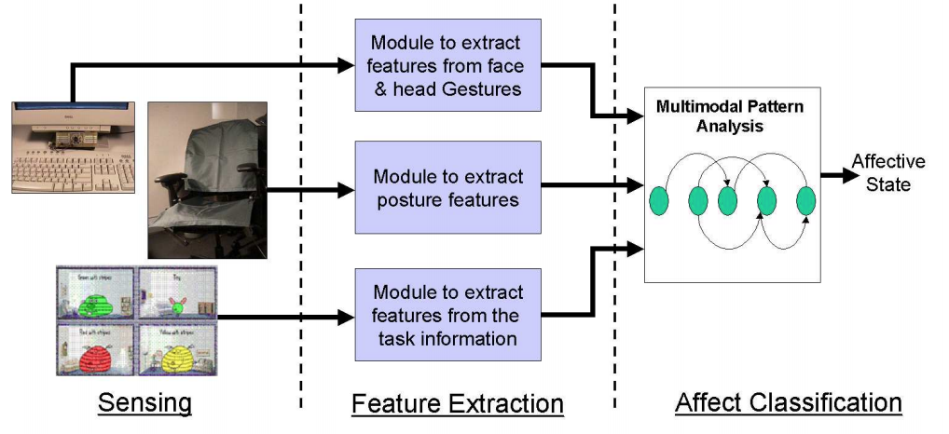
Why Multimodal?
Multimodal: involving multiple concurrent data channels, or “modalities”
Multimodal machine learning (MML) shown to yield improved models over unimodal systems
Affect detection
Goal recognition
(Kapoor et al., 2005)
Notes:
Why multimodal systems are important
First, brief definition of “multimodal”
Conceptual representation of human cognitive process compared to unimodal systems
Human perception of surrounding environments is multimodal

Slide 5
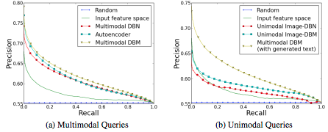
MML Applications
MML is utilized for a variety of tasks:
Speech classification (Ngiam et al., 2016)
Image annotation (Srivastava &
Salakhutdinov, 2012)
Sentiment analysis (Porio et al., 2015)
Stress detection (Kalimeri & Saltis, 2016)
Biometric identification (Rahman & Gavrilova, 2017)
In AISs, common application is affect detection
Shaping learning outcomes (Grafsgaard et al., 2014b)
(Srivastava & Salakhutdinov, 2012)
Notes:
Recent advances in computational capabilities, as well as increased access to multi-channel data through sensor and other sources have led to MML being applied to a multitude of domains
Image: Performance of multimodal automated image annotation system vs unimodal
Remedying negative affective states such as boredom or frustration (DeFalco et al., 2018; Harley et al., 2015)
Predicting positive affective states such as engagement (Grafsgaard et al., 2014a)

Slide 6
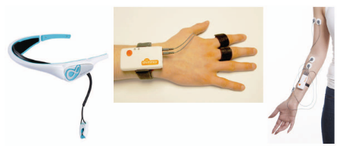
Common Modalities
Sensor-Based Modalities
Eye gaze
Facial expression
Speech
Posture
Gesture
Electrodermal Activity (EDA)
Electroencephalography (EEG)
Electromyography (EMG)
Sensor-Free Modalities
Keystroke data
Mouse movement
Interaction trace logs
(Girardi, Lanubile, & Novielli, 2017)
Notes:
Facial expression, speech are easily captured
Eye gaze, posture, gesture require easily accessible but more specialized sensors
EDA, EEG, and EMG data require highly specialized equipment
Sensor-free data is easily collected
Facial expression and voice are most commonly-used modalities

Slide 7
Issues
Multimodal systems can produce large volumes of data
Data storage
Computational resource requirements
Scalability
Sensors in sensor-based multimodal systems can be unreliable
Noise
Mistracking
Interference

Slide 8
Outline
Introduction
Related Work
Challenges in Multimodal Machine Learning
Multimodal Machine Learning in GIFT
Conclusion
Notes:
Recent applications of MML in adaptive instructional systems (AISs)
Machine learning algorithms
Modalities utilized
Addressing common issues and solutions within MML
Data fusion, alignment, and imputation
Practical considerations for multimodal data collection and analysis
Future enhancements to GIFT for further support of MML

Slide 9
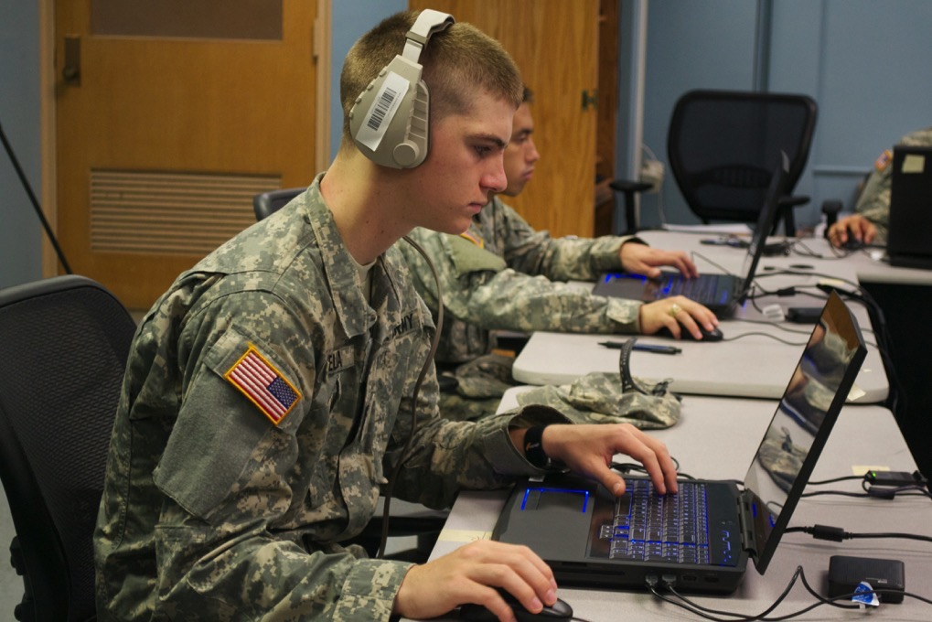
Multimodal Tasks
Recent uses of multimodal machine learning (MML):
Detection and classification of various affective states (DeFalco et al., 2018)
Performance assessment (Grafsgaard et al., 2014b)
Metacognition modeling (Bradbury, Taub, & Azevedo, 2017)
Environments for multimodal data
collection
Laboratory (Taub et al., 2017)
Classroom (Bosch et al., 2016)
Military training (DeFalco et al., 2018)
Notes:
Performance Assessment: Learning Gain, perhaps through using pretests and posttests as metrics
Frustration (DeFalco et al., 2018)
Boredom (Bosch et al., 2016)
Engagement (Grafsgaard et al., 2014a)
Because of the increased generalizability of sensors, multimodal systems have seen increasingly frequent deployment in environments such as…

Slide 10
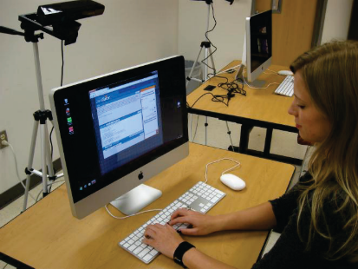
MML for AIS Tasks
MetaTutor (Harley et al., 2015)
Detecting engagement in students
Facial expressions and EDA data
JavaTutor (Vail et al., 2016)
Detecting frustration, engagement, disengagement in students
Microsoft Kinect posture data, depth data
(Harley et al., 2015)
(Vail et al., 2016)
Notes:
MetaTutor
Wel-known adaptive science-based learning environment
Results of paper focus on correlations between students’ self-reports of instances of affect during study with features within each modality
Analyzed correlations in modalities with self-reported affect
JavaTutor
Online remote tutoring system focusing on Java programming developed at NCSU
Correlated self-reported affective states with Microsoft Kinect posture data
Postural activity indicative of increased frustration and decreased engagement

Slide 11
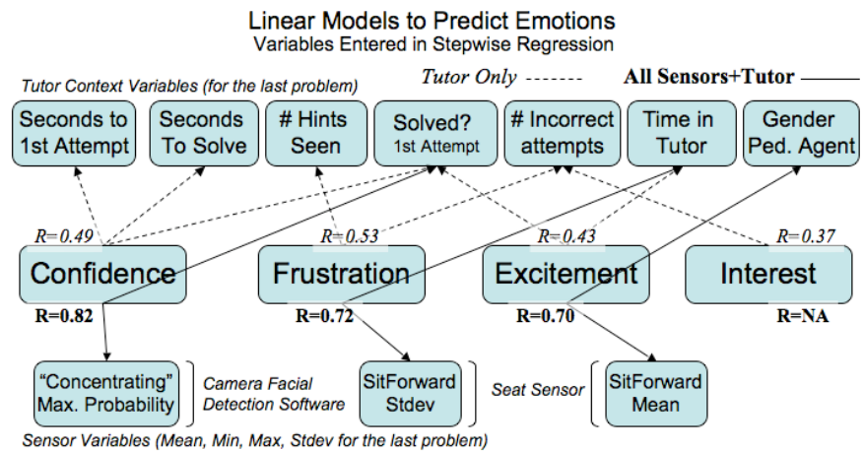
Multimodal Linear Model of Student Affect
Arroyo et al. (2009)
Notes:
Add notes AIS utilized for teaching geometry
Detecting confidence, frustration, excitement, and interest among students
Step-wise linear regression using facial expression, posture, EDA, and mouse pressure
Positive correlation between mouse pressure and frustration level
Facial expression indicative of approximately 60% of instances of affective states

Slide 12
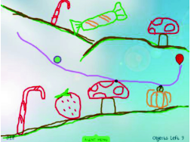
MML for AIS Tasks
Physics Playground (Bosch et al., 2015)
Constructing binary classifiers for detection of various affective states
Facial expressions, head and torso positioning, and gross body movement
Classifiers constructed using clustering techniques and Bayes Nets
Notes:
Well-known AIS teaching qualitative physics
Affective states: boredom, confusion, delight, engagement, and frustration

Slide 13
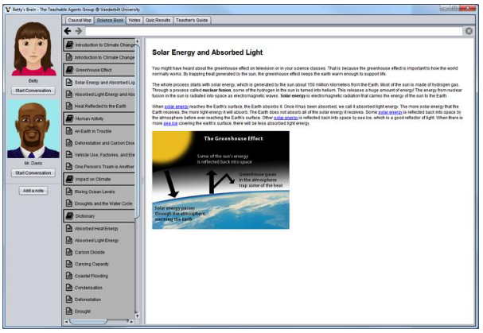
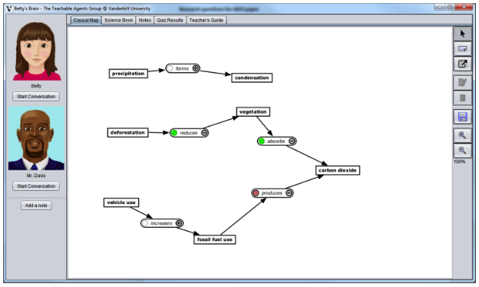
MML for AIS Tasks
Betty’s Brain (Rajendran et al., 2018)
Learning outcomes and performance assessment
Eye-gaze tracking, pupil dilation
Gradient tree boosting algorithm to model student reading performance
Notes:
Well-known ITS that uses teachable agents for science education
Find more recent citations, including Biswas

Slide 14
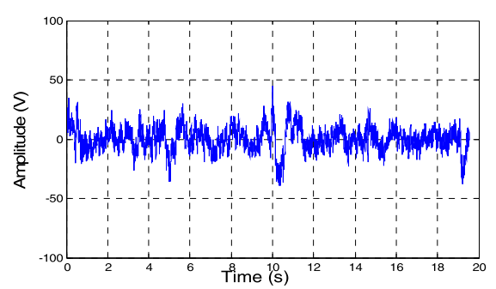
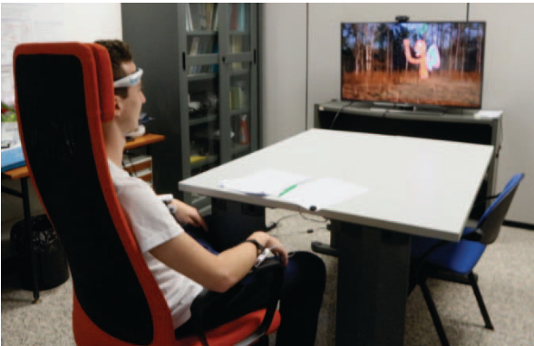
MML for non-AIS Tasks
Biometric identification (Rahman & Gavrilova, 2017)
Kinect posture data, EEG data
K-nearest neighbor clustering, histogram-oriented gradient features
Detecting arousal and valence levels (Girardi, Lanubile, & Novielli, 2017)
EEG, EDA, Electromyography (EMG) data
Naïve Bayes classifiers, support vector machines (SVMs), J48 decision trees
Notes:
Detecting arousal and valence levels while watching videos, as shown in second figure
Image: example of EEG signal from participant in biometric identification study

Slide 15
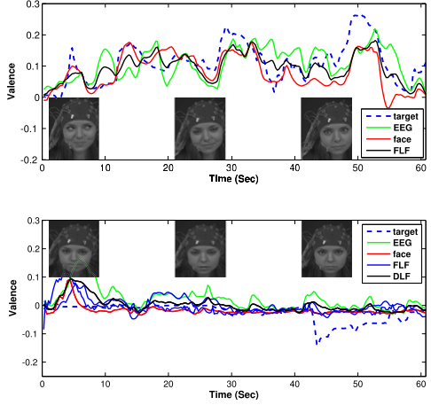
MML for non-AIS Tasks
Stress Detection (Kalimeri & Saitis, 2016)
EDA, EEG data
Random forest classifiers
Detecting arousal and valence levels (Soleymani et al., 2016)
EEG, facial expression data
Long short-term memory (LSTM) recurrent neural networks
Continuous conditional random fields
Notes:
Image; results for feature-level fusion (FLF) and decision-level fusion (DLF), where negative stimulus was not as easily detected as positive stimulus
Make point about more uncommon modalities occurring outside of AISs due to intrusiveness

Slide 16
Outline
Introduction
Related Work
Challenges in Multimodal Machine Learning
Multimodal Machine Learning in GIFT
Conclusion

Slide 17
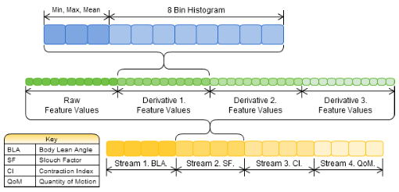
Temporal Context
Temporal information is often beneficial to MML models
Features like body lean angle and quantity of motion were extracted from postural data to add temporal context (Sanghvi et al., 2011)
Uses videos of students playing a virtual chess game
Notes:
Sensors often capture limited or no temporal context
Body lean angle, slouch factor, contraction index, quantity of motion can be extracted from postural data to add temporal context
Such information can often be beneficial to ML models (Henderson et al., 2019)

Slide 18
Multimodal Data Preprocessing
Imbalanced class problem
Example: instances of engagement occur more frequently than surprise or frustration
Resolved through minority cloning (oversampling of positive instances) or Synthetic Minority Over-sampling Technique (SMOTE) (Chawla et al., 2002)

Slide 19
Multimodal Data Imputation
Common solution is discarding data samples containing invalid modalities
Can significantly decrease size of available dataset
Alternative approach is to approximate or “impute” invalid data points based on existing data
Mean imputation
Autoencoders
Notes:
Noisy data (mistracking, background noise, low-quality sensor, etc.)
Missing data (faulty connections, sensor hardware failures, data storage issues, etc.)
Supervised techniques such as autoencoders require complete data, which might be sparse depending on the modalities available

Slide 20
Multimodal Data Fusion
Data fusion: integration of data from multiple modalities for classification or regression purposes
Early fusion: concatenation of feature vectors from separate modalities
“Feature-level fusion”
Late fusion: training a separate model for each modality and fusing the respective outputs
“Decision-level fusion”
Allows for different models to be used on each modality, possible boosting overall performance
Notes:
Most data fusion techniques are model-agnostic
Not reliant on a particular ML algorithm
Most fusion occurs before or after classification or regression has occurred
Early Fusion
Can occur before or after feature selection or reduction
Simplest fusion method
Only requires a single model
Late Fusion
Can be accomplished in several ways
Voting
Weighting
Another ML model
More robust than early fusion
Allows for models to be trained even if a modality is missing

Slide 21
Early Fusion
(Henderson et al., 2019)

Slide 22
Late Fusion
(Henderson et al., 2019)

Slide 23
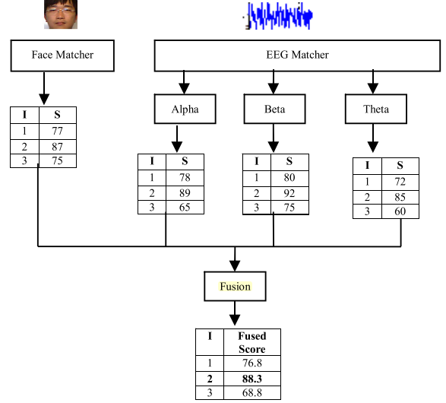
Multimodal Data Fusion
Biometric Identification (Rahman & Gavrilova, 2017)
EEG and Kinect posture data
Late fusion
Stress level detection (Kalimeri & Saitis, 2016)
EEG and EDA data
Early fusion
Affect detection (Patwardhan & Knapp, 2016)
Body tracking
Late fusion
Frustration detection (Henderson et al., 2019)
Kinect posture data, derived velocity data
Early fusion, late fusion
(Rahman & Gavrilova, 2017)
Notes:
Put back in
Consider removing earlier AIS examples instead

Slide 24
Data Alignment
Explicit alignment: aims to increase correlation between two modalities’ components
Increased emphasis on a similarity metric to evaluate alignment quality
A common approach is Dynamic Time Warping (DTW) (Wöllmer, et al., 2009)
Notes:
Data alignment: accounting for the relationships between sub-components of two or more modalities
Particularly relevant when multiple modalities operate or sample at differing frequencies
Undertaken using either explicit or implicit alignment techniques
Commonly pertains to time-series data
Dynamic programming approach applied to time-series data
Computes similarity between two modalities and inserts additional frames within modalities to find optimal match

Slide 25
Data Alignment
Implicit alignment: used for tasks where explicit alignment is not useful or feasible
Speech recognition, machine translation
Deep learning has become primary method of implicit alignment
Supervised alignment techniques require pre-labeled and aligned data
Common models include autoencoders and cross-modality retrieval models (Jaques et al., 2017)

Slide 26
Outline
Introduction
Related Work
Challenges in Multimodal Machine Learning
Multimodal Machine Learning in GIFT
Conclusion

Slide 27
MML in GIFT
GIFT has been used to develop and deploy AISs in a number of studies
Several has utilized GIFT’s Sensor Module for the collection of multimodal data
However, GIFT provides limited support for downstream analysis and modeling for MML techniques
We offer recommendations for enhancements to GIFT to better support multimodal AISs

Slide 28
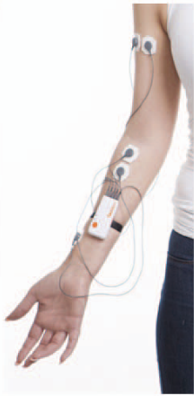
Expanding Modality Support
Current support for following modalities:
Posture
Gesture
Facial expression
EDA
EEG
Additional data channels can be added to GIFT-based AISs
Eye tracking
EMG
Additional sensor hardware support
Support for multiple sensors for a single modality
(Girardi, Lanubile, & Noviell, 2017)

Slide 29
Challenges for GIFT Multimodality
Integration of data preprocessing techniques into Sensor Module
Prior to data transmission to the GIFT Learner Module
Feature scaling
Normalization, standardization
Necessary for several ML algorithms (particularly deep learning)
Resolving class imbalances
Minority sample cloning, SMOTE
Requires data to be labeled prior to preprocessing

Slide 30
Feature Extraction Methods
Prevents Learner Module from having to process redundant or uninformative data
Principle Component Analysis
Variance thresholding
Reduces runtime requirements, computational resource needs
Supervised feature reduction or selection methods require labeled data
Forward feature selection

Slide 31
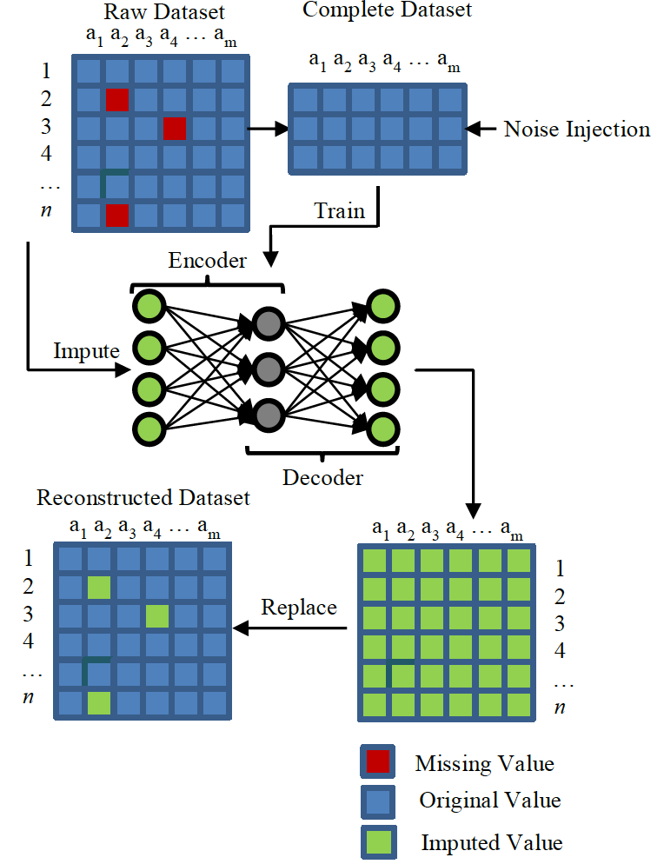
Data Imputation Methods
Reduce negative impact of missing data in GIFT analysis pipeline
Mean imputation
Does not require previously-labeled data or model training
Autoencoder-based imputation
More accurate imputation
Requires previously-labeled data, prior model training
Less effective when a majority of data is missing or invalid

Slide 32
Data Fusion Methods
Aid Learner Module in dealing with multiple data channels
Early Fusion
Programmatically simple to integrate
Modality features concatenated prior to being passed to Learner Module
Late Fusion
Requires multiple independently trained models
Requires voting schema
Higher computational workload
Shown to outperform Early Fusion (Rahman & Gavrilova, 2017)

Slide 33
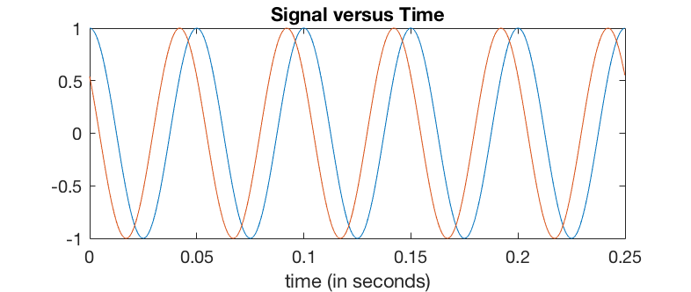
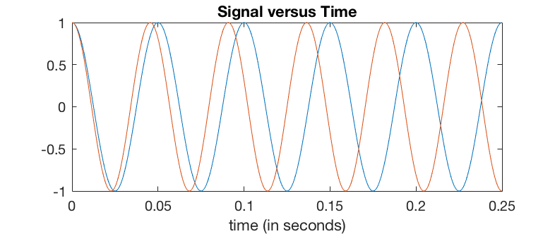
Data Alignment Techniques
Handling of disparate data streams
Explicit alignment: Dynamic Time Warping
DTW works well with linear relationships across modalities, but does not work well with non-linear relationships
Implicit Alignment: Deep Learning
Requires pre-labeled aligned data
Notes:
Commonly uses canonical correlation analysis as linear transformation for similarity metric
Implicit requirement for pre-aligned data to train network
Data often lacks explicitly annotated data
DTW requires both modalities’ timesteps to be comparable and compatible with the similarity metric
Deep learning has also been utilized as an explicit alignment technique

Slide 34
Implementation of ML tools
Allows GIFT to implement an entire multimodal data processing pipeline
Data capture
Preprocessing
Imputation (if necessary)
Modeling
Supervised ML techniques require labeled training data
Data-intensive methods such as CNNs, RNNs require adequate computational support (GPU support)

Slide 35
Outline
Introduction
Related Work
Challenges in Multimodal Machine Learning
Multimodal Machine Learning in GIFT
Conclusion

Slide 36
Conclusion
MML plays a critical role in development of AISs
Enables AISs to implement data-rich models of student learning
We have provided a survey of recent work on multimodal machine learning in AIS and non-AIS domains
There is a significant opportunity for enhancements to GIFT that would broaden support for MML in AISs
Notes:
design, development, and evaluation of AISs
Can be utilized to integrate adaptive technologies to improve student outcomes
Survey:
Common ML techniques
Key components of multimodal data analytics
Challenges faced by developers of multimodal systems

Slide 37
Randall Spain (Computer Science)
Andy Smith (Computer Science)
Andrew Emerson (Computer Science)
Sarah Reaves (Computer Science)
Wookhee Min (Computer Science)
Bradford Mott
Nathan Henderson: nlhender@ncsu.edu

