Slide 1
Teamwork Training Architecture, Scenarios, and Measures in GIFT
5/17/2019
Robert McCormack¹, Tara Kilcullen¹, Anne M. Sinatra², Alexander Case¹, Daniel Howard¹
Aptima, Inc.¹, U.S. Army Combat Capabilities Development Command (CCDC)- Solider Center - Simulation & Training Technology Center (STTC)²

Slide 2
Overview
Introduction
Teamwork Architecture
Scenario
Measures
Next Steps

Slide 3
Introduction
Objective: Develop a scalable system capable of training teamwork skills for teams and teams-of-teams in a realistic environment with GIFT.
Why train teamwork?
Teamwork skills Performance outcomes
Teams change over time. Need to proactively train rather than rely on pre-existing relationships.
There are a number of aspects of teamwork (Sottilare, et. al., 2017)
Coordination
Cohesion
Communication
Conflict Management
Etc.
GIFT offers a promising framework for teamwork tutoring, but architecture has been geared towards individual training.
+

Slide 4
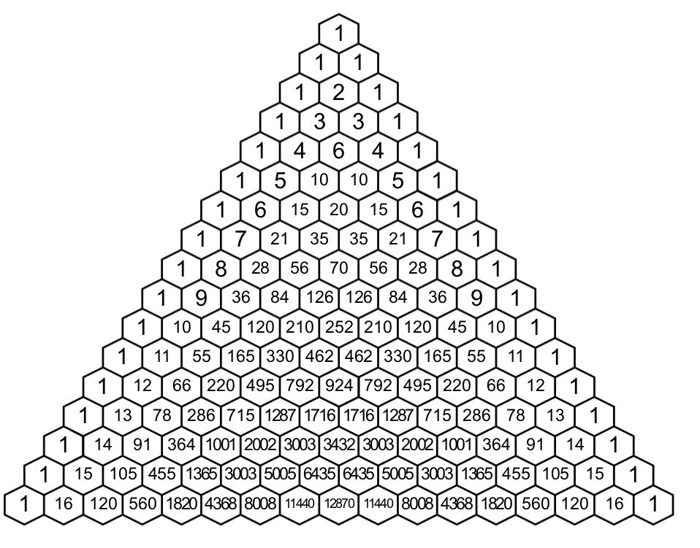
Designing a Scalable Architecture
The scalability issue
1 Trainee = 1 DKF
2 Trainees = 3 DKFs
2 individual + 1 team
3 Trainees = 7 DKFs
3 individual + 3 2-person + 1 team
4 Trainees = 15 DKFs
4 individual + 6 2-person + 4 3-person + 1 team
…
9 Trainees = 511 DKFs!!!
9 individual + 36 2-person + 84 3-person + 126 4-person+ 126 5-person + 84 6-person + 36 7-person + 9 8-person + 1 team
N Trainees =$2^{N}−1$ DKFs
$\sum_{i=1}^{N}{\left(\begin{matrix}N \\ i\end{matrix}\right)}$

Slide 5
Designing a Scalable Architecture
Since our objective is to train teamwork skills, our approach focuses primarily at the team-level (to start).
Create a single, master DKF that all trainees use.
Each trainee has an instance of GIFT running with a copy of the master DKF.
The training environment (in this case VBS3) is in charge of managing client interconnections via a data bus.
Measures and feedback are calculated by monitoring data flow on the bus and are identical across GIFT instances.
Advantages
Simplifies DKF development and management,
All team members receive the same feedback at the same time.
Limitations
Individualized measurement and feedback currently not possible,
Requires some manual coordination of GIFT lesson progression.

Slide 6
Teamwork Architecture
…
Mission Host
VBS DIS BUS
DKF
DKF
DKF
Copy
Copy
Copy
Master DKF

Slide 7
Teamwork Training Scenario
The scenario is adapted from an Army Basic Leader Course (BLC) Combat Search and Rescue (CSAR) training module.
The team consists of 9 individuals: 1 squad leader and 2 four-person fire teams.
The narrative of the scenario involves search and rescue of an F-16 pilot who has ejected and landed in hostile territory.
Primary Objective: Locate and extract the pilot
Secondary Objective: Reach the nearby village
The scenario is broken into 5 (somewhat) independent vignettes
Encountering an IED
Finding and Rescuing the Pilot
Reacting to Harassing Fire from Hostile Militia
Encountering an IED
Reacting to an Unknown Individual

Slide 8
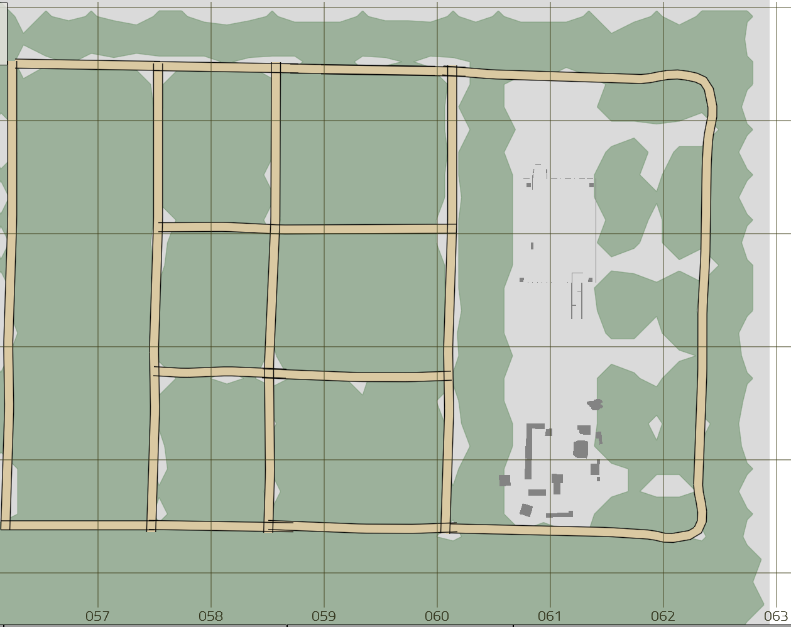
Scenario Map
Hoax IED
Start
Downed Pilot
Harassing Fire
Village/End
Civilian Cart
Real IED

Slide 9
GIFT Lesson Introduction
Welcome to Teamwork Tutor. This course is designed to provide you and your team opportunities to develop and practice teamwork skills within an analog tactical environment. Teamwork is essential in high-functioning teams and relies on close collaboration and coordination among all members. As you progress through the course, remember to communicate with your teammates and to maintain awareness of your teammates’ actions and locations.
In this course, you are a member of a nine-person squad consisting of a squad leader and two four-person fire teams. Your mission is as follows:
An USAF F-16C was shot down by S-125 Neva/Pechora Surface-to-Air Missile at 0430 this morning over AO Texas. The pilot ejected, but is currently pinned down in hostile territory. Radio communication is limited as the enemy has the ability to intercept transmissions. Although the general area where the pilot landed is known, the pilot’s exact location and medical condition are unknown at this time. Your primary objective, starting at FOB Elend is to proceed on foot to the area of the pilot’s last known location, locate the pilot, and perform a MEDEVAC. You are then to proceed to Sazed, a small village nearby.
Enemy militia are known to be very active throughout AO Texas. They are believed to be testing new IED strategies and are known to use a variety small arms against blue force. As you proceed, maintain situational awareness of your area and be on the lookout for anything or anyone unusual or out of place.
This course is broken into several vignettes, each designed to strengthen your collaboration, coordination, and communication teamwork. Before each vignette you will receive instructions on where to proceed and what to focus on. After each vignette the team will be scored on their ability to successfully solve the problems presented as a team. You have received supplemental material print-outs which may be referenced throughout the training. In some of the vignettes, you will be required to take specific actions to address the situation. These actions are found by pressing the F12 key. When it is necessary to preform these actions, the team will need to coordinate to select the correct action in the correct order. One person should not take all the actions, but rather the actions should be spread across as many team members as possible. Remember to listen and to act quickly.

Slide 10
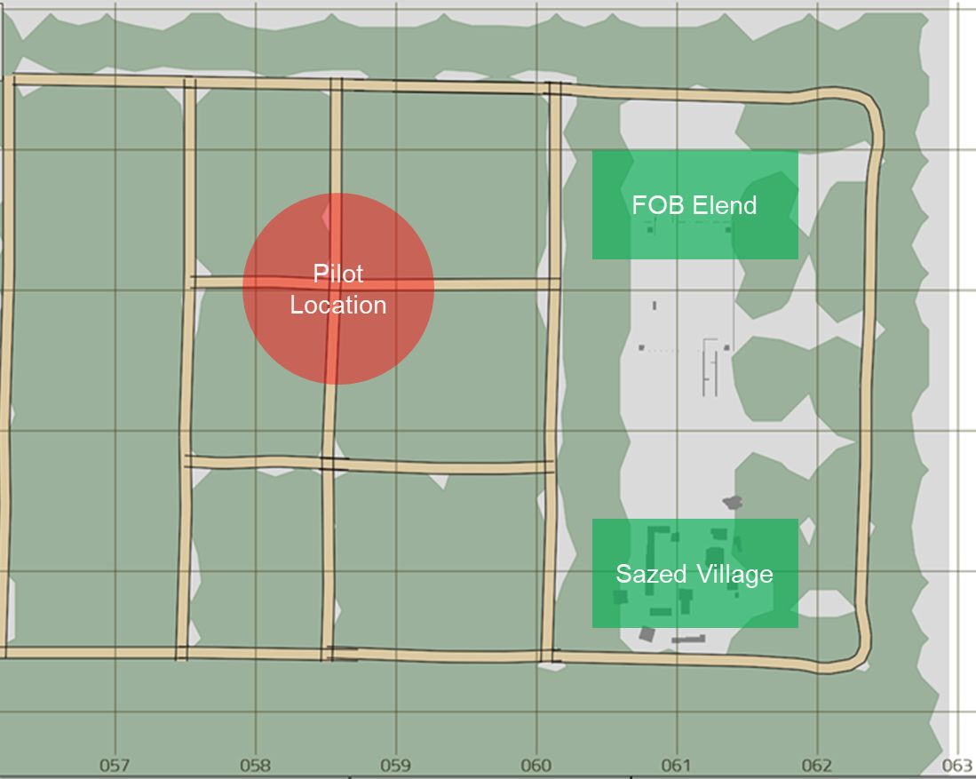
AO Texas Map

Slide 11
IED Introduction
In this first stage, your team starts at FOB Elend. You may spend as much time as you need within the FOB to familiarize yourself with the system controls. Refer to the “VBS3 Command Reference Sheet” for reminders on keyboard and mouse controls.
When you are ready, proceed along the indicated path on the map on the next page. As the team proceeds along the path, remember to maintain formation and a reasonable distance between team members. As a team, maintain visual awareness in all directions. Communicate any potential threats to each other and listen to your teammates.
When you are ready, proceed to the map on the next page.

Slide 12
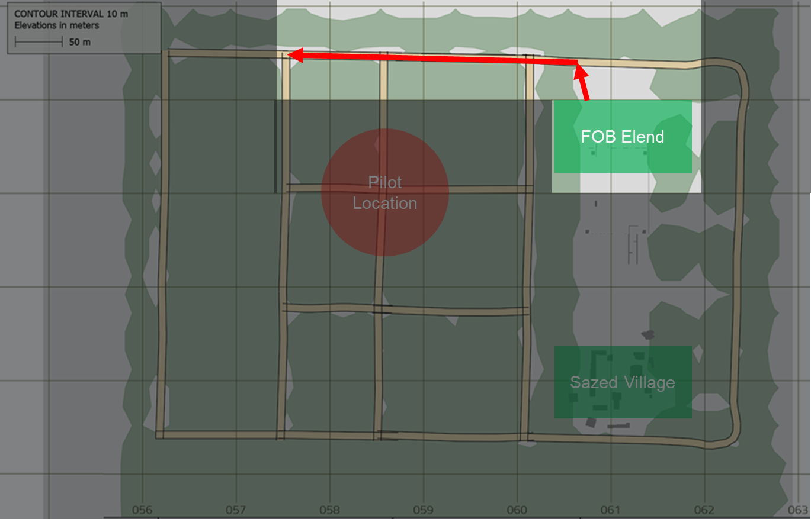
AO Texas Map

Slide 13
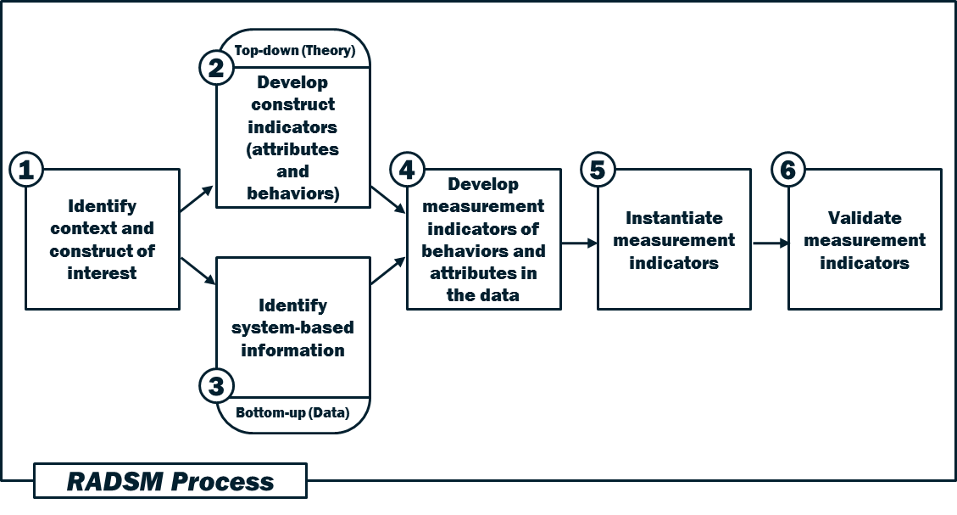
Teamwork Measurement Development
Teamwork Construct: Coordination
Synchronization and awareness of team member actions in pursuit of a common team goal

Slide 14
Teamwork Measures
Vignette: Hoax IED
The team identifies the potential threat, communicates with each other, and comes to a halt.
The team maintains a close formation during movement.
The team maintains visual control over their environment.
The team coordinates selection of the 5 “C”s after the IED threat is identified
Vignette: Pilot MEDEVAC
The team quickly locates, applies first aid, and evacuates the pilot
The team coordinates selection of the first aid procedure
The team maintains visual control over the environment
Vignette: Harassing Fire
The team maintains a close formation during movement
The team quickly takes cover when harassing fire starts
The team quickly identifies the location of the militants
The team eliminates the hostile threat (militants killed or fled), but does not pursue

Slide 15
Teamwork Measures
Vignette: Real IED
The team identifies the potential threat, communicates with each other, and comes to a halt.
The team maintains a close formation during movement.
The team maintains visual control over their environment.
The team coordinates selection of the 5 “C”s after the IED threat is identified
Vignette: Person with Cart
The team quickly identifies the person as a potential threat and halts movement
The team coordinates selection of “Show, Shout, Shoot” from the menu

Slide 16
Hoax IED Vignette Measures

Slide 17
Teamwork Measure: Formation
Name: Team Formation
Teamwork Construct: Coordination
Description: During movement along the road (prior to encounter of the hoax/real IED), the team should maintain a close formation. This initial measure will focus on the geodesic distance of the team, rather than on the relative positioning of each player. Geodesic distance is defined as the farthest distance any two team members are apart. That is, we measure the distance between each pair of individuals, and take the maximum. The geodesic distance and the teams (above/at/below) expectation rating should be reported every 15 seconds.
Relationship to Construct: Requires team members maintain visual control of each other and coordinate movement
Measurement Elements:
ID of each team member
Position of each team member
Measurement Outcome:
Above Expectation: 8m < Geodesic distance < 12m
At Expectation: 5m < Geodesic distance < 8m OR 12m < Geodesic distance < 15m
Below Expectation: Geodesic distance < 5m OR Geodesic distance > 15m
Condition Class: Geodesic Distance

Slide 18
Teamwork Measure: Halt
Name: Halt
Teamwork Construct: Coordination
Description: The first person to notice the IED halts and gives the command to teammates to halt. We define a maximum and minimum distance from the IED. Once an individual is within the maximum distance radius, we monitor their movement and look for a stop of movement. We then monitor other team members to identify if/when they stop movement. If an individual has reached the minimum radius before a halt occurs, the entire team fails.
Relationship to Construct: Requires team members to vocally or visually communicate the threat and ensure every member has been notified
Measurement Elements:
ID of first person to halt
Time of first halt
Distance of first halt
Time of calling for team members to halt by first person
ID of other team members to halt
Time of each team member’s halt
Measurement Outcome:
Above Expectation: first person halts between minimum/maximum distance, calls halt, other team members halt within 3 seconds of call.
At Expectation: first person halts between minimum/maximum distance, calls halt, some team members halt within 3 seconds, but other team members halt before reaching minimum distance, but after 3 seconds.
Below Expectation: Any team member crosses minimum distance radius before halt is complete.
Condition Class: Team Movement Coordination

Slide 19
Teamwork Measure: Visual Control
Name: Visual Control/Scanning
Teamwork Construct: Coordination
Description: After the halt is called, when all team members are stopped, the team should scan their surroundings for potential threats. To measure this, we take each team members orientation angle and assume that they can visually assess a +-30 degree arc [NOTE: we need to determine what this value actually should be based on the FOV is VBS3] from their orientation angle. The union of all of these arcs across the team should cover the entire 360 degrees. As a simple example, consider a 3 person team with the following orientations:
i. Person 1: facing 90 degrees, so their FOV is 60 degrees to 120 degrees
ii. Person 2: facing 45 degrees, so their FOV is 15 to 75 degrees
iii. Person 3: facing 150 degrees, so their FOV is 120 to 180 degrees
iv. Person 4: facing 270 degrees, so their FOV is 240 to 300 degrees
v. Person 5: facing 330 degrees, so their FOV is 300 to 360 degrees
vi. Person 6: facing 240 degrees, so their FOV is 210 to 270 degrees
If we compute the union of all FOVs, we see that 0-15 degrees is not covered and 180-210 degrees is not covered. Any threats in these arcs could not be visually assessed by the team.
Relationship to Construct: Requires knowledge of others’ position/orientation and communication of potential threats in environment
Measurement Elements:
ID of each team member
FOV of each team member
Orientation of each team member
Measurement Outcome:
Above Expectation: There are less than 10 degrees not covered in the union of FOVs
At Expectation: There are between 10 and 30 degrees not covered in the union of FOVs
Below Expectation: There are greater than 30 degrees not covered in the union of FOVs
Condition Class: Team Circular Covrage

Slide 20
Teamwork Measure: 5 “C”s
Name: 5 “C”s action sequence
Teamwork Construct: Coordination
Description: After noticing the IED, the team correctly selects the 5 “C”s from the drop down menu in the right order. Each person may only select one item from the list, and the selection should be completed in a timely manner. Team members should communicate and coordinate on who is completing a selection and which is the correct order of selection.
Relationship to Construct: Requires team members to identify the correct actions in the correct order, but also coordinate on who is selecting which action.
Measurement Elements:
ID of each team member
Actions selected
Order of selection
Time to complete selection
Measurement Outcome:
Above Expectation: 5 different individuals correctly chooses the 5 “C”s in the right order from the menu. Completes selection within one minute.
At Expectation: At least 4 different individuals choose the 5 “C”s, but in the wrong order or it takes longer than one minute, but less than two minutes.
Below Expectation: The team fails to select the correct 5 “C”s, makes an incorrect selection, or takes longer than two minutes, or selections are only made by 3 or fewer individuals
Condition Class: Team Sequence Tasks

Slide 21
Next Steps
Continue to adapt team architecture
Individualized measurement and feedback
Hierarchical team measurement and feedback
Generalizable condition classes
Expand teamwork measurement library
Cohesion
Conflict Management
Communication
Enhance communication sensing capabilities
Integrate audio capture and speech-to-text analysis
Integrate natural language processing approaches
Better team feedback
Video capture and replay capabilities
Learner Action Panel enhancements for immediate feedback

Slide 22
Acknowledgements
The research reported in this presentation was performed in connection with contract number W911NF-17-C-0061 with the U.S. Army Contracting Command - Aberdeen Proving Ground (ACC-APG). The views and conclusions contained in this document/presentation are those of the authors and should not be interpreted as presenting the official policies or position, either expressed or implied, of ACC-APG, U.S. Army Research Laboratory or the U.S. Government unless so designated by other authorized documents. Citation of manufacturer's or trade names does not constitute an official endorsement or approval of the use thereof. The U.S. Government is authorized to repro-duce and distribute reprints for Government purposes notwithstanding any copyright notation hereon.

Slide 23
Robert K. McCormack, Ph.D.
rmccormack@Aptima.com

