Slide 1
Architecture and Ontology in the Generalized Intelligent Framework for Tutoring: 2019 Update
Keith Brawner, PhD
Senior Engineer (AI /Training background)
Simulation and Training Technology Center (STTC)

Slide 2
Co-developers
Synapatic Sparks, Incorporated
Competencies
AWS Server
Language support
ICT
VHTk (this year)
Backend services for agents (SuperGLU)
After Action Review (coming soon)
Dignitas
Everyone should know them

Slide 3
AWS Maintenance
AWS / RDS Current State
Group GIFT Instance Nuxeo VM Database
Virtual
Human
Toolkit
GIFTVirtualHumanToolkitWindows
150 GB
34.215.207.19
GIFTVirtualHumanToolkitNuxeo
128 GB
virtualhumantoolkitgiftpostgresrds 100 GB
In use as CASS Integration
AWS
Cloud
Testing
GIFTSSIDevWindows
150 GB
52.43.174.125
GIFTSSIDevNuxeo
128 GB
Giftssidevrds
100 GB
GIFT
Cloud
(Production)
GIFTCloudWindows
1000 GB
34.223.241.235
GIFTCloudNuxeo
1000 GB
giftclouddbpostgre
100 GB

Slide 4
AWS Maintenance
AWS / DS Current State
GIFT Demo Machine - Stopped
Ohio State University – Grad Project with Shared AMIs – Project Beginning as Finals Concluded
Group GIFT Instance Nuxeo VM Database
Restarted for ICAP / NCSU Efforts for ~1 Month
NC
State
(Upgraded to
GIFT Cloud levels)
GIFT-0414AMIWindows
150 GB
52.35.159.244
GIFT-0414AMINuxeo
128 GB
test04282017newgiftclouddbpostgre 128 GB
Stopped
GIFTWrap
(VHT Levels)
GiftWrapDemo.gifttutoringclouddev.org
GIFTWrapWindows
150 GB
52.24.119.242
GIFTWrapNuxeo
128 GB
52.43.177.91
Giftwraprds
100 GB
Notes:
LandNav possibly being restarted

Slide 5
AWS Maintenance
AWS / RDS Current State
GIFTCloudELGG
30 GB
35.165.66.205
GIFTPiwikBitnami
10 GB
GIFTCloudMonitoring
40 GB
Support
VMs
Various Image Copies
Estimated Monthly Cost: Increased to roughly $3800 per month

Slide 6
New stuff
Instructional model (iCAP)
Old MBP is now depreciated (did anyone notice?)
VHTk
Multiple characters in latest
LTI
Sticking with v1.1.1
LRS
Conversation about xAPI profiles, CASS, LTSC
Team
In dev. Demo’d at ITSEC.
Psychomotor
In dev. USMA Land Nav x2, breathing.

Slide 7
Sorry
Community requested features currently unavailable
Wheelspinning prediction
Please use RapidMiner, Python, XML-RPC, examples…
Motivational Assessments
Soon
NLP for team interactions
Easier said than done
Better user guide
Updated
Predictive analysis of performance and Training ROI
???
Human in the Loop
In dev (see next slides)

Slide 8
Authoring items
Yes, Yes, we know that you don’t like DKFs.
GIFT Exchange now GIFT Wrap
More to come later

Slide 9
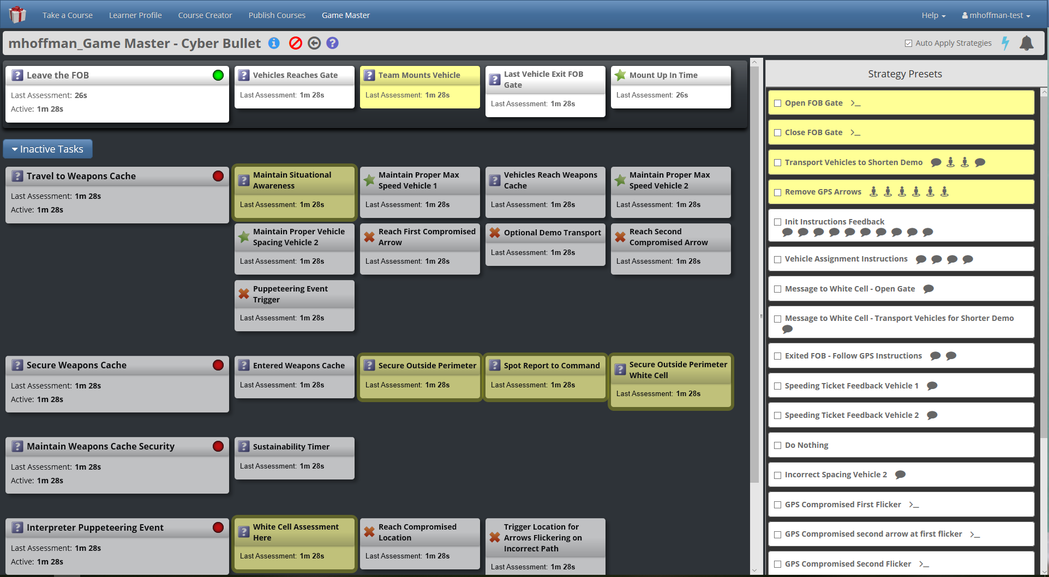
Observer-Controller

Slide 10
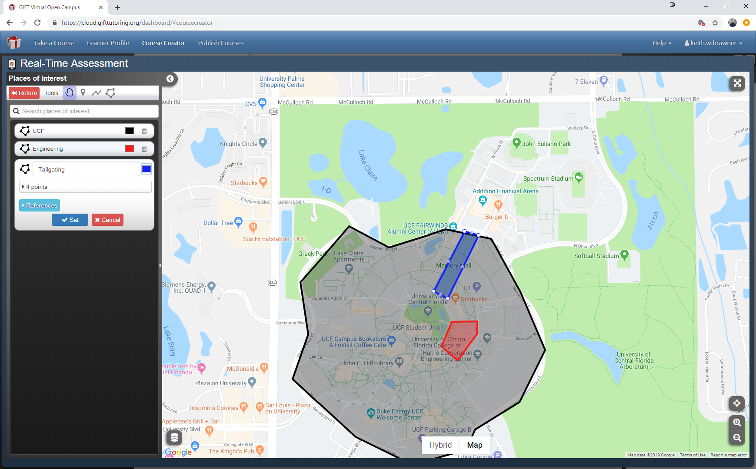
Authoring – Mobile App

Slide 11
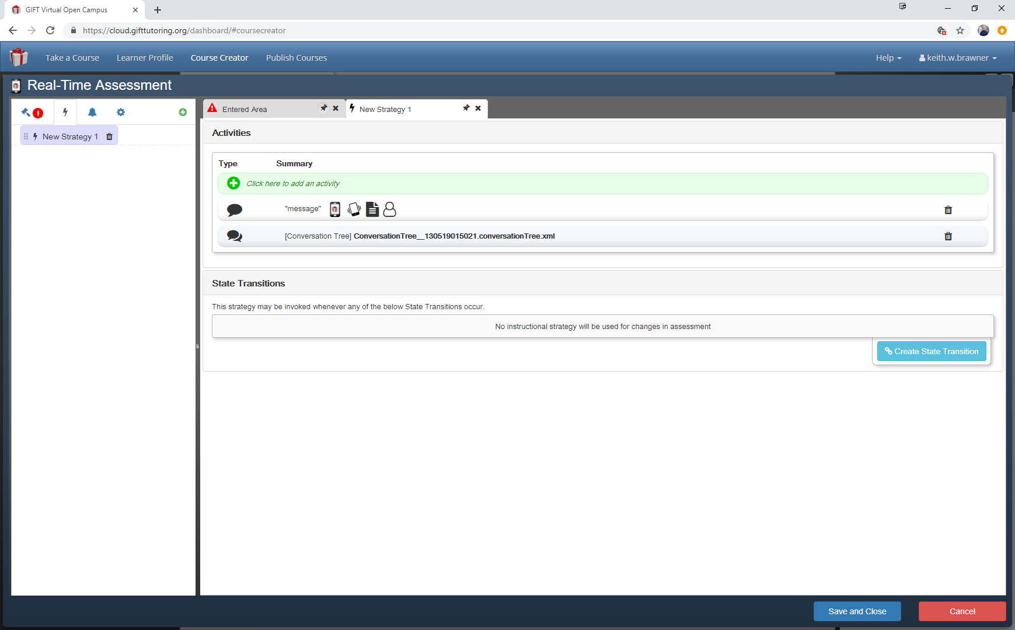
Authoring – Strategy Set

Slide 12
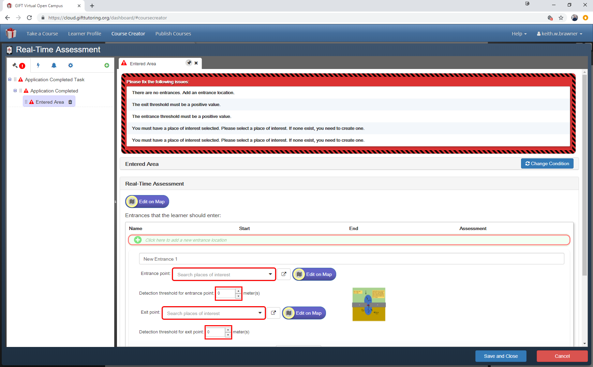
Authoring - General

Slide 13
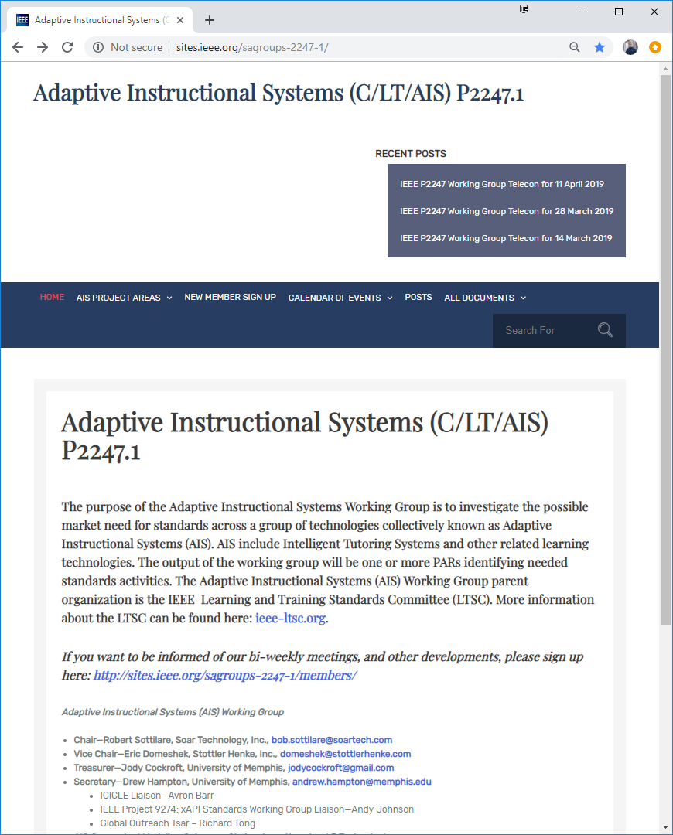
Standards
Well under way
HCII event
7/26-31/2019
ITSEC Event
12/2-6/2019
Monthly calls

Slide 14
Comments and Pain Points

