Slide 1


Authoring Team Tutors in GIFT:
An Automated Tool for Alignment of
Content to Learning Objectives
Benjamin Bell, Ph.D.¹, Keith Brawner, Ph.D.², Elliot Robson¹,
Debbie Brown¹, Elaine Kelsey¹
¹ Eduworks Corporation, Corvallis, OR
² RDECOM-NSRDEC, Orlando, FL
GIFTSym 7
UCF • Orlando, Florida • May 16-17, 2019

Slide 2
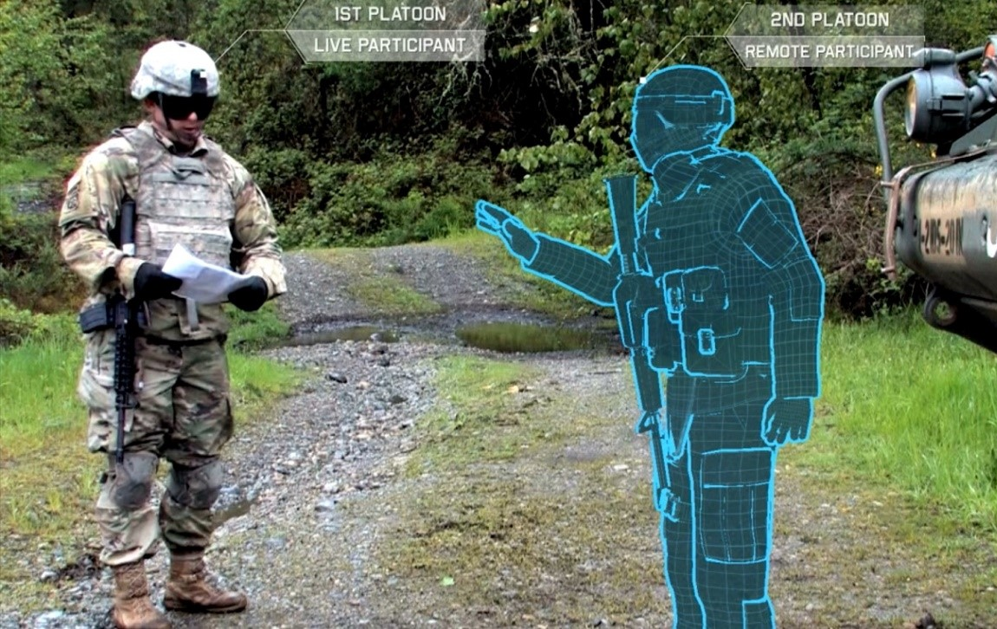

Gap: Scaling Team Training for ITS
Team tutoring & tools needed to achieve STE vision
ITS authoring tools can reduce training development time and cost
Gap: Team Training
  Need to support taskwork vs. teamwork distinctions
  Need content aligned to specific learning objectives and tasks
  Need content aligned with team roles
Impractical without
  Automated authoring support tools to streamline content tagging, discovery
  Integrated ITS development workflows that propel reuse & repurposing of tagged content

Slide 3
ISD & Authoring with MAGIC
Machine-Assisted Generation of Instructional Content
Define &
Organize LOs
Supported via integration with CASS
Find resources that align with LOs and team/soldier roles
Supported by AI and NLP enabled alignment and classification algorithms
Assemble into a team tutor
Supported by advanced search and packaging options
Need tools that:
  Find, organize & curate resources aligned with desired learning objectives
  Distinguish individual vs team tasks, team roles
  Identify content aligned with specific learning objectives, task type, and team roles
Solution Gap:
Automated Content Extraction, Tagging, & Discovery

Slide 4





MAGIC at a Glance
METLs, Learning Objectives
Training content selection that exceeds output from human instructional designers in reliability and speed
Corpus
Human Rating Data

Slide 5




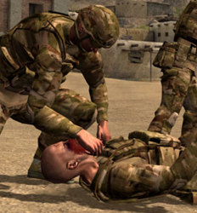
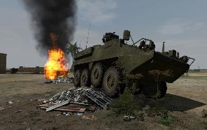
Align content w/Learning Objectives
Tag as individual or team type; Tag with team role
Learning Objectives
☑---------------------------------
☑ ____________________
☑ ____________________
☑ ____________________
☑ ____________________
☑ ____________________
☑ ____________________
Instructional Design Challenge:
Given a list of learning objectives…
Quickly find all relevant documents and portions of documents in a large corpus
Tag and filter by level of relevance
  relevance to ‘team’ or ‘individual’
  relevance to team roles
Content excerpts tagged by LO, type, & role
Content
LOs

Slide 6
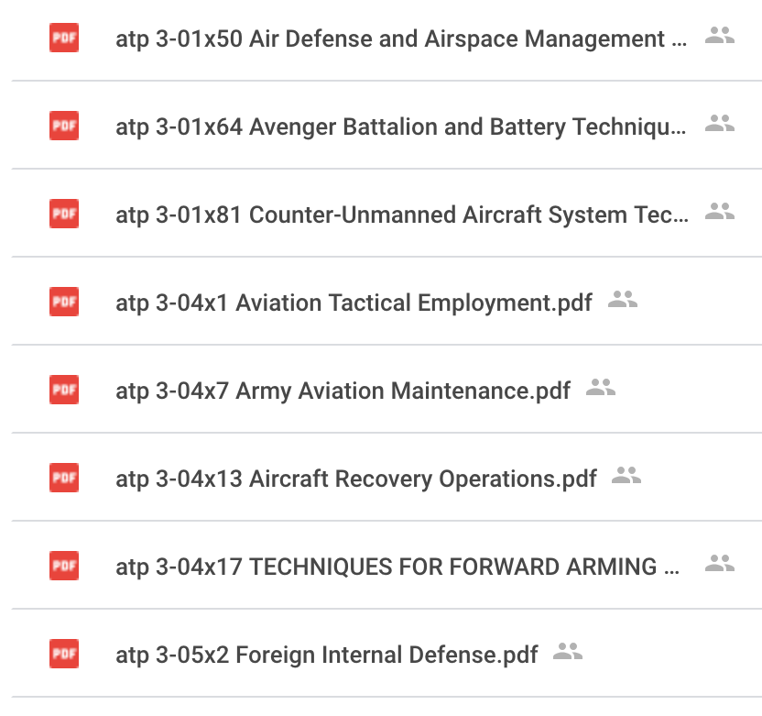
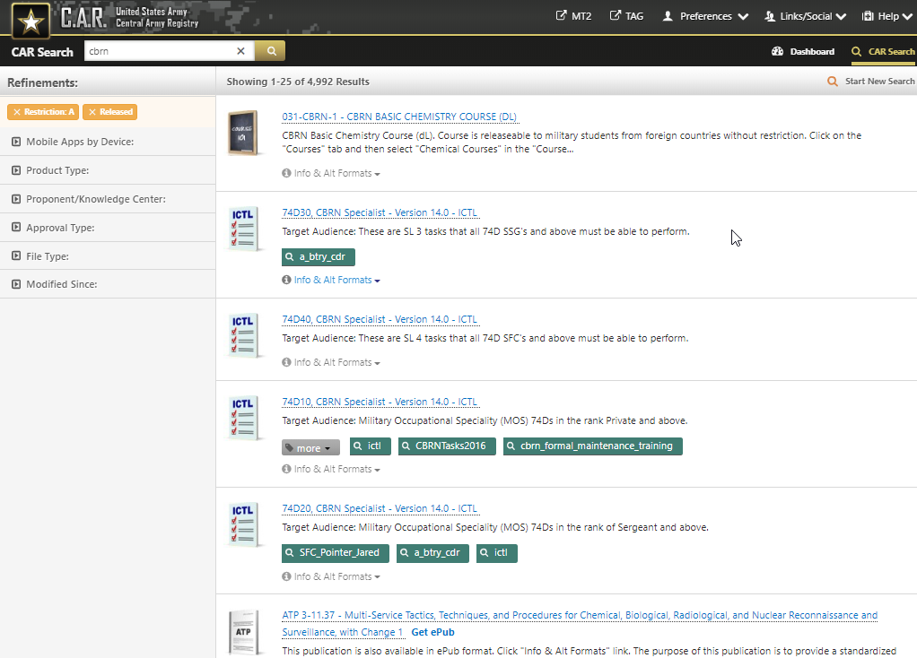
Input 1: Document Corpus

Slide 7
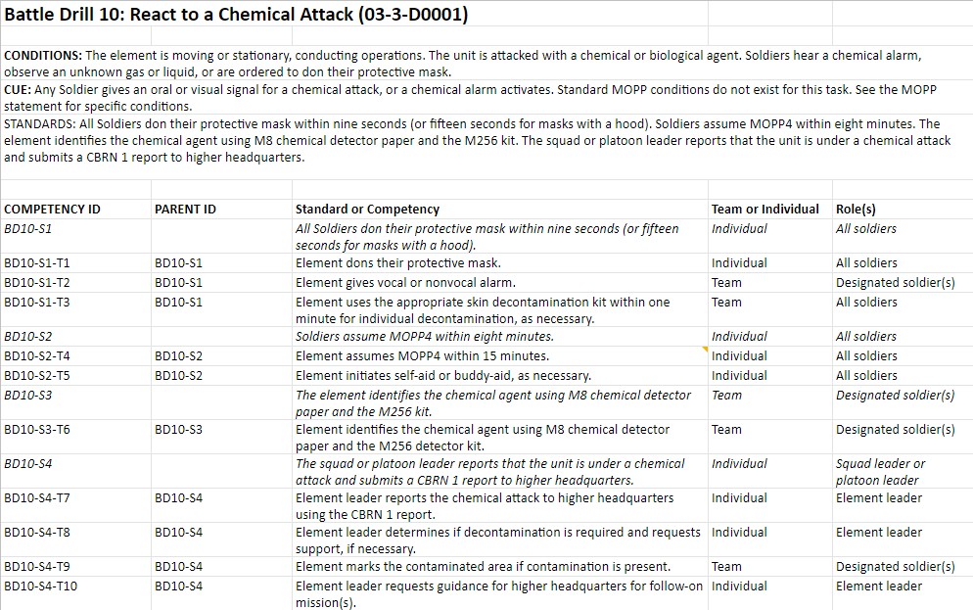
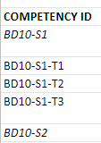

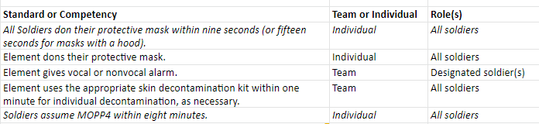
Input 2: LOs
(Team Competency Framework)
6

Slide 8
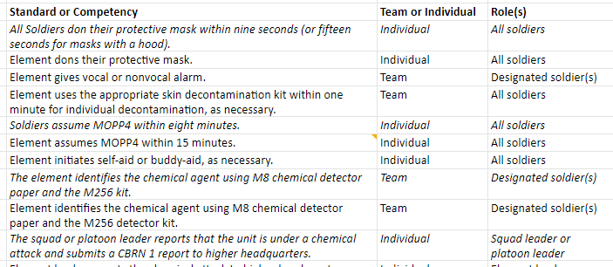
Excerpt Extraction
  Extract content excerpts aligned to LO in Competency Framework
  Much more challenging than topic detection in large documents
  Matching short text string (LO) & limited context
Notes:
TRADEM used LDA-based topic detection algorithms to detect ‘natural’ topics in a corpus of documents; each topic is modeled as a multinomial distribution of words; rich topic models are available for matching topics to content excerpts
Extracting content excerpts aligned to LOs in a competency framework is much harder - we only have a short text string (an LO) and limited context (any other LOs or text in the competency framework)
First challenge:
current short text string analysis techniques in the literature are mostly limited to keyword extraction, or named-entity extraction (using an ontology),
but there is no guarantee that those exact keywords or entities appear in the target corpus documents, or that if they do appear, they are being used in a way similar to the meaning encoded in the LO.
Humans can detect ‘concept equivalency’ between text strings that use different words or terms to describe the same underlying concepts or ideas; likewise, humans perform contextual word sense disambiguation to detect when similar words are used to describe different concepts in different contexts
A second challenge: Topics are usually modeled in purely semantic terms, but LOs (usually) consist of multiple ‘concepts’ whose relationships are defined through syntactic structure - the relationships between the concepts is important in correctly detecting the overall ‘meaning’ of the LO

Slide 9
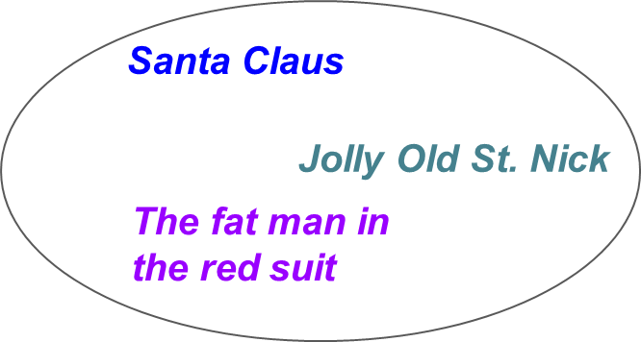
Novel Technique for Excerpt Extraction
Concept Embedding
Building a concept map aided by word embedding neural network approaches (Word2Vec, GLoVe)
Parse input corpus
Build corpus models
Define Concepts
Detect entities and relations as short text strings (rather than as individual words)
using TensorFlow / SyntaxNet - style dependency parsing, and traditional ontological approaches (e.g. Wikipedia for general knowledge ontology)
Build an entity embedding model, a relation embedding model, and a combined model (modified W2V-SG) with words replaced by the short text strings from Step 1.
Instantiate ‘concepts’ as tight clusters of phrases in the resulting entity and relation vector spaces
Notes:
Define ‘topics’ as distinct clusters in the combined vector space
Result: produces a result similar to traditional topic detection, but not limited to individual words
Possible experimental upgrade: iterative hardening of concept boundaries

Slide 10
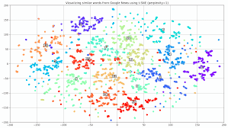
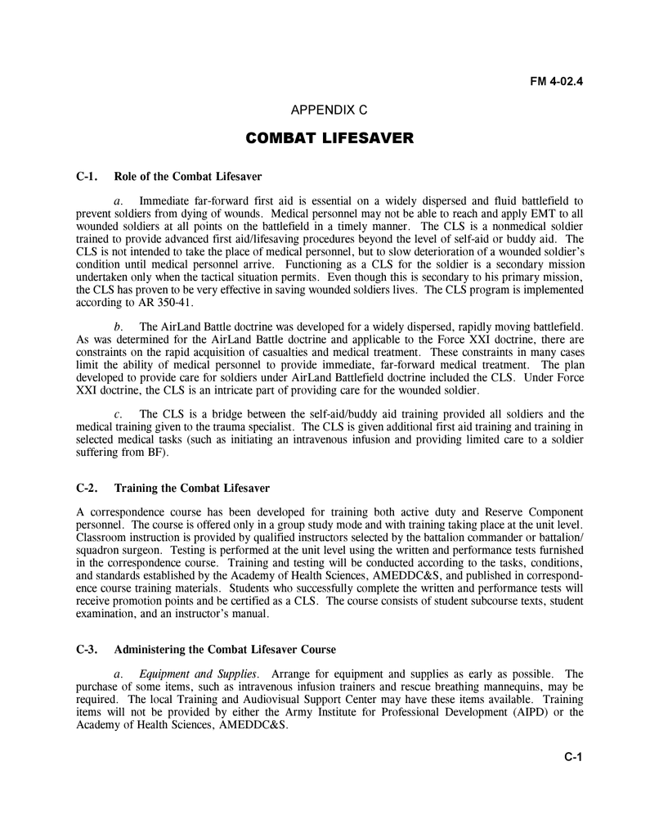
Excerpt Extraction
  Application of concept embedding:
  Extract entities/relations from LOs
  Generate embedding space
  Map entities to concepts
  Use any available context to disambiguate between concepts
  Map documents to concept space (both concept & topic levels)

Slide 11
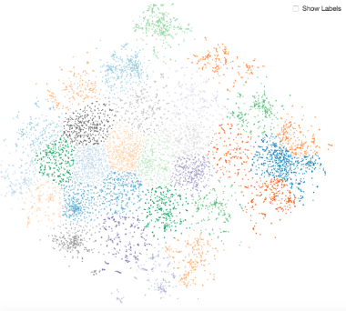

Excerpt Extraction
  Application of concept embedding (continued):
  Match ‘concepts’ in each LO to ‘concepts’ in corpus
  Rank results based on match to both entity-concepts & relation-concepts of given LO
  Team Training Relevance:
  Distinguishes different tasks being performed
  on similar entities/by similar agents

Slide 12
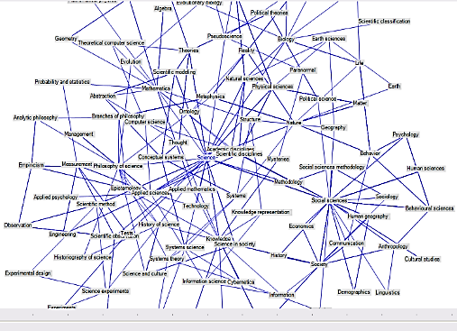

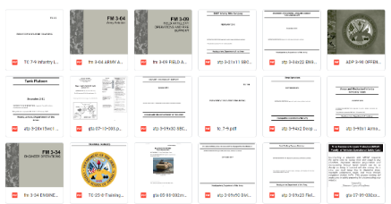
Concept Embedding using
Two Unsupervised Models
  Unsupervised General
  Trained on Wikipedia & NYTimes Corpus to map concepts
  Unsupervised Domain-specific
  Trained on military-related documents to define domain-specific concepts

Slide 13
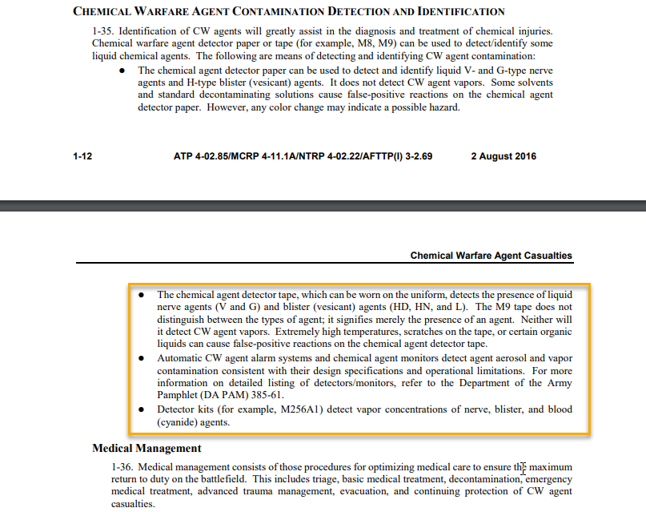
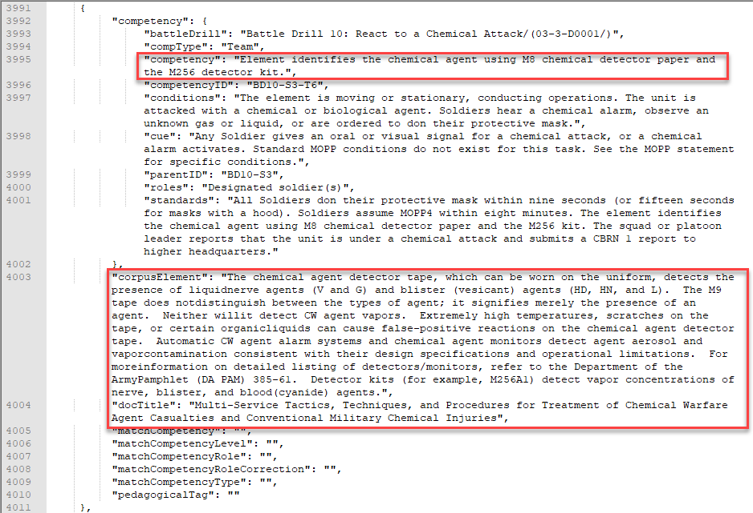
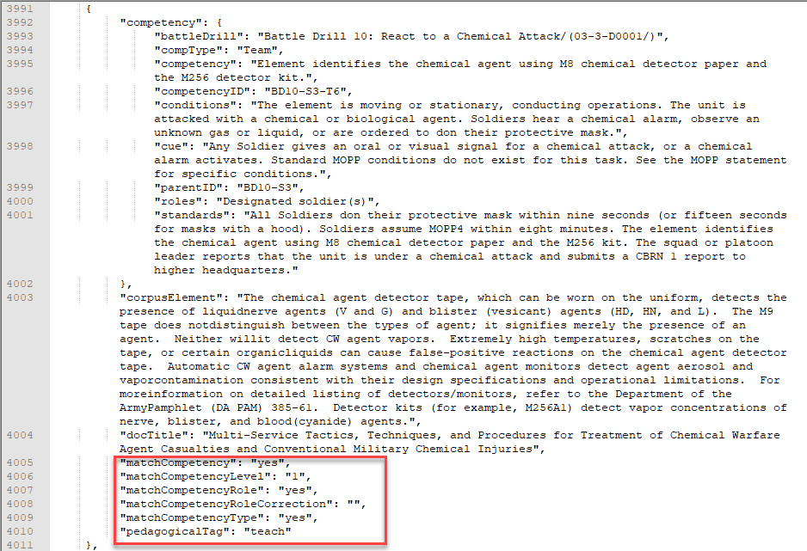
Enhancing Outcomes with
Domain-specific Supervised Learning Layer
The raters view the learning objective and corpus element selected by MAGIC.
Raters view corpus element in context in source document
Raters evaluate whether corpus element supports learning objective, at what level, & role(s) assigned to the task

Slide 14
Enhancing Outcomes with
Domain-specific Supervised Learning Layer
The raters view the learning objective and corpus element selected by MAGIC.
Average Interrater Reliability (n=3):
Text Selection and Extraction: 81.6%
Distinguish Team and Individual Content: 87.8%
Team Role Identification: 78.0%

Slide 15
Excerpt Extraction Preliminary Results
 | Unsupervised Domain-General Model | Unsupervised Domain-General Model + Unsupervised Domain-Specific Model | Unsupervised Domain-General Model + Unsupervised Domain-Specific Model + Supervised Domain-Specific Model
Match 1: Machine agrees with raters when all humans agree | 0.827 | 0.923 | 0.986
Match 2: Machine agrees with the majority when humans disagree | 0.514 | 0.723 | 0.769
Match Total | 0.762 | 0.871 | 0.948
Slightly Below Mean Human Performance
Slightly Above Mean Human Performance
Interrater Reliability: 81.6%
Approaches Mean Human Performance
Exceeds Mean Human Performance

Slide 16
Tagging LO Type (Individual v. Team)
Hybrid Machine Learning / Combined Syntactic-Semantic Patterns
ML for Extracting Human-Identified Patterns
  Machine Learning:
  Extract Semantic and Syntactic Features
  Naive Bayes or Support Vector Machine (SVM)
  Produce similar results
  More accurate w/ less training data as compared to Convolutional Neural Network (CNN) or Recurrent Neural Network (RNN)
  Syntactic-Semantic Patterns:
  Extract Combined Syntactic-Semantic Features (SyntaxNet w/ TensorFlow)
  Match to Pattern Library
SVM Layer
Syntactic-Semantic Patterns
Resolve Disagreement
Label
(Team or Individual)

Slide 17
Tagging Text Excerpts with Role
  Label an Excerpt with “Role” from predefined list
  Roles can be linked to LOs/Competency Frameworks
  Approach
  Expand each ‘Role’ into Concept using the Concept Embedding Model
  Apply similar Matching Approach
  Next Step
  Use human-labelled data to detect discourse and semantic-syntactic markers for list of common (domain-specific) roles
Team Leader
Squad or Platoon Leader
Element Leader
All Soldiers
Mounted Unit Leader
Fire Team Soldiers
Weapons Squad Leader

Slide 18
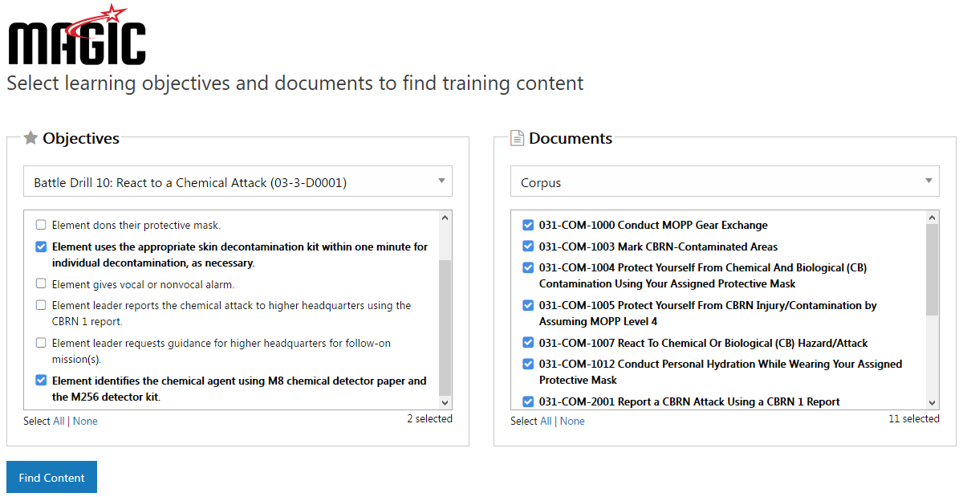
Prototype
Select the learning objectives and documents to be analyzed.

Slide 19
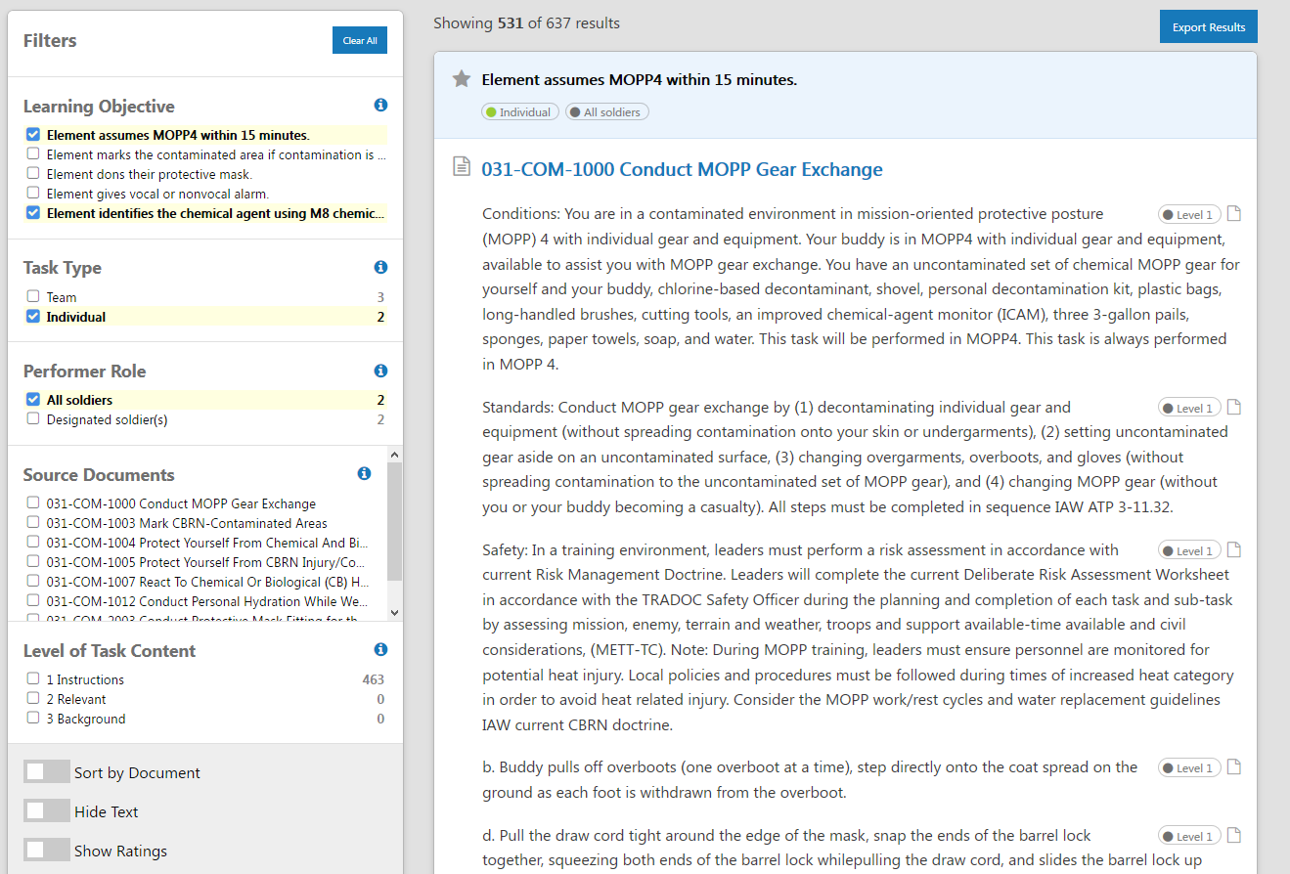
Prototype: Aligned Results
Export results for use in training
Filter by LO, task type, role, document and/or content level
Excerpts aligned to each LO
Additional options to sort & display results

Slide 20
Conclusion & Next steps
Conclusions
  Preliminary MAGIC algorithmic results on text docs approach human performance
  Incorporation of supervised models will be better than human performance
  Testing with FRAGOs show promise. Will require algorithm modifications but has potential for improved role detection
Next Steps
  Training team role models w/human-tagged role markers
  Incorporate non-text content using metadata; automated transcription
  Test/Evaluate MAGIC prototype w/authors of team training simulations
  Integrate w/Army-selected authoring/CMS/LMS tools

Slide 21
GIFT Integration in Next Phase
Develop use cases for GIFT integration
Expand MAGIC RESTful APIs to support integration requirements, including CaSS
Design UI modifications to incorporate new MAGIC-supported workflows
Document T&E plans
CaSS
Competency Framework Management
Uses CaSS API for Learning Objective management, alignment to resources
MAGIC Services
Uses MAGIC API for resource curation, ML & NLP processing pipeline, queries, performance analytics, and packaging
GIFT Cloud
20

Slide 22
Potential GIFT Integration Points
GOAL: Incorporate MAGICal powers into GIFT authoring
MAGICal curation
  Importing LOs into centrally managed, reusable frameworks
  Importing new content into the MAGIC pipeline
  Review and validation of MAGIC outputs
MAGICal searching
  Finding content in context to a set of LOs
  Finding content in context to a LO and course object
MAGICal packaging
  Integrating selected items into originating GIFT component format
Notes:
1) Viewing the search results; (2) Selecting those to be saved or collected into a folder; (3) Exporting those saved items into a data store or competency framework indexed by LO; (4) Incorporating those into the training app using GIFT as the example authoring tool.

Slide 23
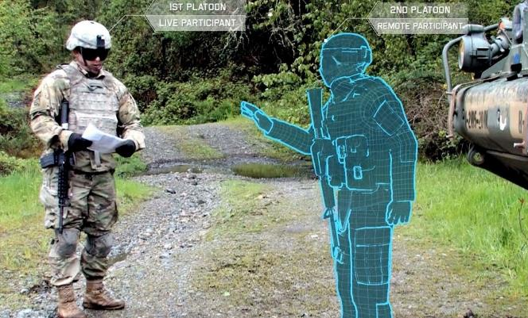
MAGIC Summary
Enabling the Future of Team Training
Enhances team training w/automated content discovery & tagging
  Finds, organizes & tags resources aligned w/desired learning outcomes
  Identifies how resources can be used for taskwork/teamwork strategies
  Automatically tags for team roles
Helps team tutors extend reach, span diverse LOs & Content
  Enhance team training outcomes across spectrum of Army needs
  Authoring & curation tools streamline design, discovery, development
  Enables workflows that propel reuse and repurposing
  Helps advance STE TMT, GIFT

