Slide 1
Enhancing the GIFT Authoring User Experience through Interaction Design
Robert A. Sottilare, Ross Hoehn,
Dar-Wei Chen, and Behrooz Mostafavi
16 May 2019 – 7th Annual GIFT Users Symposium

Slide 2
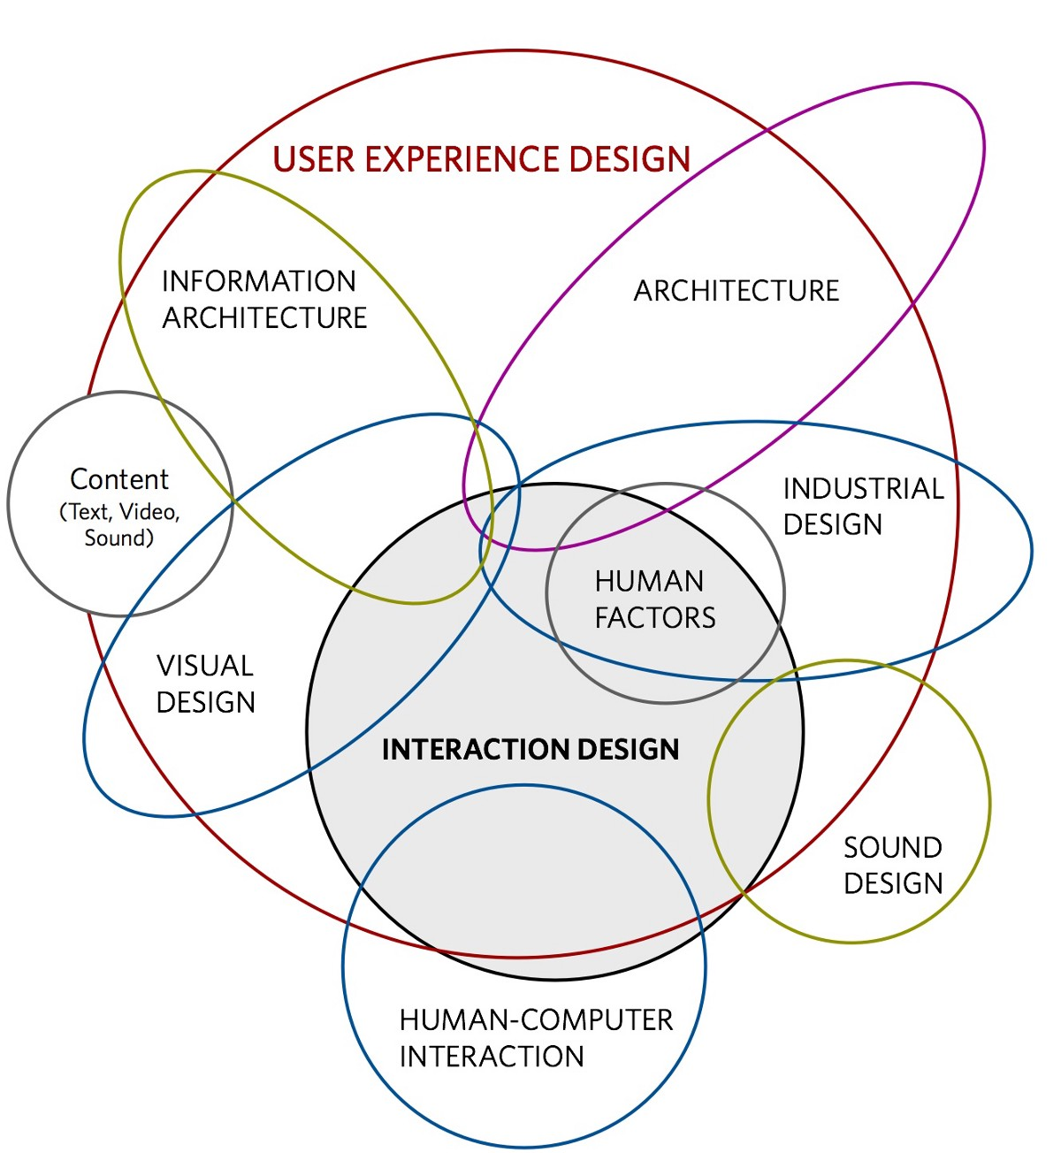
Stuff I want to talk about…
Interaction Design
AIS Usability Goals
Applying Usability Goals to GIFT
Usability of GIFT Authoring Tools
Usability of GIFT Courses (instructional management features)
Usability of GIFT Evaluation Tools
Recommendations to Improve the Interaction Design of GIFT

Slide 3
What is Interaction Design?
“designing interactive products to support the way people communicate and interact in their everyday and working lives”
  (Preece, Rogers & Sharp, 2007, p. 8)
Interaction Design for AISs considers:
  AIS user roles (e.g., learners, authors, instructional designers, system maintainers, and researchers)
  Capabilities and limitations of users in various roles
  Contributing factors to quality user experiences
  User feedback about their AIS experiences
  Measures of usability to compare/contrast alternative approaches

Slide 4
AIS Usability Goals
highly effective – a measure of how well an AIS is at doing what it was designed to do (e.g., improves knowledge and skills in a particular domain)
highly efficient – a measure of how well an AIS is at supporting users in completing tasks or reaching goals
high utility – a measure of the extent to which an AIS provides appropriate capabilities to meet user needs or desires
easy to learn – a measure of how quickly a user can reach proficiency and use AIS capabilities
easy to recall – a measure of how easy it is to remember AIS capabilities once learned

Slide 5
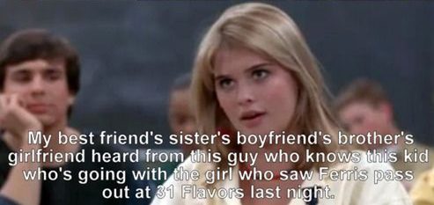
Applying Usability Goals to GIFT
Simple and natural dialogue
Speak the user’s language and be consistent
Minimize user memory load
Provide feedback
Provide clearly marked exits
Provide shortcuts
Good error messages/Prevent errors

Slide 6
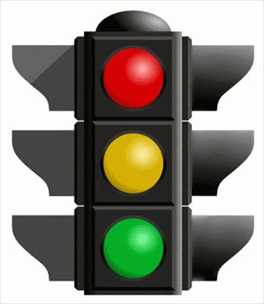
Usability of the GIFT Authoring Tools
Association of data sources with learner states
Association of content meta-data attributes with learner attributes and instructional phases
Assessment of conditions in external environments
Data Accessibility

Slide 7
Usability of the GIFT Authoring Tools
Association of data sources with learner states
Association of content meta-data attributes with learner attributes and instructional phases
Assessment of conditions in external environments
Data Accessibility

Slide 8
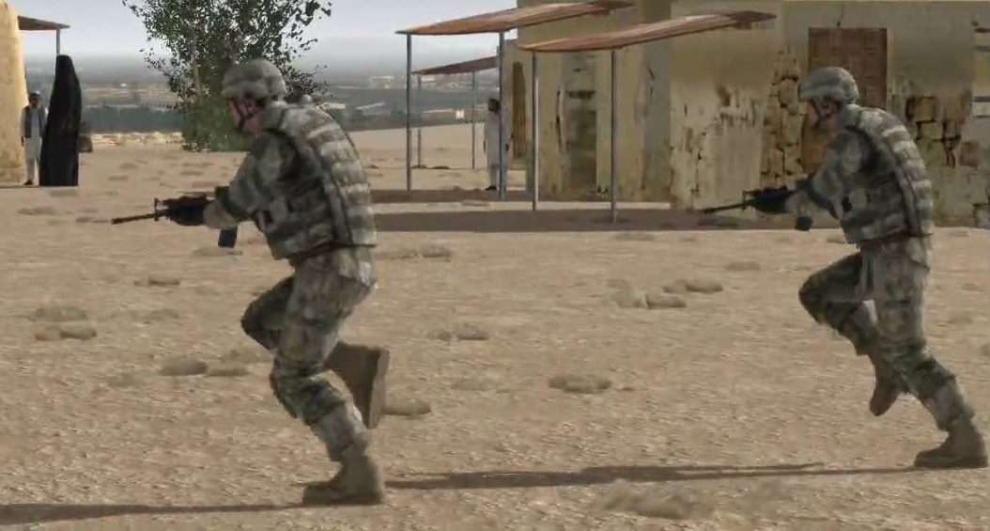
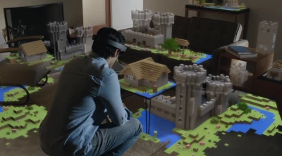
Usability of the GIFT Authoring Tools
Association of data sources with learner states
Association of content meta-data attributes with learner attributes and instructional phases
Assessment of conditions in external environments
Data Accessibility

Slide 9
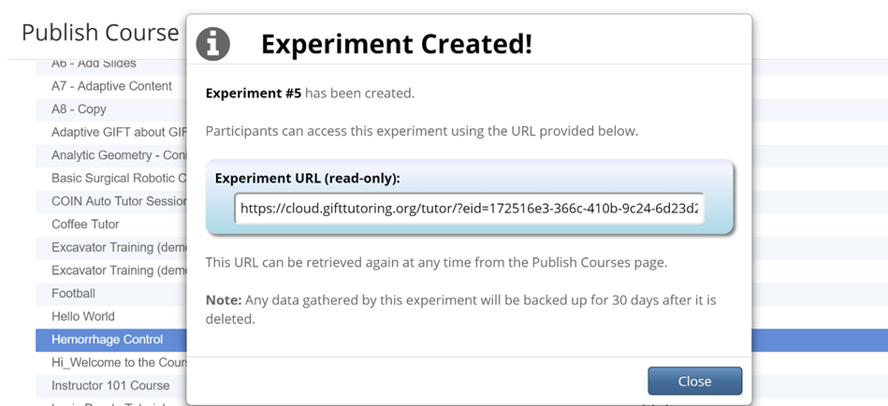
Usability of the GIFT Authoring Tools
Association of data sources with learner states
Association of content meta-data attributes with learner attributes and instructional phases
Assessment of conditions in external environments
Data Accessibility

Slide 10
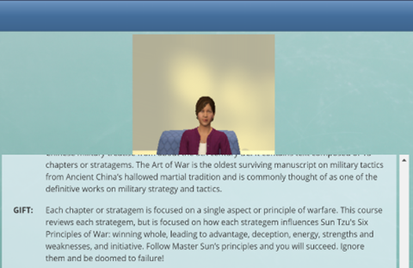
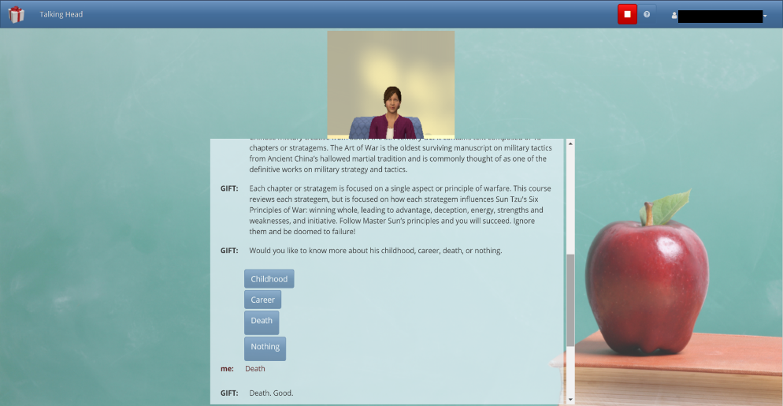
Usability of GIFT Courses
Virtual Human Interface
  window too small
  VH too small
  can’t configure the VH
  can’t see her lips move

Slide 11
Usability of the GIFT Evaluation Tools
Easy to create experiments and capture data
Easy to deploy experiments with a simple URL
Depending upon granularity of data, it can be difficult to organize multiple data sources
If a condition class has not be defined for a measure, programming is required.

Slide 12
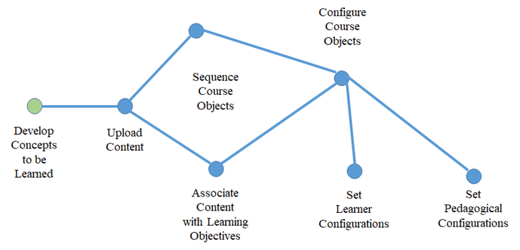
Recommendation #1: Author Dashboard
Step-by-step concept map to guide the GIFT authoring process
Notional GIFT Author Dashboard Widget

Slide 13

Recommendation #2: Collaborative Authoring
Allow multiple authors to contribute to ITS development projects
  content developers
  instructional designers
  subject matter experts
  instructors
  administrators
I think we are done…

Slide 14
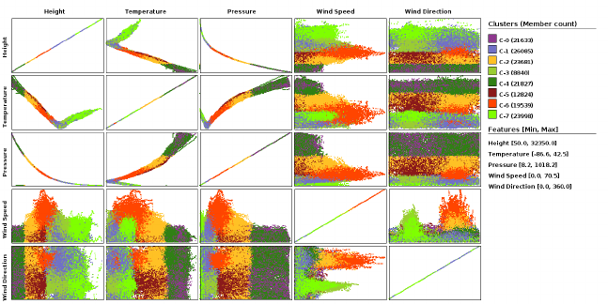
Recommendation #3: Researcher Dashboard
Visualization Tool for ERT Data

Slide 15
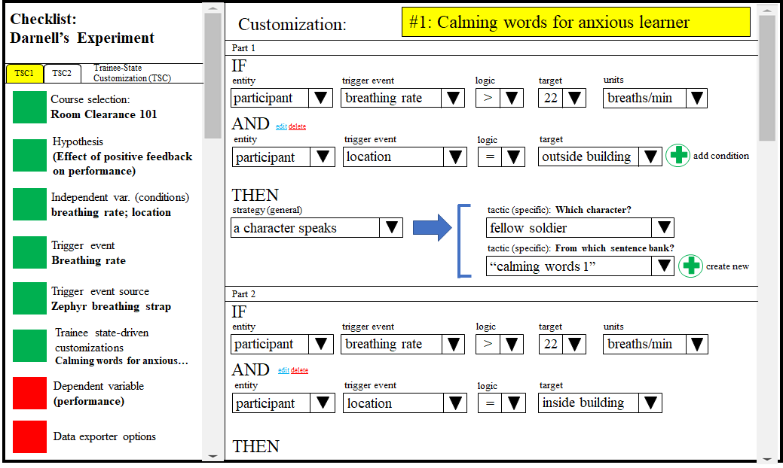
Recommendation #4: Condition Class Dashboard
Smart dashboard to create condition classes without programming

Slide 16
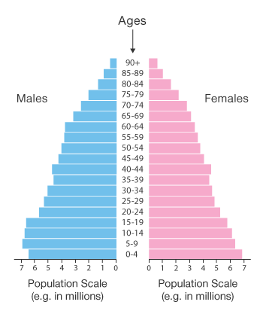
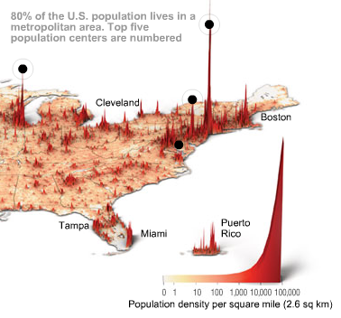
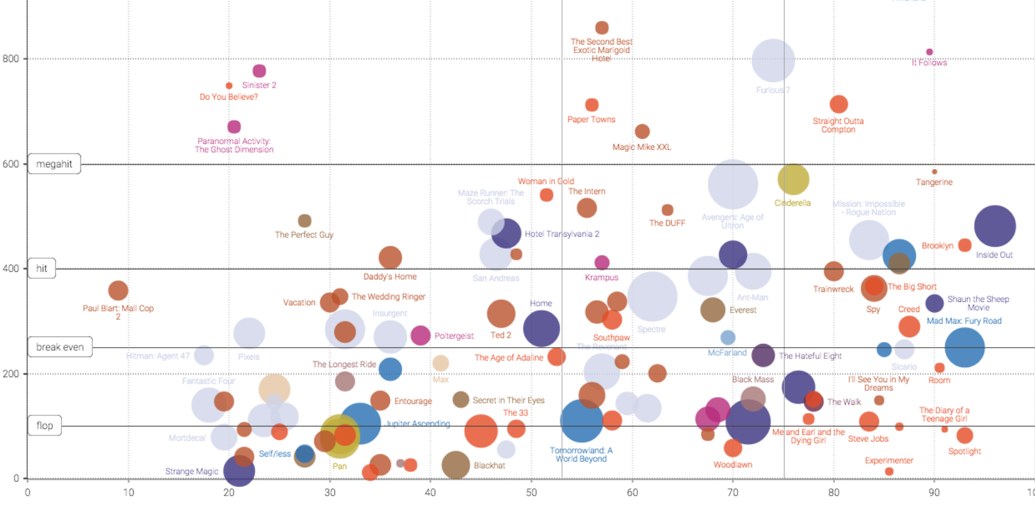
Recommendation #5: Population Model Dashboard
Visualization for population profiles to assess norms and trends

Slide 17
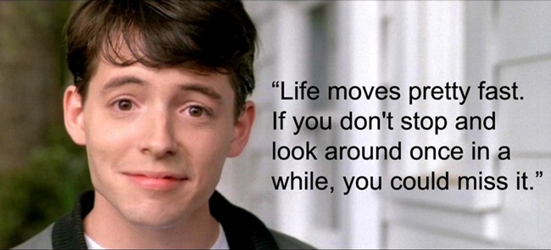
Questions
Thank you very much for your attention!

