Slide 1
GIFTSYM 7
17 MAY 2019
Notes:
Liz

Slide 2
Towards Accelerated Learning Pedagogical Templates in GIFT: Analogical Reasoning and Honesty-Humility Traits
Elizabeth Rodriguez, Jeanine A. DeFalco, United States Military Academy, West Point, NY Oak Ridge Associated Universities, USA/US Army Combat Capabilities Development Command Soldier Center – Simulation and Training Technology Center, USA
Notes:
Liz

Slide 3
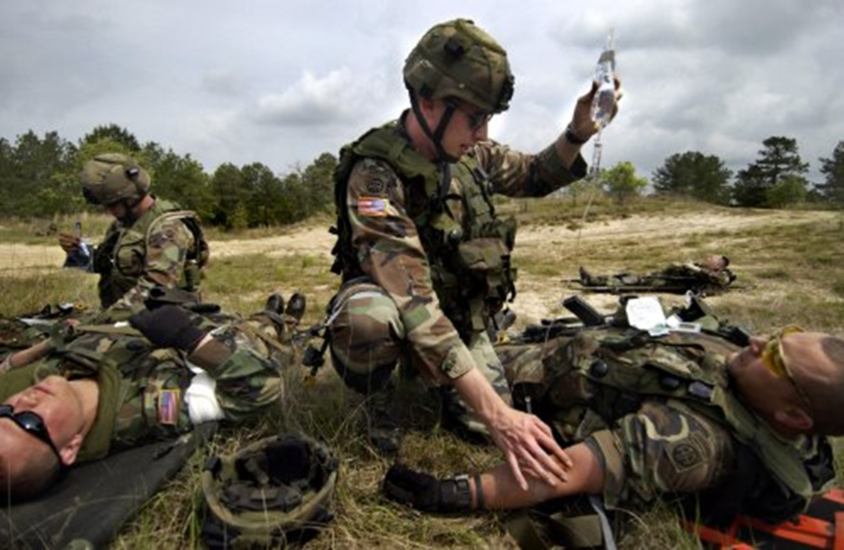
Agenda
Introduction
  Accelerating learning for TC3 via GIFT
Analogical Reasoning and
Decision-Making
  Cognitive Tasks
  Accelerated Learning
  Personality and Academic Performance
Correlational Study
  Research Question and Hypothesis
  Participants and Apparatus
  Research Design and Procedure
  Results
Conclusion and Recommendations for Future Research
  GIFT in Experiment Study
Notes:
Liz

Slide 4
Introduction
Tactical Combat Casualty Care (TC3) is taught to members of the United States military at all levels to ensure Soldier safety.
It is the process of responding to a casualty in the middle of a combat engagement.
The United States Army utilizes medical training programs to educate and evaluate TC3 for all Soldiers.
According to the Department of Defense, there are currently over one million US Army Soldiers which means that each of those Soldiers have experienced some basic level of TC3 during their Army service (DOD, 2018).
Notes:
Liz

Slide 5
Introduction
Improvement in the education of TC3 is essential to help ensure Soldier safety and begin to lower the 90% of combat related deaths that occur before the injured Soldier reaches higher level medical care (Kotwal, 2011).
The Army is also making the shift to more digital and online training to expediate learning and save on costs of hands on training for each Soldier (Army.Mil, 2013).
The balance that must be struck in the future of army training is mitigating the expense while ensuring that adequate training is being distributed to all personnel.
Notes:
Liz

Slide 6
Introduction
Adaptive online educational tools are the way forward for the Army to expediate learning and is an explicit effort of the Army Research Lab’s Essential Research Area.
In the effort of supporting expertise development, Jung (2016) and Hoffman et al., (2013) recommend fostering high-level reasoning skills.
According to the Center for Advancement of Learning and Assessment, higher order thinking skills include critical, logical, reflective, metacognitive, and creative thinking, and are activated when individuals encounter unfamiliar problems, uncertainties, questions, or dilemmas.
Notes:
DeFalco

Slide 7
Introduction
Within this framework, then, supporting an accelerated learning pathway to develop the cognitive skills of an expert includes supporting the development of creative thinking--specifically creative reasoning-- a core element of cognitive readiness.
We conceptualize an accelerated learning pathway as a pedagogical design template that would be used to accelerate learning in an adaptive instruction system (AIS) that would sequence adaption of instruction according to salient learner traits, in this case personality traits.
Notes:
DeFalco

Slide 8
Introduction
Pedagogical design templates contain:
  specific, ready-to-be-used content, and/or
  information to inform pedagogical decision-making and instruction
  that may or may not align to specific learning theories but
  can simply and streamline pedagogical planning and designs (Dobozy & Dalziel, 2016)
  a useful tool for supporting transdisciplinary learning in adaptive instructional systems (AISs) such as the Generalized Intelligent Framework for Tutoring system (GIFT).
Notes:
DeFalco

Slide 9
Introduction
The first step in developing a pedagogical design template that would support accelerated medical expertise in an AIS includes understanding what learner traits are correlated with analogical and creative reasoning.
Accordingly, our first experiment sought to determine whether there were significant positive correlations between personality traits as measured by the HEXACO with mental rotation tasks and analogical reasoning tasks—two approaches to measure an individual’s creative and analogical reasoning skills.
Our paper, and this presentation, reports on our initial findings derived from our first correlational study conducted at the United States Military Academy in the fall of 2018.
Notes:
DeFalco

Slide 10
Analogical and Spatial reasoning
The importance of analogical reasoning on decision-making is well evidenced in prior related research.
In addition to analogical reasoning, one’s skill in mental rotation tasks is another competency related to decision-making.
  Ganis and Kievit (2015) claimed that mental rotation tasks are one of the most influential paradigms in the history of cognitive psychology.
Notes:
Liz

Slide 11

Accelerated learning
Accelerated learning is a strong driving force behind the ideas of GIFT and other digital learning platforms in that they hope to educate the learner effectively and efficiently.
Accelerated learning is defined by Hoffman, Feltovich, Fiore, Klein and Ziebell (2009) as not only the hastening of basic proficiency in a task but also encompasses the achievement of expertise.
Notes:
Liz

Slide 12
Personality
Batey and Furnham (2006) note that while creativity in terms of the production of ideas is related to intelligence, creativity as originality rests largely on personality factors.
O’Connor and Paunonen (2007) studied the relationship between the Big Five personality traits and post-secondary academic achievement.
This review of other studies uncovered that Openness to Experience was found to be positively correlated with scholastic achievement while Extraversion was negatively correlated (O’Connor & Paunonen, 2007).
The current research on the Big Five lends itself to the importance of identifying the types of learners to potentially develop curriculums to improve levels of academic performance in the future (O’Connor & Paunonen, 2007).
Notes:
Liz

Slide 13
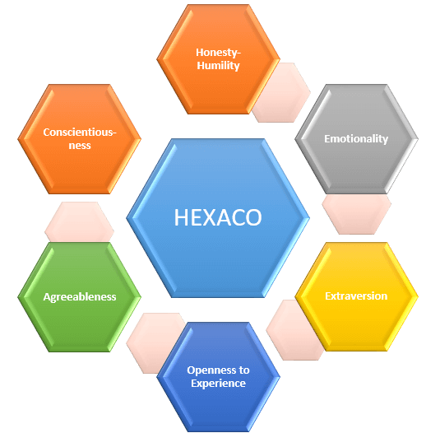
Personality
Personality might also be a viable trait to use an adaptive element in tailoring instruction to support the development of medical expertise in an AIS such as GIFT.
However, while there is a more robust body of evidence that employs the Big Five (or five factor model) as it relates to intelligence, we have made the choice to employ the HEXACO personality instrument (Ashton & Lee, 2007) as it includes a six trait—Honesty-Humility—that we hypothesize is implicated in positive learning outcomes.
Notes:
Liz

Slide 14

Honesty-humility
Importantly, the Honesty-Humility factor out predicted all factors of the Big Five for correlations with respect to an overt integrity test and business ethical dilemmas task (Ashton & Lee 2007).
This is incredibly important to both college and military training tools in that a high Honesty-Humility score could be predictive of a decreased likelihood to cheat in technology-mediated learning platforms.
Notes:
Liz

Slide 15
Openness
Also, Openness to Experience has been correlated to an increased opportunity for gains from the energy and time spend in the areas that the participant was interested in (Ashton & Lee, 2007).
Openness to Experience could be an important trait to adapt upon, as it might also be a more reliable measure that speaks to a learner’s inclination to persist in learning tasks in unfamiliar learning platforms such as could be delivered via AISs such as GIFT
Notes:
Liz

Slide 16
Correlational study
The overarching research question for this work seeks to determine the whether there are statistically significant correlations between analogical/creative reasoning tasks and spatial reasoning tasks with the personality traits measured by the HEXACO and the Short-Item Grit Scale (Duckworth & Quinn, 2009).
Notes:
Liz

Slide 17
Correlational study: Hypotheses
The first hypothesis maintained that there would be a statistically significant correlation between the HEXACO personality factor of Openness to Experience and a subject’s performance on the analogical reasoning and mental rotation tasks.
The second hypothesis stated there would be a statistically significant relationship between the HEXACO personality factor of Honesty-Humility and a subject’s performance on the analogical reasoning tasks.
The third hypothesis stated there would be a statistically significant positive correlation between the mental rotation and analogical reasoning tasks.
Notes:
Liz

Slide 18
Correlational study: Participants
97 participants (m= 19.66 SD = 1.464) received 5 points of extra credit for their introductory psychology class for their participation in the study.
Novice-journeyman-expert (self-identified) in the field of combat casualty care treatment.:
  23 participants self-identified as a novice,
  73 self-identified as a journeyman,
  1 self-identified as an expert
The cadets make up a diverse population of 18-22 years old from across the United States and some allied nations.
Notes:
Liz

Slide 19
Correlational study: Apparatus
The original plan for running this correlational study was to use GIFT to deliver the assessment instruments.
However, at the time this study was ready to be launched, it was discovered that GIFT did not have the capability to design a timed question that would launch subsequent questions at the time expiration
Notes:
Liz

Slide 20
Correlational study: LIMITATION OF GIFT
For the mental rotation tasks, to obtain a more accurate measurement of a person’s spatial ability, the instrument is designed so that participants only have 7.2 seconds to respond whether the images are the same or different before loading the next image.
At the time of writing this paper, timed questions have now been added as a functionality into GIFT, but this functionality was not integrated at the time of running this first correlational study.
Notes:
Liz

Slide 21
Correlational study: APPARATUS
With that limitation in mind, this experiment utilized Qualtrics to distribute the survey and the SONA system at USMA to obtain participants and provide those participants with extra credit points.
Qualtrics is an online survey software that allows the experimenter to digitally upload their survey for participants to complete.
The survey consisted of:
  the demographic questionnaire,
  the short item grit survey (Duckworth & Quinn, 2009),
  the HEXACO personality test (Ashton & Lee, 2007),
  the Analogical Finding Task Matrix (AFTM) (Weinberger, Iyer, & Green, 2016),
  mental rotation tasks (Ganis & Kievit, 2015).
Notes:
Liz

Slide 22
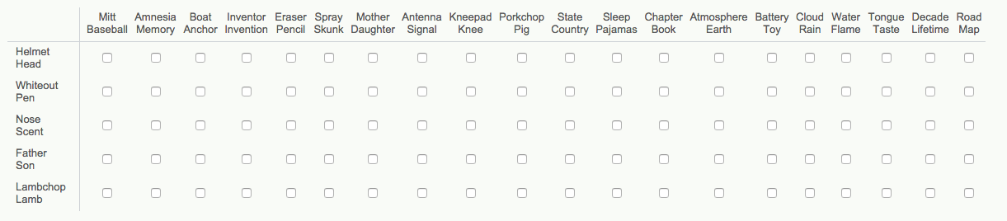
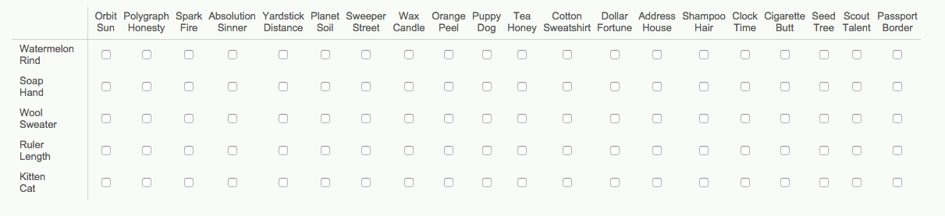
  Analogical Finding Task Matrix (AFTM) (Weinberger, Iyer, & Green, 2016),
Notes:
Liz

Slide 23
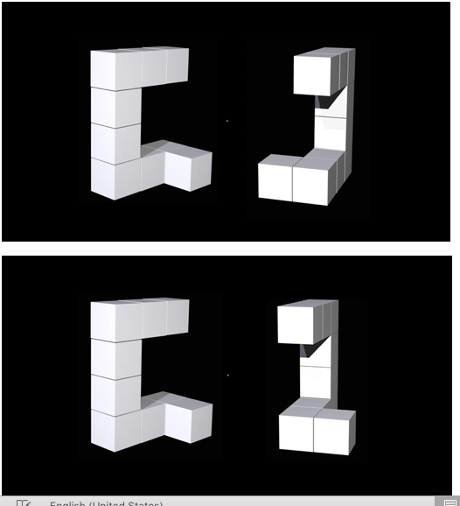
  Mental rotation tasks (Ganis & Kievit, 2015)
Notes:
Liz

Slide 24
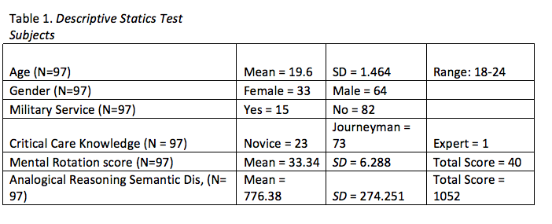
Correlational study: Results
Notes:
DeFalco

Slide 25
Correlational study: Results
After data collection from Qualtrics, data was cleaned and analyzed, correlational analyses were run in SPSS.
For the analogical reasoning tasks there were two matrices used to measure both creativity and analogical reasoning.
There was a statistically significant correlation between the Openness to Experience score on the HEXACO traits and the analogical reasoning task
  (r= 0.279, N= 97, p= 0.007).
There was also a statistically significant correlation between the analogical reasoning task and the mental rotation tasks
  (r=0.444, N=97, p=0.000).
Notes:
DeFalco

Slide 26
Correlational study: Results
There was also a statistically significant, positive correlation between GRIT and HONESTY-HUMILITY,
  r = .343, N = 97, p= 0.001.
There was a a statistically significant, positive correlation between the analogical reasoning tasks in the second matrix and the HONEST- HUMILITY score,
  r= 0.332, N = 97, p = 0.001.
In addition, we used the mean score of the Honesty-Humility factor to create high (>33) and low (<32) groups.
Running an ANCOVA, using high low groups as a fixed factor, there was a statistically significant difference in the means of the analogical reasoning tasks between the two groups:
  F(2,94) = 7.046, p = 0.001.
Notes:
DeFalco

Slide 27
CONCLUSION
The results of this correlational study confirmed that there was a statistically significant positive correlation between Honesty-Humility and an individual’s creativity levels.
Also, there was a statistically significant positive correlation between Openness to Experience and a subject’s performance on the analogical reasoning tasks.
Notes:
Liz

Slide 28

CONCLUSION
This information was relevant for informing the design of our subsequent experiment to determine whether the sequencing of content with analogical/creative reasoning tasks and/or mental rotation tasks effects the learning outcomes of medical decision-making expertise within the domain of critical care.
With this data, we expect to make significant strides towards validating a transdisciplinary pedagogical design template that could become part of the suite of tools integrated into the dashboard of GIFT’s authoring tools.
Notes:
Liz

Slide 29
Questions?

Slide 30
ACKNOWELDGEMENTS
Research was sponsored by the Army Research Laboratory and was accomplished under Cooperative Agreement Number W911NF-17-2-0152. The views and conclusions contained in this document are those of the authors and should not be interpreted as representing the official policies, either expressed or implied, of the Army Research Laboratory or the U.S. Government. The U.S. Government is authorized to reproduce and distribute reprints for Government purposes notwithstanding any copyright notation herein.

Slide 31
Images References
https://www.google.com/search?q=Learning&safe=active&source=lnms&tbm=isch&sa=X&ved=0ahUKEwiZutWkzaDiAhUSh-AKHdJODJQQ_AUIDigB&biw=1280&bih=610#imgrc=Jw3X_gyUJSjYTM:
https://www.google.com/search?q=HEXACO&safe=active&source=lnms&tbm=isch&sa=X&ved=0ahUKEwjdqqvTzqDiAhWwhOAKHSygDXgQ_AUIDigB&biw=1280&bih=610#imgrc=F7lhiECJr6SYHM:

