Slide 1
The 2019 Instructor’s Guide to GIFT
Anne M. Sinatra, Ph.D.
Research Psychologist
US Army CCDC Soldier Center Simulation & Training Technology Center
16 May 2019

Slide 2
Introduction
The Generalized Intelligent Framework for Tutoring (GIFT) is an open-source framework for creating intelligent tutoring systems (ITS) which includes features that allow course authors to:
  Build complete intelligent tutoring systems
  Create linear courses (and/or modules) that address specific identified course concepts
  Create both traditional experiments, and specific examinations in an ITS
Additionally, GIFT can be a great resource for course instructors even if they are creating non-adaptive courses.

Slide 3
GIFT IN THE CLASSROOM
Advantages of GIFT in a Class
Course material can be created by the course instructor and a GIFT course can be authored.
Instructor created GIFT courses can be used for many purposes:
  Presenting information to students
  Providing review material and quizzes
  As homework assignments and review
  As course activities during a computer lab-time
  For students to create their own ITS courses and learn by doing usability analyses

Slide 4

GIFT IN THE CLASSROOM
Advantages of GIFT in a Class
Courses can include a number of different transitions or course elements. A traditional example of a course order is:
  Welcome Message/Introduction
  Multiple choice pre-test
  Slide Show
  Image
  Website
  Multiple choice quiz
  Slide Show
  Multiple choice post-test

Slide 5
GIFT IN THE CLASSROOM
Advantages of GIFT in a Class
Advanced users may want to use:
  Adaptive Course Flow
    Remediation based on performance
  Course Concepts
  Domain Knowledge File
    If using external applications

Slide 6
GIFT IN THE CLASSROOM
Challenges of using GIFT in a Class
There are challenges to using GIFT in both in-person and online classrooms.
  Features:
    Providing output to instructors when student is logged in
    Publish Course feature should be used if instructor wishes to receive the output; it is important to add a question with the students name
    Student and Teacher user roles do not currently exist
    There is no current gradebook implementation
  Usability:
    There is some redundancy and lack of clarity between the Question Bank and Survey course objects
    Understanding the difference between the Slide Show and PowerPoint course objects

Slide 7
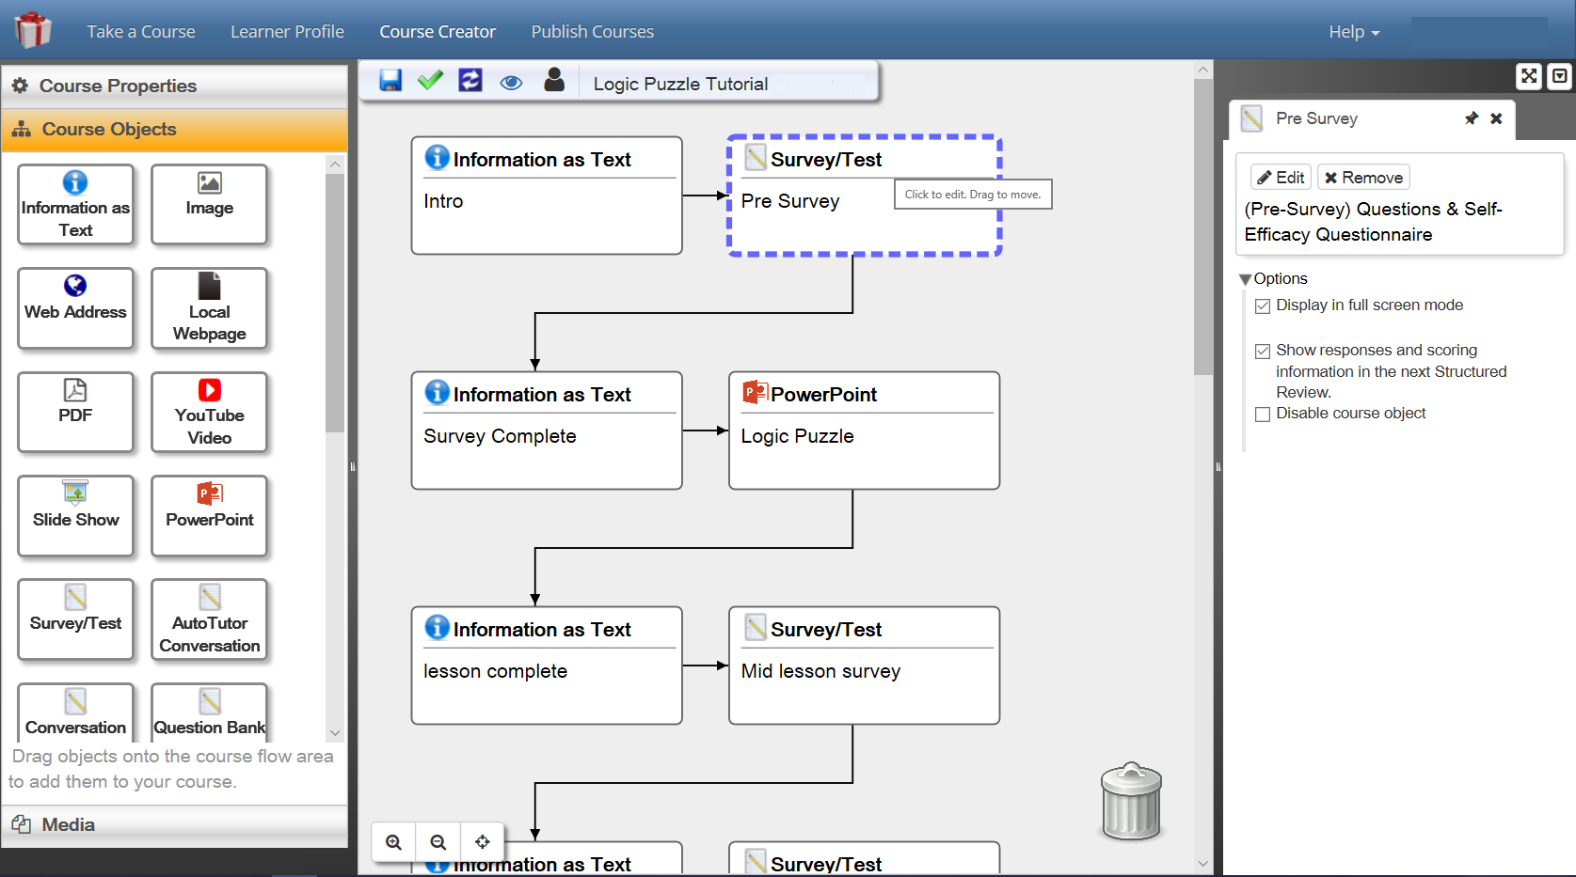
Tools for Instructors Using GIFT
Course Authoring

Slide 8
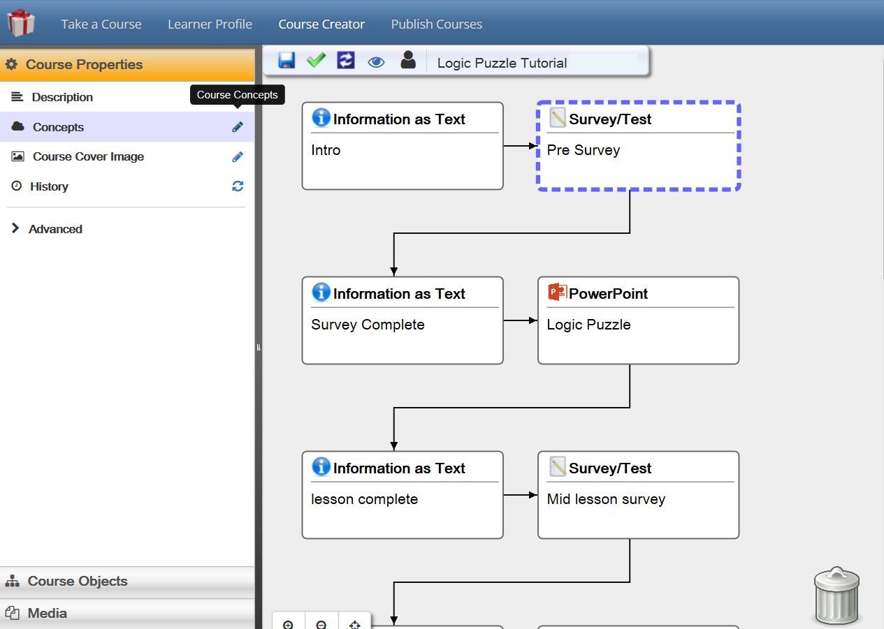
Tools for Instructors Using GIFT
Adding Course Concepts

Slide 9
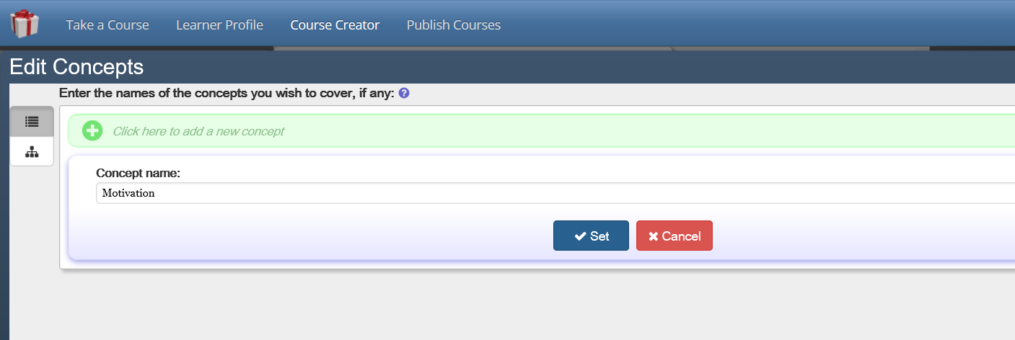
Tools for Instructors Using GIFT
Adding Course Concepts

Slide 10
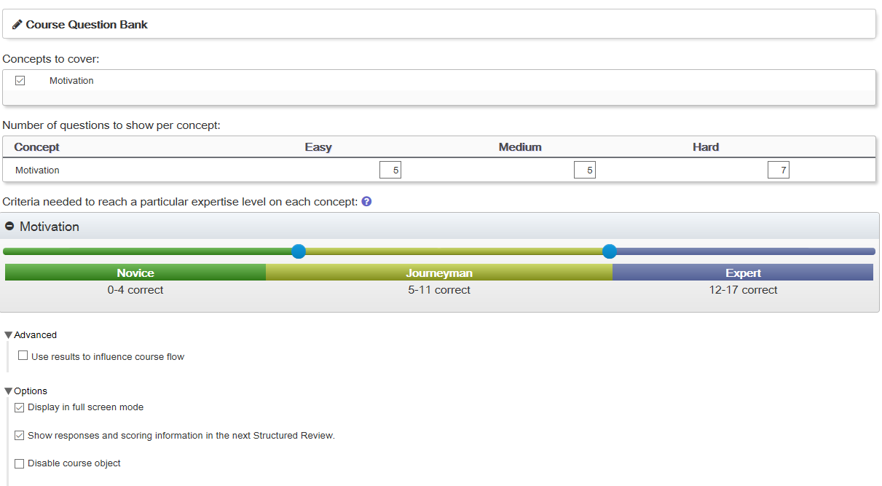
Tools for Instructors Using GIFT
Surveys and Question Bank Authoring

Slide 11
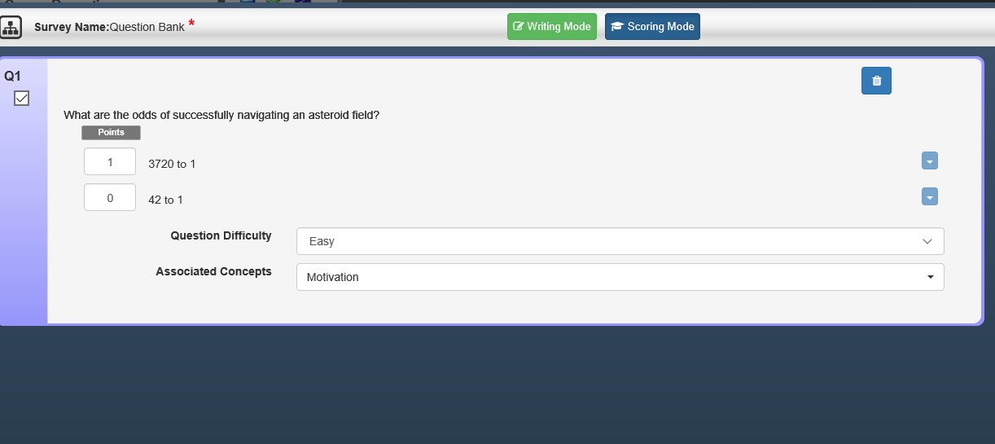
Tools for Instructors Using GIFT
Surveys and Question Bank Authoring

Slide 12
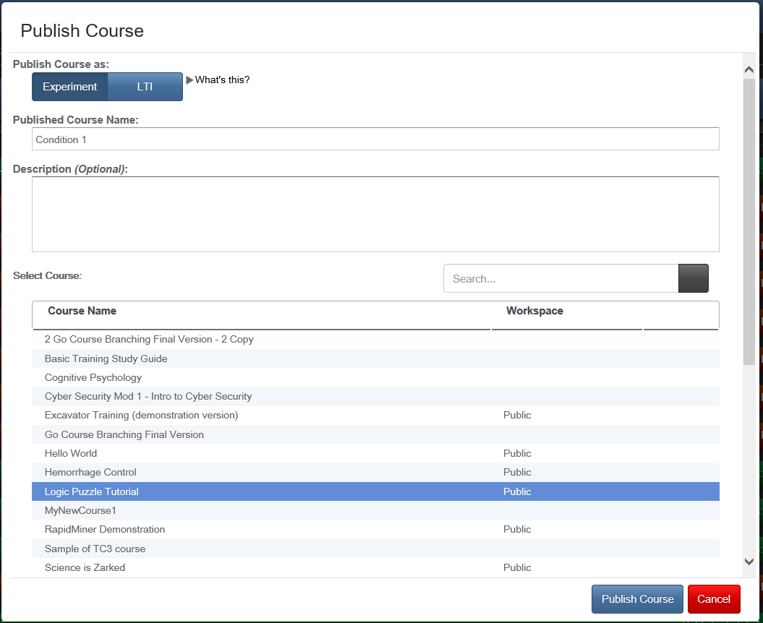
Tools for Instructors Using GIFT
Publishing a Course

Slide 13
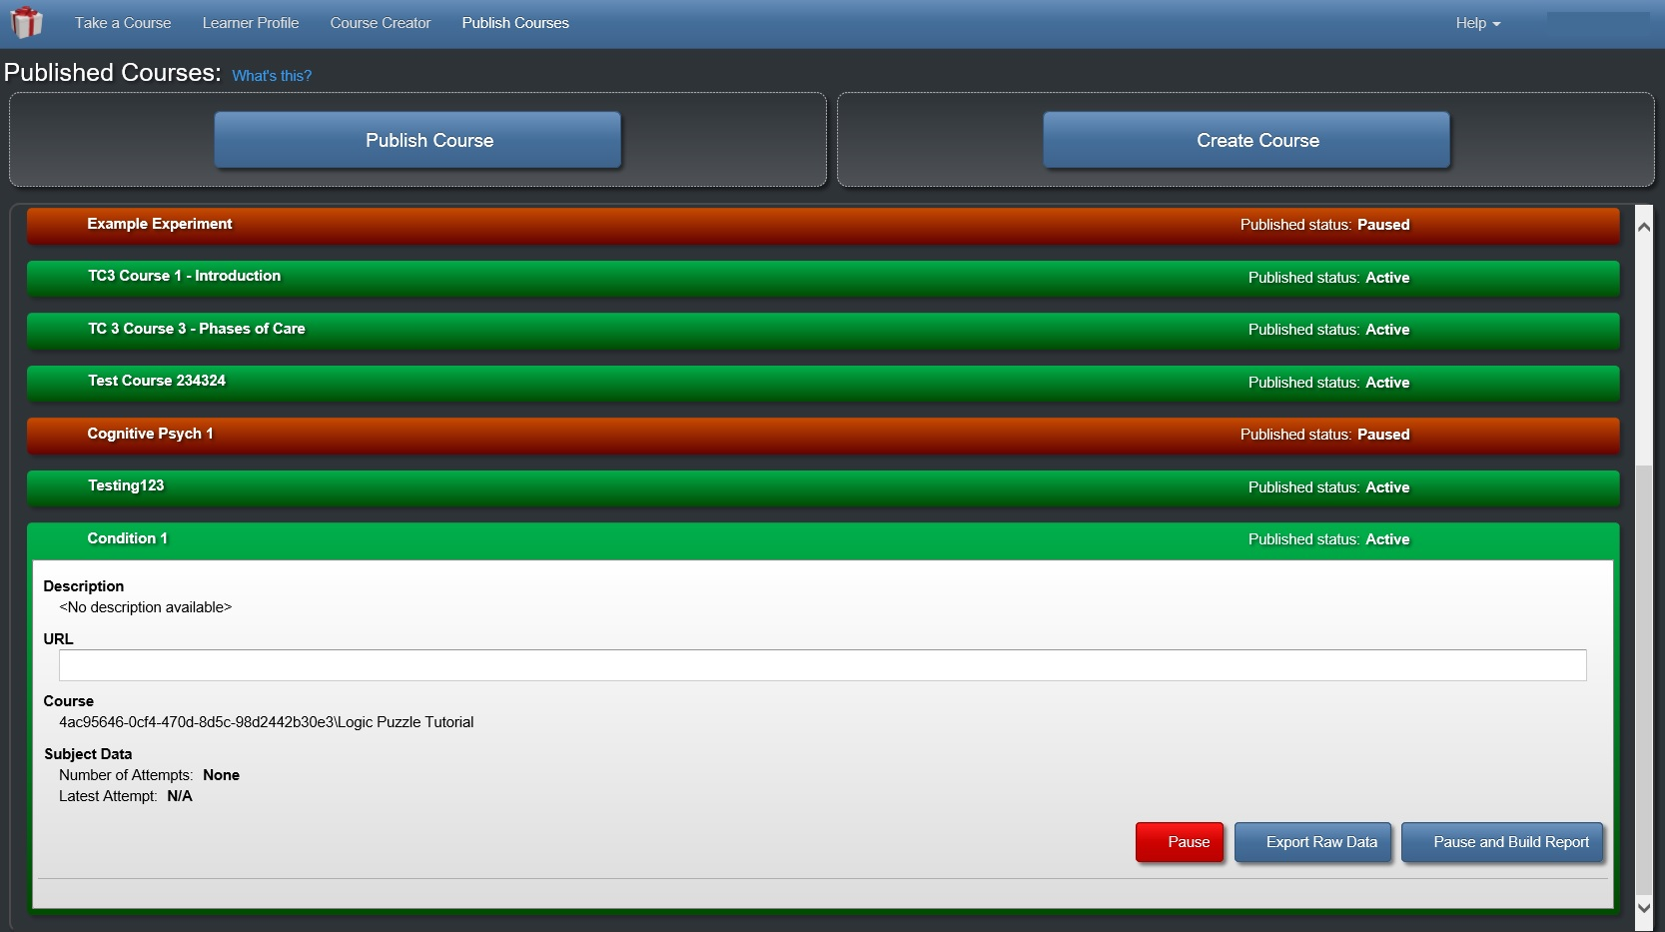
Tools for Instructors Using GIFT
Publishing a Course/Extracting Data

Slide 14
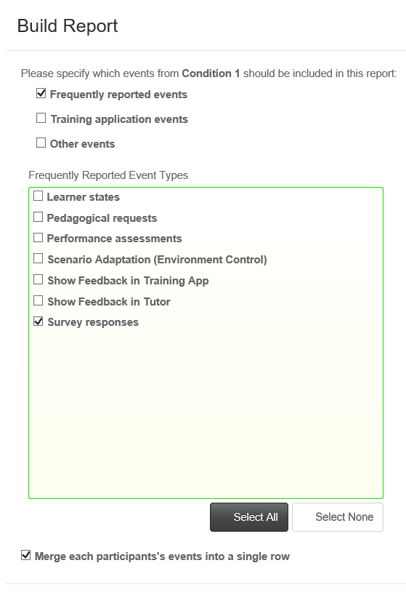
Tools for Instructors Using GIFT
Extracting Data/Grades

Slide 15

Using GIFT to Create Assignments
Suggestions for Assignments Using GIFT
  Creating their own courses
  Creating their own intelligent tutoring systems
  Collecting data and taking the role of the researcher
  Conducting a usability analysis

Slide 16
courses
Students can be assigned to generate their own courses using GIFT
  Create Slide Show materials about a topic or chapter of interest
  Generate multiple-choice questions about their Slide Show and create a Question Bank
  Use the GIFT Authoring Tool to create a course
  Export the course

Slide 17
Creating their own ITS
Students can be assigned to use the adaptive capabilities of GIFT to generate an ITS
  Students will need to think about different types of feedback and assessments they will be creating
  Students will need to work with the tools and plan their adaptive course
  Students can create their course and then export it

Slide 18
Student as a researcher
Students can take the role of the researcher
  If a student is conducting their own research study or thesis they can use GIFT to create and run their study
  Students can be asked to run themselves and classmates through an existing or created GIFT course that is structured as an experiment. The output can then be generated and analyzed by students

Slide 19
Sample Assignment
1) Choose any chapter in the textbook, and select about a 10 page excerpt of content.
2) Imagine that you were going to teach about the topic, and create a PowerPoint presentation based on the material. You will save your presentation as a PowerPoint show. It is not necessary for your materials to go over 12 slides. Make sure to include a reference to the book on the final slide. This will be a Slide Show course object.
3) Generate at least 10 multiple-choice questions based on the materials that you created.
4) Enter your questions into GIFT using a Question Bank.
5) Create a GIFT course with all of your materials and GIFT Cloud.
At minimum include:
Introduction guidance
Slide Show (.pps)
Guidance
Your 10 question Question Bank assessment
Guidance and a thank you message
*You may want to also include external website links, or instructional videos on YouTube.
6) After creating your course, publish it, and run through it.
7) Afterward, export your data into an Excel file.
8) Export your tutor.
9) While you work through the process take notes on what was easy to use, and what was difficult. What changes do you think should be made to improve the authoring experience?

Slide 20


Identified Gaps
Identified Gaps:
Gradebooks/Data Extraction
User Roles
Test Bank Import

Slide 21
& Recommendations
GIFT offers great flexibility to instructors who wish to use it for their courses.
GIFT Cloud allows for students to interact with GIFT without needing to download anything (if configured appropriately).
GIFT’s authoring tools have been improved, and can be used by individuals that do not have extensive computer programming experience.
Improvements such as the implementation of gradebooks, student/teacher roles, and the ability for instructors to easily access course output would be beneficial.

Slide 22

Questions?

Slide 23
ACKNOWLEDGEMENTS
The research described herein has been sponsored by the U.S Army Combat Capabilities Development Command – Soldier Center – Simulation and Training Technology Center. The statements and opinions expressed in this article do not necessarily reflect the position or the policy of the United States Government, and no official endorsement should be inferred.

